Slide 1
Chemical Equilibria

Slide 2
Lessons 3 & 4 Objectives
Students should be able to:
1. Define the following: Electrolytes, Acid and Bases, Amphiprotic Species, Autoprotolysis, Strength of Acids and Bases.
2. Define the equilibrium state, equilibrium-constant expression and the different types of equilibrium-constant observed in analytical chemistry.
3. Solve calculations involving Ion-product constant of water, Solubility-product constant and Acid-base dissociation constant.
4. Calculate pH of a buffer solution and appreciate the properties of a buffer solution.

Slide 3
5. Solve the multiple-equilibrium problem using the systemic method.
6. Use the systematic method to calculate solubility.
7. Solve calculations involving the separation of ions by controlling the concentration of the precipitating agent.

Slide 4
Definitions

Slide 5
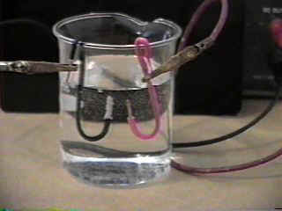
Electrolytes
Solute species whose aqueous solutions conduct electricity.

Slide 6
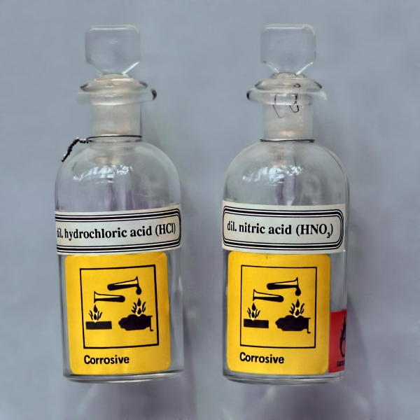
Acids
Species that are capable of donating protons to other species that in turn are capable of accepting these protons.

Slide 7
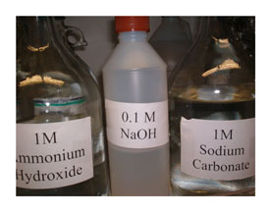
Bases
Species that are capable of accepting protons from donor (acid) species.

Slide 8
Amphiprotic Substances
Species that can either donate protons or accept protons, depending on the environment.

Slide 9
Autoprotolysis
A process in which a solvent undergoes self-dissociation.

Slide 10
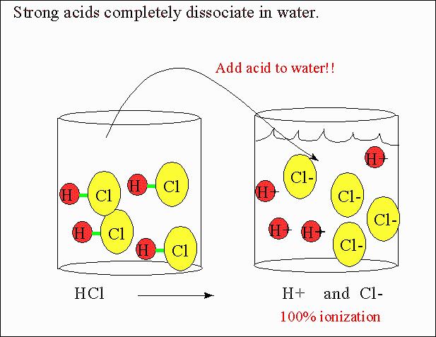
Strong Acids & Strong Bases
Acids and bases that are completely dissociated in a particular solvent.

Slide 11
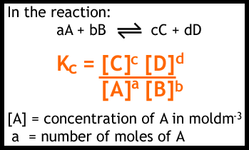
Equilibrium-Constant Expression
An algebraic statement that describes the equilibrium relationship among the participants in a chemical reaction.

Slide 12
Types of Equilibrium Constants Observed in Analytical Chemistry
Type of Equilibrium | Name & Symbol of Equilibrium Constant | Typical Example | Equilibrium-Constant Expression
Dissociation of water
 | Solubility Product, K_{sp}
Dissociation of a weak acid or base
 | β_{n}
Formation of a complex ion
 | K_{redox}
 | K_{d}

Slide 13
Buffer Solutions – pH of a buffer – James Mungall Chemistry Tutorials

Slide 14
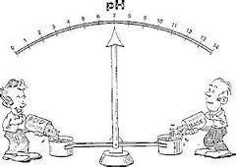
Group Activity – Buffer Calculations
See Handout.

Slide 15
Assignment
READ:
Fundamentals of Analytical Chemistry (8th Edition)
- Chapter 12: Gravimetric Methods of Analysis, pages 311 – 336

Slide 16
References
1. Fundamentals of Analytical Chemistry (8th Edition)
Douglas A. Skoog
Donald M.West
F. James Holler
Stanley R. Crouch

