Slide 1
Giant Structures

Slide 2
Examples of Structures
Example 1: Metals are strong and easily shaped.

Slide 3
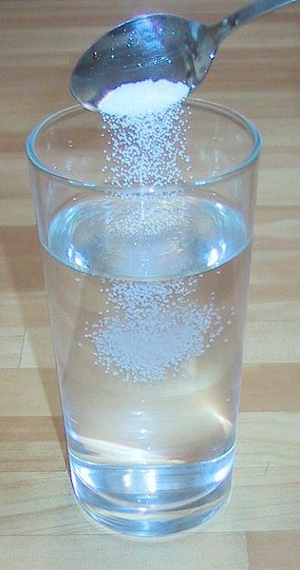
Example 2: Many substances form brittle crystals which dissolve easily in water.

Slide 4
Example 3: Diamond (a form of carbon) is obviously crystalline, and is the hardest naturally occurring substance.

Slide 5
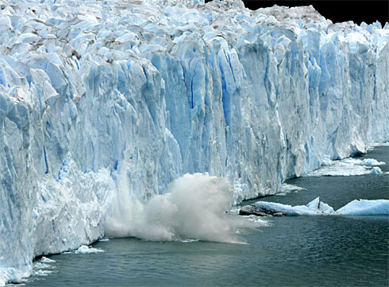
Example 4: Ice is also crystalline, but melts easily to form water.

Slide 6
The examples show some substances with quite different physical properties – hardness, melting point and solubility, for example.
This lesson will explore some of the reasons for these differences, based on the bonding in the substances.

Slide 7
What is the Difference between Giant Structures & Molecular Structures?
Substances
Molecular Structures
Giant Structures
Made up of fixed numbers of atoms joined together by covalent bonds.
Contains huge numbers of either atoms or ions arranged in some regular way, but the number of particles isn’t fixed. The bonding can be metallic, ionic or covalent.

Slide 8
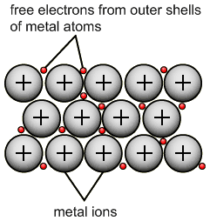
1. Giant Metallic Structures
Remember that metals consist of a regular array of positive ions in a ‘sea of electrons’. The metal is held together by the attractions between the positive ions and the delocalized electrons.

Slide 9
The Simple Physical Properties of Metals
1. Metals tend to be strong, with high melting and boiling points because of the powerful attractions involved.

Slide 10
2. Metals conduct electricity. This is because the delocalised electrons are free to move throughout the structure. Imagine what happens if a piece of metal is attached to an electrical power source.

Slide 11
3. Metals are good conductors of heat. This is again due to the mobile delocalised electrons. If you heat one end of a piece of metal, the energy is picked up by the electrons. As the electrons move around in the metal, the heat energy is transferred throughout the structure.

Slide 12
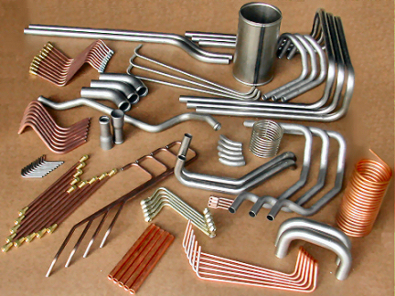
The Workability of Metals

Slide 13
The Workability of Metals
If a metal is subjected to just a small force, it will stretch and then return to its original shape when the force is released.
The metal is described as being elastic.
But if a large force is applied, the particles slide over each other and stay in their new positions.

Slide 14
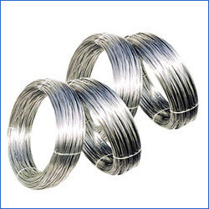
The Workability of Metals
Metals are usually easy to shape because their regular packing makes it simple for the atoms to slide over each other.
Metals are said to be malleable and ductile.
Malleable means that it is easily beaten into shape.
Ductile means that it is easily pulled into wires.

Slide 15
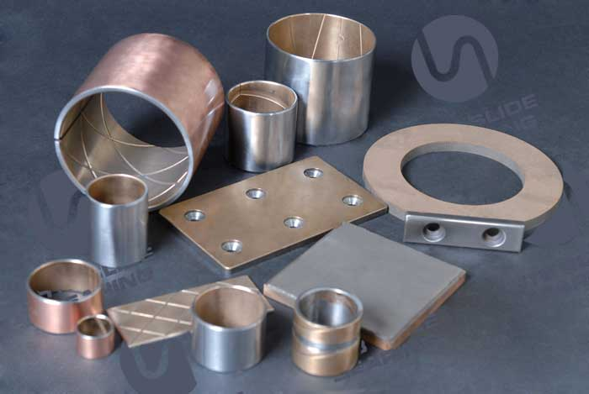
Alloys

Slide 16
What are Alloys?
Metals can be made harder by alloying them with other metals.
An alloy is a mixture of metals – for example, brass is a mixture of copper and zinc.

Slide 17
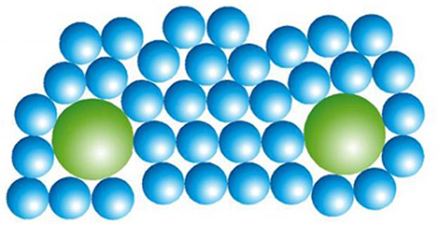
Why is an alloy harder?
In an alloy the different metals have slightly different sized atoms.
This breaks up the regular arrangement and makes it more difficult for the layers to slide.

Slide 18
The diagram shows how mixing atoms of only slightly different sizes disrupts the regular packing, and makes it much more difficult for particles to slide over each other when a force is applied.
This tends to make alloys harder than the individual metals which make them up.

Slide 19
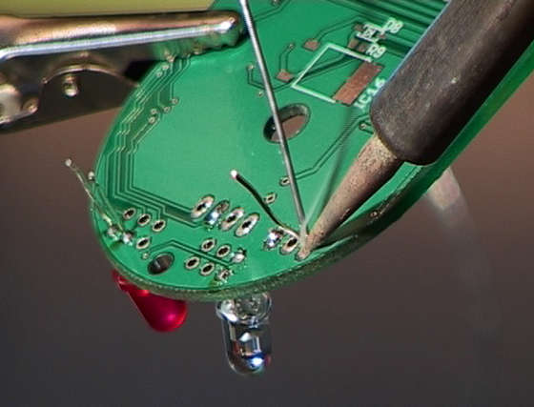
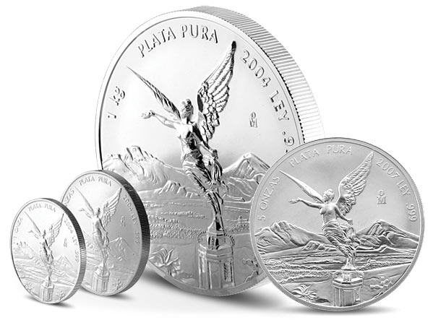
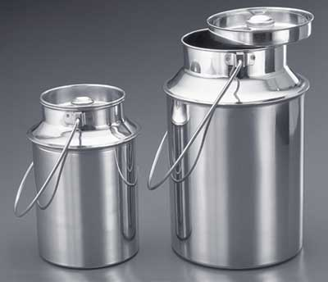
Unexpected Properties of Alloys
In some cases alloys have unexpected properties.

Slide 20
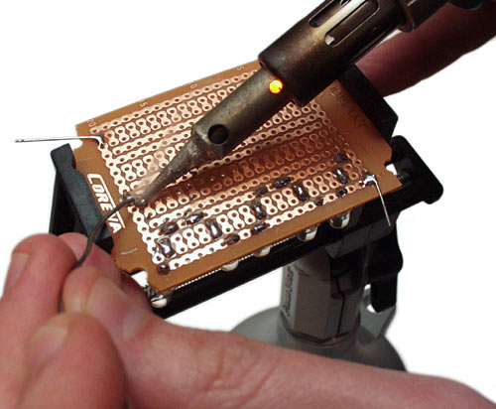
Example 1: Solder
Solder is an alloy of tin and lead which melts at a lower temperature than either of the metals individually. Its low melting point and the fact that it is a good conductor of electricity makes it useful for joining components in electrical circuits.

Slide 21
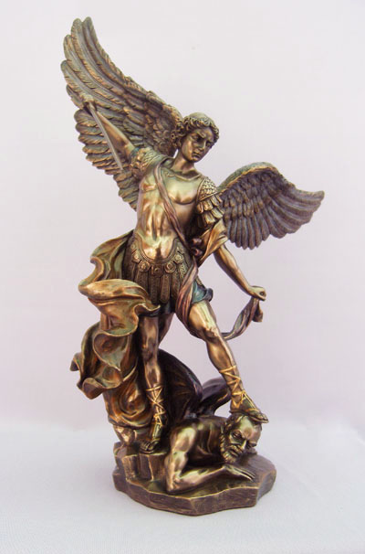
Example 2: Bronze
Bronze is an alloy of copper and tin.

Slide 22
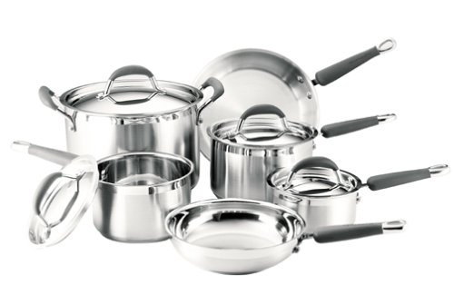
Example 3: Stainless Steel
Stainless steel is an alloy of iron with chromium and nickel.

Slide 23
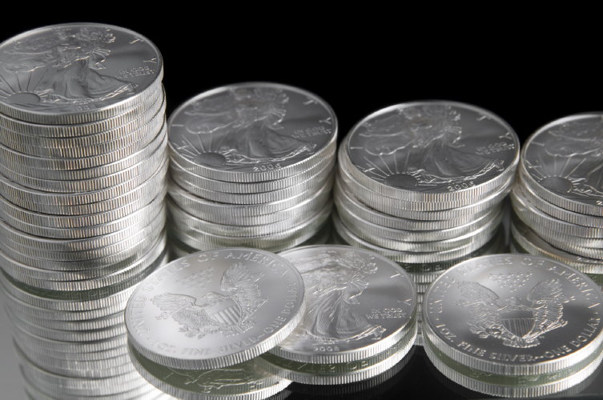
Example 4: ‘Cupronickel’
‘Cupronickel’ is a mixture of copper and nickel which is used to make ‘silver’ coins.

