Slide 1
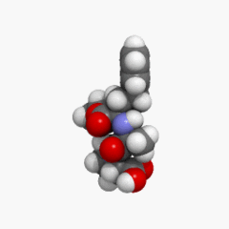
Structure of Substances

Slide 2
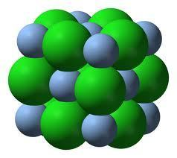
What determines the properties of a compound?
The properties of a compound, whether it is an ionic, molecular (covalent) or metallic compound, depend on the strength of the force of attraction between the individual particles.

Slide 3
What determines the properties of a compound?
This means that the properties depend on the arrangement of the particles; for example, if the particles are very tightly packed together, the compound will have a high density.

Slide 4
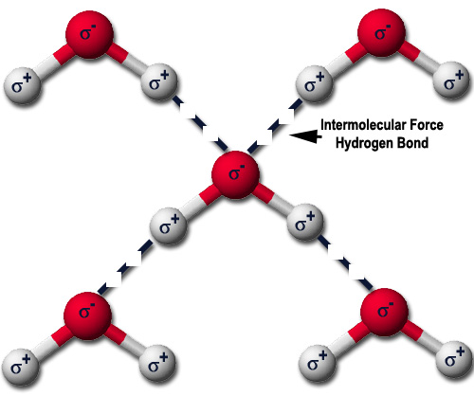
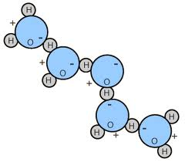
Intermolecular Forces

Slide 5
Intermolecular Forces
The physical properties of melting point, boiling point, vapour pressure, evaporation, viscosity, surface tension, and solubility are related to the strength of attractive forces between molecules.
These attractive forces are called Intermolecular Forces.
The amount of "stick togetherness" is important in the interpretation of the various properties listed above.

Slide 6
What are Intermolecular Forces?
Intermolecular forces (or attractions) are attractions between one molecule and a neighbouring molecule.
The forces of attraction which hold an individual molecule together (for example, the covalent bonds) are known as intramolecular attractions.
These two words are so confusingly similar that it is safer to abandon one of them and never use it. The term "intramolecular" won't be used again in this lesson.

Slide 7
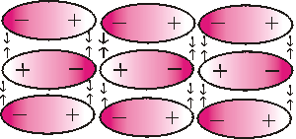
Which molecules experience intermolecular forces?
All molecules experience intermolecular attractions, although in some cases those attractions are very weak.

Slide 8
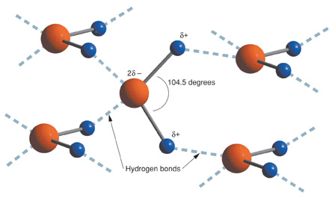
Types of Intermolecular Forces
van der Waals’ forces – dispersion forces & dipole-dipole interactions
Hydrogen bonds

Slide 9
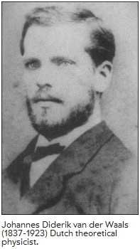
van der Waals’ forces

Slide 10
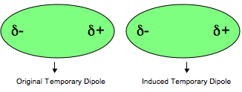
van der Waals’ forces: dispersion forces

Slide 11
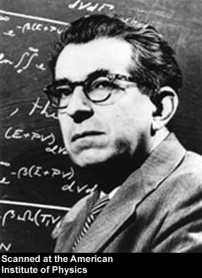
van der Waals’ forces: dispersion forces
Dispersion forces (one of the two types of van der Waals forces we are dealing with in this lesson) are also known as "London forces" (named after Fritz London who first suggested how they might arise).

Slide 12
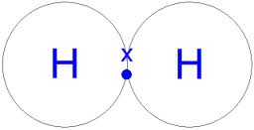
The origins of van der Waals’ dispersion forces: Temporary fluctuating dipoles
Attractions are electrical in nature. In a symmetrical molecule like hydrogen, however, there doesn't seem to be any electrical distortion to produce positive or negative parts. But that's only true on average.

Slide 13
The lozenge-shaped diagram represents a small symmetrical molecule - H₂, perhaps, or Br₂.
The even shading shows that on average there is no electrical distortion.

Slide 14
But the electrons are mobile, and at any one instant they might find themselves towards one end of the molecule, making that end δ-.
The other end will be temporarily short of electrons and so becomes δ+.
An instant later the electrons may well have moved up to the other end, reversing the polarity of the molecule.

Slide 15
This constant "sloshing around" of the electrons in the molecule causes rapidly fluctuating dipoles even in the most symmetrical molecule.
It even happens in monatomic molecules - molecules of noble gases, like helium, which consist of a single atom.
If both the helium electrons happen to be on one side of the atom at the same time, the nucleus is no longer properly covered by electrons for that instant.

Slide 16
How do temporary dipoles give rise to intermolecular attractions?
Imagine a molecule which has a temporary polarity being approached by one which happens to be entirely non-polar just at that moment. (A pretty unlikely event, but it makes the diagrams much easier to draw! In reality, one of the molecules is likely to have a greater polarity than the other at that time - and so will be the dominant one.)

Slide 17
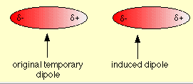
As the right hand molecule approaches, its electrons will tend to be attracted by the slightly positive end of the left hand one.
This sets up an induced dipole in the approaching molecule, which is orientated in such a way that the δ+ end of one is attracted to the δ- end of the other.

Slide 18
An instant later the electrons in the left hand molecule may well have moved up the other end.
In doing so, they will repel the electrons in the right hand one.

Slide 19
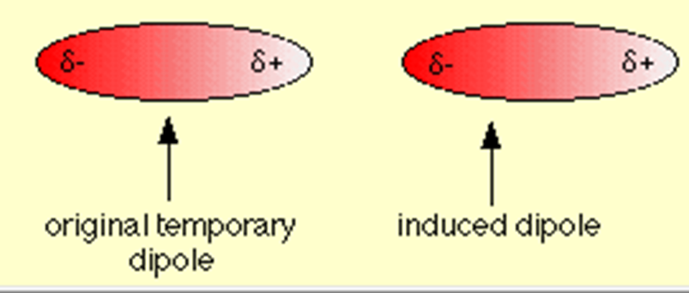
The polarity of both molecules reverses, but you still have δ+ attracting δ-. As long as the molecules stay close to each other the polarities will continue to fluctuate in synchronisation so that the attraction is always maintained.

Slide 20
There is no reason why this has to be restricted to two molecules. As long as the molecules are close together this synchronised movement of the electrons can occur over huge numbers of molecules.

Slide 21
How strong are dispersion forces?
Dispersion forces between molecules are much weaker than the covalent bonds within molecules. It isn't possible to give any exact value, because the size of the attraction varies considerably with the size of the molecule and its shape.

Slide 22
How does molecular size affect the strength of the dispersion forces?
The boiling points of the noble gases are:
helium -269°C
neon -246°C
argon -186°C
krypton -152°C
xenon -108°C
radon -62°C
All of these elements have monatomic molecules.

Slide 23
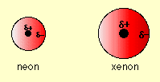
The reason that the boiling points increase as you go down the group is that the number of electrons increases, and so also does the radius of the atom.
The more electrons you have, and the more distance over which they can move, the bigger the possible temporary dipoles and therefore the bigger the dispersion forces.

Slide 24
Because of the greater temporary dipoles, xenon molecules are "stickier" than neon molecules.
Neon molecules will break away from each other at much lower temperatures than xenon molecules - hence neon has the lower boiling point.

Slide 25
This is the reason that (all other things being equal) bigger molecules have higher boiling points than small ones.
Bigger molecules have more electrons and more distance over which temporary dipoles can develop - and so the bigger molecules are "stickier".

Slide 26
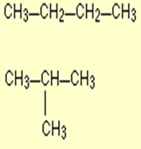
How does molecular shape affect the strength of the dispersion forces?
The shapes of the molecules also matter. Long thin molecules can develop bigger temporary dipoles due to electron movement than short fat ones containing the same numbers of electrons.
Long thin molecules can also lie closer together - these attractions are at their most effective if the molecules are really close.

Slide 27
For example, the hydrocarbon molecules butane and 2-methylpropane both have a molecular formula C₄H₁₀, but the atoms are arranged differently.
In butane the carbon atoms are arranged in a single chain, but 2-methylpropane is a shorter chain with a branch.

Slide 28
Butane has a higher boiling point because the dispersion forces are greater.
Butane molecules are longer (and so set up bigger temporary dipoles) and can lie closer together than the shorter, fatter 2-methylpropane molecules.

Slide 29
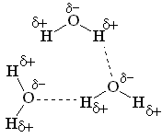
van der Waals forces: dipole-dipole interactions

Slide 30
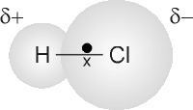
van der Waals forces: dipole-dipole interactions
A molecule like HCl has a permanent dipole because chlorine is more electronegative than hydrogen.
These permanent, in-built dipoles will cause the molecules to attract each other rather more than they otherwise would if they had to rely only on dispersion forces.

Slide 31
It's important to realise that all molecules experience dispersion forces.
Dipole-dipole interactions are not an alternative to dispersion forces - they occur in addition to them.
Molecules which have permanent dipoles will therefore have boiling points higher than molecules which only have temporary fluctuating dipoles.

Slide 32
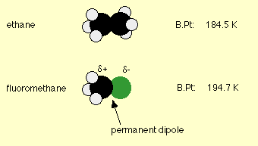
Surprisingly dipole-dipole attractions are fairly minor compared with dispersion forces, and their effect can only really be seen if you compare two molecules with the same number of electrons and the same size.
For example, the boiling points of ethane, CH₃CH₃, and fluoromethane, CH₃F, are

Slide 33
Why choose these two molecules to compare? Both have identical numbers of electrons, and if you made models you would find that the sizes were similar - as you can see in the diagrams.
That means that the dispersion forces in both molecules should be much the same.

Slide 34
The higher boiling point of fluoromethane is due to the large permanent dipole on the molecule because of the high electronegativity of fluorine.
However, even given the large permanent polarity of the molecule, the boiling point has only been increased by some 10°.

Slide 35
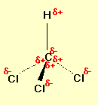
Here is another example showing the dominance of the dispersion forces.
Trichloromethane, CHCl₃, is a highly polar molecule because of the electronegativity of the three chlorines.
There will be quite strong dipole-dipole attractions between one molecule and its neighbours.

Slide 36
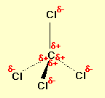
On the other hand, tetrachloromethane, CCl₄, is non-polar.
The outside of the molecule is uniformly δ- in all directions.
CCl₄ has to rely only on dispersion forces.

Slide 37
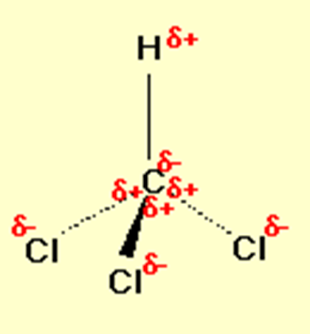
So which has the highest boiling point? CCl₄ does, because it is a bigger molecule with more electrons.
The increase in the dispersion forces more than compensates for the loss of dipole-dipole interactions.
The boiling points are:
CHCl₃ 61.2°C
CCl₄ 76.8°C

Slide 38
Hydrogen Bonds

Slide 39
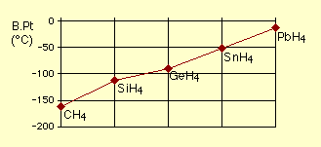
The Evidence for Hydrogen Bonds
Many elements form compounds with hydrogen.
If you plot the boiling points of the compounds of the Group 4 elements with hydrogen, you find that the boiling points increase as you go down the group.

Slide 40
The increase in boiling point happens because the molecules are getting larger with more electrons, and so van der Waals dispersion forces become greater.

Slide 41
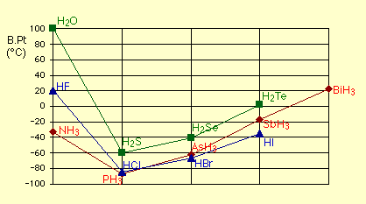
If you repeat this exercise with the compounds of the elements in Groups 5, 6 and 7 with hydrogen, something odd happens.

Slide 42
Although for the most part the trend is exactly the same as in group 4 (for exactly the same reasons), the boiling point of the compound of hydrogen with the first element in each group is abnormally high.

Slide 43
In the cases of NH₃, H₂O and HF there must be some additional intermolecular forces of attraction, requiring significantly more heat energy to break.
These relatively powerful intermolecular forces are described as hydrogen bonds.

Slide 44
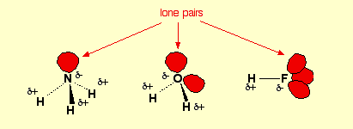
The origin of hydrogen bonding
The molecules which have this extra bonding are:

Slide 45
Notice that in each of these molecules:
1. The hydrogen is attached directly to one of the most electronegative elements, causing the hydrogen to acquire a significant amount of positive charge.
2. Each of the elements to which the hydrogen is attached is not only significantly negative, but also has at least one "active" lone pair.

Slide 46
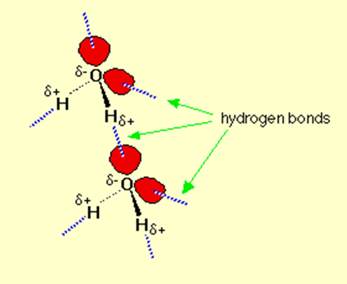
Strength of a Hydrogen Bond
A hydrogen bond is stronger than a van der Waals’ bond but weaker than a covalent or an ionic bond.

Slide 47
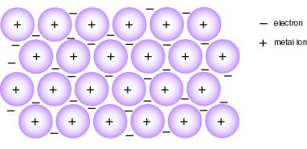
Metallic Bonding

Slide 48
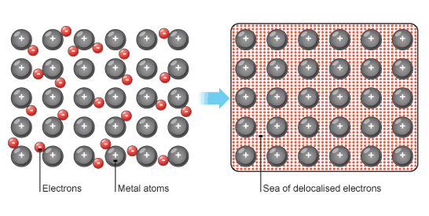
Metallic Bonding
Metals have very distinct chemical and physical properties as a result of the type of bonding that occurs between the metals atoms.
The type of bonding between metal atoms is known as metallic bonding.

Slide 49
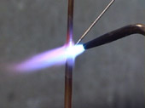
Evidence for strong bonding in metals
The high melting point and boiling point of a metal suggest that there must be strong bonds between the atoms.

Slide 50
Sea of electrons in metals
The high density of metals means that the atoms must be packed very close together.
Because of this tight packing, the outer shells overlap and the valence electrons become delocalised, i.e. they are not associated with any particular atom.

Slide 51
Sea of electrons in metals
These delocalised electrons (also known as mobile electrons) form a ‘sea’ of moving electrons, which belong to the metal lattice as a whole.

Slide 52
Sea of electrons in metals
Positive metal ions (cations) are formed when the electrons become delocalised. The metal is held together by the strong forces of attraction between the positive cation and the delocalised electrons.
This force of attraction is called the metallic bond.

Slide 53
Why do metals conduct electricity?
Electrical conductivity in a compound depends on whether a compound has charged particles which are able to move.
Possible charged particles are electrons or ions.

Slide 54
Why do metals conduct electricity?
Metals can conduct an electric current because they have delocalised electrons which are able to move throughout the metal.

Slide 55
Summary
In this lesson we learnt about:
van der Waals’ forces
Hydrogen Bonds
Metallic Bonding

