Slide 1
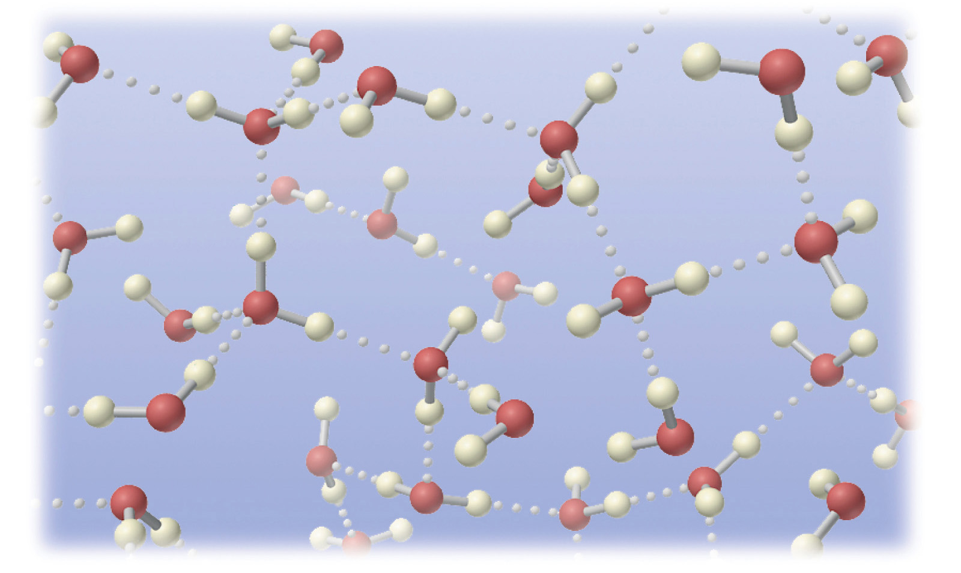
Covalent Bonding

Slide 2
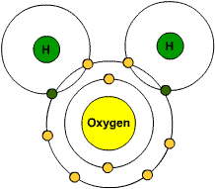
What is covalent bonding?
Covalent bonding results when electrons are shared between non-metal atoms to form a molecule.

Slide 3
What happens in covalent bonding?
In the formation of the covalent bond, the atoms involved in the bonding approach each other so that the outermost electron shells overlap.

Slide 4
What happens in covalent bonding?
Electron pairs are shared between the two overlapping atoms. These electron pairs are called bonding pairs.

Slide 5
What happens in covalent bonding?
The bonding pairs spend time with both atoms, orbiting around each nucleus.

Slide 6
What happens in covalent bonding?
Each of the atoms will now have a completed outer electron shell, increasing their stability.

Slide 7
Representation of Covalent Bonds
Covalent bonds are often shown using ‘dot-and-cross’ diagrams.
Although the electrons are drawn as dots and crosses, there is absolutely no difference between them in reality.
The dots and crosses simply show that the electrons have come from two different atoms.
You could equally well use two different colour dots or two different colour crosses.

Slide 8
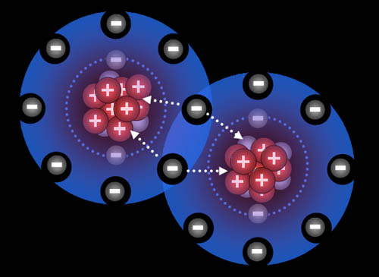
Other Examples of Covalent Bonds

Slide 9
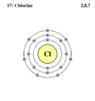
Example 1: Chlorine Gas
Chlorine is a non-metal with seven electrons in its outer electron shell.
Chlorine needs one electron to complete its outer electron shell.

Slide 10
The shared electron pair orbits around both atoms forming a single covalent bond.
The formula for chlorine is Cl₂.

Slide 11
Two chlorine atoms come close enough for their outer electron shells to overlap.
The two electrons share one pair of electrons between them.

Slide 12
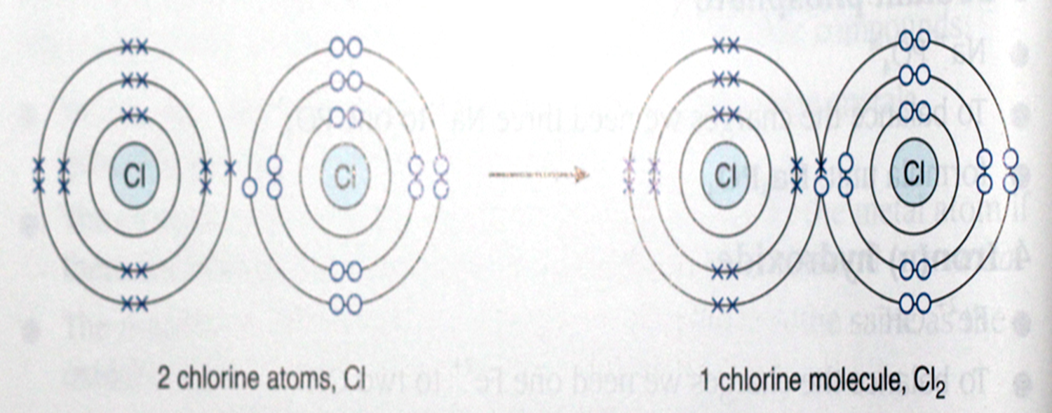
The single covalent bond can also be shown as one line between the two atoms, i.e. Cl-Cl
Each line represents one pair of shared electrons.

Slide 13
Both chlorine nuclei are strongly attracted to the shared pair of electrons.
The covalent bond between the two chlorine atoms is very strong. Chlorine atoms therefore go around in pairs, called a chlorine molecule, with the symbol Cl₂.

Slide 14
Molecules have a certain fixed number of atoms in them joined together by covalent bonds.
Chlorine molecules are said to be diatomic because they contain two atoms.
Other sorts of molecules may have as many as thousands of atoms joined together.

Slide 15
Why does chlorine form molecules?
Whenever a bond is formed (of whatever kind), energy is released; that makes the things involved more stable than they were before.
The more bonds an atom can form, the more energy is released and the more stable the system becomes.
In the chlorine case, each chlorine atom only has one electron to share, so it can only form one covalent bond.
The Cl₂ molecule is much more stable than two separate chlorine atoms.

