Slide 1
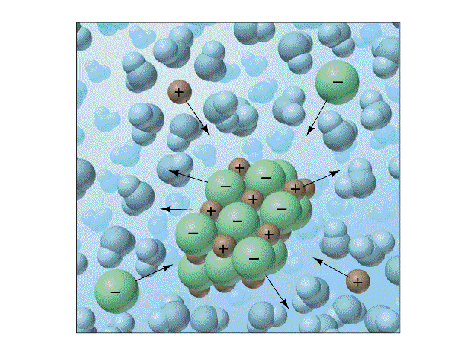
Ionic Equilibria III: The Solubility Product Principle

Slide 2
Lesson 7 Objectives
Students should be able to:
1. Write solubility product constant expressions.
2. Explain how K_{sp} values are determined.
3. Use K_{sp} values in chemical calculations.
4. Identify common, slightly soluble compounds.
5. Outline fractional precipitation and how it can be used to separate ions.
6. Outline how simultaneous equilibria can be used to control solubility.
7. Describe some methods of dissolving precipitates.

Slide 3
Solubility Product Constants
In equilibria that involve slightly soluble compounds in water, the equilibrium constant is called the solubility product constant, K_{sp}.
Example:
BaSO₄(s) Ba²⁺(aq) + SO₄²⁻(aq)
Ksp = [Ba²⁺][SO₄²⁻]

Slide 4
Solubility Product Principle
The solubility product expression for a compound is the product of the concentrations of its constituent ions, each raised to the power that corresponds to the number of ions in one formula unit of the compound.
The quantity is constant at constant temperature for a saturated solution of the compound.
This statement is the solubility product principle.

Slide 5
Determination of Solubility Product Constants
If the solubility of a compound is known, the molar solubility and the value of its solubility product can be calculated.

Slide 6
Example Calculations
Example 20-1: Molar Solubility and Product Constants
Example 20-2: Molar Solubility and Solubility Product Constant
Exercise – 6, 8

Slide 7
Uses of Solubility Product Constants
When the solubility product for a compound is known, the solubility of the compound in H₂O at 25ºC can be calculated.

Slide 8
Example Calculations
Example 20-3: Molar Solubilities from Ksp Values
Exercise – 16

Slide 9
The Common Ion Effect in Solubility Calculations
The common ion effect applies to solubility equilibria just as it does to other ionic equilibria.
Example: Silver acetate, AgCH₃COO(s), is a slightly soluble salt:
AgCH₃COO(s) Ag⁺(aq) + CH₃COO⁻(aq)
If we add another salt that provides one of the product ions, say Ag+ (from AgNO₃), this dissolution reaction is shifted to the left (LeChatelier’s Principle).

Slide 10
Example Calculations
Example 20-4: Molar Solubilities and the Common Ion Effect
Exercises – 20 & 26

Slide 11
The Reaction Quotient in Precipitation Reactions
Another application of the solubility product principle is the calculation of the maximum concentration of ions that can coexist in solution.
From these calculations, we can determine whether a precipitate will form in a given solution.
The reaction quotient, Q, is useful in such decisions.

Slide 12
Comparing Q_{sp} with K_{sp}
If Q_{sp} < K_{sp} | Forward process is favoured. No precipitation occurs; if solid is present, more solid can dissolve.
If Q_{sp} = K_{sp} | Solution is just saturated. Solid and solution are in equilibrium; neither forward nor reverse process is favoured.
If Q_{sp} > K_{sp} | Reverse process is favoured. Precipitation occurs to form more solid.

Slide 13
Example Calculations
Example 20-5: Predicting Precipitate Formation
Example 20-6: Initiation of Precipitation
Example 20-7: Concentration of Common Ion
Exercises – 28, 30, 29 & 32

Slide 14
Fractional Precipitation
We sometimes wish to remove selected ions from solution while leaving others with similar properties in solution.
This separation process is called fractional precipitation.

Slide 15
Example Calculations
Example 20-8: Concentration Required to Initiate Precipitation
Example 20-9: Fractional Precipitation
Exercise – 36 & 38

Slide 16
Simultaneous Equilibria Involving Slightly Soluble Compounds
Many weak acids and bases react with many metal ions to form insoluble compounds.
In such cases, we must take into account the weak acid or weak base equilibrium as well as the solubility equilibrium.
The most common examples involve the reaction of metal ions with aqueous ammonia to form insoluble metal hydroxides.

Slide 17
Example Calculations
Example 20-10: Simultaneous Equilibria
Example 20-11: Simultaneous Equilibria
Example 20-12: Simultaneous Equilibira
Exercises – 46, 42 & 44

Slide 18
Dissolving Precipitates
A precipitate dissolves when the concentrations of its ions are reduced so that K_{sp} is no longer exceeded, that is, when Q_{sp} < K_{sp}.
Precipitates can be dissolved by the following methods:
Converting an ion to a weak electrolyte
Converting an ion to another species by a redox reaction
Complex ion formation

Slide 19
Assignment
READ:
General Chemistry (9th Edition)
Chapter 20: Ionic Equilibria III: The Solubility Product Principle, pages 771 – 793
Chapter 21: Electrochemistry, pages 794 – 841

Slide 20
References
1. General Chemistry (9th Edition)
Kenneth W. Whitten
Raymond E. Davis
M. Larry Peck
George G. Stanley
ISBN-13:978-0-495-39163-0
ISBN-10:0-495-39163-8

