Slide 1
Chemical Equations

Slide 2
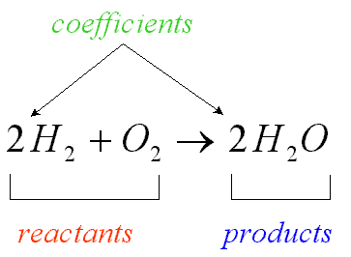
Chemical Equations
Chemical equations use symbols and formulae to represent chemical change.

Slide 3
Chemical Formula
Examples:
2H – 2 atoms of hydrogen, not bonded together.
The 2 is called a coefficient.
H₂ – 1 molecule of hydrogen, made up of 2 atoms of hydrogen bonded together.
2H₂ – 2 molecules of hydrogen, in total 4 atoms of hydrogen.

Slide 4
Chemical Formula
Examples:
Ca(OH)₂ – 1 Ca²⁺ and 2 OH⁻
So the amount of each element is 1Ca, 2O and 2H atoms.
3H₂SO₄ – consists of 6H, 3S and 12O atoms.

Slide 5
Writing Chemical Equations
The conventions which are used when writing chemical equations are:
The reactants are placed on the left side of the equation and the products are placed on the right side with an arrow (→) separating reactants from products.
A plus sign (+) separates each reactant or product.
The physical state of the chemical is usually written as a subscript. These physical states are:
(s) – solid, (l) – liquid, (g) – gas, (aq) – aqueous

Slide 6
Other chemicals and factors which are required for the reaction to occur but do not change during the reaction can be written above the arrow, e.g. catalysts, a specific temperature, a specific pressure.
If a reaction is reversible a double arrow is used :
When reading a chemical equation, each of the signs represents a word or statement.
Example: 2Fe_{(s)} + 3Cl_{(g)} → 2FeCl_{3(s)}
‘Solid iron reacts with chlorine gas to form solid iron (III) chloride’

Slide 7
Balancing Chemical Equations

Slide 8
When is a scale balanced?

Slide 9
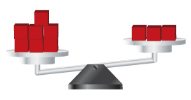
What do we need to do to balance the scale below?

Slide 10
Balancing Chemical Equations
Early chemists noticed that in a chemical reaction, the total mass of the reactants always equalled the total mass of the products. This led to the Law of Conservation of Mass which states that matter can neither be created nor destroyed.

Slide 11
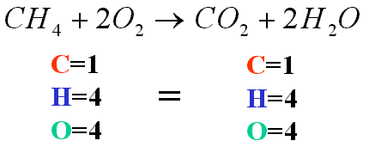
Atoms in a chemical equation are neither created nor destroyed; they are only rearranged. A chemical equation that conforms to this law is known as a balanced chemical equation.
In a balanced chemical equation there must be the same number of atoms of each element on the right hand side of the equation as there are on the left hand side.
When an equation is balanced, the mass of the reactants will equal the mass of the products.

Slide 12
Example 1
Balance the equation: Zn_{(s)} + HCl_{(aq)} → ZnCl_{2(aq)} + H_{2(g)}
To balance, we need 2 H and 2 Cl on the left. Therefore, we put a 2 in front of HCl.
We get, Zn_{(s)} + 2HCl_{(aq)} → ZnCl_{2(aq)} + H_{2(g)}
Atom | Zn + HCl | ZnCl₂ + H₂
Zn | 1 | 1
H | 1 | 2
Cl | 1 | 2
Atom | Zn + 2HCl | ZnCl₂ + H₂
Zn | 1 | 1
H | 2 | 2
Cl | 2 | 2

Slide 13
Example 2
Balance the equation: N_{2(g)} + H_{2(g)} → NH_{3(g)}
We need 2 N on the right, so we put a 2 in front of NH₃
We need 6 H on the left, so we put a 3 in front of H₂
We get, N_{2(g)} + 3H_{2(g)} → 2NH_{3(g)}
Atom | N₂ + H₂ | NH₃
N | 2 | 1
H | 2 | 3
Atom | N₂ + H₂ | 2NH₃
N | 2 | 2
H | 2 | 6
Atom | N₂ + 3H₂ | 2NH₃
N | 2 | 2
H | 6 | 6

Slide 14
Example 3
Balance the equation: Fe_{(s)} + H₂SO_{4(aq)} → Fe₂(SO₄)_{3(aq)} + H_{2(g)}
We need 2 Fe and 3 SO₄ on the left, so we put a 2 in front of Fe and a 3 in front of H₂SO₄
We need 6 H on the right, so we put a 3 in front of H₂
Atom | Fe + H₂SO₄ | Fe₂(SO₄)₃ + H₂
H | 2 | 2
Fe | 1 | 2
SO₄ | 1 | 3
Atom | 2Fe + 3H₂SO₄ | Fe₂(SO₄)₃ + H₂
H | 6 | 2
Fe | 2 | 2
SO₄ | 3 | 3
Atom | 2Fe + 3H₂SO₄ | Fe₂(SO₄)₃ + 3H₂
H | 6 | 6
Fe | 2 | 2
SO₄ | 3 | 3
We get, 2Fe_{(s)} + 3H₂SO_{4(aq)} → Fe₂(SO₄)_{3(aq)} + 3H_{2(g)}

Slide 15
Example 4
Balance the equation: C₃H_{8(g)} + O_{2(g)} → CO_{2(g)} + H₂O_{(g)}
To balance, put a 3 in front of CO₂ and a 4 in front of H₂O
To balance the O, put a 5 in front of O₂
Atom | C₃H₈ + O₂ | CO₂ + H₂O
C | 3 | 1
H | 8 | 2
O | 2 | 2 1
Atom | C₃H₈ + O₂ | 3CO₂ + 4H₂O
C | 3 | 3
H | 8 | 8
O | 2 | 6 4
Atom | C₃H₈ + 5O₂ | 3CO₂ + 4H₂O
C | 3 | 3
H | 8 | 8
O | 10 | 6 4
We get, C₃H_{8(g)} + 5O_{2(g)} → 3CO_{2(g)} + 4H₂O_{(g)}

Slide 16
Examination Tip
When balancing chemical equations its is best to begin with an element other than hydrogen or oxygen.
Start with the elements immediately after the arrow, excluding hydrogen and oxygen.
Balance the hydrogen atoms second from last and oxygen atoms last.

Slide 17
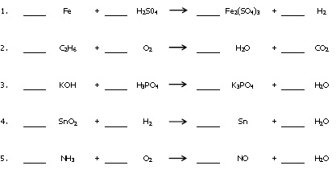
Worksheet Balance the following chemical equations.

Slide 18
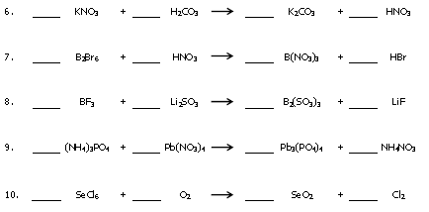

Slide 19
Calculations from Equations

Slide 20
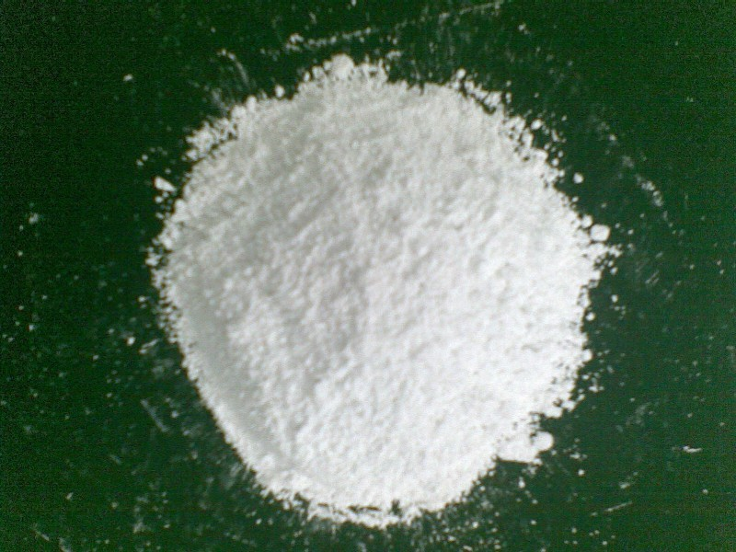
Example 1
When limestone, CaCO₃, is heated, calcium oxide is formed.
Calculate the mass of calcium oxide which would be produced by heating 25g of limestone.
(Relative atomic masses: C = 12; O = 16; H = 1)

Slide 21
Answer
CaCO_{3(s)} → CaO_{(s)} + CO_{2(g)}
1 mol CaCO₃ produces 1 mol CaO_{(s)}
100g CaCO_{3(s)} (1 mol) produces 56g (1 mol) CaO_{(s)}
If 100g CaCO_{3(s)} gives 56g CaO_{(s)}
Then 1g CaCO₃ will give 56 g CaO_{(s)}
100
And, 25g CaCO₃ will give 56 x 25 g CaO_{(s)}
100
= 14g CaO

Slide 22
Example 2
Lead is extracted from galena, PbS. The ore is heated in air to produce lead(II) oxide, PbO.
2PbS_{(s)} + 3O_{2(g)} → 2PbO_{(s)} + 2SO_{2(g)}
The lead(II) oxide is reduced to lead by heating it with carbon in a blast furnace.
PbO_{(s)} + C_{(s)} → Pb_{(l)} + CO_{(g)}

Slide 23
The molten lead is tapped from the bottom of the furnace.
Calculate:
The mass of sulphur dioxide produced when 1 tonne of galena is heated.
The mass of lead that would be produced from 1 tonne of galena.
(Relative Atomic Masses: O = 16; S = 32; Pb = 207)

Slide 24
Answer (i)
2PbS_{(s)} + 3O_{2(g)} → 2PbO_{(s)} + 2SO_{2(g)}
2 mol PbS produces 2 mol SO₂
(2 x 239)g PbS produces (2 x 64)g SO₂
478g PbS produces 128g SO₂
478 tonnes PbS produces 128 tonnes SO₂
So, 1 tonne PbS will produce 128 tonnes SO₂
478
= 0.267 tonnes SO₂

Slide 25
Answer (ii)
2PbS_{(s)} + 3O_{2(g)} → 2PbO_{(s)} + 2SO_{2(g)}
PbO_{(s)} + C_{(s)} → Pb_{(l)} + CO_{(g)}
2 mol PbS produces 2 mol PbO
2 mol PbO produces 2 mol Pb
(We’ve doubled the second equation so that we can trace what happens to all the PbO from the first one)
(2 x 239) g PbS produces (2 x 207) g Pb
478g PbS produces 414g Pb
So, 478 tonnes PbS produces 414 tonnes Pb
1 tonne PbS would produce 414 tonnes Pb = 0.886 tonnes Pb
478

Slide 26
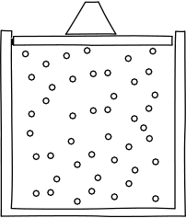
Calculations involving Gas Volumes

Slide 27
Calculations Involving Gas Volumes
Units of Volume
Volumes (of gases or liquids) are measured in cubic centimetres (cm³) or
cubic decimetres (dm³) or
litres (l).
1 litre = 1 dm³ = 1000cm³

Slide 28
Avogadro’s Law
Equal volumes of gases at the same temperature and pressure contain equal numbers of molecules.

Slide 29
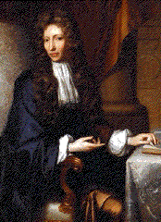
The Molar Volume of a Gas
1 mole of any gas occupies 24 dm³ (24 000 cm³) at rtp (room temperature and pressure).
1 mole of any gas occupies 22.4 dm³ (22 400 cm³) at stp (standard temperature and pressure).

Slide 30
Example 1
Calculate the volume of carbon dioxide produced at room temperature and pressure when an excess of dilute hydrochloric acid is added to 1.00 g of calcium carbonate.
(RAMs: C = 12; O = 16; Ca = 40. Molar volume = 24 dm³ at rtp)

Slide 31
Answer
CaCO_{3(s)} + 2HCl_{(aq)} → CaCl_{2(aq)} + CO_{2(g)} + H₂O_{(l)}
1 mol CaCO₃ gives 1 mol CO₂
100 g CaCO₃ gives 24dm³ CO₂ at rtp
1 g CaCO₃ gives 1 x 24 dm³ CO₂
100
= 0.24 dm³ CO₂

Slide 32
Example 2
What is the maximum mass of aluminium which you could add to an excess of dilute hydrochloric acid so that you produced no more than 100 cm³ of hydrogen at room temperature and pressure?
(RAM: Al = 27. Molar volume = 24 000 cm³ at rtp)
N.B. In this example, dilute hydrochloric acid is in excess and aluminium is the limiting reactant.
Using an excess of dilute hydrochloric acid ensures that all of the aluminium reacts completely.

Slide 33
Answer
2Al_{(s)} + 6HCl_{(aq)} → 2AlCl_{3(aq)} + 3H_{2(g)}
2 mol Al gives 3 mol H₂
(2x27)g Al gives (3x24000)cm³ H₂
54 g Al gives 72000 cm³ H₂
72 000 cm³ H₂ comes from 54 g Al
100 cm³ H₂ comes from 54 x 100 g Al
72000
= 0.075 g Al

Slide 34
Limiting Reactant

Slide 35
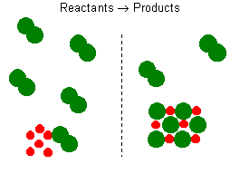
Limiting Reactant
Limiting Reactant - The reactant in a chemical reaction that limits the amount of product that can be formed. The reaction will stop when all of the limiting reactant is consumed.
Excess Reactant - The reactant in a chemical reaction that remains when a reaction stops when the limiting reactant is completely consumed. The excess reactant remains because there is nothing with which it can react.

Slide 36
Example 1
Consider the combustion of benzene, represented by the following chemical equation:
This means that 15 mol molecular oxygen is required to react with 2 mol benzene.
The amount of oxygen required for other quantities of benzene can be calculated using cross-multiplication.
For example, if 1.5 mol of benzene is present, 11.25 mol of oxygen is required:
So, if 18 mol of oxygen are present, there will be an excess of (18 - 11.25) = 6.75 mol of unreacted oxygen when all the benzene is consumed.
Benzene is then the limiting reagent.

Slide 37
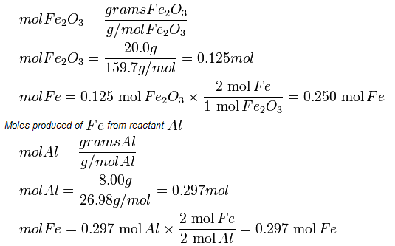
Example 2
Which reactant is limiting if 20.0 g of Fe₂O₃ are reacted with 8.00 g Al in the followng reaction?
Since the reactant amounts are given in grams, they must be first converted into moles for comparison with the chemical equation, in order to determine how many moles of Fe can be produced from either reactant.
There is enough Al to produce 0.297 mol Fe, but only enough Fe₂O₃ to produce 0.250 mol Fe. This means that the amount of Fe actually produced is limited by the Fe₂O₃ present, which is therefore the limiting reagent.

Slide 38
Percentage Yield
In theory, a reaction may be shown to produce a certain amount of product. However, some product may be left on the apparatus or some might be spilled.
Example
If your calculation shows that you should get 10 g of product but you only recover 9 g, then your yield is 9 g out of a possible 10 g.
Percentage Yield = 9 x 100
10
= 90 %

Slide 39
Worksheet
(1)Titanium is manufactured by heating titanium (IV) chloride with sodium.
TiCl_{4(g)} + 4Na_{(l)}→ Ti_{(s)} + 4NaCl_{(s)}
What mass of sodium is required to produce 1 tonne of titanium?
(RAMs: Na = 23; Ti = 48)

Slide 40
Worksheet
(2) 2.67g of aluminium chloride was dissolved in water and an excess of silver nitrate solution was added to give a precipitate of silver chloride.
AlCl_{3(aq)} + 3AgNO_{3(aq)} → Al(NO₃)_{3(aq)} + 3AgCl_{(s)}
What mass of silver chloride precipitate would be formed?
(RAMs: Al = 27; Cl = 35.5; Ag = 108)

Slide 41
Worksheet
(3) Copper(II) sulphate crystals, CuSO₄.5H₂O, can be made by heating copper (II) oxide with dilute sulphuric acid and then crystallisingthe solution formed. Calculate the maximum mass of crystals that could be made from 4.00g of copper (II) oxide using an excess of sulphuric acid.
CuO_{(s)} + H₂SO_{4(aq)} → CuSO_{4(aq)} + H₂O_{(l)}
CuSO_{4(aq)} + 5H₂O_{(l)} → CuSO₄.5H₂O_{(s)}
(RAMs: H = 1; O = 16; S = 32; Cu = 64)

Slide 42
Summary
In this lesson we learnt how to:
1. Write balanced chemical equations to describe chemical reactions.
2. Use balanced chemical equations to calculate the moles and masses of reactants and products involved in each of the reactions.

Slide 43
Summary
3. Determine which reactant is the limiting reactant in reactions.
4. Use the limiting reactant concept in calculations involving chemical equations.
5. Compare the amount of substance actually formed in a reaction (actual yield) with the predicted amount (theoretical yield), and use to determine the percent yield.

