Slide 1
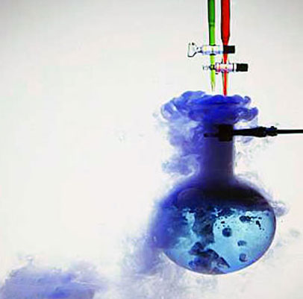
Some Types of Chemical Reactions

Slide 2
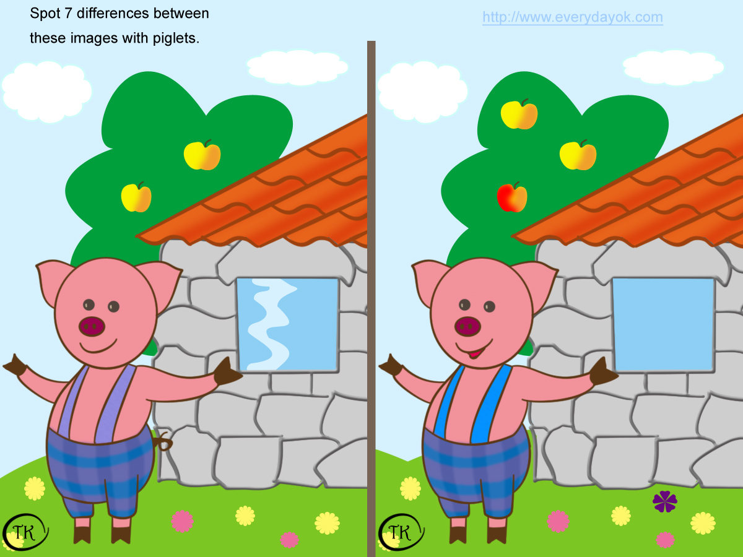
Can you spot three (3) differences?

Slide 3
Can you spot the differences in the reactions?
(1) 2Mg_{(s)} + O_{2(g)} → 2MgO_{(s)}
(2) CaCO_{3(s)} → CaO_{(s)} + CO_{2(g)}
(3) NaOH_{(aq)} + HCl_{(aq)} → NaCl_{(aq)} + H₂O_{(l)}
(4) 2Al_{(s)} + 3CuSO_{4(aq)} → Al₂(SO₄)_{3(aq)} + 3Cu_{(s)}
(5) AgNO_{3(aq)} + KBr_{(aq)} → AgBr_{(s)} + KNO_{3(aq)}
(6) Zn_{(s)} + CuSO_{4(aq)} → ZnSO_{4(aq)} + Cu_{(s)}
(7) NH₄Cl_{(s)} NH_{3(g)} + HCl_{(g)}

Slide 4
Combination Reactions
A combination reaction is any reaction in which two or more substances combine to form a single product.

Slide 5
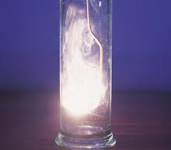
Examples of Combination Reactions
Example 1:
magnesium + oxygen → magnesium oxide
2Mg_{(s)} + O_{2(g)} → 2MgO_{(s)}

Slide 6
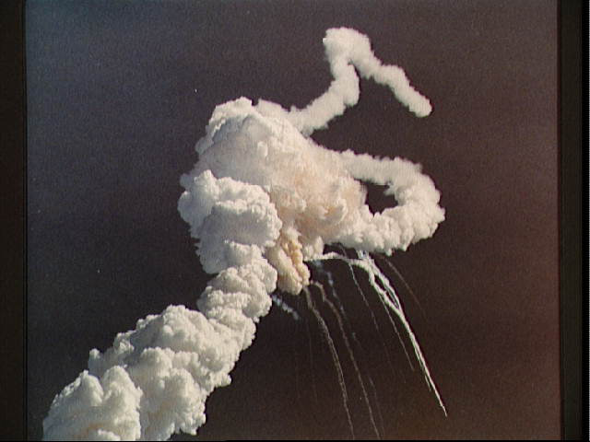
Example 2:
hydrogen + oxygen → water
2H_{2(g)} + O_{2(g)} → 2H₂O_{(g)}

Slide 7
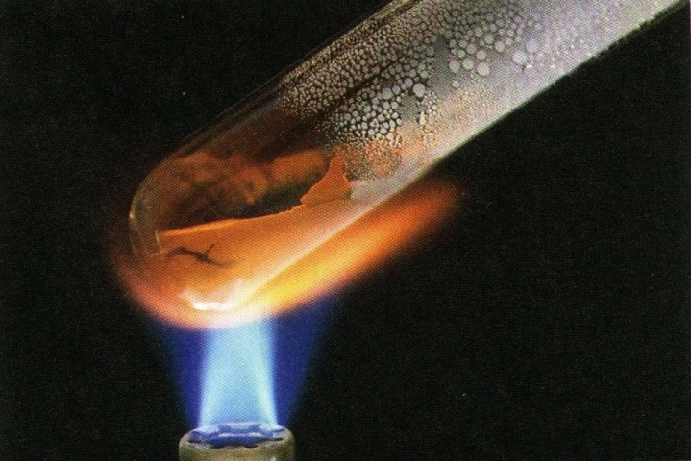
Decomposition Reactions
A decomposition reaction is any reaction where a single reactant is broken down into two or more products. A decomposition reaction will take place if the compound is unstable, if the compound is heated or if an electrical current is passed through it.

Slide 8
Examples of Decomposition Reactions
A decomposition reaction is generally symbolised by:
AB → A + B
Example 1:
calcium carbonate calcium oxide + carbon dioxide
CaCO_{3(s)} CaO_{(s)} + CO_{2(g)}
Example 2:
potassium chlorate e potassium chloride + oxygen
2KClO_{3(s)} 2KCl_{(s)} + 3O_{2(g)}

Slide 9
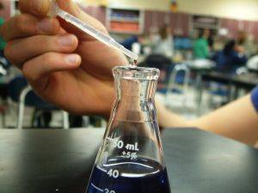
Neutralisation Reactions
Neutralization reactions are reactions between a base (or an alkali) and an acid. The acid is neutralized by the base (or alkali) and the products formed are a salt and water.

Slide 10
Examples of Neutralization Reactions
Example 1: Reaction between sodium hydroxide and hydrochloric acid
NaOH_{(aq)} + HCl_{(aq)} → NaCl_{(aq)} + H₂O_{(l)}
Ionic Equation:
OH⁻_{(aq)} + H⁺_{(aq)} → H₂O_{(l)}
Example 2: Reaction between copper(II) oxide and dilute sulphuric acid
CuO_{(s)} + H₂SO_{4(aq)} → CuSO_{4(aq)} + H₂O_{(l)}
Ionic Equation:
O²⁻_{(s)} + 2H⁺_{(aq)} → H₂O_{(l)}

Slide 11
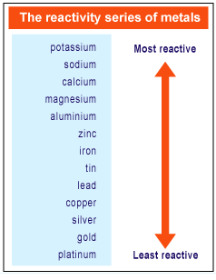
The Reactivity Series
The Reactivity Series lists elements (mainly metals) in order of decreasing reactivity.

Slide 12
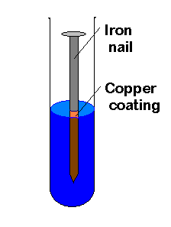
Single Displacement Reactions
A single displacement reaction involves the reaction between an element and a compound where the element takes the place of (displaces) another element from the compound.
Any metal higher in the series will displace one lower down from a compound.

Slide 13
Examples of Single Displacement Reactions
A single displacement reaction is generally symbolised by:
A + BC → AC + B
Example 1
aluminium + copper sulphate → aluminium sulphate + copper
2Al_{(s)} + 3CuSO_{4(aq)} → Al₂(SO₄)_{3(aq)} + 3Cu_{(s)}
Ionic Equation: 2Al_{(s)} + 3Cu²⁺_{(aq)} → Al³⁺_{(aq)} + 3Cu_{(s)}
Example 2
Carbon + copper(II) oxide → carbon dioxide + copper
C_{(s)} + 2CuO_{(s)} → CO_{2(g)} + 2Cu_{(s)}
Ionic Equation: C_{(s)} + Cu²⁺_{(aq)} → C²⁺_{(aq)} + Cu_{(s)}

Slide 14
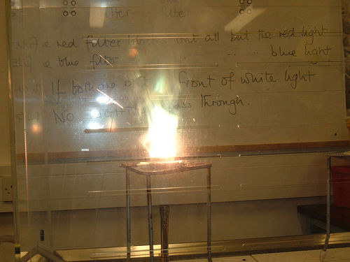
Example 3
Magnesium + zinc oxide → magnesium oxide + zinc
Mg_{(s)} + ZnO_{(s)} → MgO_{(s)} + Zn_{(s)}
Ionic Equation: Mg_{(s)} + Zn²⁺_{(aq)} → Mg²⁺_{(aq)} + Zn_{(s)}

Slide 15
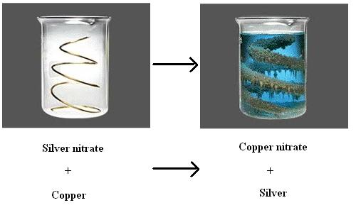
Example 4
Copper + silver nitrate → copper(II) nitrate + silver
Cu_{(s)} + 2AgNO_{3(aq)} → Cu(NO₃)_{2(aq)} + 2Ag_{(s)}
Ionic Equation: Cu_{(s)} + 2Ag⁺_{(aq)} → Cu²⁺_{(aq)} + Ag_{(s)}

Slide 16
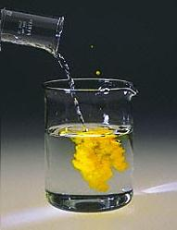
Ionic Precipitation Reactions
Ionic precipitation reactions are sometimes referred to as double displacement reactions or metathesis reactions. They mostly involve compounds which are in solution, where the compounds exchange ions.

Slide 17
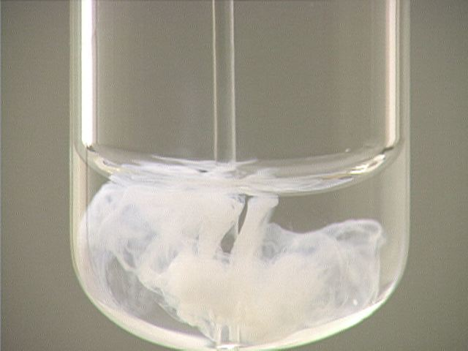
An ionic precipitation reaction is generally symbolised by:
AB + CD → AD + CB
To have a successful ionic precipitation reaction, one or both of the products must be incapable of undergoing the reverse reaction, generally because they form an insoluble precipitate.

Slide 18
Examples of Ionic Precipitation Reactions
Example 1:
AgNO_{3(aq)} + KBr_{(aq)} → AgBr_{(s)} + KNO_{3(aq)}
Ionic Equation: Ag⁺_{(aq)} + Br⁻_{(aq)} → AgBr_{(s)}
Example 2:
BaCl_{2(aq)} + Na₂SO_{4(aq)} → BaSO_{4(s)} + 2NaCl_{(aq)}
Ionic Equation: Ba²⁺_{(aq)} + SO₄²⁻_{(aq)} → BaSO_{4(s)}

Slide 19
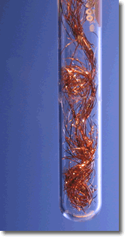
Redox Reactions
Redox reactions or oxidation-reduction reactions are chemical reactions in which one reactant is oxidised and the other is reduced or both change is oxidation number.

Slide 20
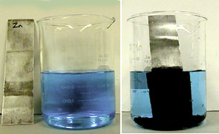
Example of a Redox Reaction
One of many examples is when zinc metal is placed in a solution of copper sulphate, the copper is reduced and appears as a black coating on the zinc.

Slide 21
Reversible Chemical Reactions
There are certain chemical reactions which, under certain conditions, are reversible, i.e. the products can react to produce the original reactants again. These are known as reversible chemical reactions.
Most reactions are not reversible; they can only proceed in one direction.
If a reaction is reversible a double arrow ( )is used. In a reversible reaction we refer to the forward reaction as proceeding from left to right and the reverse reaction as proceeding from right to left.

Slide 22
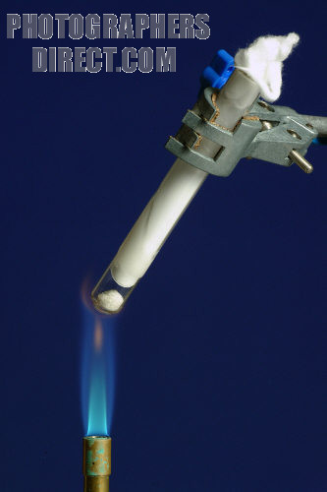
Example of a Reversible Chemical Reaction
When ammonium chloride solid is heated it sublimes into ammonia and hydrogen chloride gas. On cooling the two gases recombine to from ammonium chloride again.
NH₄Cl_{(s)} NH_{3(g)} + HCl_{(g)}

Slide 23
Questions
1. Balance the following equations, and then classify the reactions as synthesis, decomposition, single displacement, ionic precipitation or neutralisation reactions:
(a) H₂CO_{3(g)} → H₂O_{(l)} + CO_{2(g)}
(b) Fe_{(s)} + Cl_{2(g)} → FeCl_{3(s)}
(c) Zn_{(s)} + HCl_{(aq)} → ZnCl_{2(aq)} + H_{2(g)}
(d) NaOH_{(aq)} + H₂SO_{4(aq)} → Na₂SO_{4(aq)} + H₂O_{(l)}
(e) AgNO_{3(aq)} + MgBr_{2(aq)}→ AgBr_{(s)} + Mg(NO₃)_{2(aq)}

Slide 24
Questions
2. (a) When a zinc strip is placed in lead nitrate solution, crystals grow. Explain why.
(b) What happens when a lead strip is placed in silver nitrate solution?
(c) Write word and balanced symbol equations for the reaction in part (a).
(d) Write the ionic equation for the reaction in part (a).
(e) Why is the reactivity series of metals useful to us?

Slide 25
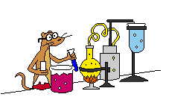
Making Predictions using the Reactivity Series
You can make predictions about unfamiliar metals if you know their position in the reactivity series.

Slide 26
A problem involving manganese
Manganese, Mn, lies between aluminium and zinc in the Reactivity Series and forms a 2+ ion. Solutions of manganese(II) salts are very, very pale pink (almost colourless).
Use the Reactivity Series to predict whether manganese will react with copper(II) sulphate solution. If it will react, describe what you would see, name the products and write an equation for the reaction.
Explain why you would expect manganese to react with steam. Name the products of the reaction and write the equation.

Slide 27
Answer
Manganese is above copper in the Reactivity Series and so will displace it from the copper(II) sulphate.
A brown deposit of copper will be formed. The colour of the solution will fade from blue and leave a very pale pink (virtually colourless) solution of manganese(II) sulphate.
Mn_{(s)} + CuSO_{4(aq)} → MnSO_{4(aq)} + Cu_{(s)}

Slide 28
(b) Manganese is above hydrogen in the Reactivity Series and so reacts with steam to give hydrogen and the metal oxide – in this case, manganese(II) oxide.
You couldn’t predict the colour of the manganese(II) oxide and the question doesn’t ask you to do it.
Mn_{(s)} + H₂O_{(g)} → MnO_{(aq)} + H_{2(g)}

Slide 29
Oxidation-reduction reactions

Slide 30
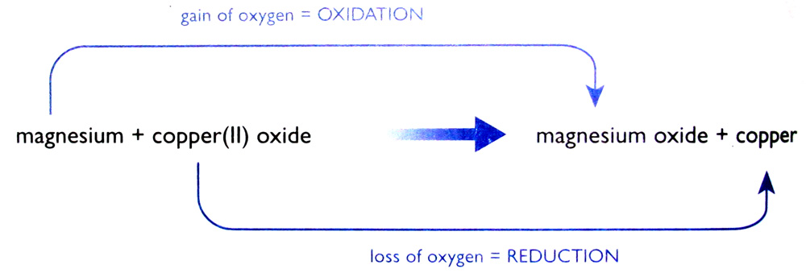
Oxidation and reduction
Oxidation and reduction – oxygen transer
A substance has been oxidised if it gains oxygen. Oxidation is gain of oxygen.
A substance has been reduced if it loses oxygen. Reduction is loss of oxygen.

Slide 31
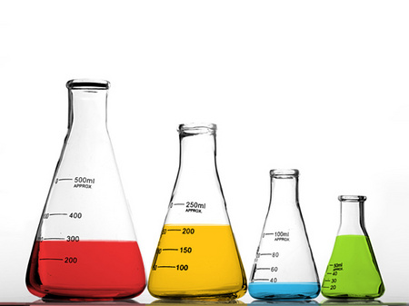
Redox Reactions
A redox reaction is one in which both reduction and oxidation are occurring.
Oxidation and reduction always go hand-in-hand.

Slide 32
Reducing & Oxidising Agents
A reducing agent is a substance that reduces something else. In this case the magnesium is the reducing agent.
An oxidising agent is a substance that oxidises something else. The copper(II) oxide is the oxidising agent in this reaction.

Slide 33
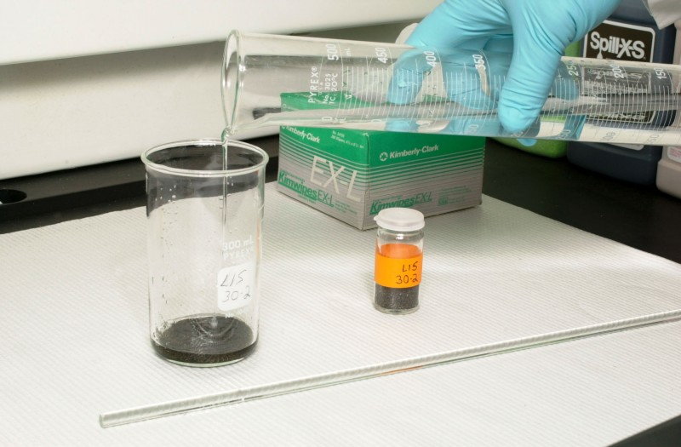
Hydrogen Peroxide (H₂O₂)
Hydrogen peroxide is unusual. It can act as both an oxidising agent and as a reducing agent.
Example 1: H₂O₂ as an oxidising agent
PbS + 4H₂O₂ → PbSO₄+ 4H₂O
Example 1: H₂O₂ as a reducing agent
2MnO₄⁻ + 5H₂O₂ + 6H⁺ → 2Mn₂⁺+ 8H₂O + 5O₂

Slide 34
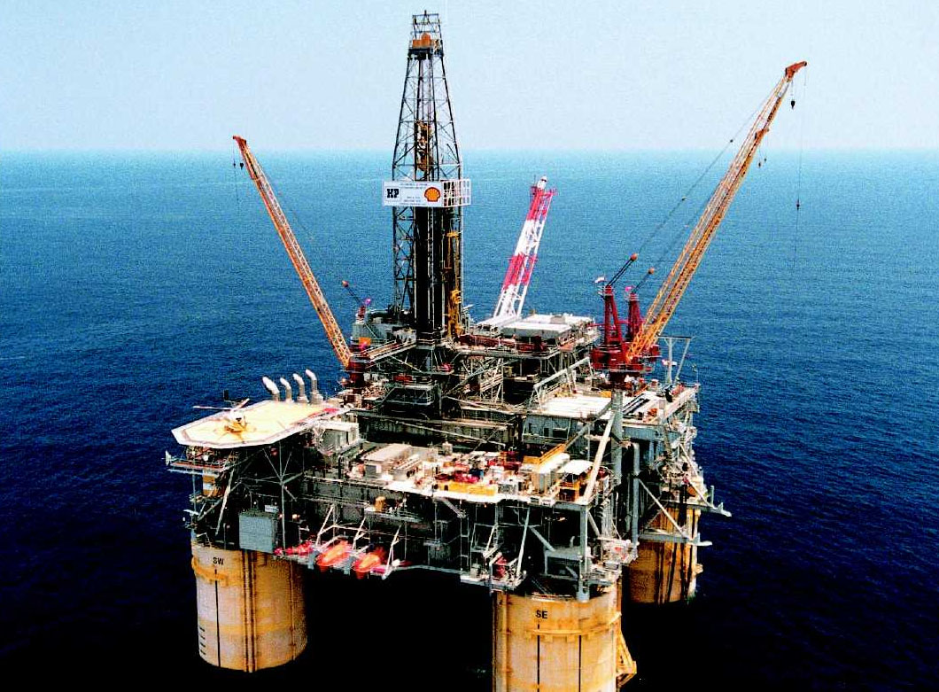
Oxidation and reduction
Oxidation and reduction – electron transfer
Oxidation Is Loss of electrons
Reduction Is Gain of electons
(Remember: OILRIG)

Slide 35
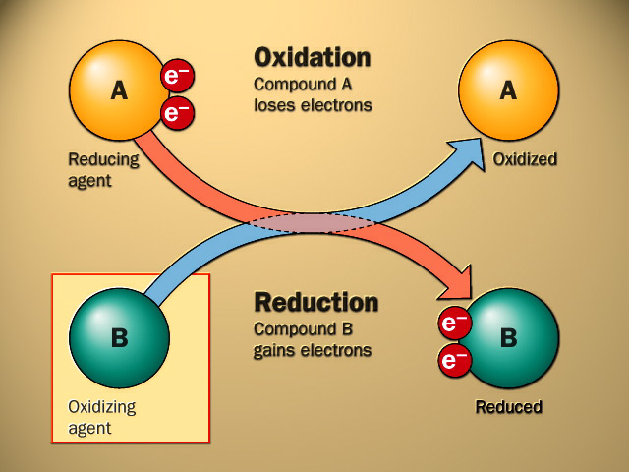
Oxidation and reduction – electron transfer

Slide 36
Questions
1. Define oxidation and reduction in terms of a transfer of electrons.
2. State whether the following half reactions show oxidation or reduction:
(a) Fe²⁺ + 2e⁻→ Fe
(b) Fe → Fe²⁺ + 2e⁻
(c) H₂ → 2H⁺ + 2e⁻
(d) Cu²⁺ + 2e⁻ → Cu

Slide 37
Oxidation Numbers
Example 1
Determine the oxidation number of S in SO₂
S + 2(O) = 0
S + 2(-2) = 0
S + (-4) = 0
S – 4 = 0
S = +4
Therefore the oxidation number of S = +4
The compound SO₂ can be called sulphur(IV) oxide because of the oxidatioin state of the sulphur in the compound.

Slide 38
Example 2
Determine the oxidation number of N in NO₃⁻
N + 3(O) = -1
N + 3(-2) = -1
N + (-6) = -1
N – 6 = -1
N = -1 + 6 = +5
Therefore the oxidation number of N = +5
The name of this ion is the nitrate(V) ion because of the oxidation state of nitrogen in the ion.

Slide 39
Example 3
Determine the oxidation number of C in H₂CO₃
2(H) + 1(C) + 3(O) = 0
2(+1) + 1(C) + 3(-2) = 0
+2 + C + (-6) = 0
+2 + C - 6 = 0
C = +6 - 2
C = +4
Therefore the oxidation number of C = +4

Slide 40
Example 4
Determine the oxidation number of Mn in MnO₄⁻
1(Mn) + 4(O) = -1
Mn + 4(-2) = -1
Mn + (-8) = -1
Mn - 8 = -1
Mn = -1 + 8
Mn = +7
Therefore the oxidation number of Mn = +7
The name of this ion is the manganate(VII) ion because of the oxidation state of manganese in this ion.

Slide 41
Example 5
Determine the oxidation number of Cr in K₂Cr₂O₇
2(K) + 2(Cr) + 7(O) = 0
2(+1) + 2(Cr) + 7(-2) = 0
+2 + 2Cr + (-14) = 0
+2 + 2Cr – 14 = 0
2Cr = +14 – 2 = +12
Cr = +6
Therefore the oxidation number of Cr = +6
The name of this compound is potassium dichromate(VI) because of the oxidation state of the chromium.

Slide 42
Example 6
Determine the oxidation number of P in Mg₃(PO₄)₂
3(Mg) + 2(P) + 8(O) = 0
3(+2) + 2(P) + 8(-2) = 0
+6 + 2P + (-16) = 0
+6 + 2P – 16 = 0
2P = +16 – 6 = +10
P = +5
Therefore the oxidation number of P = +5

Slide 43
Questions
1. Determine the oxidation number of:
(a)Cu in CuO
(b) Mn in MnO₂
(c) S in H₂SO₄
(d) N in NH₃
(e) N in N₂O

Slide 44
Example
Reaction between magnesium and copper(II) oxide
Mg_{(s)} + CuO_{(s)} → MgO_{(s)} + Cu_{(s)}
Ionic Equation:
Mg_{(s)} + Cu²⁺_{(s)} + O²⁻_{(s)} →Mg²⁺_{(s)} + O²⁻_{(s)} + Cu_{(s)}
Removing spectator ions, we get:
Mg_{(s)} + Cu²⁺_{(s)} → Mg²⁺_{(s)} + Cu_{(s)}
The ionic equation shows that the reaction has nothing to do with oxygen.

Slide 45
What is actually happening is that magnesium atoms are turning into magnesium ions.
The magnesium atoms lose electrons to form magnesium ions.
Mg_{(s)} → Mg²⁺_{(s)}+ 2e⁻ (Mg is oxidised)
Those electrons have been gained by the copper(II) ions to make the atoms present in metallic copper.
Cu²⁺_{(s)}+ 2e⁻ → Cu_{(s)} (Cu²⁺ is reduced)
(Remember: OILRIG)

Slide 47
Using hydrogen as a reducing agent
The reduction of copper(II) oxide to copper
Copper won’t react with water because copper is below hydrogen in the Reactivity Series, but that means that you can get a reaction between hydrogen and copper(II) oxide.
The hydrogen removes the oxygen from the copper(II) oxide, so that hydrogen is a reducing agent.

Slide 48
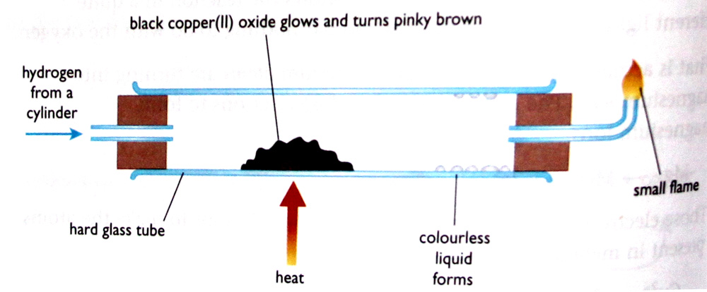
Experiment
Hydrogen is passed over hot copper(II) oxide. The oxide glows red hot and continues glowing, even if you remove the Bunsen burner. Lots of heat is released during the reaction.
Colourless liquid – water
Pinky brown solid – copper
Small flame at end – excess hydrogen being burned off

Slide 49
Displacement reactions involving solutions of salts
The reaction between zinc and copper(II) sulphate solution
Zn_{(s)} + CuSO_{4(aq)} → ZnSO_{4(aq)} + Cu_{(s)}
Ionic Equation:
Zn_{(s)} + Cu²⁺_{(aq)} + SO₄²⁻_{(aq)} →Zn²⁺_{(aq)} + SO₄²⁻_{(aq)} + Cu_{(s)}
Removing Spectator Ions:
Zn_{(s)} + Cu²⁺_{(aq)} →Zn²⁺_{(aq)} + Cu_{(s)}
This is a redox reaction.

Slide 50
The reaction between zinc and copper(II) sulphate solution

Slide 51
The reaction between copper and silver nitrate solution
Cu_{(s)} + 2AgNO_{3(aq)} → Cu(NO₃)_{2(aq)} + 2Ag_{(s)}
Ionic Equation:
Cu_{(s)} + 2Ag⁺_{(s)} + 2NO₃⁻_{(aq)} →Cu²⁺_{(aq)} + 2NO₃⁻_{(aq)} + 2Ag_{(s)}
Removing Spectator Ions:
Cu_{(s)} + 2Ag⁺_{(s)} → Cu²⁺_{(aq)} + 2Ag_{(s)}
This is a redox reaction.

Slide 52
The reaction between copper and silver nitrate solution

Slide 53
Questions
1. If a mixture of zinc powder and cobalt(II) chloride is heated, the following reaction occurs:
Zn_{(s)} + CoO_{(s)}→ ZnO_{(s)} + Co_{(s)}
(a) Which metal is higher in the reactivity series?
(b) The zinc can be described as a reducing agent. Using this example, describe what is meant by the term reducing agent.
(c)Which substance in this reaction has been oxidised?

Slide 54
Summary
In this lesson we learnt about:
Different Types of Chemical Reactions
Redox Reactions

