Slide 1
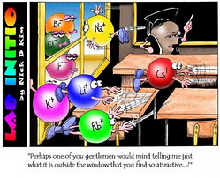
Attraction between Positive & Negative Ions

Slide 2
Attraction between Positive & Negative Ions
Positively charged ions and negatively charged ions are attracted to each other and this attraction is the basis of ionic bonding.

Slide 3
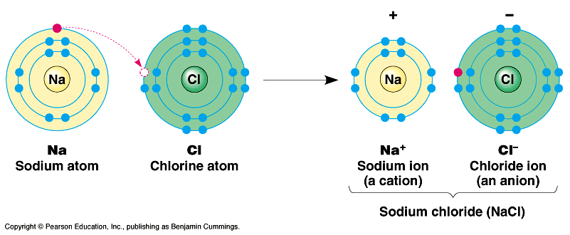
Attraction between Positive & Negative Ions
In an ionic compound, the number of positive
charges must equal the number of negative charges, hence the compound is neutral overall.

Slide 4
Activity: Using models in order to deduce the formulae of ionic compounds.
(See Activity Sheet)

Slide 5
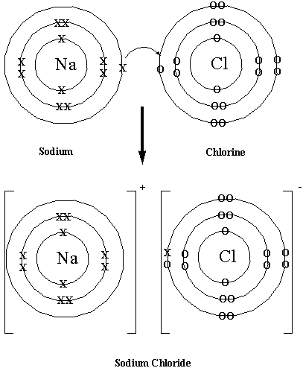
Using Shell Diagrams to Represent Ionic Bonding

Slide 6
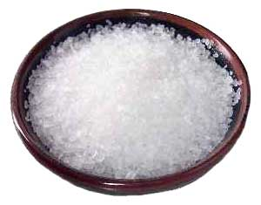
Example 1: Sodium Chloride
Sodium is a metal with one valence electron; therefore it loses this electron to form a positive sodium ion (Na⁺).
Chlorine is a non-metal with seven valence electrons; therefore it gains one electron to form a negative chloride ion (Cl⁻).

Slide 7
The diagram shows how to use shell diagrams to represent ionic bonding in sodium chloride.
Sodium atom
Chlorine atom
Sodium ion (Na⁺)
Chlorine
ion (Cl⁻)

Slide 8
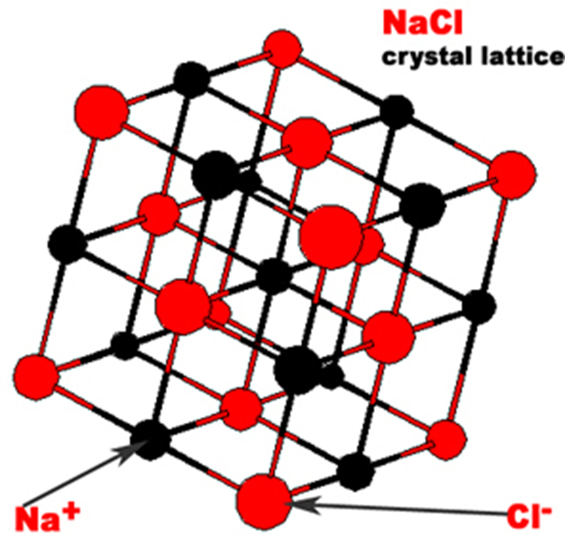
It is important to note that there is no separate entity such as NaCl.
Each Na⁺ ion is immediately surrounded by six Cl⁻ ions and each Cl⁻ ions is immediately surrounded by six Na⁺ ions.

Slide 9
NaCl is referred to as the formula unit or empirical formula of the ionic compound.
The ions attract each other forming a highly ordered arrangement known as a crystal lattice.
The attraction between each positive cation and each negative anion is known as an ionic bond.
Ionic bonds are strong bonds and their strength accounts for some of the properties of ionic compounds.

Slide 10
Example 2: Magnesium Fluoride
Magnesium is a metal with two valence electrons; magnesium will lose these two electrons, forming a magnesium ion (Mg2⁺).
Fluorine is a non-metal with seven valence electrons; fluorine will gain one electron, forming a fluoride ion (F⁻).
For each magnesium atom (that loses two valence electrons) there will need to be two fluorine atoms.
Each fluorine atom will accept one electron.

Slide 11
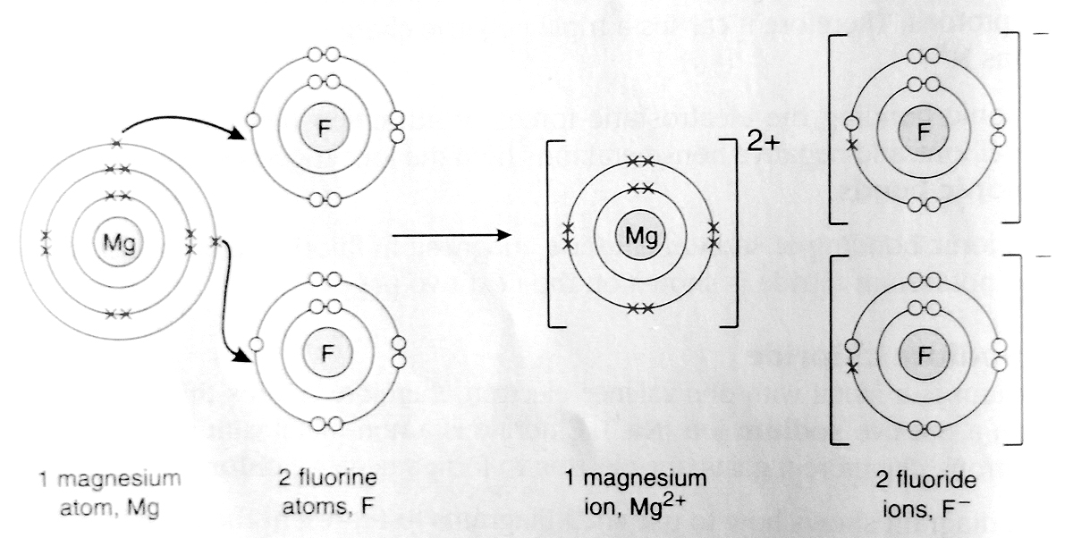
The diagram shows how to use shell diagrams to represent ionic bonding in magnesium fluoride.

Slide 12
Example 3: Aluminium Oxide
Aluminium is a metal with three valence electrons; aluminium will lose three electrons, forming an aluminium ion (Al³⁺).
Oxygen is a non-metal with six valence electrons; oxygen will gain two electrons, forming an oxide ion (O²⁻).
Two aluminium atoms will lose six electrons and three oxygen atoms are needed to accept these six electrons therefore the ratio of aluminium to oxygen will be 2:3.

Slide 13
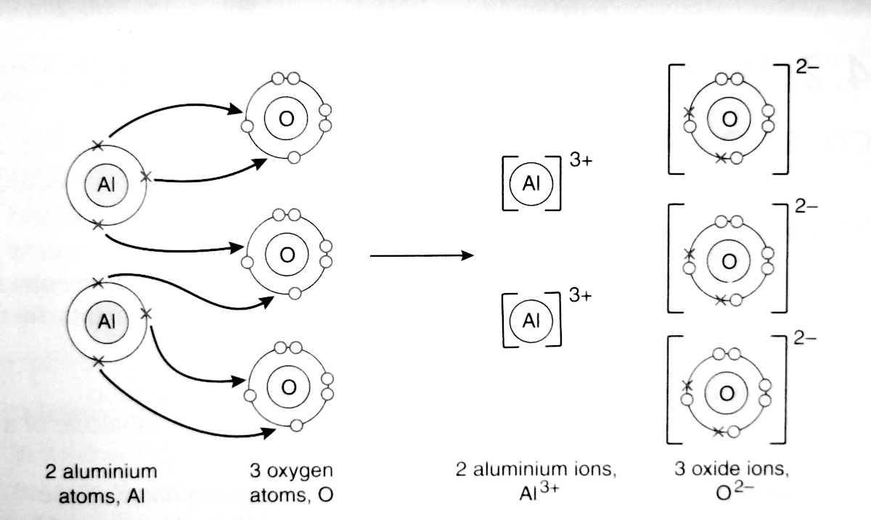
The diagram shows how to use shell diagrams to represent ionic bonding in aluminium oxide.

Slide 14
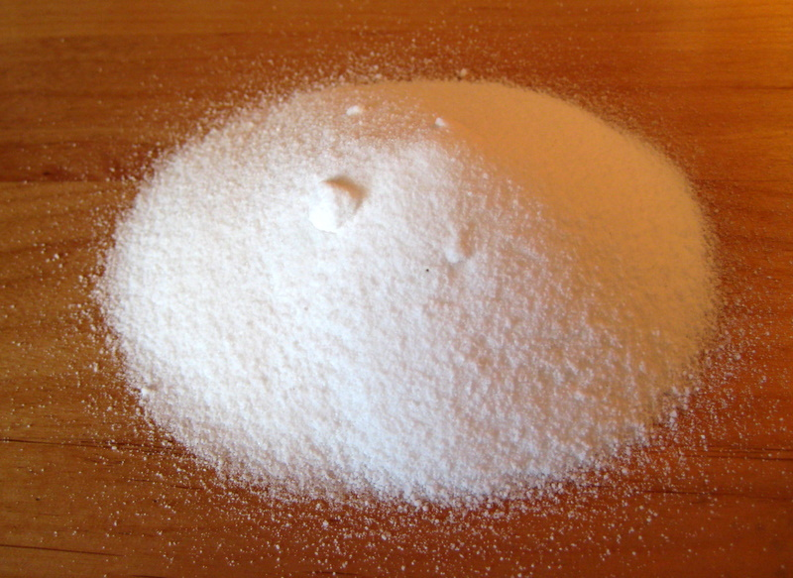
Example 4: Potassium Nitride
Potassium has one valence electron; potassium will lose one electron to form a potassium ion (K⁺).
Nitrogen has five valence electrons; nitrogen will gain three electrons to form a nitride ion (N³⁻).
Three potassium ions will lose three electrons to one nitrogen atom.

Slide 15
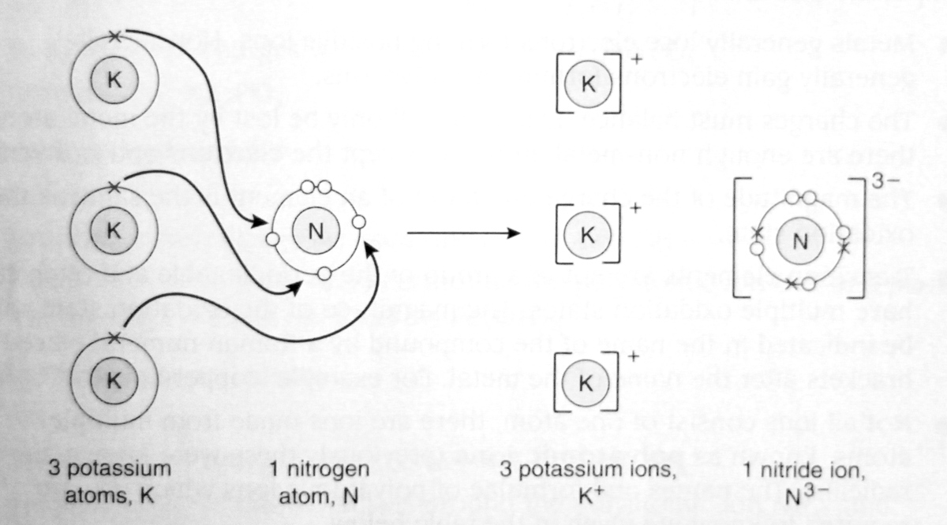
The diagram shows how to use shell diagrams to represent ionic bonding in potassium nitride.

Slide 16
Summary
In this lesson we learnt about:
The octet rule
Dot and cross representations of ionic bonding
Cations and anions
Formulae of compounds
Compound Names

