Slide 1
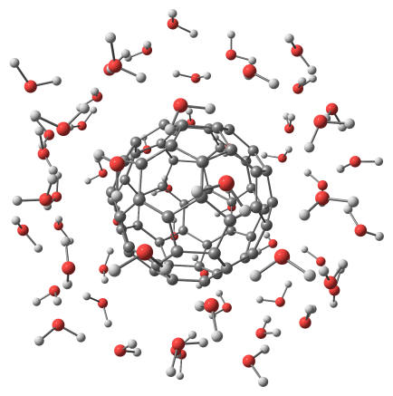
Structure & Bonding

Slide 2
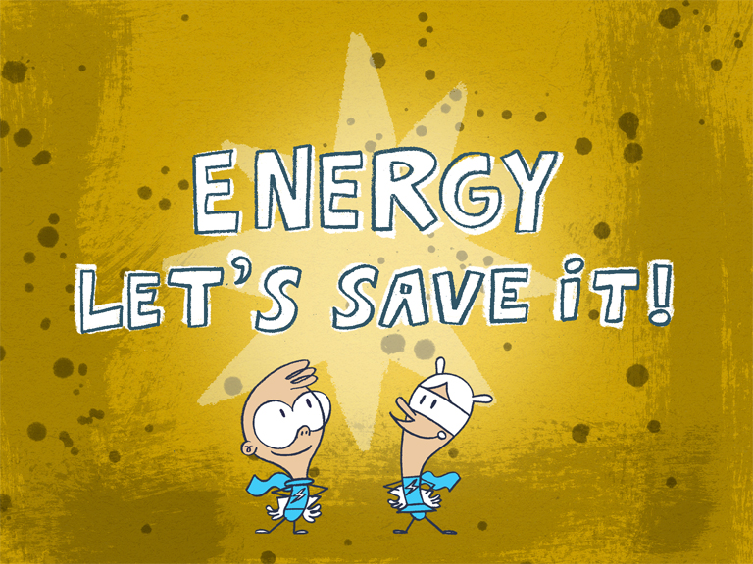
Energy
As a general rule, natural objects contain as little energy as possible.

Slide 3
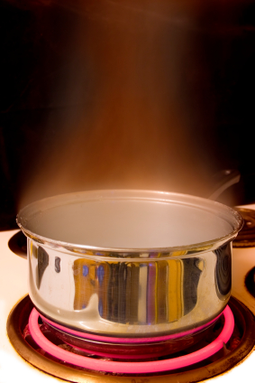
Example 1: What happens to a hot saucepan if it is left out on a counter?
It will eventually cool down – hot saucepans to do not reheat by themselves.

Slide 4
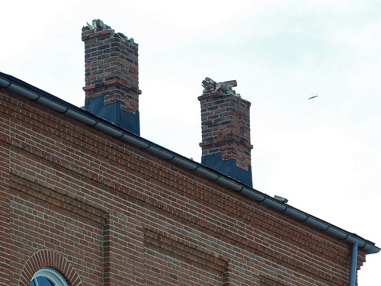
Example 2: What may happen to a brick if it is at the edge of the roof of a tall building?
The brick may fall down from the top of a building, but it will never jump up there by itself!

Slide 5
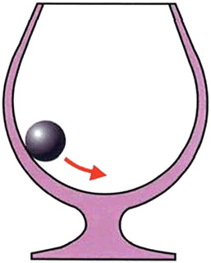
Example 3: What will happen to the ball in the picture below?
It will roll to the bottom of the interior of the glass.

Slide 6
The saucepan, the brick and the ball lose energy to reach their lowest energy state without any help from us. They become more stable.

Slide 7
Recap of Atomic Structure
Activity: Fill in the blanks to recap your knowledge of atomic structure.
Atoms have a central nucleus surrounded by __________. The electrons around the nucleus are arranged in _________.
The electron configuration is the number of _________in each occupied shell.
For example, an atom of _______ contains 11 electrons and the electron configuration of the _______ atom is 2.8.1.
An atom with a full outermost electron shell is an atom of a ________ gas, such as helium, argon or neon.

Slide 8
Answers
Atoms have a central nucleus surrounded by electrons. The electrons around the nucleus are arranged in shells.
The electron configuration is the number of electrons in each occupied shell.
For example, an atom of sodium contains 11 electrons and the electron configuration of the sodium atom is 2.8.1.
An atom with a full outermost electron shell is an atom of a noble gas, such as helium, argon or neon.

Slide 9
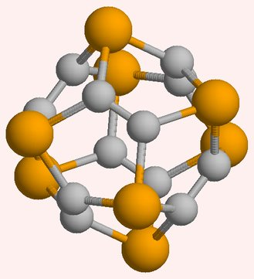
Stable Electronic Structures

Slide 10
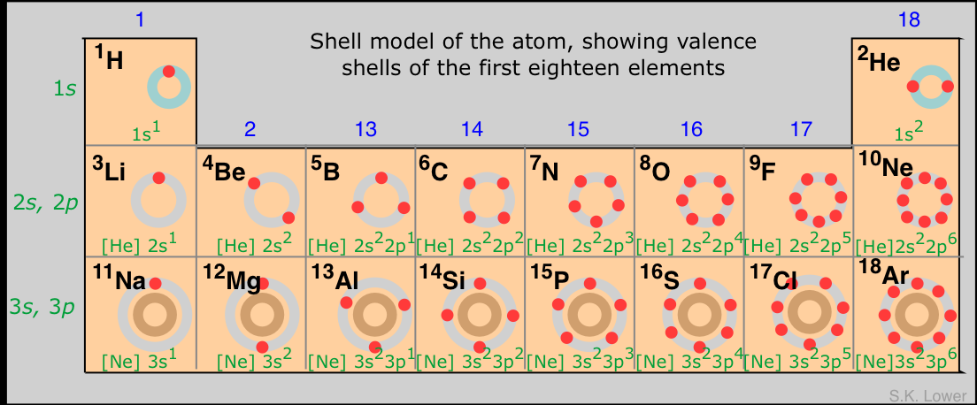
Stable Electronic Structures
Activity: Look at your copy of the Periodic Table.

Slide 11
Stable Electronic Structures
What happens to the number of electrons in the outer shell as you move from left to right across a period?
It increases across a period until the shell becomes full at the right-hand end of the period.
What is the name of the group of elements with full outer shells?
The noble gases.
Scientists have found that the noble gases are very unreactive. What does this tell you about a full outer shell of electrons?
It provides stability; therefore, atoms of elements in other groups may also seek to attain a full outer shell of electrons.

Slide 12
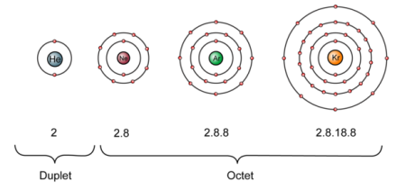
Stable Electronic Structures
Noble gases exist as single atoms because the full outer shell makes each atom stable.

Slide 13
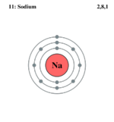
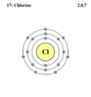
Stable Electronic Structures
Atoms of other elements do not have full outer shells.
Examples:
What would atoms of these other elements have to do to achieve a full outer shell?
Sodium
2, 8, 1
Chlorine
2, 8, 7

Slide 14
Stable Electronic Structures
Atoms gain stability if they obtain the noble gas configuration of the nearest noble gas to them in the periodic table.

Slide 15
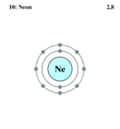
Stable Electronic Structures
Example 1: What is the nearest noble gas to sodium?
What would sodium have to do in order to attain the electronic configuration of neon?

Slide 16
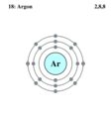
Stable Electronic Structures
Example 2: What is the nearest noble gas to chlorine?
What would chlorine have to do in order to attain the electronic configuration of argon?

Slide 17
Stable Electronic Structures
Atoms can obtain the noble gas configuration of the nearest noble gas to them in the periodic table during the following chemical changes. They can:
donate one or more electrons to another atom
2. gain one or more electrons from another atom
3. share electrons with another atom

Slide 18
Stable Electronic Structures
This chemical change is known as chemical bonding. A chemical bond is an electrostatic force of attraction between two or more atoms or ions.
There are three main types of chemical bonding:
ionic bonding – formed between metals and non-metals
2. covalent bonding – formed between two or more non-metals
3. metallic bonding – formed between metals

Slide 19
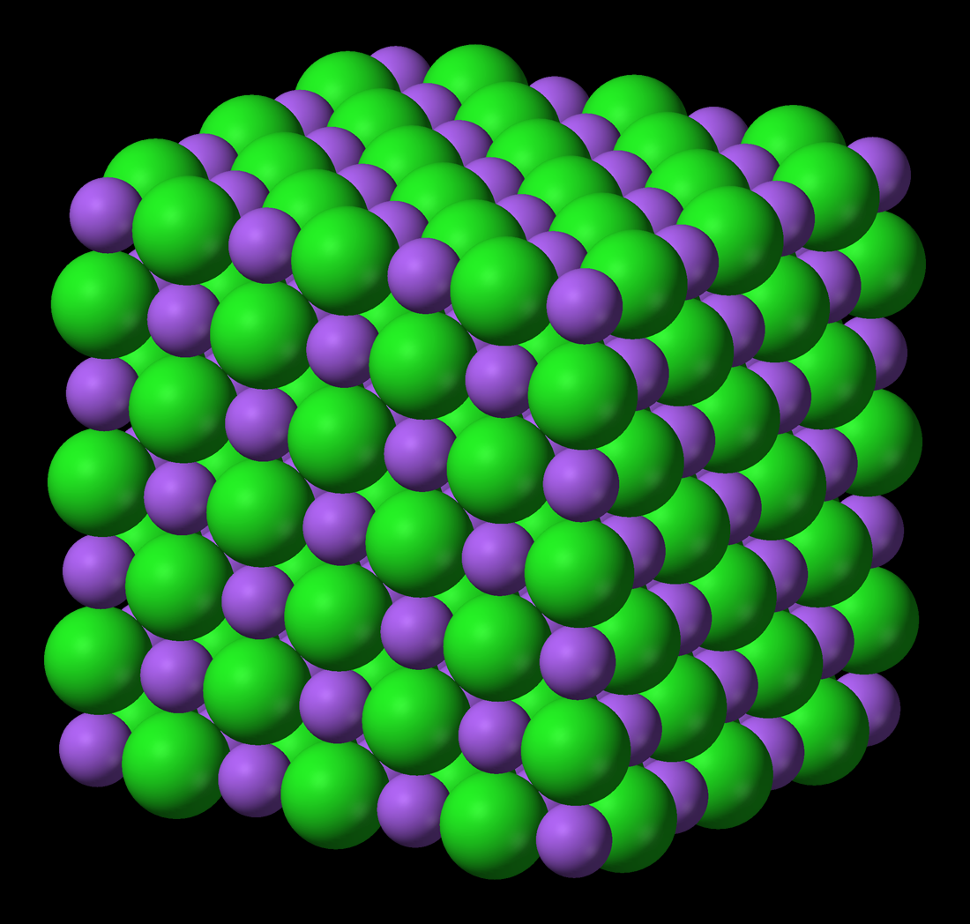
Ionic Bonding

Slide 20
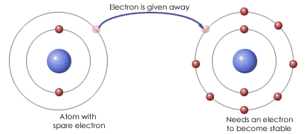
Ionic Bonding
Ionic bonding is a transfer of valence electrons between metal and non-metal atoms.
Usually the transfer is from the metal atom to the non-metal atom.

Slide 21
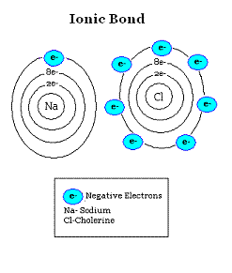
Ionic Bonding
Metals lie to the left of the periodic table; if they lose electrons they can attain noble gas configuration.
Non-metals lie to the right of the periodic table; if they gain electrons they can attain noble gas configuration.

Slide 22
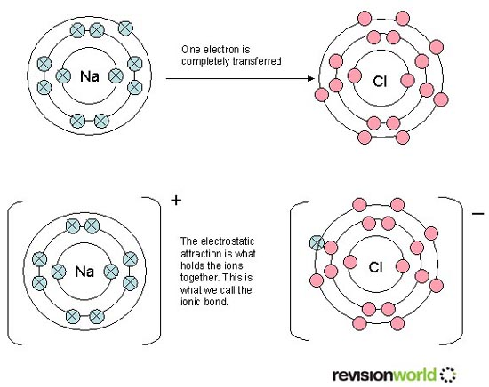
Ionic Bonding
When an atom loses or gains electrons it forms an ion.
The ions formed are now charged particles because they no longer contain the same number of protons and electrons.

Slide 23
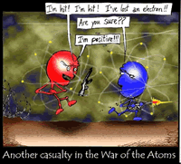
Cations & Anions

Slide 24
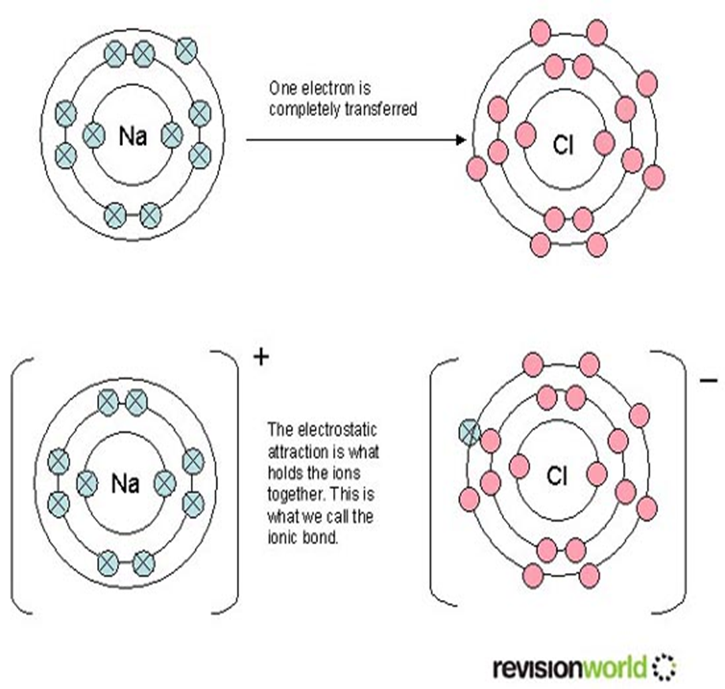
Cations & Anions
When a metal atom loses electrons it forms a positive ion called a cation.
When a non-metal atom gains electrons it forms a negative ion called an anion.

Slide 25
Losing & Gaining Electrons

Slide 26
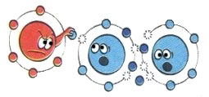
Losing Electrons – Group 1
One way to obtain a full outer orbital is to lose electrons from a partially filled orbital.
Atoms of elements in Group 1, and hydrogen, have a single electron in their outer orbital.
If this electron is lost then the full orbital beneath now becomes the full outer orbital.

Slide 27
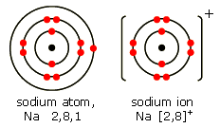
Losing Electrons
Example: Sodium
The chemical reaction is:
Na → Na⁺ + e⁻
An electron configuration of 2.8.1 becomes 2.8.

Slide 28
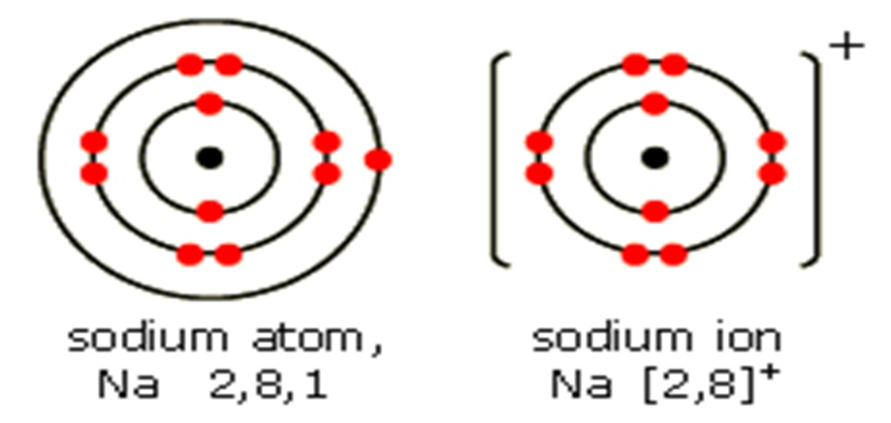
Losing Electrons
In an atom the number of electrons in the orbitals is equal to the number of protons in the nucleus.
If one electron is removed this leaves a net charge of +1; a sodium atom has become a sodium ion.

Slide 29
Losing Electrons – Group 2
Similarly Group 2 elements have two electrons in their outer orbital.
Example: Magnesium
Mg → Mg²⁺+2e⁻
An electron configuration of 2.8.2 becomes 2.8.
As the magnesium atom has lost two electrons, the magnesium ion carries a charge of +2.
2+

Slide 30
Losing Electrons – Group 3
It is possible for aluminium to produce the aluminium ion, Al³⁺, by losing three electrons.
Activity: Draw the electronic configuration of the aluminium atom and the electronic configuration of the aluminium ion.
Beyond this, it requires too much energy to remove four or more electrons so the elements from Group 4 and onwards do not form positively charged ions.

Slide 31
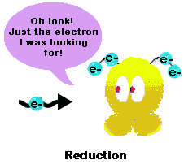
Gaining Electrons
As well as losing electrons, it is possible to obtain a full outer orbital by gaining electrons.

Slide 32
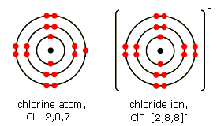
Gaining Electrons – Group 7
Atoms of the elements in Group 7 have seven electrons in their outer orbital.
They can attain a full outer orbital by gaining one more electron:
Cl + e⁻ → Cl⁻
An electron configuration of 2.8.7 becomes 2.8.8.

Slide 33
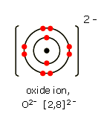
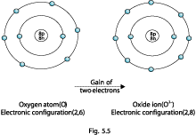
Gaining Electrons – Group 6
Group 6 elements need two electrons to attain a full outer orbital:
O + 2e⁻ → O²⁻
An electron configuration of 2.6 becomes 2.8.
Oxygen atom,
O, 2, 6

Slide 34
Gaining Electrons – Group 5
It is possible for phosphorus to produce the phosphide ion, P³⁻, by gaining three electrons.
Activity: Draw the electronic configuration of the phosphorous atom and the electronic configuration of the phosphide ion.
Beyond this, gaining four or more electrons would make an atom too unstable so elements up to and including Group 4 do not form negatively charged ions.

Slide 35
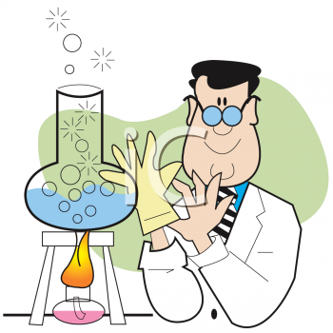
Additional Information
When an atom forms a negative ion, the name of the ion ends with ‘-ide’,
e.g. chloride, bromide, iodide, oxide, sulphide.
Also, some groups of two or more atoms combine to form a negative ion, which we see in compounds such as hydroxide, OH⁻, nitrate, NO₃⁻, and sulphate, SO₄²⁻.

