Slide 1
What is a Trend?

Slide 2
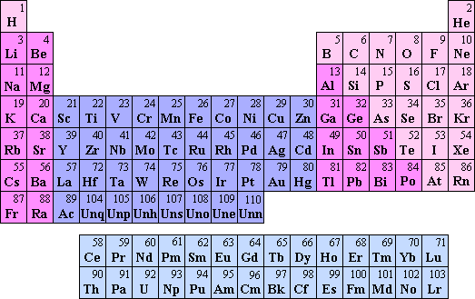
Periodic Table Trends

Slide 3
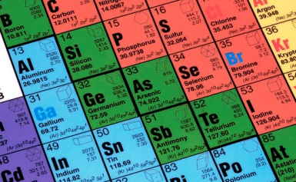
Periodic Table Trends
The Periodic Table is arranged according to the Periodic Law.
The Periodic Law states that when elements are arranged in order of increasing atomic number, their physical and chemical properties show a periodic pattern.

Slide 4
Activity – Trends in Atomic Radius
Look at the partial Periodic Table below.
The values are the atomic radius in pm. Copy the table and answer the questions which follow.
Li 145 | Be 112 | B 85 | C | N 65
Na 186 | Mg 150 | Al | Si 110 | P 100
K 220 | Ca | 1pm = | 1/1000000000000 | of a metre
Rb 248 | Sr 215 |  | (one trillionth)
Cs 260 | Ba 215

Slide 5
1. What appears to be the trend in atomic radius as you move from left to right in a row?
(Atomic radius decreases across a row)
2. What appears to be the trend in atomic radius as you move down a column?
(Atomic radius increases down a group)
3. Predict the atomic radius C.
(70pm)
4. Predict the atomic radius of Al.
(125pm)
5. Predict the atomic radius of Ca.
(180pm)
6. Is the pattern of atomic radius absolute or general (always true or generally true)?
(general)

Slide 6
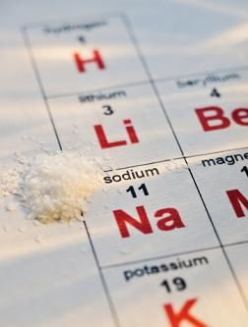
Electronic Configuration & The Periodic Table
Elements in the same group display similar chemical properties because they have similar electronic configurations.
There are seven periods in the periodic table. As you move along a period, the properties of the elements slowly change, from metals on the left hand side to non-metals on the right hand side.

Slide 7
Trends in Groups & Periods
The elements in the periodic table are arranged in such a manner that there are trends in their physical and chemical properties in a particular group and in a particular period.
Look at the electronic configuration of the elements in your periodic table, are there:
any similarities between the elements in the same period?
any similarities between the elements in the same group?

Slide 8
Electronic Configuration of the first 20 Elements
 | GROUPS
 |  | I | II | III | IV | V | VI | VII | 0
 | I | H (1) |  |  |  |  |  |  | He (2)
 | II | Li (2,1) | Be (2,2) | B (2,3) | C (2,4) | N (2,5) | O (2,6) | F (2,7) | Ne (2,8)
 | III | Na (2,8,1) | Mg (2,8,2) | Al (2,8,3) | Si (2,8,4) | P (2,8,5) | S (2,8,6) | Cl (2,8,7) | Ar (2,8,8)
 | IV | K (2,8,8,1) | Ca (2,8,8,2)

Slide 9
Similarities in Electronic Configuration of Elements in the same Group
1. All elements in the same group have the same number of electrons in the outermost shell, i.e., they have the same number of valence electrons.
2. The number of valence electrons is equal to the group number.
3. All elements in group 0 have a full outermost shell.

Slide 10
Similarities in Electronic Configuration of Elements in the same Period
1. All elements in the same period have their outermost electrons in the same shell. For example, lithium and sulphur are both in Period 2 and their outermost electrons are in the second shell.
2. The period number is an indication of the number of occupied shells in an atom, i.e. the number of shells which contain electrons. For example, calcium is in Period 4 and its electrons occupy four shells.

Slide 11
Determining Electronic Configuration from Period & Group Number
Do you think you can determine the electronic configuration of an atom from the period number and group number? How?

Slide 12
Answer
Yes!
Example:
Knowing an atom is in Group IV and Period 3 of the periodic table tells us that the outermost shell of the atom contains four electrons and its atom has three shells which contain electrons. The electronic configuration is therefore (2,8,4)

Slide 13
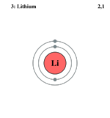
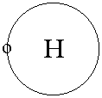
Relationship between Groups & Shells
As you move down a group, an extra shell is added.
For example, hydrogen has one shell followed by lithium which has two shells.

Slide 14
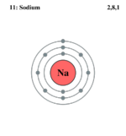
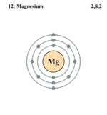
Relationship between Periods & Electrons
As you move along a period, another electron is added to the outermost shell.
For example, sodium has one electron in shell 3, followed by magnesium which has two electrons in shell 3.

Slide 15
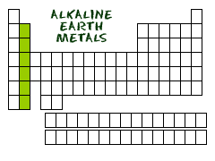
The Elements in Group II

Slide 16
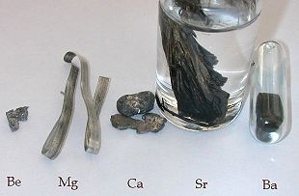
The Elements in Group II
The elements in Group II are all metals which are very chemically reactive and are never found free in nature.
The elements in Group II are collectively known as the alkaline earth metals.

Slide 17
Properties of Elements in Group II
Group II elements have the following common properties. They:
are soft metals
are silvery-white when freshly cut, but turn dull very quickly owing to their reaction with air. The dullness is an oxide layer that forms on the metal when it reacts with oxygen in the air

Slide 18
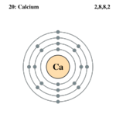
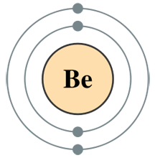
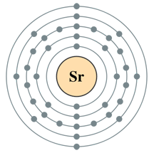
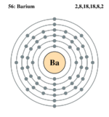
have two valence electrons

Slide 19
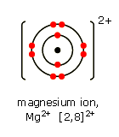
readily lose the valence electrons to form metal cations with a charge of 2+, eg Mg²⁺, Ba²⁺

Slide 20
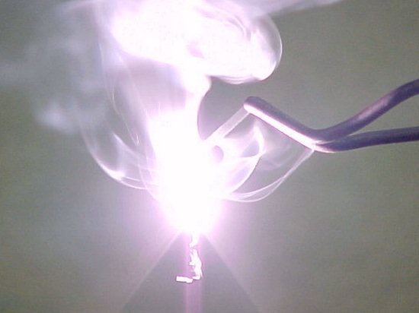
react with oxygen to form basic metal oxides, e.g. magnesium reacts with oxygen to form magnesium oxide

Slide 21
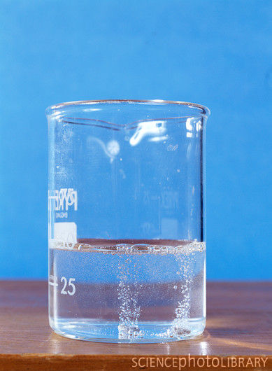
react with water to form metal hydroxides and hydrogen gas, e.g. magnesium reacts with water to form magnesium hydroxide and hydrogen gas

Slide 22
react with dilute hydrochloric acid to from metal chlorides and hydrogen gas, e.g. magnesium reacts with dilute hydrochloric acid to form magnesium chloride and hydrogen gas.

Slide 23
Periodicity in Group II
Questions: Look at your copy of the Periodic Table.
1. What do the elements in Group II have in common?
2. What is different about the elements in Group II?

Slide 24
Periodicity in Group II
Elements in Group II all have very similar properties because their atoms all have two valence electrons.
However, as one moves down Group II the number of occupied shells increases, resulting in an increase in the radii of the atoms.
The inner shells ‘shield’ the valence electrons from the attractive pull of the positive nucleus.

Slide 25
The greater the ‘shielding’ effect, the more readily the atom will lose its valence electrons to form an ion, i.e. ionise.
The larger the atom, the more readily it ionises and the more reactive it is.
The reactivity of the metals in Group II therefore, increases as one moves down the group as does their metallic nature.
Beryllium (Be) is the least reactive element and radium (Ra) is the most reactive element.

Slide 26
Reactions of Group II Elements
This trend in Group II can be demonstrated by investigating the reactivity of magnesium, calcium and barium with oxygen, water and dilute hydrochloric acid.
The ease with which the metal reacts is called the reactivity of the metal.
How fast or how vigorously these three metals react with oxygen, water and dilute hydrochloric acid can be compared to rank them in order from most reactive to least reactive.

Slide 27
Reactions of Group II Elements
See
Table 1: Reactions of Group II Elements with Oxygen, Water and dilute Hydrochloric Acid.
1. Which element is the most reactive?
Barium
2. Which element is the least reactive?
Magnesium

Slide 28
Reactions of Group II Elements
From the trends in the reactivity of the Group II metals, one can predict the reactivity of beryllium, strontium and radium.
What would you expect their reactivity to be?

Slide 29
Reactions of Group II Elements
We would expect beryllium to be the least reactive of the elements in the group and radium the most reactive, and the reactivity of strontium to be greater than that of calcium but less than barium.

Slide 30
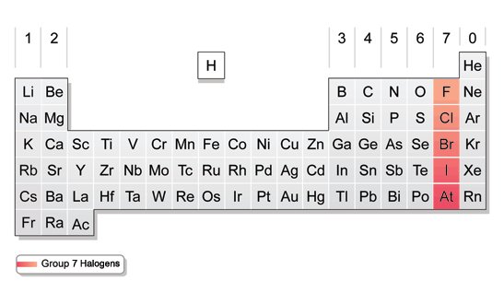
The Elements in Group VII

Slide 31
The Elements in Group VII
The elements in Group VII display similar properties an react very readily with metals to form salts.
The elements in Group VII are collectively known as the halogens.

Slide 32
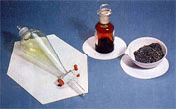
Properties of Elements in Group VII
Group VII elements have the following common properties. They:
are poisonous non-metals
exist as diatomic molecules, e.g. F₂, Cl₂, Br₂ and I₂
have low melting points and boiling points

Slide 33
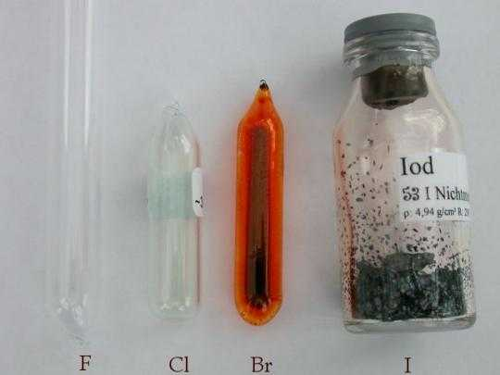
have varying colours – fluorine is pale yellow, chlorine is yellowish green, bromine is reddish brown and iodine is greyish black with a metallic shine

Slide 34
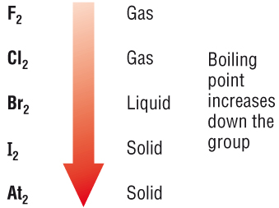
exist in different states at room temperature – at room temperature, fluorine and chlorine are gases, bromine is a liquid and although iodine is a solid, it sublimes at just above room temperature

Slide 35
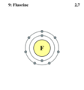
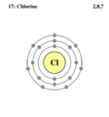
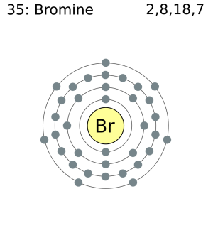
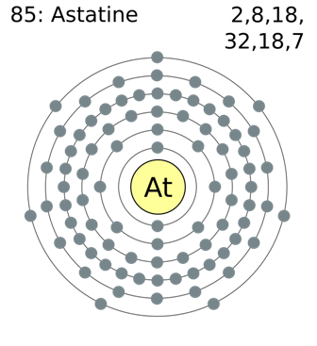
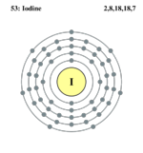
have seven valence electrons

Slide 36
are soluble in non-polar solvents, e.g. organic solvents
readily accept an electron to form non-metal anions with a charge of 1-, e.g. F⁻, Cl⁻, Br ⁻
readily share an electron with other non-metal atoms

Slide 37
Periodicity in Group VII
Elements in Group VII have very similar properties because their atoms all have seven valence electrons.
As in Group II, as one moves down Group VII the number of occupied shells increases. In this group, however, the greater the ‘shielding’ effect the less readily the atom will gain an electron into its valence shell to form an ion.
(2, 7)
(2, 8, 7)
(2, 8, 18, 7)
(2, 8, 18, 18, 7)
(2, 8, 18, 32, 18, 7)

Slide 38
Periodicity in Group VII
The smaller the atom, the more readily it ionises and the more reactive it is. The reactivity of the non-metals in Group VII therefore increases as one moves up the group as does their non-metallic nature.
Fluorine (F) is the most reactive element and astatine (At) is the least reactive element in Group VII.

Slide 39
Summary
Trends in atomic radius across a period and down a group
Elements of Groups II and VII, their reactivity and physical state at room temperature

