Slide 1
Interconversion of mass, moles and number of atoms or molecules.

Slide 2
Moles and Mass
The molar mass gives us the relationship between the number of moles and the mass of an element or compound.
We can use the molar mass to calculate the mass or number of moles of an element or compound.

Slide 3
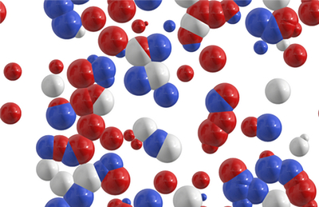
Simplified method for mole conversions

Slide 4
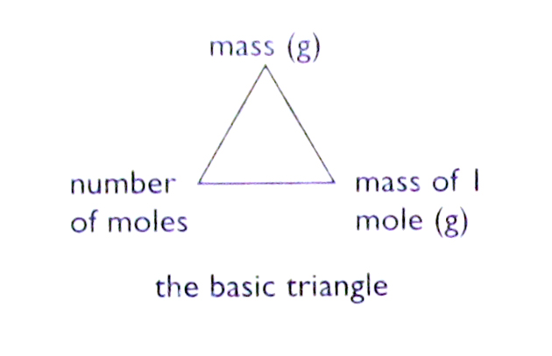
Formulae

Slide 5
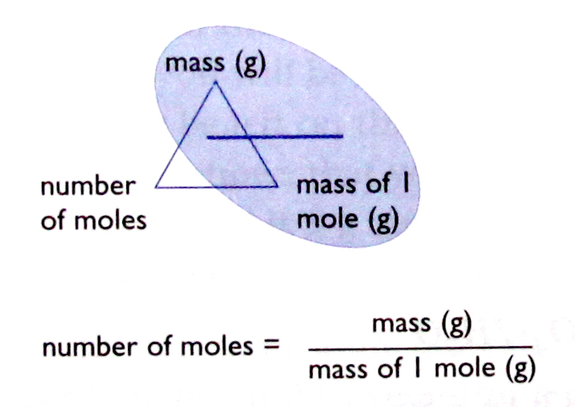
Formulae

Slide 6
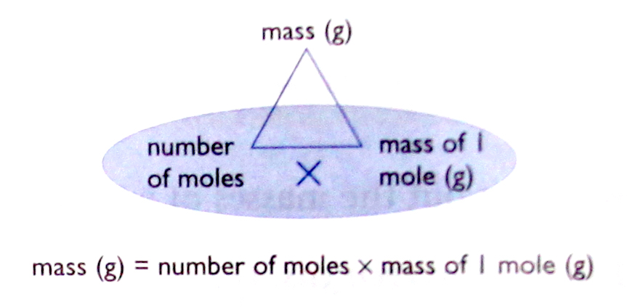
Formulae

Slide 7
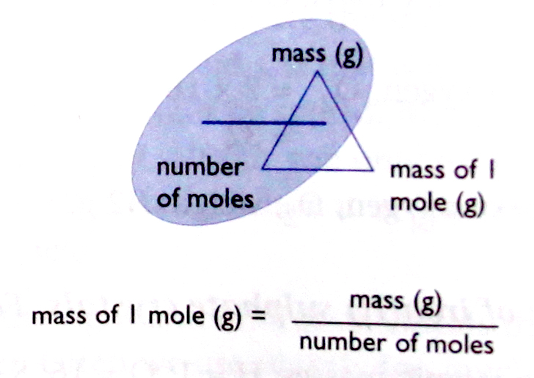
Formulae

Slide 8
Example 1 – Mass to moles
Calculate the number of moles in 10g of calcium carbonate, CaCO₃.
First, calculate the molar mass of CaCO₃
M(CaCO₃) = 40 + 12 + (3x16) = 100gmol⁻¹
i.e. mass of 1 mol CaCO₃ = 100g
So, number of moles in 10g = 10 ÷ 100
= 0.1 mol

Slide 9
Example 2 – Mass to moles
Calculate the number of moles in 54g of water, H₂O.
First, calculate the molar mass of H₂O
M(H₂O) = (2x1) + 16 = 18gmol⁻¹
i.e. mass of 1 mol H₂O = 18g
So, number of moles in 54g = 54 ÷ 18
= 3 mol

Slide 10
Example 3 – Moles to mass
Calculate the mass of 0.2 mol of sulphuric acid, H₂SO₄.
First, calculate the molar mass of H₂SO₄
M(H₂SO₄ ) = (2x1) + 32 + (4x16) = 98gmol⁻¹
i.e. mass of 1 mole = 98g
So, mass of 0.2 mol = 0.2 x 98g
= 19.6g

Slide 11
Example 4 – Moles to mass
Calculate the mass of 0.5 mol of sodium chloride, NaCl.
First, calculate the molar mass of NaCl
M(NaCl ) = 23 + 35.5 = 58.5gmol⁻¹
i.e. mass of 1 mole = 58.5g
So, mass of 0.5 mol = 0.5 x 58.5g
= 29.3g

Slide 12
Mass, moles and number of atoms or molecules
The number of atoms or molecules in one mole is known, i.e. 6.0 x 10²³, therefore we can calculate the number of particles in any number of moles.

Slide 13
Example 1
Calculate the number of atoms in 0.5 mol of copper, Cu.
1 mol Cu contains 6.0 x 10²³ atoms
So, 0.5 mol Cu contains 0.5 x 6.0 x 10²³
= 3.0 x 10²³ atoms

Slide 14
Example 2
Calculate the number of moles of calcium, Ca, that contains 2 x 10²³ calcium atoms.
1 mol Ca contains 6.0 x 10²³ atoms
So, number of moles in 2 x 10²³ atoms = 2 x 10²³
6.0 x 10²³
= 0.33 mol

Slide 15
Example 3
Calculate the number of molecules in 1.8g of water, H₂O.
M(H₂O ) = (2 x 1) + 16 = 18gmol⁻¹
i.e. mass of 1mol = 18g
So, no. of moles in 1.8g = 1.8 = 0.1mol
18
1 mol H₂O contains 6.0 x 10²³ molecules
So, 0.1 mol H₂O contains 0.1 x 6.0 x 10²³
= 6.0 x 10²² molecules

Slide 16
Example 4
Calculate the mass of 1.5 x 10²³ molecules of hydrogen chloride, HCl.
1 mol HCl contains 6.0 x 10²³ molecules
So, no. of moles in 1.5 x 10²³ molecules = 1.5 x 10²³
6.0 x 10²³
= 0.25mol
M(HCl) = 1 + 35.5 = 36.5gmol⁻¹
i.e. mass of 1 mol HCl = 36.5g
So, mass of 0.25mol HCl = 0.25 x 36.5g
= 9.13g

Slide 17
Example 5
Calculate the number of aluminium ions (Al³⁺) in 40.8g of aluminium oxide, Al₂O₃.
M(Al₂O₃) = (2 x 27) + (3 x 6) = 102gmol⁻¹
i.e. mass of 1 mol Al₂O₃ = 102g
So, no. of moles in 40.8g = 40.8 mol = 0.4mol
102
1 mol Al₂O₃ contains 6.0 x 10²³ formula units
So, 0.4 mol Al₂O₃ contains 0.4 x 6.0 x 10²³ formula units
= 2.4 x 10²³ formula units
1 Al₂O₃ formula units contains 2 Al³⁺ ions
So, 2.4 x 10²³ Al₂O₃ formula units contains 2 x 2.4 x 10²³ ions
= 4.8 x 10²³ Al³⁺ ions

Slide 18
Percentage Composition

Slide 19
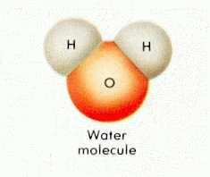
Percentage Composition
The percentage composition of a compound indicates the percentage mass of each element in the compound.
For example, the percentage composition of water shows what percentage of the mass of a water molecule is made up of hydrogen and what percentage of the mass is made up of oxygen.

Slide 20
Calculating Percentage Composition
To calculate the percentage composition of a compound, divide the mass that each element contributes to one mole of the compound by the molar mass of the entire compound.
To calculate the percentage composition of a compound:
% by mass of element = total mass of element present in 1 mole x 100
molar mass of compound

Slide 21
Example 1
Calculate the percentage composition of H and O in H₂O.
M(H₂O) = (2x1) + 16 = 18gmol⁻¹
%H = 2 x 100 = 11.11%
18
%O = 16 x 100 = 88.89%
18

Slide 22
Example 2
Calculate the percentage of H₂O in CuSO₄.5H₂O
M(CuSO₄.5H₂O) = 160 + (5x18)
= 250gmol⁻¹
M(H₂O) = (2x1) + 16
= 18gmol⁻¹
% H₂O = 5x18 x 100
250
= 36.0%

Slide 23
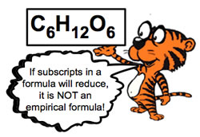
Empirical & Molecular Formula

Slide 24
Empirical and Molecular Formula
The empirical formula is defined as the ratio between the atoms in a molecule or ions in an ionic compound. We can generalize and state that the subscripts of an empirical formula represent the smallest whole number ratio of the atoms or ions in a compound.
The mole ratio between the elements is used to determine the empirical formula, which then gives us the atom or ion ratios. The mole ratios are obtained from the percentage composition of each atom or ion in the compound.

Slide 25
The molecular formula of a compound represents the actual numbers of atoms of each element in a single molecule of that compound. The molecular formula could be the same as the empirical formula or some whole number multiple of the empirical formula. The formula of an ionic compound represents the smallest whole number ratio of ions that will result in a neutral compound. Therefore the formula of an ionic compound is the same as the empirical formula.

Slide 26
If the empirical formula and the molar mass of the molecular formula are known, the molecular formula can be determined from the ratio between the molar mass of the molecular formula and the molar mass of the empirical formula.

Slide 27
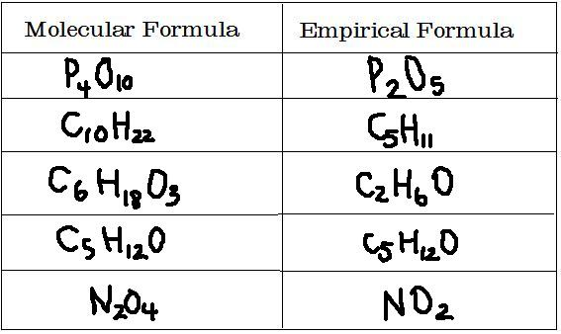
Examples of Empirical & Molecular Formulae

Slide 28
Example 1
A sample of a solid is decomposed and found to consist of 6.52g of potassium, 4.34g of chromium and 5.34g of oxygen. What is the empirical formula?

Slide 29
Answer
 | K | Cr | O
mass (in grams) | 6.52 | 4.34 | 5.34
molar mass (in gmol⁻¹) | 39 | 52 | 16
number of moles | 6.52 = 0.167 39 | 4.34 = 0.083 52 | 5.34 = 0.333 16
÷ by smallest number to get whole number ratio, i.e. ÷ 0.083 | 2 | 1 | 4
The empirical formula is K₂CrO₄

Slide 30
Example 2
Glucose is a sugar that is metabolised by the body to produce energy. Glucose is composed of hydrogen, carbon and oxygen. The percentage composition is 40% C, 6.7% H and 53.3% O. The molar mass of glucose is 180gmol⁻¹. Calculate the molecular formula.

Slide 31
Answer
 | C | H | O
mass (in grams) | 40 | 6.7 | 53.3
molar mass (in gmol⁻¹) | 12 | 1 | 16
number of moles | 40 = 3.3 12 | 6.7 = 6.7 1 | 53.3 = 3.3 16
÷ by smallest number to get whole number ratio, i.e. ÷ 0.083 | 1 | 2 | 1
The empirical formula is CH₂O
M(CH₂O) = 12 + (2x1) + 16 = 30gmol⁻¹
M(Glucose) = 180gmol⁻¹
Ratio between glucose and CH₂O = 180 = 6
30
So, molecular formula is C₆H₁₂O₆

Slide 32
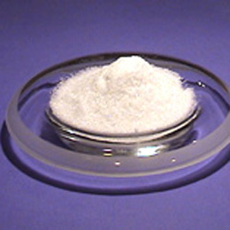
Percentage Purity

Slide 33
Percentage Purity
We can use titrations to find out how pure a sample is.
Example
Concentration of NaOH solution = 4.0 g dm⁻³
Molarity = 4.0 = 0.1M (Molar mass NaOH = 40)
40
When this solution was titrated against standard acid, its concentration was found to be only 3.5g dm⁻³
Percentage purity = 3.5 x 100
4.0
= 87.5%

Slide 34
Summary
In this lesson we learnt about:
Interconversion of mass, moles and number of atoms or molecules.
Calculating percent composition
Calculating empirical & molecular formulae
Calculating percentage purity

