Slide 1
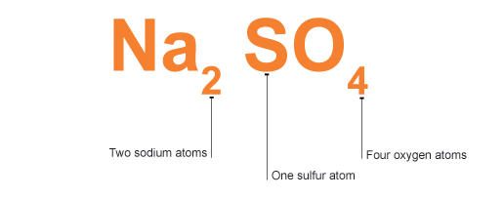
Chemical Formulae & Composition Stoichiometry

Slide 2
Definitions

Slide 3
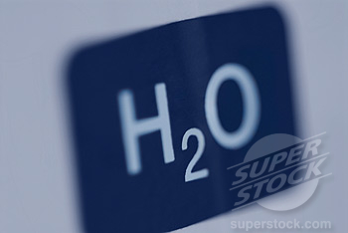
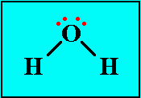
1. Chemical Formulae
Chemical formulae tell us which elements are found in a compound as well as the ratio between the elements in the compound.

Slide 4
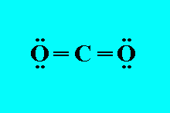
Types of Chemical Formulae
The molecular formula e.g. H₂O, CO₂, C₆H₁₂O
The structural formula e.g.
The empirical formula e.g. NaCl

Slide 5
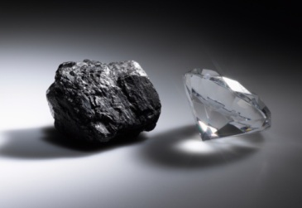
2. Allotropes
Allotropes are different physical forms of the same element.
For example, diamond and graphite are allotropes of carbon.

Slide 6
3. Stoichiometry
Stoichiometry deals with the relative quantities of reactants and products in chemical reactions.
In a balanced chemical reaction, the relations among quantities of reactants and products typically form a ratio of whole numbers.
For example, in a reaction that forms ammonia (NH₃), exactly one molecule of nitrogen (N₂) reacts with three molecules of hydrogen (H₂) to produce two molecules of NH₃:
N₂ + 3 H₂ → 2 NH₃

Slide 7
Reaction Stoichiometry
N₂ + 3 H₂ → 2 NH₃
Reaction stoichiometry describes the quantitative relationships among substances as they participate in chemical reactions.
In the example above, reaction stoichiometry describes the 1:3:2 ratio of molecules of nitrogen, hydrogen, and ammonia.

Slide 8
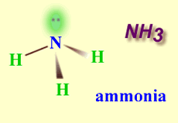
Composition Stoichiometry
Composition stoichiometry describes the quantitative (mass) relationships among elements in compounds.
For example, composition stoichiometry describes the nitrogen to hydrogen ratio in the compound ammonia: 1 mol of ammonia consists of 1 mol of nitrogen and 3 mol of hydrogen.

Slide 9
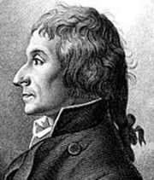
The Law of Constant Composition
The law of constant composition states that however you make a compound, it always contains the same elements in the same proportions by mass.
This law is also known as the law of definite proportion or Proust’s Law.

Slide 10
Writing chemical formulae for ionic compounds

Slide 11
Writing chemical formulae for ionic compounds
Ionic compounds are represented using an empirical formula. There are important points to note when writing the formulae of ionic compounds:
Metals generally lose electrons forming positive ions.
Non-metals generally gain electrons forming negative ions.

Slide 12
The charges must balance.
The magnitude of the charge on an ion of an element is the same as the oxidation state.
Transition elements often have multiple oxidation states.
Not all ions consist of one atom.
When balancing the number of charges, if multiple numbers of the polyatomic ion are required, the polyatomic ion is placed in brackets.

Slide 13
Writing Chemical Formulae
Steps:
1. Identify the metal and non-metal.
2. Write the symbols.
3. Write the charges.
4. Cross-over the charges from top to bottom.
5. Remove the charge.
6. Simplify the numbers and remove the 1’s.

Slide 14
Example 1
Write the chemical formula for calcium iodide.
Calcium and Iodide
Ca I
Ca²⁺ I¹⁻
Ca₁₋ I₂₊
Ca₁I₂
CaI₂

Slide 15
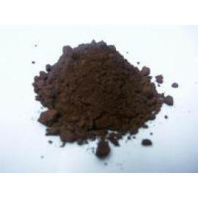
Example 2
Write the chemical formula for copper(II) oxide.
Copper and oxide
Cu O
Cu²⁺ O²⁻
Cu₂₋ O₂₊
Cu₂O₂
CuO

Slide 16
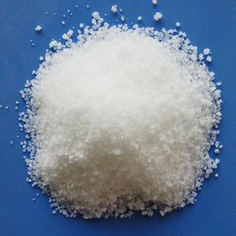
Example 3
Write the chemical formula for sodium phosphate.
Sodium and phosphate
Na PO₄
Na¹⁺ PO₄³⁻
Na₃₋ (PO₄)₁₊
Na₃ (PO₄)₁
Na₃ PO₄

Slide 17
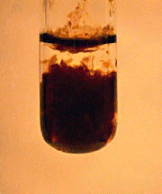
Example 4
Write the chemical formula for iron(II) hydroxide.
Iron and hydroxide
Fe OH
Fe²⁺ OH¹⁻
Fe₁₋ (OH)₂₊
Fe₁ (OH)₂
Fe (OH)₂

Slide 18
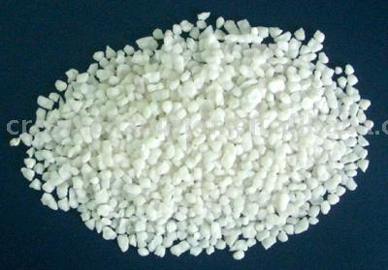
Example 5
Write the chemical formula for ammonium sulphate.
Ammonium and sulphate
NH₄ SO₄
NH₄¹⁺ SO₄²⁻
(NH₄)₂₋ (SO₄)₁₊
(NH₄)₂ (SO₄)₁
(NH₄)₂ SO₄

Slide 19
Naming ionic compounds
The names of ionic compounds are built from the cation and anion names.
Examples:
AgCl – Silver chloride
NaOH – Sodium hydroxide
Ca₃(PO₄)₂ – Calcium phosphate
(Na)₂Cr₂O₇ – Sodium dichromate

Slide 20
If the metal is a transition metal, determine the charge of the metal ion by looking at the ratio of the metal ion to the negative ion.
Example FeCl₂
Iron (Fe) is a transition metal.
Chloride (Cl) has a charge of 1- therefore 2 Cl will have a charge of 2-
The charge on iron (Fe) must therefore be 2+
Name of compound – iron(II) chloride.

Slide 21
Worksheet 1
1. Write the formula of each of the following compounds:
(a) Copper(I) hydroxide
(b) Magnesium sulphate
(c) Sodium carbonate
(d) Aluminium phosphate
2. Write the names of each of the following compounds:
LiF (b) KCl
(c) Ca₃(PO₄)₂ (d) CaSO₄

Slide 22
Introduction to the Mole Concept

Slide 23
Activity 1 – Counting Units
When you buy eggs you usually ask for a dozen eggs. You know that one dozen of any item is _____.
Paper is not packaged by the dozen. Paper is packaged by a ream. A ream of paper has 500 sheets. Why is it useful to have units like a dozen or a ream?

Slide 24
What determines how many items should make up a particular unit?
_______________________________________
If you were asked to design a new unit to count something, what would you consider when choosing how many items should be included in your new counting unit?
_______________________________________

Slide 25
Activity 2 – The Owl
A dozen represents 12 items.
Since I did not have enough items to make a dozen, I decided to make a new counting unit. I called this unit an OWL.
Each of your packages contains ___ items.
We will call this number of items an OWL.
Use the concept of OWL as a counting unit, just like a dozen for counting by 12, to complete Activity 2.

Slide 26
(a) An OWL of paper clips will have ___ paper clips.
(b) An OWL of paper will have ______ pieces of paper.
(c) An OWL of rubber bands will have ______ rubber bands.
(d) An OWL of oranges will have ______ oranges.
(e) An OWL of atoms of iron will have _____ atoms of iron.
(f) An OWL of molecules of water will have ______ molecules of water.

Slide 27
2. (a) How many paper clips are in 2 OWLS?
(b) How many pieces of paper are in 10 OWLS?
(c) How many Snickers minis are in 4.5 OWLS?
(d) How many atoms of copper are in 16 OWLS?
(e) How many molecules of hydrogen are in 100 OWLS?

Slide 28
3. Based on your answers in question (2), write directions for finding the number of items if given the number of OWLS.
Number of Items =

Slide 29
4. (a) How many OWLS are in 48 paper clips?
(b) How many OWLS are in 10 pieces of paper?
(c) How many OWLS are in 25 Snickers minis?
(d) How many OWLS are in 40 atoms of nitrogen?
(f) How many OWLS are in 14 molecules of water?

Slide 30
5. Based on your answers in question (4), write directions for finding the number of OWLS if given the number of pieces.
Number of OWLS =

Slide 31
Activity 3 – The Mole
One mole of anything has
602, 200, 000, 000, 000, 000, 000, 000 items.
This number is called Avogadro’s Number and is usually written in scientific notation as
6.02 x 10²³
One mole of anything has 6.02 x 10²³ items.

Slide 32
Calculations
Recall how to multiply and divide numbers written in scientific notation.

Slide 33
Multiplication Examples:
4 x 6.02 x 10²³
= (6.02 x 4) x 10²³
= 24. 1 x 10²³
= 2.41 x 10²⁴
(ii) (6 x 10⁴⁵) x (3 x 10³⁰)
= (6 x 3) x 10⁴⁵⁺³⁰
= 18 x 10⁷⁵
= 1.8 X 10⁷⁶
Division Example:
(6 x 10⁴⁵) (3 x 10³⁰)
= (6 3) x 10⁴⁵⁻³⁰
= 2 x 10¹⁵

Slide 34
(a) How many paper clips make up 1 mole?
(b) How many Snickers minis make up 10 moles?
(c) How many molecules of water are in 6 moles?
(d) How many atoms of silver are in 0.5 moles?
(e) How many formula units are in 0.25 moles of NaCl?

Slide 35
2. (a) How many moles of paper clips are in 6.02 x 10²³ paper clips?
(b) How many moles of Snickers minis are in 1.204 x 10²⁴ Snickers minis?
(c) How many moles are in 1.204 x 10²⁴ calcium atoms?
(d) How many moles are in 3.01 x 10²⁴ molecules of oxygen?
(e) How many moles are in 6.02 x 10²² formula units of salt?

Slide 36
Worksheet 2
1. How many items are in a mole?
2. (a) How many Hershey’s kisses make up 1 mole?
(b) How many atoms of magnesium are in 10 moles?
(c) How many molecules of oxygen are in 0.5 moles?
3. (a) How many moles are in 6.02 x 10²³ atoms of lead?
(b) How many moles are in 3.612 x 10²⁴ atoms of iron?
(c) How many moles are in 1.204 x 10²³ molecules of oxygen?

Slide 37
Summary of The Mole Concept
In chemistry, we use the mole to represent a fixed number.
1 Mole = 6.0 x 10²³, known as Avogadro’s number (N_{A}).
The mole has been defined using the carbon-12 isotope because of its abundance and stability.
The mole is defined as the number of atoms in exactly 12g of carbon-12. This number of atoms is 6.0 x 10²³, i.e. Avogadro’s number.

Slide 38
Relative Atomic Mass

Slide 39
Relative Atomic Mass
The relative atomic mass (A_{r}) of an element is found by comparing the mass of one atom of the element to the mass of a carbon-12 atom.
The relative atomic mass of an element can be found in the periodic table, for example:
1. Sodium relative atomic mass = 23
2. Calcium relative atomic mass = 40

Slide 40
Relative molecular mass & Relative formula mass
Relative molecular mass – The products of covalent bonding.
Relative formula mass – The products of ionic bonding.
To determine the relative molecular mass or relative formula mass, we add the relative atomic masses of all the elements present in the compound.

Slide 41
Example 1
Calculate the relative molecular mass of nitric acid, HNO₃.
Answer:
HNO₃ = 1 atom of H, 1 atom of N and 3 atoms of O.
Relative molecular mass = (1x1) + (1x14) + (3x16)
= 63

Slide 42
Example 2
Calculate the relative formula mass of calcium carbonate, CaCO₃.
Answer:
CaCO₃ = 1 atom of Ca, 1 atom of C and 3 atoms of O.
Relative formula mass = (1x40) + (1x12) + (3x16)
= 100

Slide 43
Molar Mass
The mass of one mole of a substance is known as the molar mass (M). The molar mass of an element or compound has a unit of grams per mole, i.e. gmol⁻¹
The molar mass of an element is the relative atomic mass in gmol⁻¹. The molar mass of a compound is the relative formula mass or relative molecular mass in gmol⁻¹.

Slide 44
Examples – Molar mass of elements
1. M(C) = 12 gmol⁻¹
2. M(Na) = 23 gmol⁻¹
3. M(Ca) = 40 gmol⁻¹
4. M(K) = 39 gmol⁻¹

Slide 45
Examples – Molar mass of compounds
1. M(H₂O) = (2x1) + 16 = 18 gmol⁻¹
2. M(CuSO₄) = 64 + 32 + (4x16) = 160 gmol⁻¹
3. M((NH₄)₂CO₃) = 2 x (14 + (4x1)) + 12 + (3x16)
= 96 gmol⁻¹
4. M(CuSO₄.5H₂O) = 160 + (5x18) = 250 gmol⁻¹

Slide 46
Relationship between mass, moles and number of atoms
Example: Sulphur
Relative atomic mass of sulphur, A_{r}(S) = 32
Therefore, molar mass of sulphur = 32 gmol⁻¹
The relationship between mass, moles and number of moles is given in the table below.
Mass of sulphur (g) | Number of moles | Number of atoms
32 | 1 | 6.0 x 10²³
16 | 0.5 | 3.0 x 10²³

Slide 47
Worksheet 3
1. Calculate the relative molecular mass of oxygen, O₂.
2. Calculate the relative molecular mass of a chlorine molecule, Cl₂
3. Calculate the relative formula mass of calcium hydroxide, Ca(OH)₂
4. Calculate the relative formula mass of hydrated copper sulphate, CuSO₄.5H₂O

Slide 48
Summary
In this lesson we learnt about:
The definitions for chemical formulae, allotropes & stoichiometry
The Law of constant composition
Writing chemical formulae of compounds

Slide 49
Summary
Using the IUPAC system for naming compounds.
Relative atomic mass, relative molecular mass & relative formula mass
The mole
SI units (review)
Calculating molar mass of an element or compound

