Slide 1
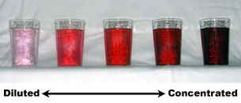
Concentration of Solutions

Slide 2
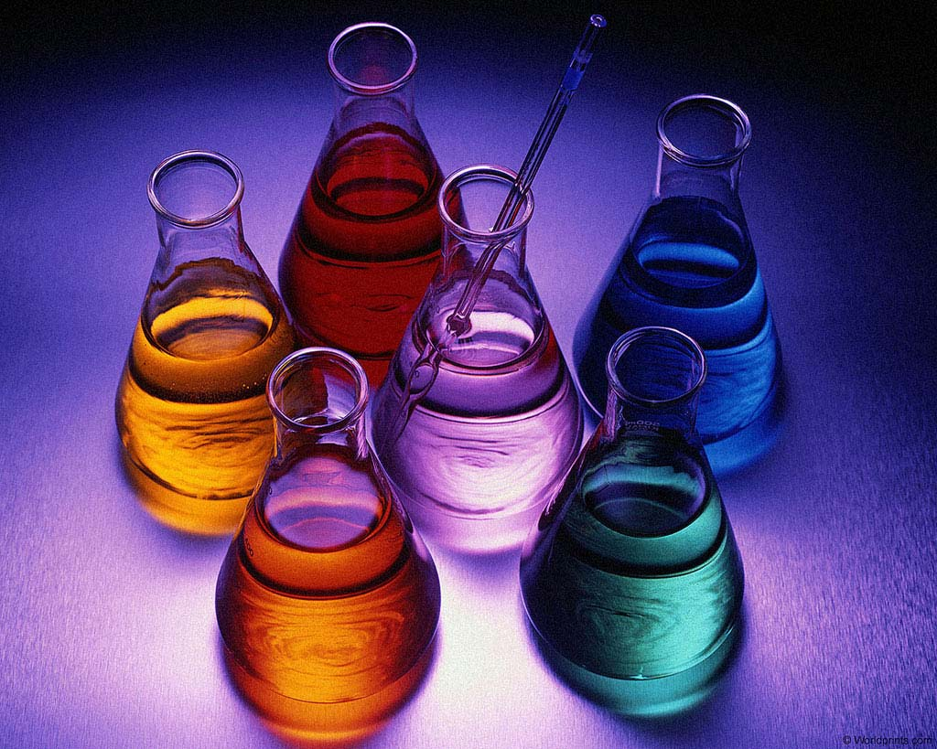
Working with Solution Concentrations
Concentrations can be measured in either
g dm⁻³ (grams per cubic decimetre)
mol dm⁻³ (moles per cubic decimetre)

Slide 3
Example 1 Converting from g dm⁻³ to mol dm⁻³
A sample of sea water had a concentration of sodium chloride of 35.1 g dm⁻³. Find its concentration in mol dm⁻³.
(RAMs: Na = 23; Cl = 35.5)
Answer
1 mol NaCl weighs 58.5g
35.1g is 35.1 mol = 0.6 mol
58.5
The concentration of the NaCl is 0.6 mol dm⁻³

Slide 4
Example 2 Converting from mol dm⁻³ to g dm⁻³
What is the concentration of a 0.050 mol dm⁻³ solution of sodium carbonate, Na₂CO₃, in g dm⁻³?
(RAMs: C = 12; O = 16; Na = 23)
Answer
1 mol Na₂CO₃ weighs 106g
0.050 mol weighs 0.050 x 106g = 5.3g
0.050 mol dm⁻³ is therefore 5.3 g dm⁻³

Slide 5
Example 3 A Tricky example!
What is the concentration in mol dm⁻³ of a solution containing 2.1g sodium hydrogen carbonate, NaHCO₃, in 250 cm³ of solution?
(RAMs: H = 1; C = 12; O = 16; Na = 23)

Slide 6
Answer
The problem here is that the volume is wrong! The solid is dissolved in 250 cm³ instead of 1000 cm³ (1 dm³).
250 cm³ is 1 of 1000 cm³ (1 dm³)
4
Therefore, a solution containing 2.1g in 250 cm³ has the same concentration as one containing 4 x 2.1g in 1000 cm³.
4 x 2.1g = 8.4g
1 mol NaHCO₃ weighs 84g
8.4g is 8.4 mol = 0.10 mol
84
The concentration is therefore 0.10 mol dm⁻³

Slide 7
Dilution of Solutions
To dilute a solution, distilled water is added.
The number of moles of the solute remains the same in the concentrated and dilute solution; it is the amount of solvent that changes.

Slide 8
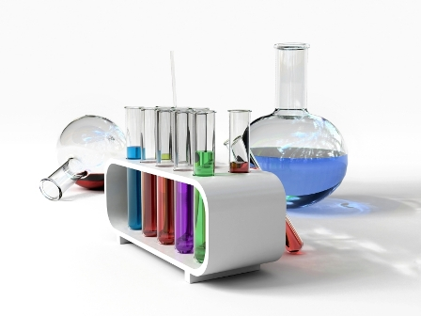
Example
Describe the steps you would perform in the laboratory to produce 10 dm³ of a 0.5 mol dm⁻³ hydrochloric acid (HCl) solution from a 2 mol dm⁻³ hydrochloric acid.

Slide 9
Answer
Final volume = 10 dm³
Final molar concentration = 0.5 mol dm⁻³
1 dm³ of final solution contains 0.5 mol HCl
10 dm³ of final solution contains (10 x 0.5) mol HCl
= 5 mol HCl
Therefore, 5 mol HCl needs to be taken out of the original solution.

Slide 10
Calculate the volume of original solution which contains 5 mol HCl:
original molar concentration = 2 mol dm⁻³
2 mol HCl are contained in 1 dm³ of original solution
5 mol HCl are contained in 1 x 5 dm³ of original solution
2
= 2.5 dm³ of original solution
Therefore to make 10 dm³ of final solution required 2.5dm³ of original solution added to 7.5dm³ distilled water.

Slide 11
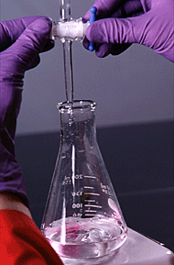
Calculations from Titrations
You do a titration to find the concentration of one solution, knowing the concentration of the other one.

Slide 12
Example 1 The Standard Calculation
25.0 cm³ of 0.100 mol dm⁻³ sodium hydroxide solution required 23.5 cm³ dilute hydrochloric acid for neutralisation. Calculate the concentration of the hydrochloric acid.
NaOH_{(aq)} + HCl_{(aq)} → NaCl_{(aq)} + H₂O_{(l)}

Slide 13
Answer
Number of moles NaOH = 25.0 x 0.100 mol
1000
= 0.00250 mol
1 mol NaOH reacts with 1 mol HCl
0.00250 mol NaOH reacts with 0.00250 mol HCl
If 23.5 cm³ HCl contains 0.00250 mol HCl
1000 cm³ will contain 0.00250 x 1000 mol HCl
23.5
= 0.106 mol
The concentration is 0.106 mol dm⁻³

Slide 14
Example 2 A Slightly Harder Calculation
25cm³ of sodium hydroxide solution of unknown concentration was titrated with dilute sulphuric acid of concentration 0.050 mol dm⁻³.
20.0 cm³ of the acid was required to neutralise the alkali.
Find the concentration of the sodium hydroxide solution in mol dm⁻³.

Slide 15
Answer
2NaOH_{(aq)} + H₂SO_{4(aq)} → Na₂SO_{4(aq)} + 2H₂O_{(l)}
No. of moles of sulphuric acid used = 20.0 x 0.050 mol
1000
= 0.0010 mol
Ratio of H₂SO₄ : NaOH = 1 : 2
So, no. of moles Sodium hydroxide = 2 x 0.0010 mol
= 0.0020 mol
Concentration of sodium hydroxide = 0.0020 x 1000 mol dm⁻³
25
= 0.080 mol dm⁻³

Slide 16
Example 3
Washing soda crystals have the formula Na₂CO₃.nH₂O.
28.6 g of washing soda crystals were dissolved in pure water. More pure water was added to make the total volume of the solution up to 1000 cm³.
A 25.0 cm³ sample of this solution was neutralised by 40.0 cm³ of 0.125 mol dm⁻³ hydrochloric acid using methyl orange as indicator.
Na₂CO_{3(aq)} + 2HCl_{(aq)} → 2NaCl_{(aq)} + CO_{2(g)} + H₂O_{(l)}

Slide 17
Calculate the concentration of the sodium carbonate in moles of sodium carbonate (Na₂CO₃) per cubic decimetre.
Calculate the mass of Na₂CO₃ and mass of water in the washing soda crystals, and use these results to find a value for ‘n’ in the formula Na₂CO₃.nH₂O.
(RAMs: H =1; C = 12; O = 16; Na = 23)

Slide 18
Answer (a)
No. of moles of HCl = 0.125 x 40 mol
1000
= 0.00500 mol
Ratio of Na₂CO₃ : HCl = 1 : 2
No. of moles Na₂CO₃ = 0.00500 mol = 0.00250 mol
2
The sodium carbonate solution contained 0.00250 mol in 25.0 cm³.
Concentration of Na₂CO₃ = 0.00250 x 1000 mol dm⁻³
25
= 0.100 mol dm⁻³

Slide 19
Answer (b)
1 mol Na₂CO₃ weighs 106g
0.100 mol Na₂CO₃ weighs 0.100 x 106g = 10.6g
The original mass of the crystals dissolved in the water was 28.6 g. Of this, we have worked out that 10.6g is Na₂CO₃.
Mass of water = 28.6 – 10.6 = 18.0g
But, I mol water weighs 18 g
There is therefore 1 mol of H₂O in the crystals together with 0.100 mol of Na₂CO₃.
Since there are ten times as many moles of H₂O as Na₂CO₃, the formula is Na₂CO₃.10H₂O

Slide 20
Percentage Purity
Example
Concentration of NaOH solution = 4.0 g dm⁻³
Molarity = 4.0 = 0.1M (Molar mass NaOH = 40)
40
When this solution was titrated against standard acid, its concentration was found to be only 3.5g dm⁻³
Percentage purity = 3.5 x 100
4.0
= 87.5%

