Slide 1
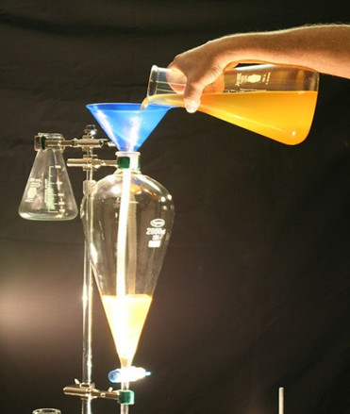
Method 5: Separating Funnel

Slide 2
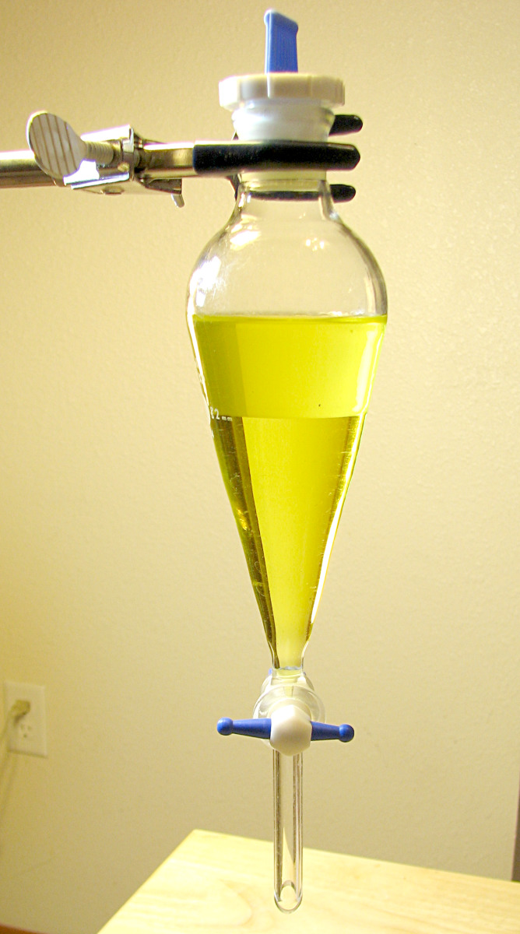
What is a separating funnel?
A separating funnel is a container which has a tap at the bottom, allowing you to drain off one liquid before the other.

Slide 3
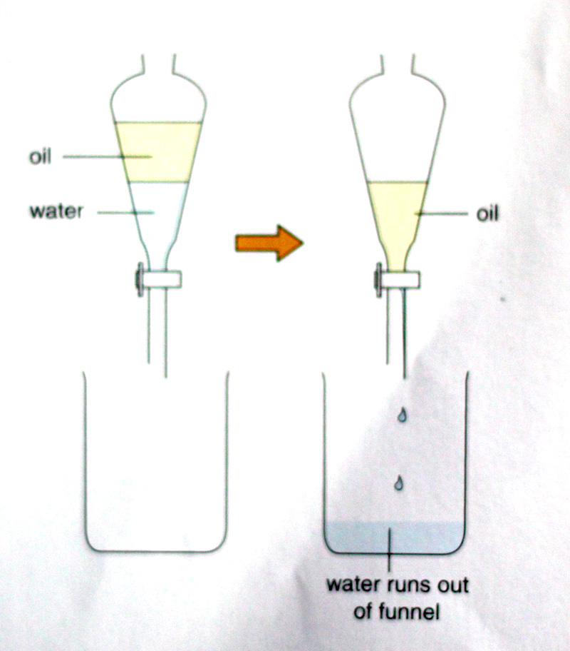
Separation Using a Separating Funnel

Slide 4
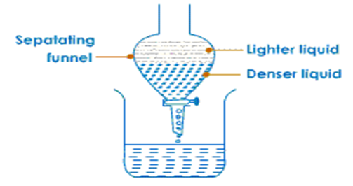
When is a separating funnel used?
A separating funnel is used to separate a mixture of liquids which are immiscible and have different densities.

Slide 5
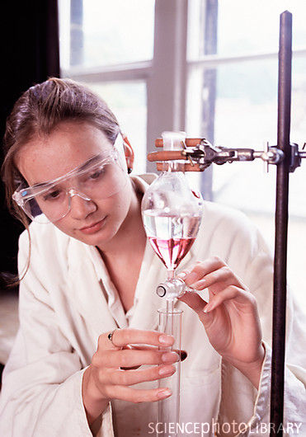
Using a separating funnel
Oil and water are two liquids which are immiscible and they have different densities.
If a mixture of oil and water is placed in a separating funnel, the oil will float on the water. Opening the tap allows the liquid with the highest density (water) to run off into the beaker below.

Slide 6
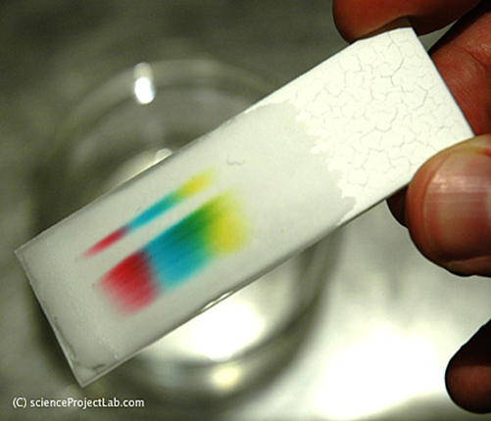
Method 6: Paper Chromatography

Slide 7
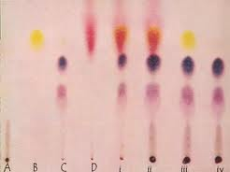
When is Paper Chromatography used?
Paper chromatography is used to separate a mixture of different dissolved substances which will travel through a material.
The dissolved substances are separated based on their solubility in the solvent.

Slide 8
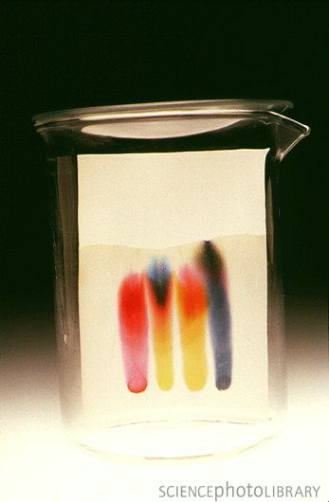
What is Paper Chromatography used to separate?
Many inks and food colourings are mixtures of two or more dyes.
Paper chromatography is a very useful technique for separating those dyes.

Slide 9
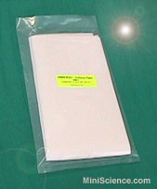
Method of Paper Chromatography
The method by which paper chromatography works is:
1. Absorbent paper is required for the process, this paper may be special chromatography paper or plain filter paper.

Slide 10
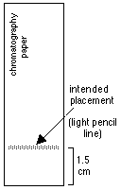
Method of Paper Chromatography
2. A pencil line, known as a datum line, is drawn near the bottom of the paper and a small drop of the mixture is placed on the line.
A datum line is drawn with a pencil because the pencil lead contains no dye and therefore will not interfere with the results.

Slide 11
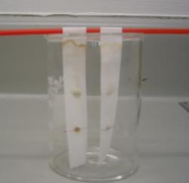
Method of Paper Chromatography
3. The chromatography paper hangs from a glass rod. The paper must not touch the sides of the beaker.

Slide 12
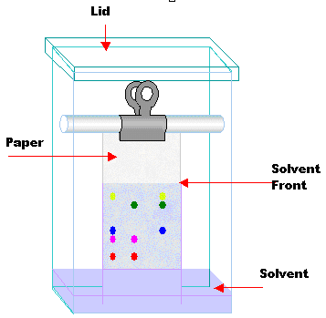
Method of Paper Chromatography
4. The bottom edge of the paper is placed in a solvent.
The spot of solute must be above the level of the solvent in the beaker.
The solvent travels up the paper to this level; its edge is called the solvent front.

Slide 13
Method of Paper Chromatography
5. The solvent must be able to dissolve the mixture, although some of the dyes will be more soluble than others.

Slide 14
Method of Paper Chromatography
6. The solvent dissolves the mixture in the drop and moves up the paper, carrying the dyes with it.

Slide 15
Method of Paper Chromatography
7. The different dyes will travel up the paper at different rates.
They dyes that are most soluble in the solvent will travel faster and will therefore reach the highest level on the paper.
Question: Look at the diagram. Which colour dye is the most soluble?

Slide 16
Method of Paper Chromatography
6. Dyes that are less soluble will travel more slowly and not reach as far up the paper.
Questions: Look at the diagram. Which colour dye is the least soluble?

Slide 17
Method of Paper Chromatography
7. Once the solvent has completed its movement up the paper, the paper is allowed to dry.
There will be a pattern of colours on the paper, each one representing a part of the mixture, i.e. one of the dyes.
The result is called a chromatogram.

Slide 18
Summary
In this lesson we learnt about the following separation methods:
Filtration
Evaporation
Simple Distillation
Fractional Distillation
Separating Immiscible Liquids
Paper Chromatography

