Slide 1
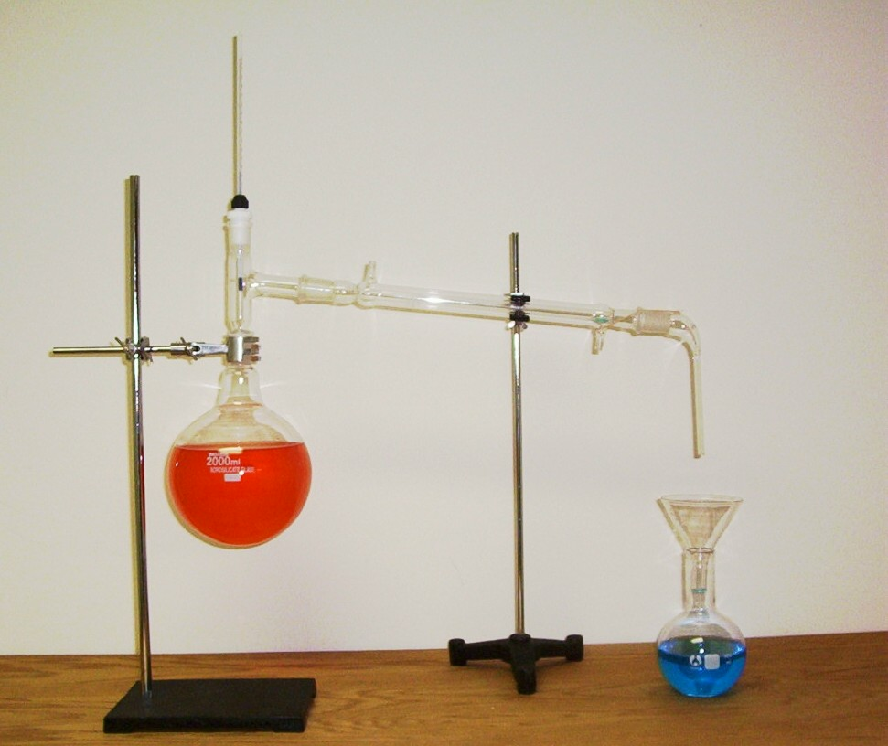
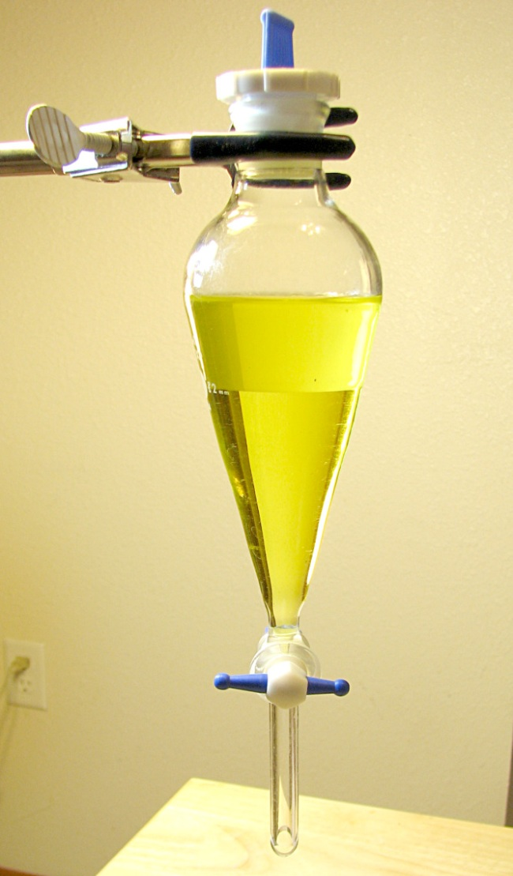
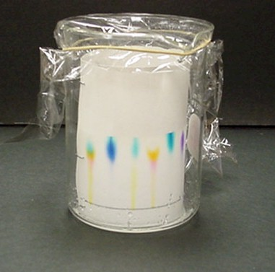
Separating Mixtures

Slide 2
Why is it important to separate mixtures?
Since mixtures form part of our everyday life, the separation of these mixtures into their component parts is important.
Examples: purification of drinking water, making of filter coffee.
If you were stuck on a desert island without any drinking water your knowledge of separating mixtures could help you to make pure water from sea water.

Slide 3
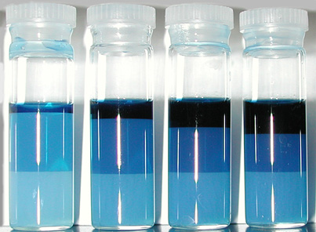
What are mixtures?
Mixtures are a type of matter where component parts can be separated by physical means.

Slide 4
How do we know which separation method to choose?
The method by which a mixture can be separated into its component parts is determined by the physical properties of these parts, e.g. particle size, boiling point, solubility.

Slide 5
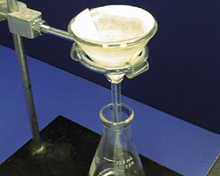
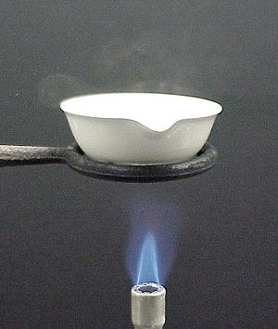
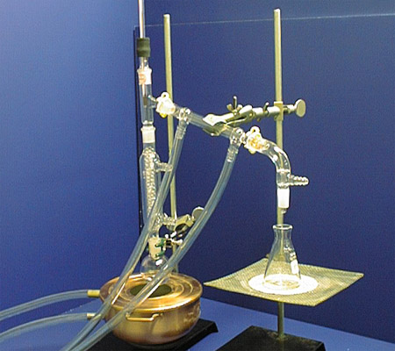
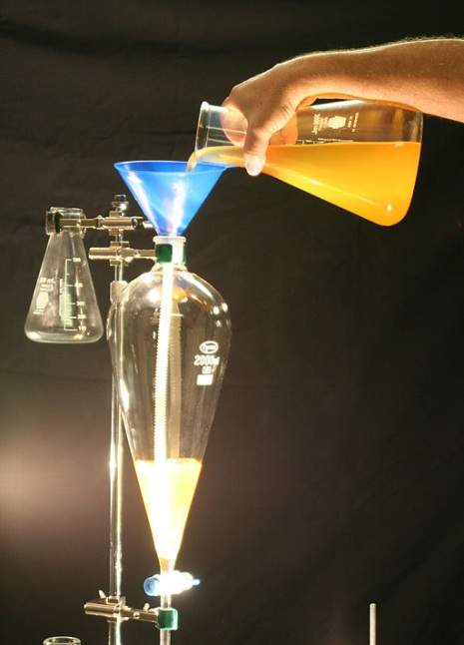
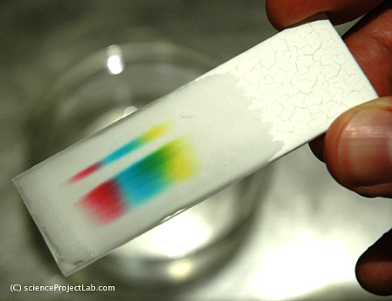
Methods of Separating Mixtures

Slide 6
Method 1: Filtration

Slide 7
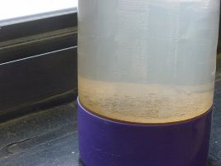
When is filtration used?
Filtration is used to separate a mixture of a solid and a liquid where the solid does not dissolve in the liquid.
The mixture is called a suspension.

Slide 8
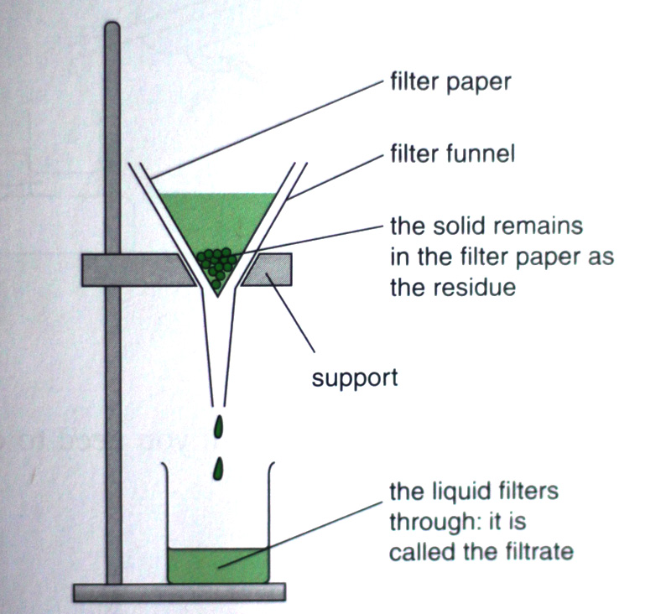
Filtration Apparatus

Slide 9
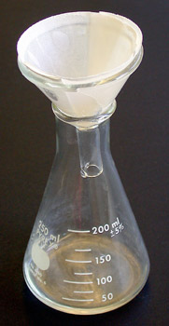
Filter Paper
Filtration makes use of filter paper to separate the solid from the liquid.
Question: Why is the filter paper used?

Slide 10
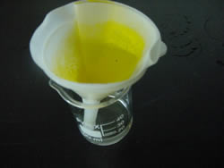
How does filter paper work?
The filter paper works as a sieve keeping back the solid particles.
These particles are too big to pass through the filter paper, whereas the liquid particles are small enough to pass through the filter paper.

Slide 11
Filtrate & Residue
The part of the mixture that stays behind on the filter paper is known as the residue and the part that passes through the filter paper is known as the filtrate.
Questions: 1. What is the colour of the reside below?
2. What is the colour of the filtrate below?

Slide 12
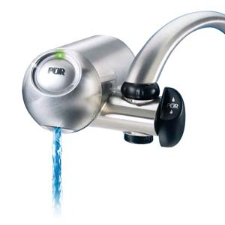
Everyday Examples of Filtration
1. Filtration is one of the steps in the purification of drinking water. Most simple water purification devices use filtration as their main method of purification, separating the solid impurities from the water.

Slide 13
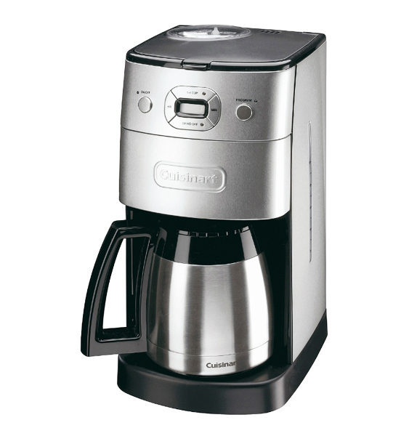
Everyday Examples of Filtration
2. Coffee machines make use of filters, in the form of a filter paper to separate the coffee granules from the liquid.

Slide 14
Method 2: Evaporation

Slide 15
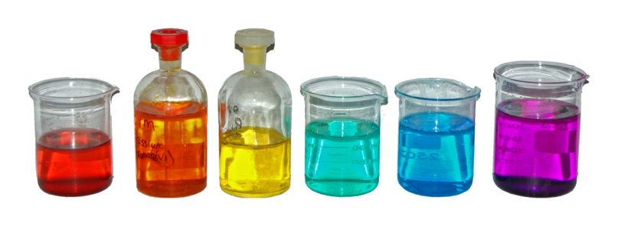
When is evaporation used?
Evaporation is used to separate a solution of a solid dissolved in a liquid, but it only allows the solid to be collected.

Slide 16
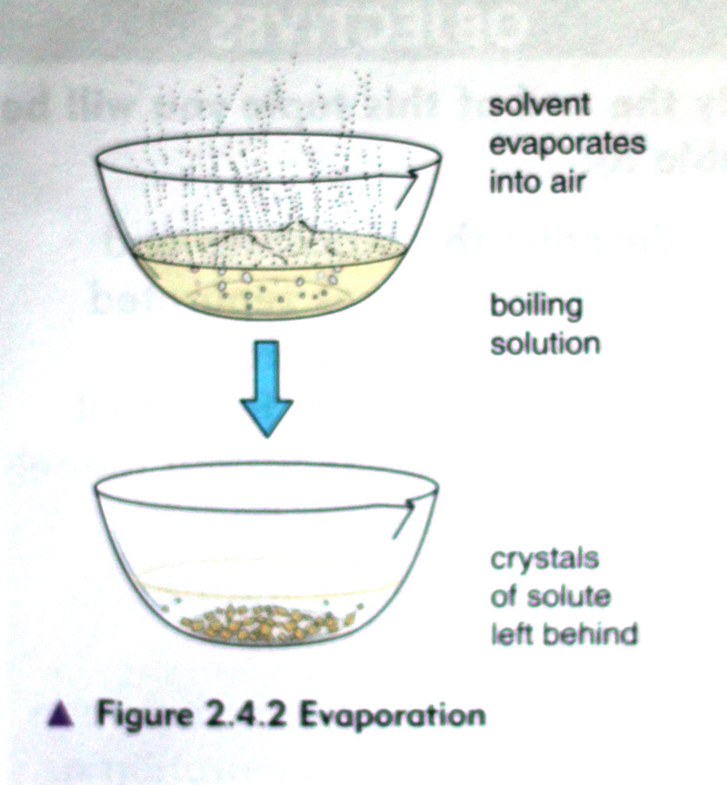
Evaporation Apparatus

Slide 17
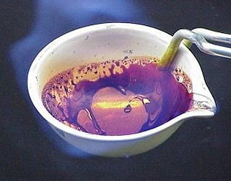
What happens during evaporation?
During evaporation, the solution is boiled allowing the liquid to vaporise into the air.
The solute will be left behind in the container.

Slide 18
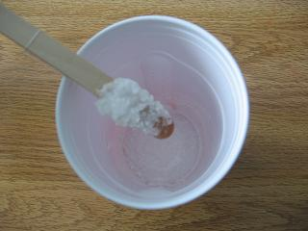
Temperature for evaporation
Evaporation occurs at all temperatures, not just the boiling point of the solvent, so if a beaker containing a solution of salt dissolved in water is left for a while it will eventually contain only salt, as the water will have evaporated.

