Slide 1
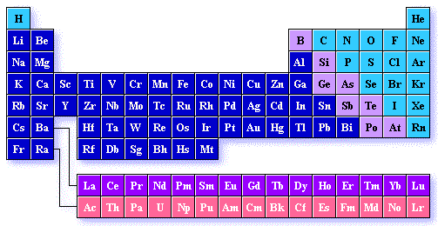
The Periodic Table

Slide 2
Activity: Use the basic periodic table you completed as your homework project to answer the questions in Worksheet 1.

Slide 3
Worksheet 1
1. Which elements had complete outer shells? Give the name and symbol for each.
What do you notice about the location of these elements?
2. Which elements had only one valence electron? Give the name and symbol for each.
What do you notice about the location of these elements?

Slide 4
3. What do you notice about the number of valence electrons as you move from left to right across a row or period in the periodic table?
(Na→ Mg→ Al→ Si→ P→ S→ Cl→ Ar)
4. What do you notice about the number of energy levels or shells as you move down a group or column in the periodic table?
(H→ Li→ Na)

Slide 5
5. Write the name of each family at the top of the columns on your periodic table using the following information:
Alkali Metals – 1 valence electron
Alkaline Earth Metals – 2 valence electrons
Boron Family – 3 valence electrons
Carbon Family – 4 valence electrons
Nitrogen Family – 5 valence electrons
Oxygen Family – 6 valence electrons
Halogens – 7 valence electrons
Noble Gases – complete outer shells

Slide 6
6. What do you notice about the location of the elements in each family?
7. In which family would you classify hydrogen? Explain your choice.
8. In what family would each of these elements be classified?
Radium –
Iodine –
Tin –
Cesium -

Slide 7
9. Predict the number of valence electrons for each element based on its location in the Period Table of Elements. You will need to use the table in your textbook.
Barium –
Lead –
Bismuth –
Potassium -

Slide 8
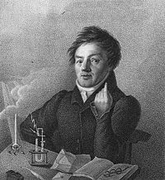
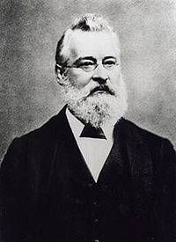
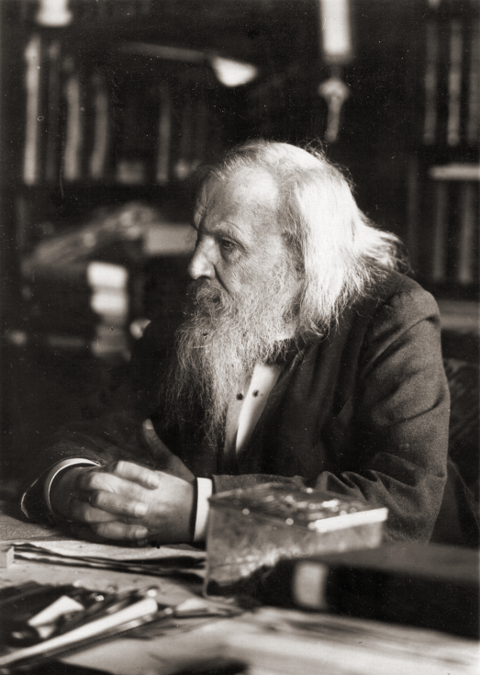
The History of the Periodic Table
Johann
Wolfgang
Dobereiner
John Newlands
Dimitri Mendeleev

Slide 9
Johann Wolfgang Dobereiner
In work beginning 1817, Dobereiner investigated some groups of three elements with similar chemical properties – for example, lithium, sodium and potassium.
He noticed that the atomic weight (what we would now call the relative atomic mass) of the middle one was the average of the other two:
lithium: 7 sodium: 23 potassium: 39
23 = (7 + 39) ÷ 2

Slide 10
He found similar patterns with calcium, strontium and barium; with sulphur, selenium and tellurium; and with chlorine, bromine and iodine.
These became known as Dobereiner’s triads.
At the same time, this was no more than a curiosity, but the real advances some 50 years later were again based on patterns in atomic weights.

Slide 11
John Newlands
In 1864-65, Newlands noticed that by arranging the known elements into atomic weight order, elements with similar properties recurred at regular intervals.
Every eight element was similar.
He proposed a law which said that ‘The properties of the elements are a periodic function of their atomic weights’.
By drawing an analogy with music, his law became known as the ‘Law of Octaves’.

Slide 12
John Newlands’ Table
1 | 2 | 3 | 4 | 5 | 6 | 7
H | Li | Be | B | C | N | O
F | Na | Mg | Al | Si | P | S
Cl | K | Ca | Cr | Ti | Mn | Fe
This works up to a point, but it soon goes wrong.
For example, there is no similarity at all between the metal manganese, Mn, and the non-metals nitrogen and phosphorous in Newlands’ sixth group.

Slide 13
Criticism of John Newlands’ Table
Newlands’ ideas were greeted with ridicule at the time. One of his critics suggested that he might as well have arranged his elements in alphabetical order. With hindsight his theory was bound to fail.
There were lots of undiscovered elements, and some of the known ones had been given the wrong atomic weights.
We also know that the patterns get more complicated when you get beyond calcium.

Slide 14
Dimitri Mendeleev
In 1869, only a few years after Newlands, Mendeleev used the same idea but improved it almost beyond recognition.
He arranged the elements in atomic weight order, but accepted that the pattern was going to be more complicated than Newlands suggested. Where necessary he left gaps in the table to be filled by as yet undiscovered elements.
He also had the confidence to challenge existing values for atomic weight where they forced an element into the wrong position in his Periodic Table.

Slide 15
And he was right!
One of Mendeleev’s early triumphs was to leave a gap underneath silicon in the table for a new element which he called ‘ekasilicon’.
He predicted what the properties of this element and its compounds would be.
When what we now call germanium was isolated in 1886, it proved to have almost exactly the properties that Mendeleev predicted.

Slide 16
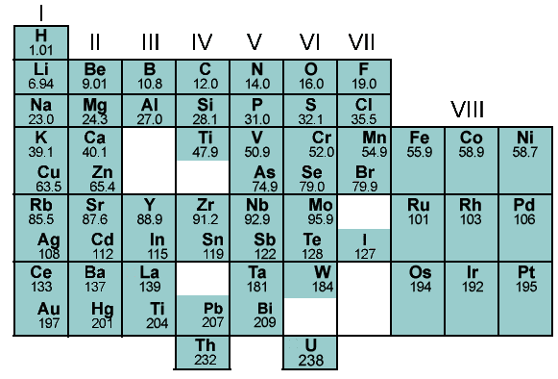
Part of Mendeleev’s Table

Slide 17
Comparing the Modern Periodic Table with Mendeleev’s Table
You might notice that the noble gases (helium, neon, argon and the rest) are missing – they were not known at this time. When argon was discovered in 1894, it was obvious that it did not fit anywhere in the existing table.
Argon was put into a new group – Group 0. This suggested that there must be other members of this group, and helium, neon, krypton and xenon were quickly found over the next four years.

Slide 18
Problems with Mendeleev’s Table
There were some residual problems in Mendeleev’s Table which had to be left for later. The atomic weight order was not exactly followed.
For example, tellurium, Te, has a slightly higher atomic weight than iodine – but iodine obviously has to go where it is in the Table because its properties are very similar to chlorine and bromine.

Slide 19
Problems with Mendeleev’s Table – The Tellurium / Iodine Issue
Group 6 | Group 7
O | F
S | Cl
Cr Se | Mn Br
Mo I | * Te
Group 6 | Group 7
O | F
S | Cl
Cr Se | Mn Br
Mo Te | * I
correct order in terms of atomic weight
Mendeleev swapped Te and I so that their properties matched the rest of the group

Slide 20
Another Problems with Mendeleev’s Table – The Argon / Potassium Issue
Group 0 | Group 1
He | Li
Ne | Na
K | Ar
Argon’s atomic weight is slightly higher than potassium’s. Putting elements in their correct order of increasing atomic weight would put argon into the same group as lithium and sodium, and potassium in with gases like neon. That’s obviously wrong!

Slide 21
Last Problems with Mendeleev’s Table – The need for sub-groups
The need for sub-groups (starting in Period 4) is also awkward.
For example, lithium, sodium, potassium and rubidium are described as being in Group 1a; copper and silver are in Group 1b. There’s not much resemblance between the two sub-groups.
These problems are completely overcome in the modern version of the Periodic Table.

Slide 22
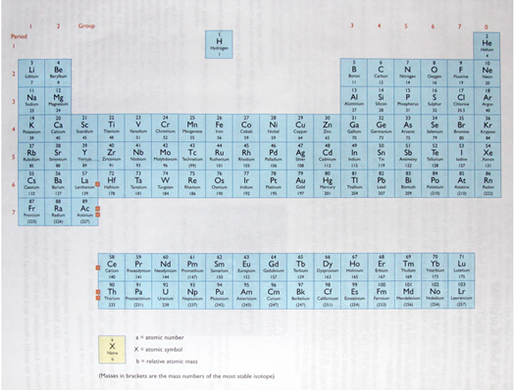
The Modern Periodic Table

Slide 23
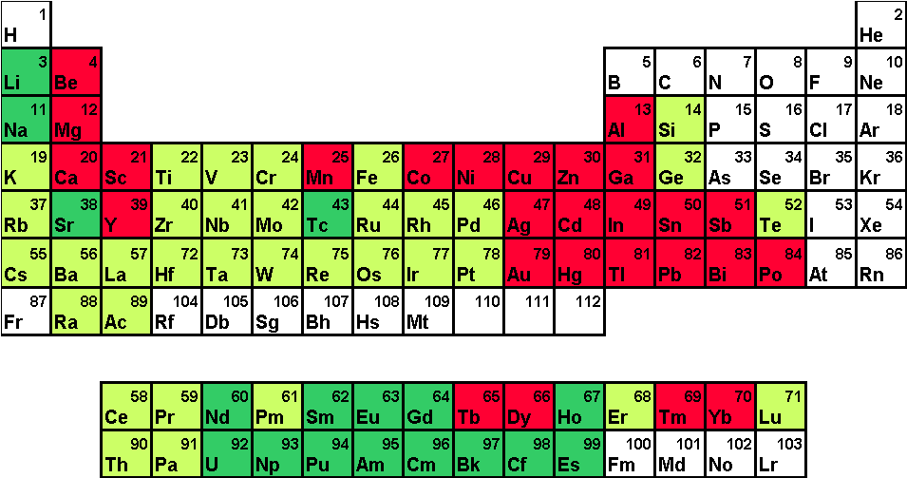
The Periodic Table
There are 103 different elements in the periodic table, arranged in order of increasing atomic number.

Slide 24
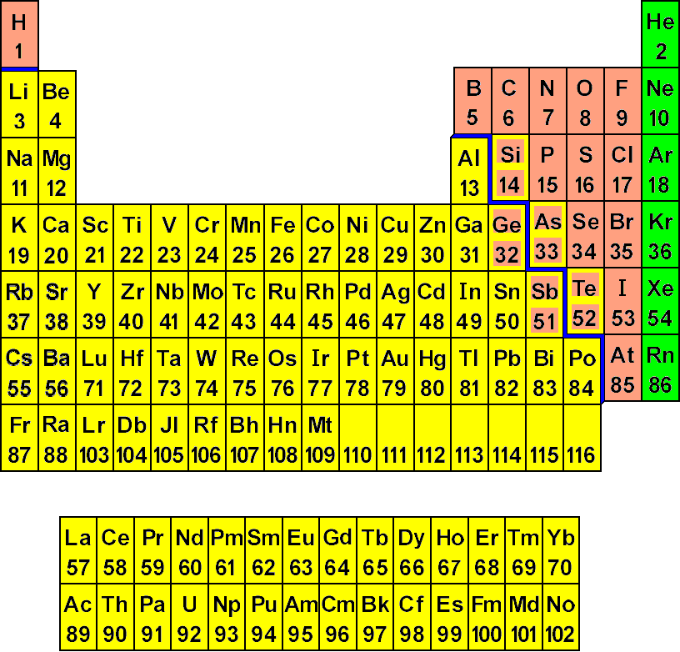
Elements in the Periodic Table
Elements in the Periodic Table can be divided into metals and non-metals, with the metalloids being those elements which border these two groups of elements.

Slide 25
Location of Metals, Non-Metals and Metalloids in the Periodic Table
Look at the Periodic Table.
The solid line which runs from above aluminium stepping down to astatine divides the metals and the non-metals.
All those elements to the left of the line, excluding hydrogen, are metals and those to the right of the line, including hydrogen, are non-metals.
Those elements which border the line, eg silicon, arsenic and germanium are metalloids.

Slide 26
Groups and Periods in the Periodic Table
The Periodic Table consists of vertical columns called groups and horizontal rows called periods.

Slide 27
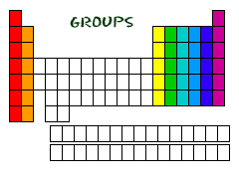
Groups in the Periodic Table
Look at your copy of the Periodic Table.
How many groups are there?

Slide 28
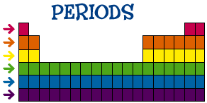
Periods in the Periodic Table
Look at your copy of the Periodic Table.
How many periods are there?

Slide 29
Groups and Periods in the Periodic Table
There are 18 groups in the Periodic Table, but only 8 of the groups are numbered; the first two and the last six.
The columns that lie between Group II and Group III are known as the transition elements (or metals).
Elements in the same group show similar properties and because of this, they have been assigned special names.

Slide 30
Groups and Periods in The Modern Periodic Table
Look at your copy of the Periodic Table.
Where are the groups?
They are the vertical columns that run from top to bottom.
Where are the periods?
They are the horizontal rows that run from left to right.
Which element is found in period 3 of group 3?
Aluminium, Al
Which element is found in period 2 of group 7?
Fluorine, F

Slide 31
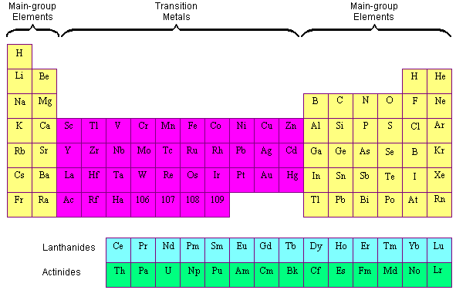
The Transition Elements

Slide 32
Position of the Transition Elements in the Modern Periodic Table
The position of the transition elements are shown below.
Look at your periodic table. What are some examples of transition elements?

Slide 33
Position of the Transition Elements in the Modern Periodic Table
The inner transition elements are usually dropped out of their proper places, and written separately at the bottom of the Periodic Table.
The reason for this is not very subtle. If you put them where they should be, everything has to be drawn slightly smaller to fit on the page.
That makes it more difficult to read.

Slide 34
Most periodic tables stop at the end of the second inner transition series.
Some continue beyond that to include a small number of more recently discovered elements.
New elements are still being discovered, although they are highly radioactive and have incredibly short existences. Knowing where they are in the Periodic Table, however, means that you can make good predictions about what their properties would be.

Slide 35
What is a Trend?

Slide 36
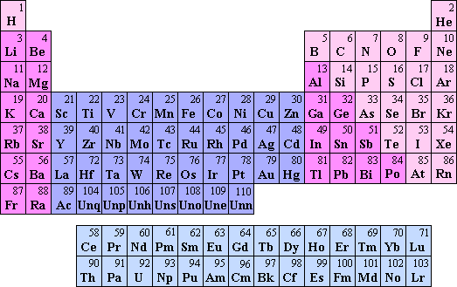
Periodic Table Trends

Slide 37
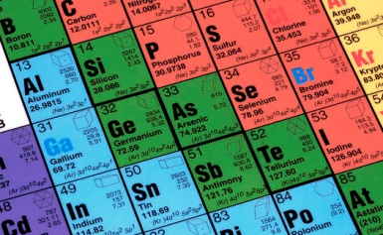
Periodic Table Trends
The Periodic Table is arranged according to the Periodic Law.
The Periodic Law states that when elements are arranged in order of increasing atomic number, their physical and chemical properties show a periodic pattern.

Slide 38
Activity – Trends in Atomic Radius
Look at the partial Periodic Table below.
The values are the atomic radius in pm. Copy the table and answer the questions which follow.
Li 145 | Be 112 | B 85 | C | N 65
Na 186 | Mg 150 | Al | Si 110 | P 100
K 220 | Ca | 1pm = | 1/1000000000000 | of a metre
Rb 248 | Sr 215 |  | (one trillionth)
Cs 260 | Ba 215

Slide 39
1. What appears to be the trend in atomic radius as you move from left to right in a row?
(Atomic radius decreases across a row)
2. What appears to be the trend in atomic radius as you move down a column?
(Atomic radius increases down a group)
3. Predict the atomic radius C.
(70pm)
4. Predict the atomic radius of Al.
(125pm)
5. Predict the atomic radius of Ca.
(180pm)
6. Is the pattern of atomic radius absolute or general (always true or generally true)?
(general)

Slide 40
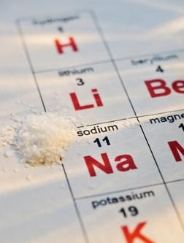
Electronic Configuration & The Periodic Table
Elements in the same group display similar chemical properties because they have similar electronic configurations.
There are seven periods in the periodic table. As you move along a period, the properties of the elements slowly change, from metals on the left hand side to non-metals on the right hand side.

Slide 41
Trends in Groups & Periods
The elements in the periodic table are arranged in such a manner that there are trends in their physical and chemical properties in a particular group and in a particular period.
Look at the electronic configuration of the elements in your periodic table, are there:
any similarities between the elements in the same period?
any similarities between the elements in the same group?

Slide 42
Electronic Configuration of the first 20 Elements
 | GROUPS
 |  | I | II | III | IV | V | VI | VII | 0
 | I | H (1) |  |  |  |  |  |  | He (2)
 | II | Li (2,1) | Be (2,2) | B (2,3) | C (2,4) | N (2,5) | O (2,6) | F (2,7) | Ne (2,8)
 | III | Na (2,8,1) | Mg (2,8,2) | Al (2,8,3) | Si (2,8,4) | P (2,8,5) | S (2,8,6) | Cl (2,8,7) | Ar (2,8,8)
 | IV | K (2,8,8,1) | Ca (2,8,8,2)

Slide 43
Similarities in Electronic Configuration of Elements in the same Group
1. All elements in the same group have the same number of electrons in the outermost shell, i.e., they have the same number of valence electrons.
2. The number of valence electrons is equal to the group number.
3. All elements in group 0 have a full outermost shell.

Slide 44
Similarities in Electronic Configuration of Elements in the same Period
1. All elements in the same period have their outermost electrons in the same shell. For example, lithium and sulphur are both in Period 2 and their outermost electrons are in the second shell.
2. The period number is an indication of the number of occupied shells in an atom, i.e. the number of shells which contain electrons. For example, calcium is in Period 4 and its electrons occupy four shells.

Slide 45
Determining Electronic Configuration from Period & Group Number
Do you think you can determine the electronic configuration of an atom from the period number and group number? How?

Slide 46
Answer
Yes!
Example:
Knowing an atom is in Group IV and Period 3 of the periodic table tells us that the outermost shell of the atom contains four electrons and its atom has three shells which contain electrons. The electronic configuration is therefore (2,8,4)

Slide 47
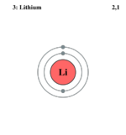
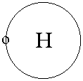
Relationship between Groups & Shells
As you move down a group, an extra shell is added.
For example, hydrogen has one shell followed by lithium which has two shells.

Slide 48
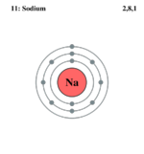
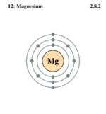
Relationship between Periods & Electrons
As you move along a period, another electron is added to the outermost shell.
For example, sodium has one electron in shell 3, followed by magnesium which has two electrons in shell 3.

Slide 49
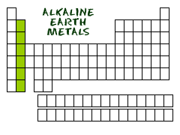
The Elements in Group II

Slide 50
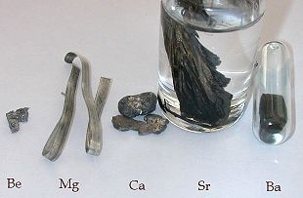
The Elements in Group II
The elements in Group II are all metals which are very chemically reactive and are never found free in nature.
The elements in Group II are collectively known as the alkaline earth metals.

Slide 51
Properties of Elements in Group II
Group II elements have the following common properties. They are:
soft metals
silvery-white when freshly cut, but turn dull very quickly owing to their reaction with air. The dullness is an oxide layer that forms on the metal when it reacts with oxygen in the air

Slide 52
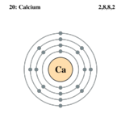
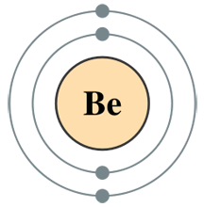
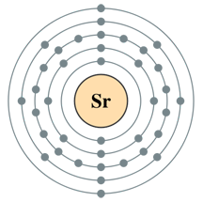
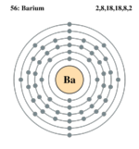
have two valence electrons

Slide 53
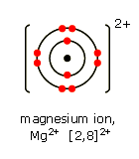
readily lose the valence electrons to form metal cations with a charge of 2+, eg Mg²⁺, Ba²⁺

Slide 54
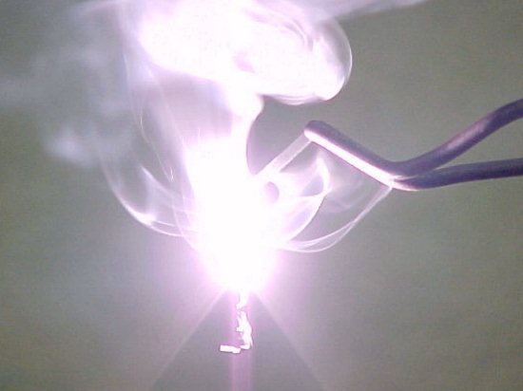
react with oxygen to form basic metal oxides, e.g. magnesium reacts with oxygen to form magnesium oxide

Slide 55
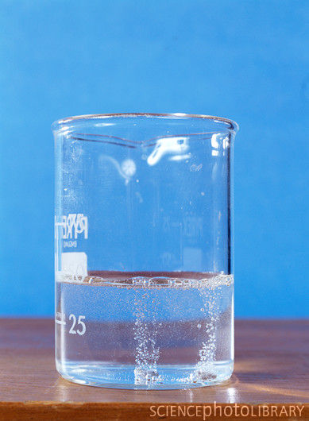
react with water to form metal hydroxides and hydrogen gas, e.g. magnesium reacts with water to form magnesium hydroxide and hydrogen gas

Slide 56
react with dilute hydrochloric acid to from metal chlorides and hydrogen gas, e.g. magnesium reacts with dilute hydrochloric acid to form magnesium chloride and hydrogen gas.

Slide 57
Periodicity in Group II
Questions: Look at your copy of the Periodic Table.
1. What do the elements in Group II have in common?
2. What is different about the elements in Group II?

Slide 58
Periodicity in Group II
Elements in Group II all have very similar properties because their atoms all have two valence electrons.
However, as one moves down Group II the number of occupied shells increases, resulting in an increase in the radii of the atoms.
The inner shells ‘shield’ the valence electrons from the attractive pull of the positive nucleus.

Slide 59
The greater the ‘shielding’ effect, the more readily the atom will lose its valence electrons to form an ion, i.e. ionise.
The larger the atom, the more readily it ionises and the more reactive it is.
The reactivity of the metals in Group II therefore, increases as one moves down the group as does their metallic nature.
Beryllium (Be) is the least reactive element and radium (Ra) is the most reactive element.

Slide 60
Reactions of Group II Elements
This trend in Group II can be demonstrated by investigating the reactivity of magnesium, calcium and barium with oxygen, water and dilute hydrochloric acid.
The ease with which the metal reacts is called the reactivity of the metal.
How fast or how vigorously these three metals react with oxygen, water and dilute hydrochloric acid can be compared to rank them in order from most reactive to least reactive.

Slide 61
Reactions of Group II Elements
See
Table 1: Reactions of Group II Elements with Oxygen, Water and dilute Hydrochloric Acid.
1. Which element is the most reactive?
Barium
2. Which element is the least reactive?
Magnesium

Slide 62
Reactions of Group II Elements
From the trends in the reactivity of the Group II metals, one can predict the reactivity of beryllium, strontium and radium.
What would you expect their reactivity to be?

Slide 63
Reactions of Group II Elements
We would expect beryllium to be the least reactive of the elements in the group and radium the most reactive, and the reactivity of strontium to be greater than that of calcium but less than barium.

Slide 64
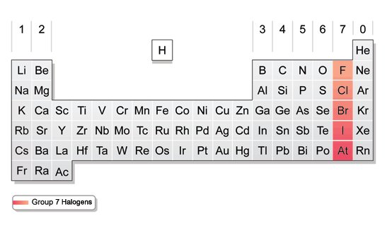
The Elements in Group VII

Slide 65
The Elements in Group VII
The elements in Group VII display similar properties an react very readily with metals to form salts.
The elements in Group VII are collectively known as the halogens.

Slide 66
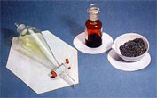
Properties of Elements in Group VII
Group VII elements have the following common properties. They:
are poisonous non-metals
exist as diatomic molecules, e.g. F₂, Cl₂, Br₂ and I₂
have low melting points and boiling points

Slide 67
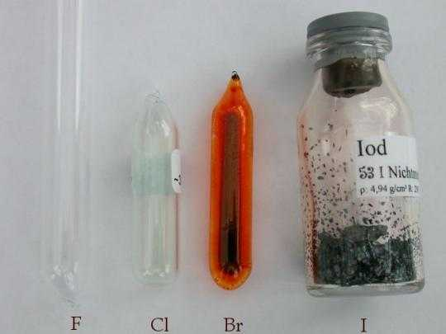
have varying colours – fluorine is pale yellow, chlorine is yellowish green, bromine is reddish brown and iodine is greyish black with a metallic shine

Slide 68
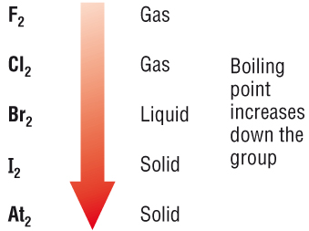
exist in different states at room temperature – at room temperature, fluorine and chlorine are gases, bromine is a liquid and although iodine is a solid, it sublimes at just above room temperature

Slide 69
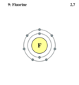
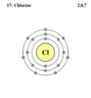
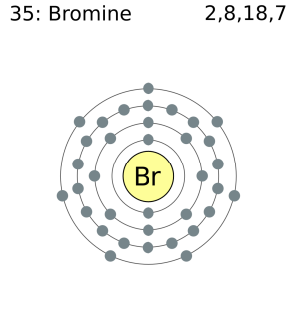
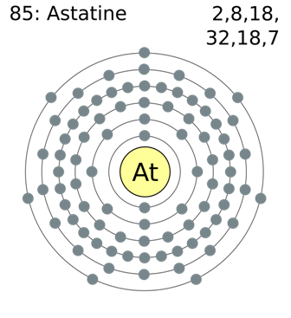
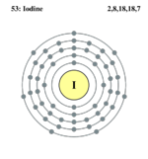
have seven valence electrons

Slide 70
are soluble in non-polar solvents, e.g. organic solvents
readily accept an electron to form non-metal anions with a charge of 1-, e.g. F⁻, Cl⁻, Br ⁻
readily share an electron with other non-metal atoms

Slide 71
Periodicity in Group VII
Elements in Group VII have very similar properties because their atoms all have seven valence electrons.
As in Group II, as one moves down Group VII the number of occupied shells increases. In this group, however, the greater the ‘shielding’ effect the less readily the atom will gain an electron into its valence shell to form an ion.
(2, 7)
(2, 8, 7)
(2, 8, 18, 7)
(2, 8, 18, 18, 7)
(2, 8, 18, 32, 18, 7)

Slide 72
Periodicity in Group VII
The smaller the atom, the more readily it ionises and the more reactive it is. The reactivity of the non-metals in Group VII therefore increases as one moves up the group as does their non-metallic nature.
Fluorine (F) is the most reactive element and astatine (At) is the least reactive element in Group VII.

Slide 73
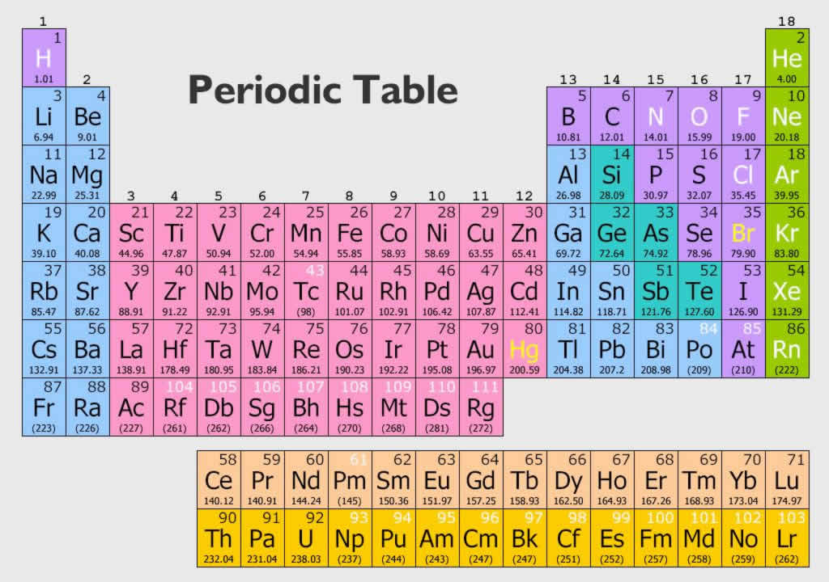
Trends in Atomic Radii & Electronegativity

Slide 74
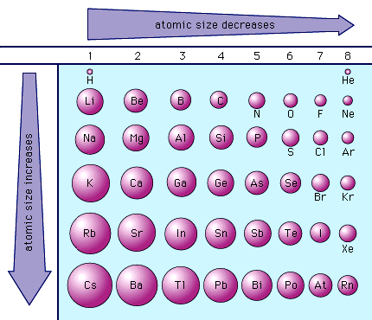
Trend in Atomic Radii Down Groups
Question: What is the trend in atomic radius? Suggest a reason for this trend.

Slide 75
Trend in Atomic Radii Down Groups
Answer: The atomic radius increases down the group because new shells are being added as we move down the group and the electrons are further away from the nucleus so the attraction between the nucleus and the electron is smaller.

Slide 76
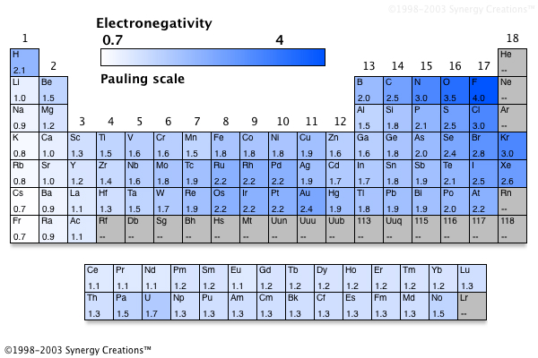
Trend in Electronegativity
Electronegativity the amount of pull that one atom exerts on the electrons that it is sharing with other atoms

Slide 77
Trend in Electronegativity
Question: What is the trend in electronegativity? Suggest a reason for this trend.

Slide 78
Trend in Electronegativity
When you go from one atom to another down a group, you are adding one more energy level of electrons for each period.
The increased shielding nearly balances the increased nuclear charge and the predominant factor is the number of energy levels that are used by the electrons.
So as you go from fluorine to chlorine to bromine and so on down the periodic table, the electrons are further away from the nucleus and better shielded from the nuclear charge and thus not as attracted to the nucleus.
For that reason the electronegativity decreases as you go down the periodic table.

Slide 79
Summary
In this lesson we learnt about:
The history of the development of the Periodic Table.
Arrangement of elements in the Periodic Table into Groups & Periods.
Symbols and representation of elements from atomic numbers 1-20

Slide 80
Summary
Structure of elements from atomic numbers 1-20.
Trends in Groups II & VII.
Trends in atomic radii & electronegativity.

