Slide 1
Chemical Equations

Slide 2
Laws
The Law of Conservation of Mass
In a chemical reaction the total mass of everything at the end of the reaction is the same as the total mass at the beginning.
The Law of Constant Composition
However you make a compound, it always contains the same elements in the same proportions by mass.

Slide 3
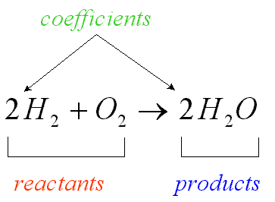
Chemical Equations
Chemical equations use symbols and formulae to represent chemical change.

Slide 4
Chemical Formula
Examples:
2H – 2 atoms of hydrogen, not bonded together.
The 2 is called a coefficient.
H₂ – 1 molecule of hydrogen, made up of 2 atoms of hydrogen bonded together.
2H₂ – 2 molecules of hydrogen, in total 4 atoms of hydrogen.

Slide 5
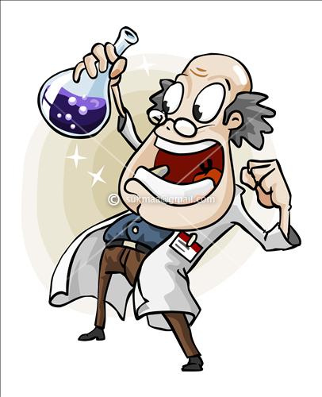
Chemical Formula
Examples:
Ca(OH)₂ – 1 Ca²⁺ and 2 OH⁻
So the amount of each element is 1Ca, 2O and 2H atoms.
3H₂SO₄ – consists of 6H, 3S and 12O atoms.

Slide 6
Writing Chemical Equations
The conventions which are used when writing chemical equations are:
The reactants are placed on the left side of the equation and the products are placed on the right side with an arrow (→) separating reactants from products.
A plus sign (+) separates each reactant or product.
The physical state of the chemical is usually written as a subscript. These physical states are:
(s) – solid, (l) – liquid, (g) – gas, (aq) – aqueous

Slide 7
Other chemicals and factors which are required for the reaction to occur but do not change during the reaction can be written above the arrow, e.g. catalysts, a specific temperature, a specific pressure.
If a reaction is reversible a double arrow is used :
When reading a chemical equation, each of the signs represents a word or statement.
Example: 2Fe_{(s)} + 3Cl_{(g)} → 2FeCl_{3(s)}
‘Solid iron reacts with chlorine gas to form solid iron (III) chloride’

Slide 8
Balancing Chemical Equations

Slide 9
When is a scale balanced?

Slide 10
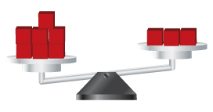
What do we need to do to balance the scale below?

Slide 11
Balancing Chemical Equations
Early chemists noticed that in a chemical reaction, the total mass of the reactants always equalled the total mass of the products. This led to the Law of Conservation of Mass which states that matter can neither be created nor destroyed.

Slide 12
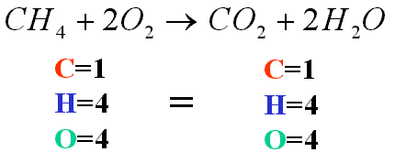
Atoms in a chemical equation are neither created nor destroyed; they are only rearranged. A chemical equation that conforms to this law is known as a balanced chemical equation.
In a balanced chemical equation there must be the same number of atoms of each element on the right hand side of the equation as there are on the left hand side.
When an equation is balanced, the mass of the reactants will equal the mass of the products.

Slide 13
Example 1
Balance the equation: Zn_{(s)} + HCl_{(aq)} → ZnCl_{2(aq)} + H_{2(g)}
To balance, we need 2 H and 2 Cl on the left. Therefore, we put a 2 in front of HCl.
We get, Zn_{(s)} + 2HCl_{(aq)} → ZnCl_{2(aq)} + H_{2(g)}
Atom | Zn + HCl | ZnCl₂ + H₂
Zn | 1 | 1
H | 1 | 2
Cl | 1 | 2
Atom | Zn + 2HCl | ZnCl₂ + H₂
Zn | 1 | 1
H | 2 | 2
Cl | 2 | 2

Slide 14
Example 2
Balance the equation: N_{2(g)} + H_{2(g)} → NH_{3(g)}
We need 2 N on the right, so we put a 2 in front of NH₃
We need 6 H on the left, so we put a 3 in front of H₂
We get, N_{2(g)} + 3H_{2(g)} → 2NH_{3(g)}
Atom | N₂ + H₂ | NH₃
N | 2 | 1
H | 2 | 3
Atom | N₂ + H₂ | 2NH₃
N | 2 | 2
H | 2 | 6
Atom | N₂ + 3H₂ | 2NH₃
N | 2 | 2
H | 6 | 6

Slide 15
Example 3
Balance the equation: Fe_{(s)} + H₂SO_{4(aq)} → Fe₂(SO₄)_{3(aq)} + H_{2(g)}
We need 2 Fe and 3 SO₄ on the left, so we put a 2 in front of Fe and a 3 in front of H₂SO₄
We need 6 H on the right, so we put a 3 in front of H₂
Atom | Fe + H₂SO₄ | Fe₂(SO₄)₃ + H₂
H | 2 | 2
Fe | 1 | 2
SO₄ | 1 | 3
Atom | 2Fe + 3H₂SO₄ | Fe₂(SO₄)₃ + H₂
H | 6 | 2
Fe | 2 | 2
SO₄ | 3 | 3
Atom | 2Fe + 3H₂SO₄ | Fe₂(SO₄)₃ + 3H₂
H | 6 | 6
Fe | 2 | 2
SO₄ | 3 | 3
We get, 2Fe_{(s)} + 3H₂SO_{4(aq)} → Fe₂(SO₄)_{3(aq)} + 3H_{2(g)}

Slide 16
Example 4
Balance the equation: C₃H_{8(g)} + O_{2(g)} → CO_{2(g)} + H₂O_{(g)}
To balance, put a 3 in front of CO₂ and a 4 in front of H₂O
To balance the O, put a 5 in front of O₂
Atom | C₃H₈ + O₂ | CO₂ + H₂O
C | 3 | 1
H | 8 | 2
O | 2 | 2 1
Atom | C₃H₈ + O₂ | 3CO₂ + 4H₂O
C | 3 | 3
H | 8 | 8
O | 2 | 6 4
Atom | C₃H₈ + 5O₂ | 3CO₂ + 4H₂O
C | 3 | 3
H | 8 | 8
O | 10 | 6 4
We get, C₃H_{8(g)} + 5O_{2(g)} → 3CO_{2(g)} + 4H₂O_{(g)}

Slide 17
Example 5
You try it!
Balance the equation: C₂H_{6(g)} + O_{2(g)} → CO_{2(g)} + H₂O_{(g)}
Answer: 2C₂H_{6(g)} + 7O_{2(g)} → 4CO_{2(g)} + 6H₂O_{(g)}

Slide 18
Examination Tips
When balancing chemical equations its is best to begin with an element other than hydrogen or oxygen.
Start with the elements immediately after the arrow, excluding hydrogen and oxygen.
Balance the hydrogen atoms second from last and oxygen atoms last.

Slide 19
Calculations from Equations

Slide 20
Limiting Reactant & Excess Reactant
Limiting Reactant - The reactant in a chemical reaction that limits the amount of product that can be formed. The reaction will stop when all of the limiting reactant is consumed.
Excess Reactant - The reactant in a chemical reaction that remains when a reaction stops when the limiting reactant is completely consumed.

Slide 21
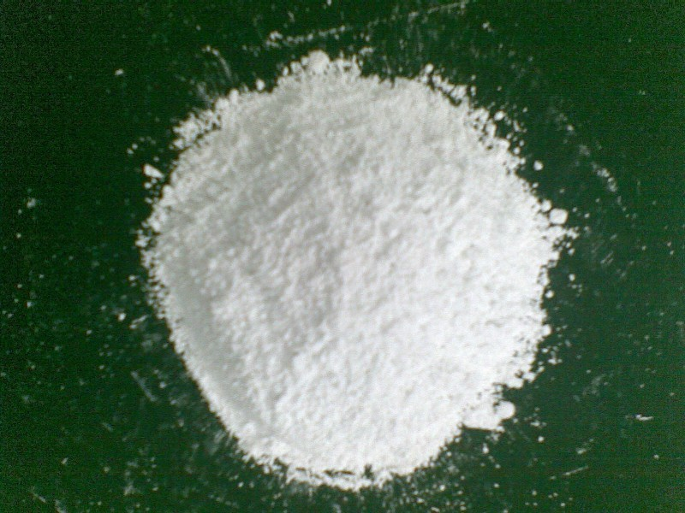
Example
When limestone, CaCO₃, is heated, calcium oxide is formed.
Calculate the mass of calcium oxide which would be produced by heating 25g of limestone.
(Relative atomic masses: C = 12; O = 16; H = 1)

Slide 22
Answer
CaCO_{3(s)} → CaO_{(s)} + CO_{2(g)}
1 mol CaCO₃ produces 1 mol CaO_{(s)}
100g CaCO_{3(s)} (1 mol) produces 56g (1 mol) CaO_{(s)}
If 100g CaCO_{3(s)} gives 56g CaO_{(s)}
Then 1g CaCO₃ will give 56 g CaO_{(s)}
100
And, 25g CaCO₃ will give 56 x 25 g CaO_{(s)}
100
= 14g CaO

Slide 23
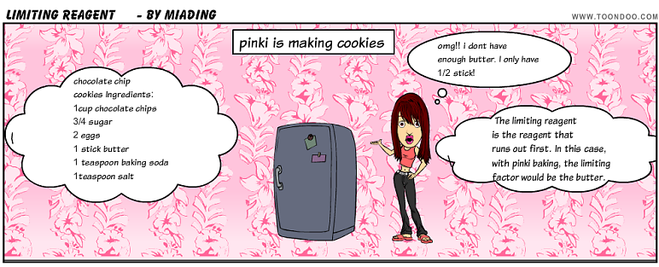
Worksheet
Calculations based on Chemical Equations.

Slide 24
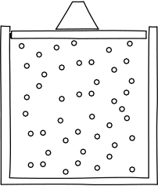
Calculations involving Gas Volumes

Slide 25
Calculations Involving Gas Volumes
Units of Volume
Volumes (of gases or liquids) are measured in cubic centimetres (cm³) or
cubic decimetres (dm³) or
litres (l).
1 litre = 1 dm³ = 1000cm³

Slide 26
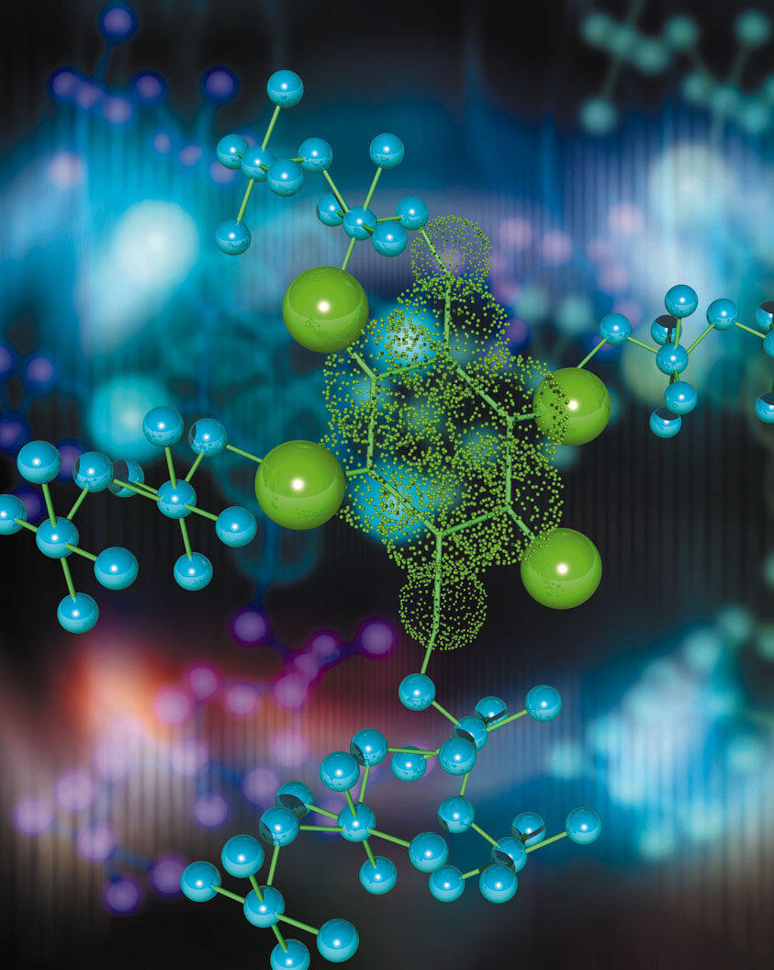
Avogadro’s Law
Equal volumes of gases at the same temperature and pressure contain equal numbers of molecules.

Slide 27
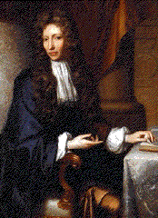
The Molar Volume of a Gas
1 mole of any gas occupies 24 dm³ (24 000 cm³) at rtp (room temperature and pressure).
1 mole of any gas occupies 22.4 dm³ (22 400 cm³) at stp (standard temperature and pressure).

Slide 28
Example 1
Calculate the volume of carbon dioxide produced at room temperature and pressure when an excess of dilute hydrochloric acid is added to 1.00 g of calcium carbonate.
(RAMs: C = 12; O = 16; Ca = 40. Molar volume = 24 dm³ at rtp)

Slide 29
Answer
CaCO_{3(s)} + 2HCl_{(aq)} → CaCl_{2(aq)} + CO_{2(g)} + H₂O_{(l)}
1 mol CaCO₃ gives 1 mol CO₂
100 g CaCO₃ gives 24dm³ CO₂ at rtp
1 g CaCO₃ gives 1 x 24 dm³ CO₂
100
= 0.24 dm³ CO₂

Slide 30
Example 2
What is the maximum mass of aluminium which you could add to an excess of dilute hydrochloric acid so that you produced no more than 100 cm³ of hydrogen at room temperature and pressure?
(RAM: Al = 27. Molar volume = 24 000 cm³ at rtp)
N.B. In this example, dilute hydrochloric acid is in excess and aluminium is the limiting reactant.
Using an excess of dilute hydrochloric acid ensures that all of the aluminium reacts completely.

Slide 31
Answer
2Al_{(s)} + 6HCl_{(aq)} → 2AlCl_{3(aq)} + 3H_{2(g)}
2 mol Al gives 3 mol H₂
(2x27)g Al gives (3x24000)cm³ H₂
54 g Al gives 72000 cm³ H₂
72 000 cm³ H₂ comes from 54 g Al
100 cm³ H₂ comes from 54 x 100 g Al
72000
= 0.075 g Al

Slide 32
Worksheet
1. Carbon monoxide burns according to the equation:
2CO_{(g)} + O_{2(g)} → 2CO_{2(g)}
(a) Calculate the volume of oxygen needed for the complete combustion of 100 cm³ of carbon monoxide.
(b) What volume of carbon dioxide will be formed?

Slide 33
Worksheet
2. Calculate the volume of hydrogen (measured at room temperature and pressure) obtainable by reacting 0.240 g of magnesium with an excess of dilute sulphuric acid. (RAM: Mg = 24. Molar volume = 24 000 cm³ at rtp)
Mg_{(s)} + H₂SO_{4(aq)} → MgSO_{4(aq)} + H_{2(g)}

Slide 34
Percentage Yield
In theory, a reaction may be shown to produce a certain amount of product. However, some product may be left on the apparatus or some might be spilled.

Slide 35
Percentage Yield Example
If your calculation shows that you should get 10 g of product but you only recover 9 g, then your yield is 9 g out of a possible 10 g.
Percentage Yield = 9 x 100
10
= 90 %

