Slide 1
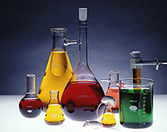
Separating Mixtures

Slide 2
Mixtures & Their Separation
Mixtures, elements and their compounds from a part of our everyday lives.
Every time we breathe we are inhaling an element, oxygen gas.
When we place salt on our food we are eating a compound, sodium chloride.
When we drink a cold soft drink we are drinking a mixture.
It may be useful to know how to separate some of these mixtures into their component parts. An example of this is the purification of drinking water.

Slide 3
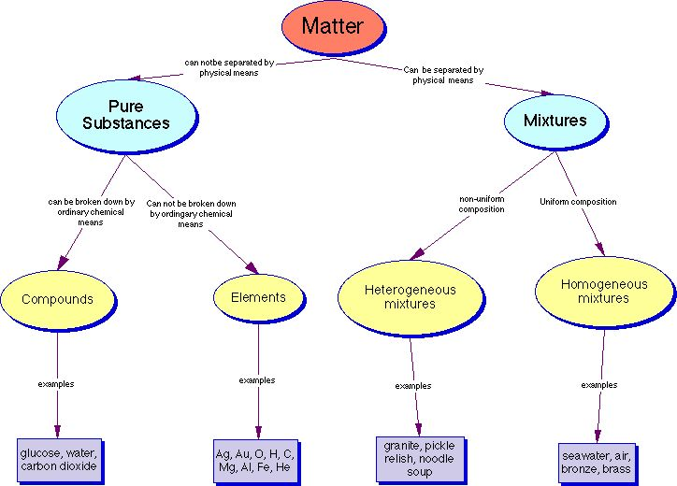
Elements, Compounds & Mixtures

Slide 4
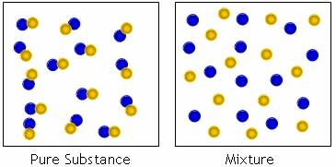
Elements, Compounds & Mixtures
Matter can be classified into two main groups: pure substances and mixtures.

Slide 5
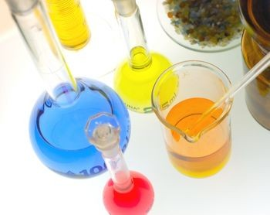
Elements, Compounds & Mixtures
Pure substances are a type of mixture where the component parts cannot be separated by physical means and the composition is constant.
Mixtures are a type of matter where the components can be separated by physical means.

Slide 6
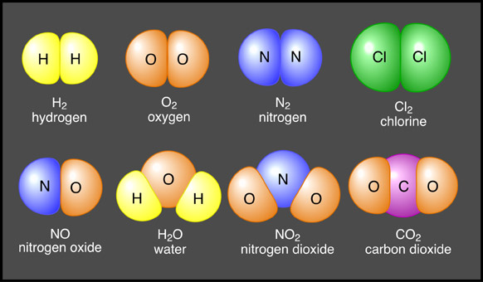
Elements, Compounds & Mixtures
Pure substances can be further classified into elements and compounds.
Question: What is the difference between an element and a compound?

Slide 7
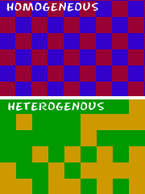
Elements, Compounds & Mixtures
Mixtures can be further classified into homogenenous and heterogeneous mixtures.

Slide 8
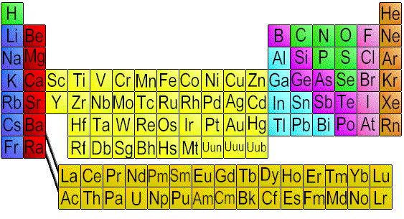
Elements
An element is a pure substance that cannot be broken down into any simpler substance by ordinary chemical or physical means. We use the term ‘ordinary chemical means’ to exclude nuclear reactors.

Slide 9
Elements
The smallest particle in an element which has the same properties as the element is an atom. Elements are composed of only one kind of atom.
Question: What are some examples of elements?

Slide 10
Compounds
A compound is a pure substance that contains two or more different types of elements which are chemically combined in such a way that their properties change.

Slide 11
Compounds
Compounds are composed of more than one kind of atom, which will always be in the same proportion by mass.
A compound can be represented by a formula which indicates the elements that the compound is made up of, and the ratio in which they have combined.
Examples of compound are water (H₂O), sodium chloride (NaCl) and methane (CH₄).
The components of a compound cannot be separated by physical means.

Slide 12
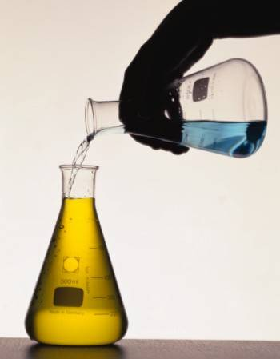
Mixtures

Slide 13
Mixtures
Mixtures are a type of matter where components are not chemically combined and can be separated by physical means.
Some of the physical methods of separating mixtures which will be investigated in our next lesson are filtration, evaporation, simple distillation, fractional distillation and paper chromatography.
In a mixture the component parts are not in a fixed ratio and they retain their physical properties.

Slide 14
Homogeneous & Heterogeneous Mixtures
Mixtures can be either homogeneous or heterogeneous.

Slide 15
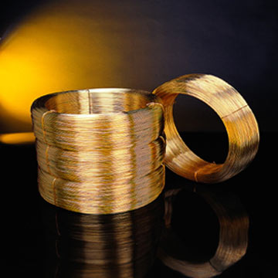
Homogeneous Mixtures
Homogeneous mixtures are mixtures in which the properties and composition are uniform throughout the sample.
We cannot distinguish the component parts from each other.
Examples – air, salt dissolved in water and metal alloys like brass (a mixture of copper and zinc)

Slide 16
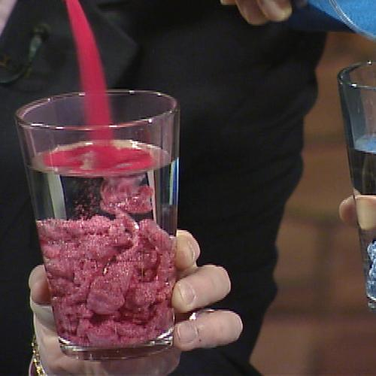
Heterogeneous Mixtures
Heterogeneous mixtures are mixtures in which the properties and composition are not uniform throughout the sample.
We can distinguish the components parts from each other.
Examples – mixtures of salt and pepper, sand and water, and mayonnaise.

Slide 17
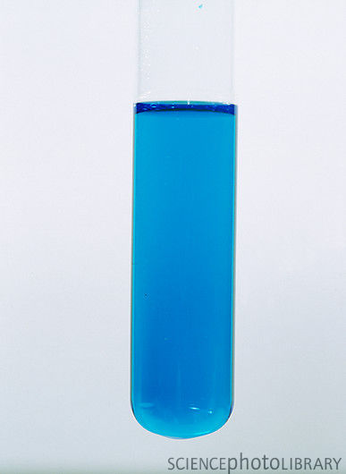
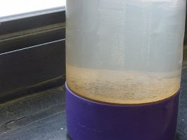
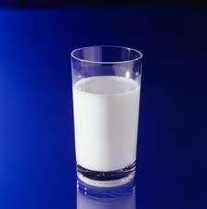
Solutions, Suspensions & Colloids

Slide 18
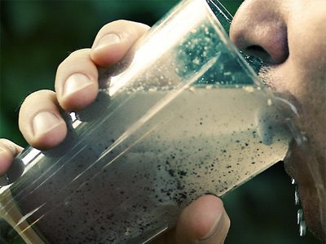
Solutions, Suspensions & Colloids
Solutions, suspensions and colloids form part of our everyday lives. For example, sea water is a solution, muddy water is a suspension and milk and fog are both colloids.

Slide 19
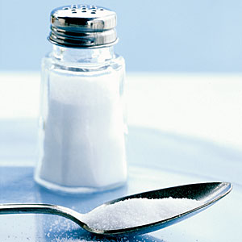
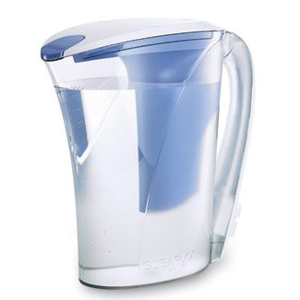
Solutions
Questions:
1. What will happen if we mix a teaspoon of salt into a pitcher of water?
2. What is happening to the salt? Is it disappearing or is it still there?

Slide 20
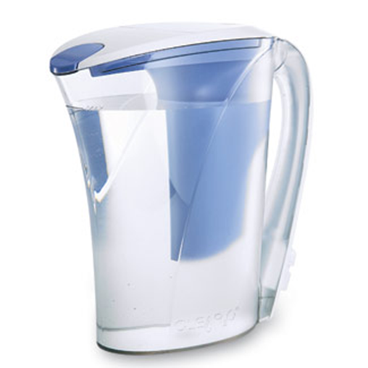
Solutions
Solutions are homogeneous mixtures consisting of two or more components. The major component of a solution is known as the solvent and the minor component is known as the solute.

Slide 21
Solutions
Question: In the salt and water example, what was the solute and what was the solvent?
In a mixture of salt and water, salt is the solute and water is the solvent.

Slide 22
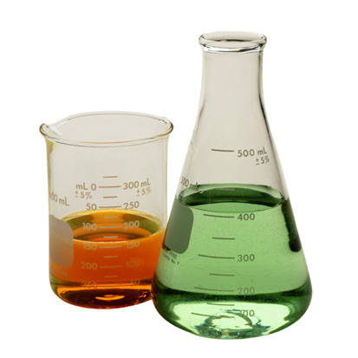
Solutions
The solute and the solvent can be either gases, liquids or solids.
When a gas or a solid dissolve in a liquid, the liquid is always the solvent.

Slide 23
Examples of Solutions
Solute | Solvent | Example | Components of Solution
Solid | Liquid | Sea water | Salt in water
Gas | Liquid | Soda water | CO₂ in water
Solid | Solid | Brass | Zinc in copper
Liquid | Liquid | Rum | Ethanol in water
Gas | Gas | Air | O₂, Ar & CO₂ in N₂

Slide 24
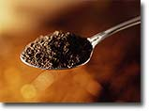
Suspensions
Questions:
1. What will happen if we mix a teaspoon of dirt into a pitcher of water?
2. What did this happen?
3. What will happen to the mixture eventually?

Slide 25
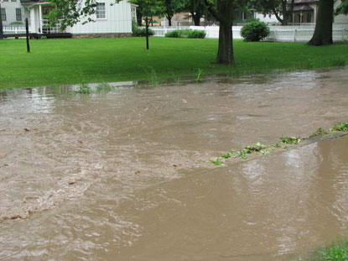
Suspensions
A suspension is a heterogeneous mixture where minute but visible particles are dispersed in another substance, usually a liquid. Muddy water is an example of a suspension.

Slide 26
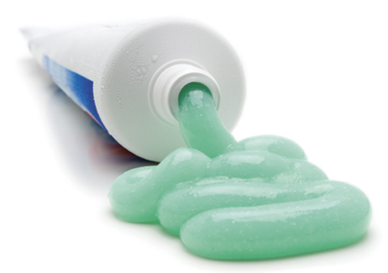
Colloids
Question: Would you classify toothpaste as a solution or a suspension? Why?

Slide 27
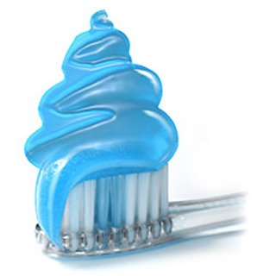
Colloids
Colloids are heterogeneous mixtures which have properties somewhere between that of a solution and a suspension. An example of a colloid is toothpaste.

Slide 28
Other Examples of Colloids
Fog is a colloid where a gas is dispersed in a liquid; also known as a liquid aerosol.

Slide 29
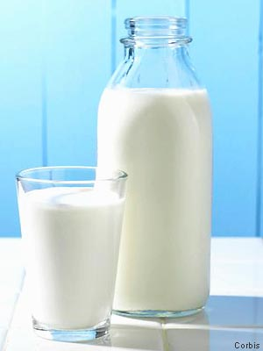
Other Examples of Colloids
Milk is a colloid where a liquid is dispersed in a liquid; also known as an emulsion.

Slide 30
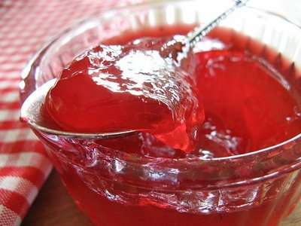
Other Examples of Colloids
Jelly is a colloid where a solid is dispersed in a liquid; also known as a gel.

Slide 31
Comparison of Solutions, Suspensions & Colloids
A comparison of the distinguishing features of solutions, suspensions and colloids is given in the table (see hand-out).

Slide 32
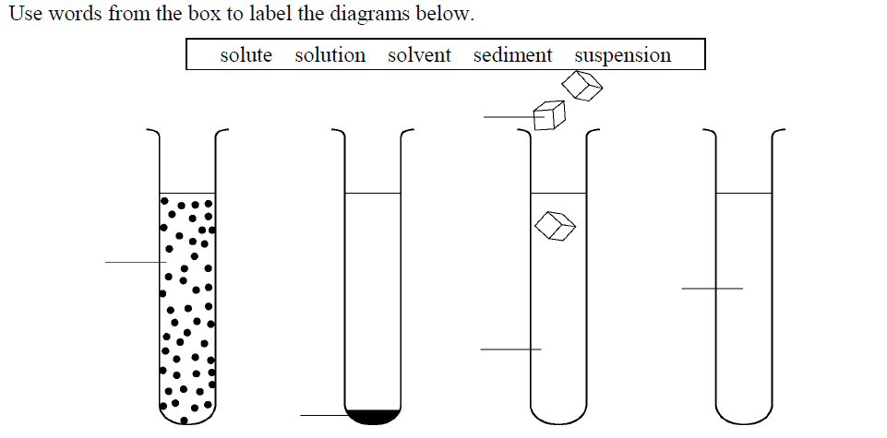
Worksheet – Question 1

Slide 33
Worksheet – Question 2
Underline the correct word from the choices given in each sentence below.
(a) A solute is dissolved in a solvent/solution.
(b) Soluble/insoluble substances do not dissolve.
(c) When an insoluble substance settles to the bottom of a liquid, it forms a suspension/sediment.
(d) A mixture in which some or all of the particles settle out is called a solution/suspension.

Slide 34
(e) A mixture in which the particles can be filtered out is called a solution/suspension.
(f) A colloid/suspension is a mixture that contains particles that are larger than the particles in a
solution but smaller than those in a suspension.
(g) A colloid in which tiny droplets of one liquid are spread evenly throughout another liquid is called
an emulsion/suspension.

Slide 35
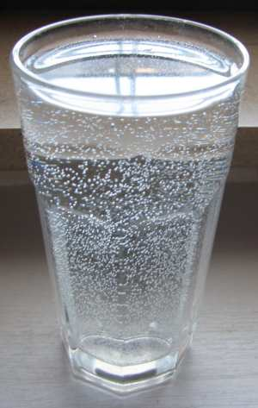
Solubility

Slide 36
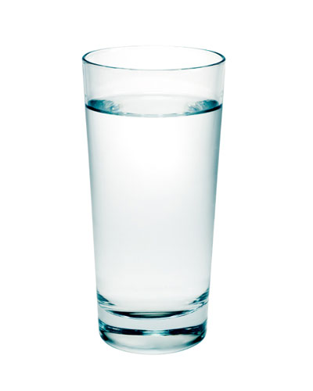
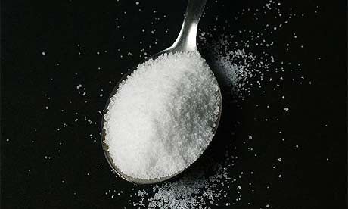
Solubility
Questions:
1. What would happen if we kept adding teaspoons of salt to a glass of water?
2. Why does this happen?

Slide 37
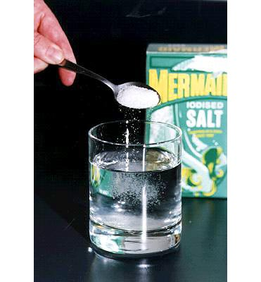
Solubility
The solubility of a solute is an indication of how much of the solute can dissolve in a fixed mass of solvent at a particular temperature.
For example, we can find the solubility of sodium chloride in water by determining how much sodium chloride can dissolve in water at a particular temperature.

Slide 38
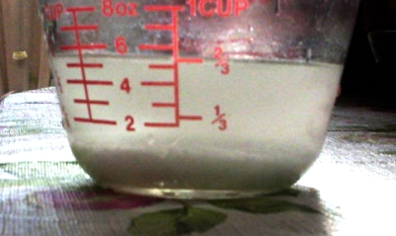
Solubility
When no more solute can be dissolved in the solvent the solution reaches saturation point and we say that the solution is saturated.

Slide 39
Solubility
If any more solute is added to the solvent, the solute will remain in solid form and will be mixed in with the saturated solution.

Slide 40
Solubility
Each solute and solvent combination has a specific solubility at a given temperature. The solubility of a solute in a solvent is determined by the structure of the solute and solvent, the temperature and the pressure.

Slide 41
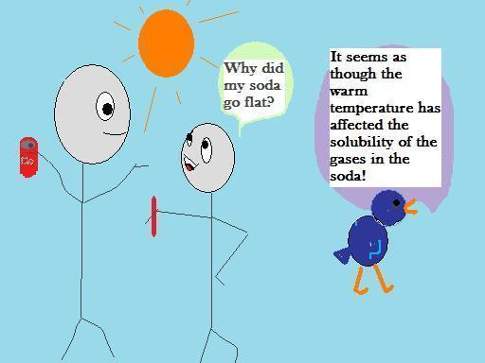
Effect of Temperature on Solubility

Slide 42
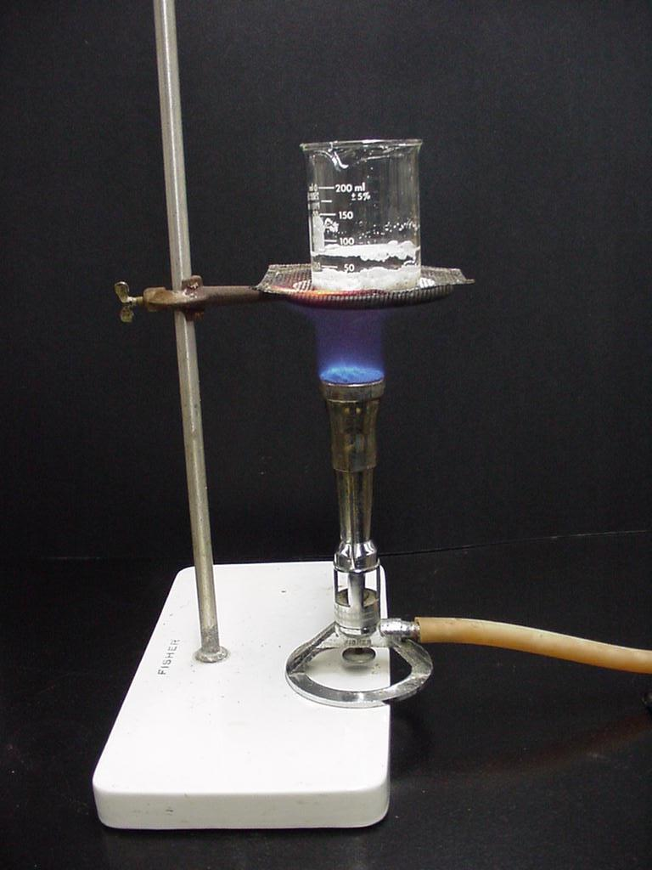
Effect of Temperature on Solubility
For most solid solutes in water, solubility increases as temperature increases.

Slide 43
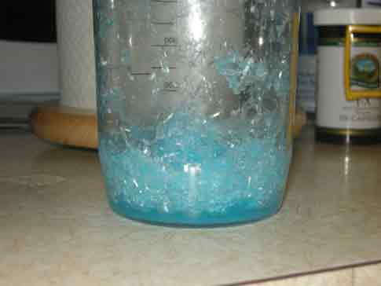
Effect of Temperature on Solubility
If a saturated solution is cooled, crystals of the solute will form since less of the solute can dissolve at the lower temperature.

Slide 44
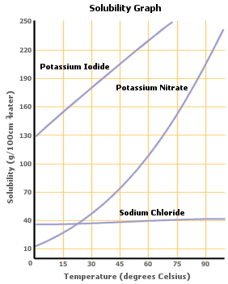
Effect of Temperature on Solubility
Solubility in water is usually expressed in grams of solute per 100g of water.
We can plot the solubility of a solute on a graph known as a solubility curve.

Slide 45
Worksheet – Question 3(a) Use the data below to plot the solubility curve for potassium nitrate.
Temperature (ºC) | Solubility of potassium nitrate (g/100g water)
0 | 18
10 | 25
20 | 30
30 | 50
40 | 70
50 | 90
60 | 110
70 | 140
80 | 170
90 | 205
100 | 245

Slide 46
3(b) Questions on solubility curve for potassium nitrate.
(i) What is the solubility of potassium nitrate at 45⁰C?
(ii) What is the solubility of potassium nitrate at 85⁰C?
(iii) At what temperature will the solubility of potassium nitrate be 100g/100g of water?
(iv) At what temperature will the solubility of potassium nitrate be 150g/100g of water?
(v) What is the effect of temperature on the solubility of potassium nitrate?

Slide 47
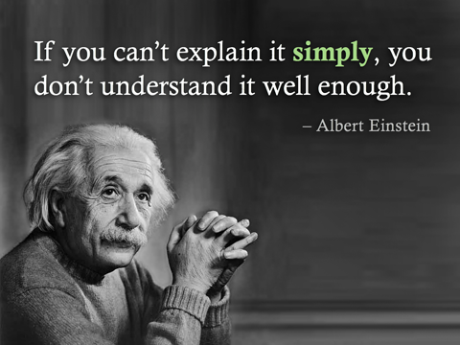
Summary
In this lesson we learnt about:
The components of solutions
Colloids and suspensions
Measuring solubility of solids and illustrating with a solubility curve

