Slide 1
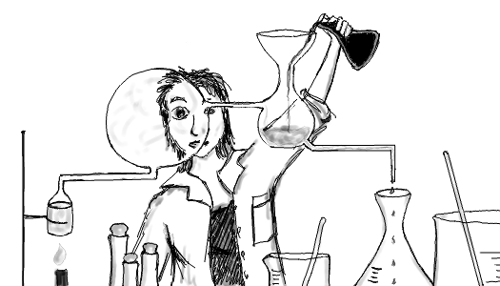
Operations of Analytical Chemistry (Chemicals, Apparatus & Units) and Calculations

Slide 2
Lesson 2 Objectives
Students should be able to:
1. Define and classify the following: reagent grade, Primary- Standard Grade and Special- Purpose Reagent Chemicals.
2. Describe the selection and handling of chemicals.
3. Outline the treatment of laboratory ware and liquid evaporation.
4. Describe the analytical balance and the following types of balances: macrobalance, semimicroanalytical balance, microanalytical balance.
5. Distinguish between the other types of analytical balances: Electronic, Single-Pan Mechanical and Auxiliary Analytical balances.

Slide 3
6. Describe the precautions and sources of errors in weighting.
7. Describe the equipment and procedures used in weighting, filtering and ignition.
8. Outline the units, apparatus and procedures used in measuring volume.
9. Use SI units of measurement and differentiate between mass (m) and weight (w).
10. Distinguish between moles and millimoles.

Slide 4
11. Solve calculations using the amount of moles and millimoles.
12. Solve calculations converting between moles and millimoles.
13. Define concentration, density and specific gravity of a solution.
14. Define and differentiate between the follow terms stoichiometry, empirical formulas, molecular formulas and structural formulas.
15. Solve calculations using stoichiometric values for mass, moles and concentration.

Slide 5
Definitions

Slide 6
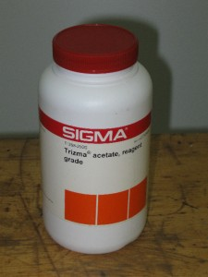
Reagent Grade Chemicals
Conform to the minimum standards set forth by the Reagent Chemical Committee of the American Chemical Society and are used whenever possible in analytical work.

Slide 7
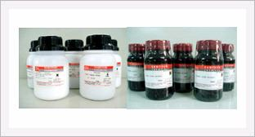
Primary Standard
A highly pure chemical compound that is used to prepare or determine the concentrations of standard solutions for titrimetry.

Slide 8
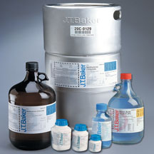
Special Purpose Chemicals
Reagents that have been specially purified for a particular end use, for example, spectrophotometry and high-performance liquid chromatography.

Slide 9
Rules for Handling Reagents & Solutions
Select the best grade of chemical available for analytical work. Try to select smallest bottle.
Replace the top of every container immediately after removal of the reagent.
Hold the stoppers of reagent bottles between your finger; never rest them on desk tops.
Unless specifically directed otherwise, never return any excess reagent to a bottle.

Slide 10
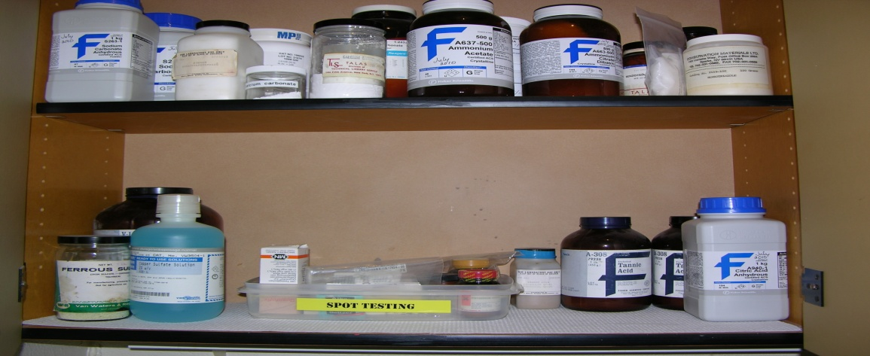
5. Unless directed otherwise, never insert spatulas, spoons, or knives into a bottle that contains a solid reagent.
6. Keep the reagent shelf and the laboratory balance clean and neat.
7. Observe local regulations concerning the disposal of surplus reagents and solutions.

Slide 11
Cleaning & Marking of Laboratory Ware
Mark all sample vessels in order to positively identify contents.
Clean all vessels before use.
Wash with hot detergent
Rinse with copious amounts of tap water
Rinse with small amounts of deionized water
N.B. - It is seldom necessary to dry
- Grease films may be removed by an
organic solvent.

Slide 12
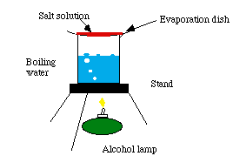
Evaporating Liquids
- Difficult to control because of bumping. Bumping can be minimized by careful and gentle heating and by the use of glass beads where permissible.

Slide 13
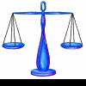
Measuring Mass
In most analyses, an analytical balance must be used to obtain highly accurate masses.

Slide 14
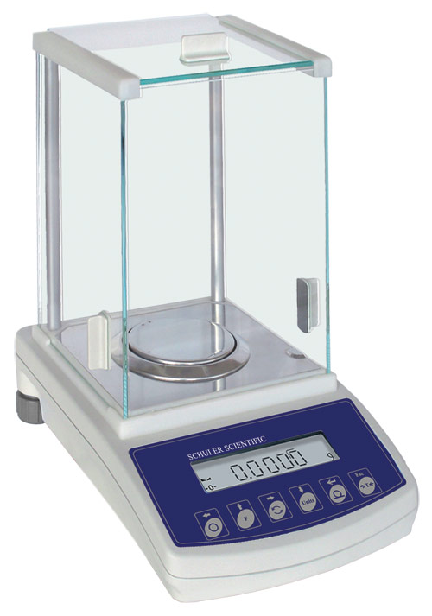
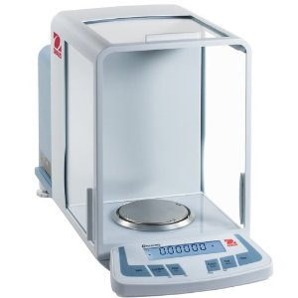
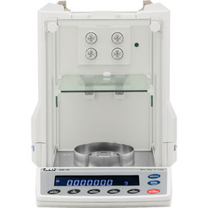
Analytical Balances
An analytical balance has a maximum capacity that ranges from 1g to several kilograms and a precision at maximum capacity of a least 1 part in 10⁵.

Slide 15
Most Common Types of Analytical Balances
Type of Analytical Balance | Maximum Load | Precision
Macrobalances | 160 g – 200 g | ± 0.1 mg
Semimicroanalytical Balances | 10 g – 30 g | ± 0.01 mg
Microanalytical Balance | 1 g – 3 g | ± 0.001 mg

Slide 16
Other Types of Analytical Balances
Group Discussion & Presentation.
Distinguish between the other types of analytical balances: Electronic, Single-Pan Mechanical and Auxiliary Analytical balances.

Slide 17
Sources of Error in Weighing

Slide 18
Sources of Error in Weighing
1. Buoyancy Error
The weighing error that develops when the object being weighed has a significantly different density than the standard masses.
Equation to make corrections for buoyancy errors for electronic balances:
W₁ = W₂ + W₂ (d_{air}/d_{obj} – d_{air}/d_{wts})
(See Example 2.1)

Slide 19
Sources of Error in Weighing
2. Temperature Error
Attempts to weigh an object whose temperature is different from that of its surroundings will result in a significant error.
Home Work: Outline other sources of error in weighing.

Slide 20
Other Types of Analytical Balances
Group Discussion & Presentation.
Describe the equipment and procedures used in weighting, filtering and ignition.

Slide 21
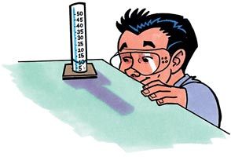
Measuring Volume
Precise measurement of volume is as important in analytical chemistry as the precise measurement of mass.
The unit of volume is the liter (L). For smaller volumes the milliliter (mL, 10⁻³ L) or the microliter (μL, 10⁻⁶ L) may be used.

Slide 22
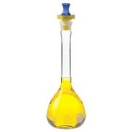
Effect of Temperature on Volume Measurements
The volume occupied by a given mass of liquid varies with temperature, as does the device that holds the liquid during measurement.

Slide 23
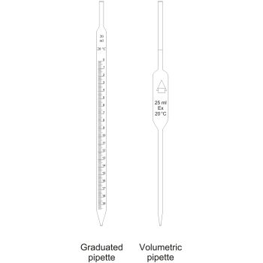
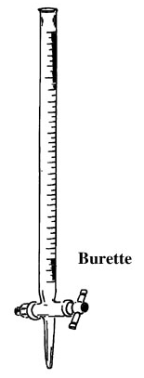
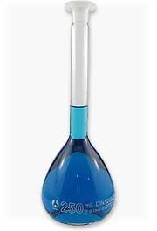
Apparatus for Precisely Measuring Volume

Slide 24
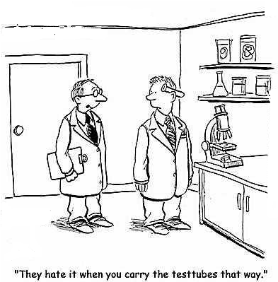
Safety in The Laboratory
Work in a chemical laboratory necessarily involves a degree of risk; accidents can and do happen.
What are three safety rules for the laboratory?

Slide 25
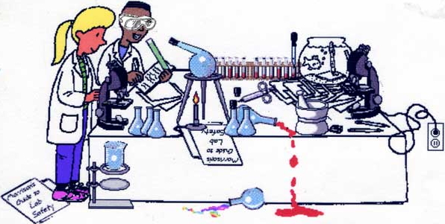
Assignment 1
CONSTRUCT (in groups of three to present to class):
A electronic copy of a poster on safety in the laboratory (Due: Next Week)

Slide 26
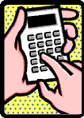
Calculations Used in Analytical Chemistry

Slide 27
SI Units of Measurement
Scientists throughout the world have adopted a standardized system of units knows as the International System of Units (SI). This system is based on the seven fundamental base units shown below.
SI Base Units
Physical Quantity | Name of Unit | Abbreviation
Mass | Kilogram | Kg
Length | Metre | m
Time | Second | s
Temperature | Kelvin | K
Amount of Substance | Mole | mol
Electric Current | Ampere | A
Luminous Intensity | Candela | cd

Slide 28
Prefixes for Units
Prefix | Abbreviation | Multiplier
Giga-
Mega-
Kilo-
Hecto-
Deca-
Deci-
Centi-
Milli-
Micro-
Nano-
Pico-

Slide 29
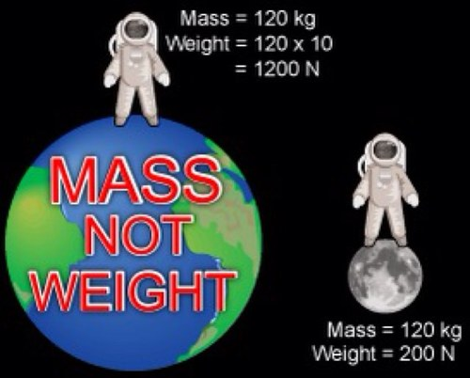
Difference Between Mass and Weight
Mass – an invariant measure of the amount of matter in an object.
Weight – force of attraction between an object and its surroundings, principally the earth.

Slide 30
The Mole

Slide 31
Definitions

Slide 32
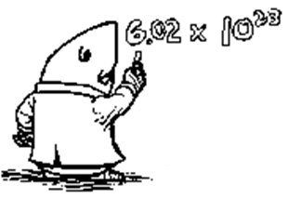
The Mole & The Millimole
Mole – the SI unit for the amount of a chemical species. A mole of a chemical species is 6.022 x 10²³ atoms, molecules, ions, electrons, ion pairs, or subatomic particles.
Millimole – 1/1000 of a mole. The mass in grams of a millimole, the millimolar mass, is 1/1000 of the molar mass.

Slide 33
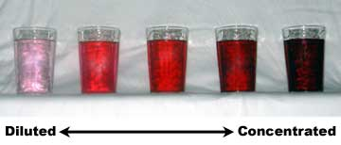
Concentration
The amount of a substance per defined space. Concentration usually is expressed in terms of mass per unit volume.

Slide 34
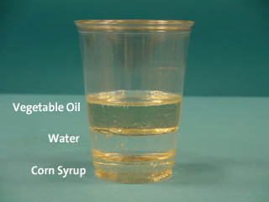
Density
The ratio of the mass of an object to its volume.

Slide 35
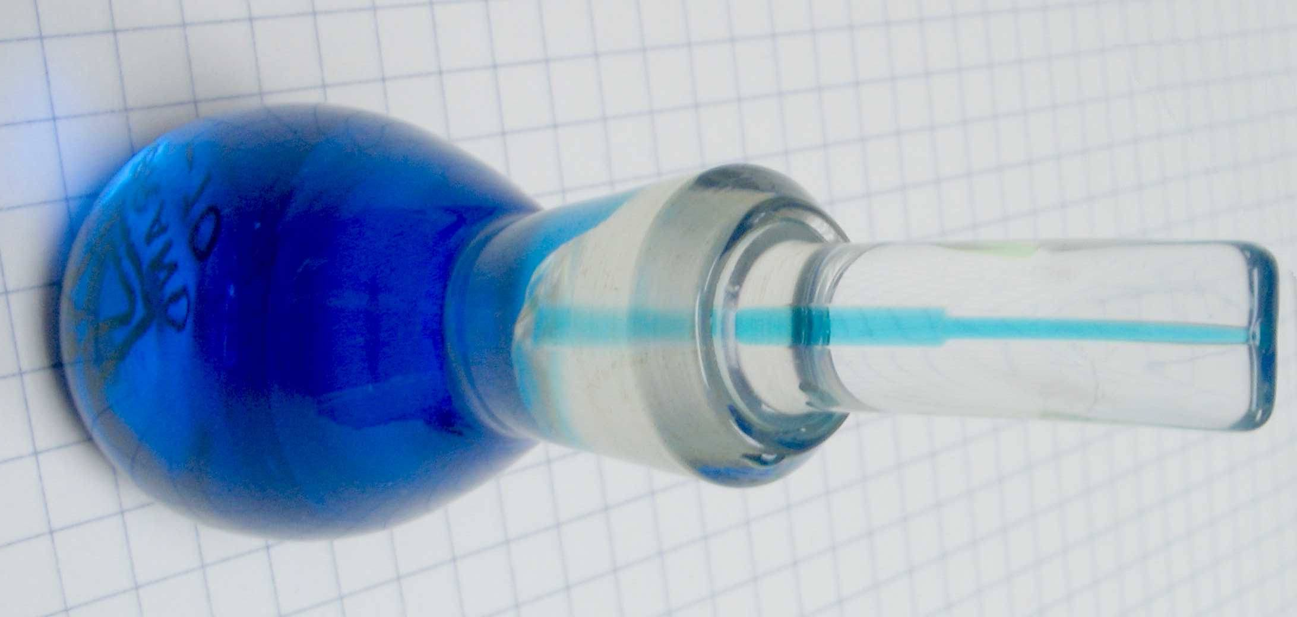
Specific Gravity
The ratio of the density of a substance to that of water at a specified temperature (ordinarily 4ºC).

Slide 36
Stoichiometry
Refers to the combining ratios among molar quantities of species in a chemical reaction.

Slide 37
Empirical & Molecular Formula
The simplest whole-number combination of atoms in a molecule.

Slide 38
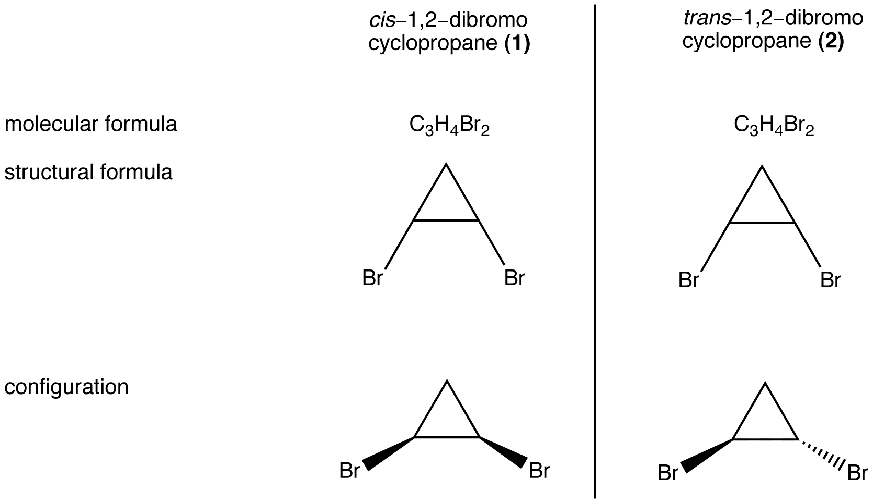
Molecular Formula
A formula that includes structural information in addition to the number and identity of the atoms in a molecule.

Slide 39
Group Calculations – Moles
Review Examples 4-1 - 4-14
Work on Exercises 4-5, 4-7, 4-9, 4-11, 4-19, 4-21, 4-23, 4-25, 4-27, 4-29, 4-31, 4-33, 4-35.

Slide 40
Assignment 2
READ:
Fundamentals of Analytical Chemistry (8th Edition)
- Chapter 9: Aqueous Solutions and Chemical Equilibria, pages 225 – 266

Slide 41
References
1. Fundamentals of Analytical Chemistry (8th Edition)
Douglas A. Skoog
Donald M.West
F. James Holler
Stanley R. Crouch

