Slide 1
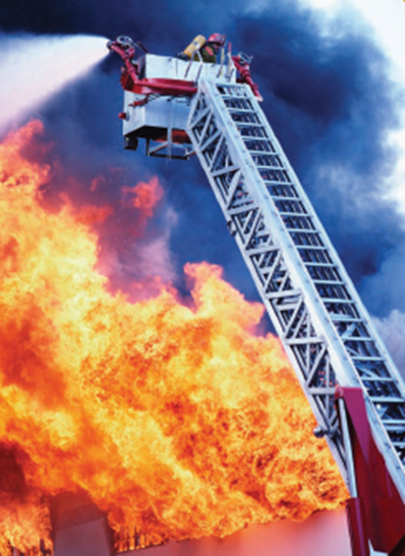
Chemical Kinetics

Slide 2
Lesson 2 Objectives
Students should be able to:
1. Describe the main aspects of transition state theory and the role of activation energy in determining the rate of a reaction.
2. Explain how the mechanism of a reaction is related to its rate-law expression.
3. Devise the rate-law expression that would result from a proposed reaction mechanism.
4. Identify reactants, products, intermediates, and catalysts in a multistep reaction mechanism.
5. Explain how temperature affects rates of reactions.

Slide 3
6. Use the Arrhenius equation to relate the activation energy for a reaction to changes in its rate constant with changing temperature.
7. Explain how a catalyst changes the rate of a reaction.
8. Describe homogenous and heterogeneous catalysis.

Slide 4
Transition State Theory
According to the transition state theory, the reactants pass through a short-lived, high-energy intermediate state, called a transition state, before the products are formed.
In the transition state, at least one bond is in the process of being broken while a new bond is being formed. This is represented by dashed lines (or dots) between the atoms.
A + B-B → A…..B…..B → A-B + B
reactants transition products
state
A + B₂ AB₂ AB + B

Slide 5
Activation Energy, E_{a}
The activation energy (or activation barrier), E_{a}, is the kinetic energy that molecules must have to allow them to reach the transition state.
If they do not possess the necessary amount of energy, E_{a}, when they collide, a reaction cannot occur.
If they do possess sufficient energy, E_{a}, the reaction can occur.

Slide 6
Net Release of Energy, ΔE_{rxn}
The net release of energy is ΔE_{rxn}.
ΔE_{rxn} relates product energy to reactant energy, regardless of the pathway.
ΔE_{rxn} is negative when energy is given off.
ΔE_{rxn} is positive when energy is absorbed from the surroundings.

Slide 7
Reaction Mechanisms & The Rate-Law Expression
Most reactions take place in a single step, but most reactions occur in a series of elementary or fundamental steps.
The step-by-step pathway by which a reaction occurs is called the reaction mechanism.

Slide 8
The reaction orders for any single elementary step are equal to the coefficients for that step.
An overall reaction can never occur faster than its slowest elementary reaction step.
For the general overall reaction
aA + bB → cC + dD
the experimentally determined rate-law expression has the form
rate = k[A]^{x}[B]^{y}
The values of x and y are related to the coefficients of the reactants in the slowest (rate-determining) step, influenced in some cases by earlier reaction steps.

Slide 9
Reactants, Products & Intermediates
Reactant: More is consumed than is formed.
Product: More is formed than is consumed.
Reaction intermediate: Formed in earlier steps, then consumed in an equal amount in later steps.

Slide 10
Devising the Rate-Law Expression

Slide 11
Temperature: The Arrhenius Equation
Group Discussion & Presentation.
Summarize the effect of temperature on reaction rates.
How does temperature affect the rates of reactions?
How is the Arrhenius equation used to relate activation energy to changes in the rate constant with changing temperature?

Slide 12
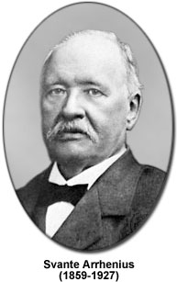
Temperature: The Arrhenius Equation

Slide 13
Group Calculations – Arrhenius Equation
Review Examples 16-11 & 16-12
Work on Exercises 55 & 56

Slide 14
Catalysts
Group Discussion & Presentation.
Summarize Catalysts
What is a catalyst?
How do catalysts change the rate of a reaction?
What is the difference between homogenous and heterogeneous catalysts?

Slide 15
Assignment
READ:
General Chemistry (9th Edition)
Chapter 16: Chemical Kinetics, pages 606 – 659
- Chapter 17: Chemical Equilibrium, pages 685 - 702

Slide 16
References
1. General Chemistry (9th Edition)
Kenneth W. Whitten
Raymond E. Davis
M. Larry Peck
George G. Stanley
ISBN-13:978-0-495-39163-0
ISBN-10:0-495-39163-8

