Slide 1
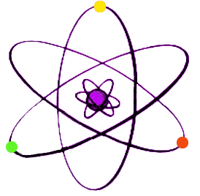
Electronic Configuration of an Atom

Slide 2
Electronic Configuration of an Atom
Electrons spin around the nucleus of the atom in a series of levels known as energy shells.
The electrons are grouped together in a specific arrangement.
We can represent the arrangement of electrons in an atom, known as the electronic configuration, using the scientific model.

Slide 3
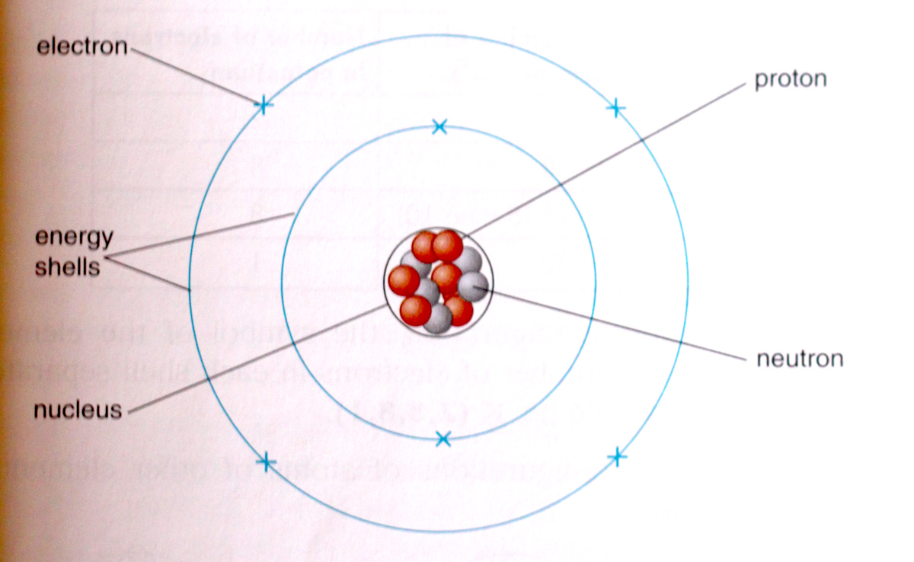
Model of the Arrangement of Electrons in an Atom

Slide 4
In this scientific model, the energy shells are drawn as concentric circles around the nucleus, but as this is only a model, this in not how they actually look.
The shells are numbered according to their distance from the nucleus.
The shell closest to the nucleus is assigned number 1, the next furthest, number 2 etc.
Each shell can hold a certain maximum number of electrons. The maximum number of electrons that an energy shell can hold is given by the formula 2n² where n is the shell number.

Slide 5
Maximum Number of Electrons in Each Shell
Electron Shell Number (n) | Maximum Number of Electrons (2n²)
1 | 2
2 | 8
3 | 18 (8 then 10)
4 | 32

Slide 6
The electrons are constantly being attracted to the positive nucleus by an electrostatic force of attraction.
They maintain their spin around, and distance from, the nucleus because of the energy they possess.
Electrons in a lower shell (closer to the nucleus) have less energy than those in a higher shell (further from the nucleus).
In fact, electrons can only occupy a specific shell if they have the required energy.

Slide 7
Electronic Configuration
The electronic configuration (or structure) of an atom of an element can be represented by drawing a shell diagram, or in writing using numbers.
When drawing the electronic configuration of an atom using a shell diagram, there are certain rules that must be followed.

Slide 8
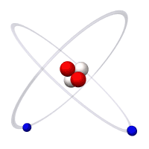
Rules for Drawing Electronic Configuration
1. First you need to know the number of electrons in the atom of the element. This is the same as the number of protons or the atomic number.
2. Electrons will always fill up the shells in order, i.e. electrons fill up shell 1 and when that is full, they start filling up shell 2 and so on.

Slide 9
3. There is something unusual that occurs in shell number 3. When 8 electrons have been placed in shell number 3, the next 2 electrons are placed in shell number 4. Only after these 2 electrons have been placed in shell number 4 are the remaining 10 electrons placed in shell number 3.
4. To represent the electronic configuration, concentric circles are drawn around a central point (the nucleus of the atom). Crosses or dots are used to represent the electrons in the shells. The number of concentric circles is determined by the number of shells that are going to be filled (or partially filled).

Slide 10
Example: What is the electronic configuration of potassium?
Answer: Potassium has 19 electrons.
When writing the electronic configuration, the symbol of the element is written first, followed by the number of electrons in each shell separated by commas.
For potassium it would be K (2,8,8,1)
Shell Number (n) | Max number of electrons (2n²) | Number of electrons in potassium
1 | 2 | 2
2 | 8 | 8
3 | 18 (8 then 10) | 8
4 | 32 | 1

Slide 11
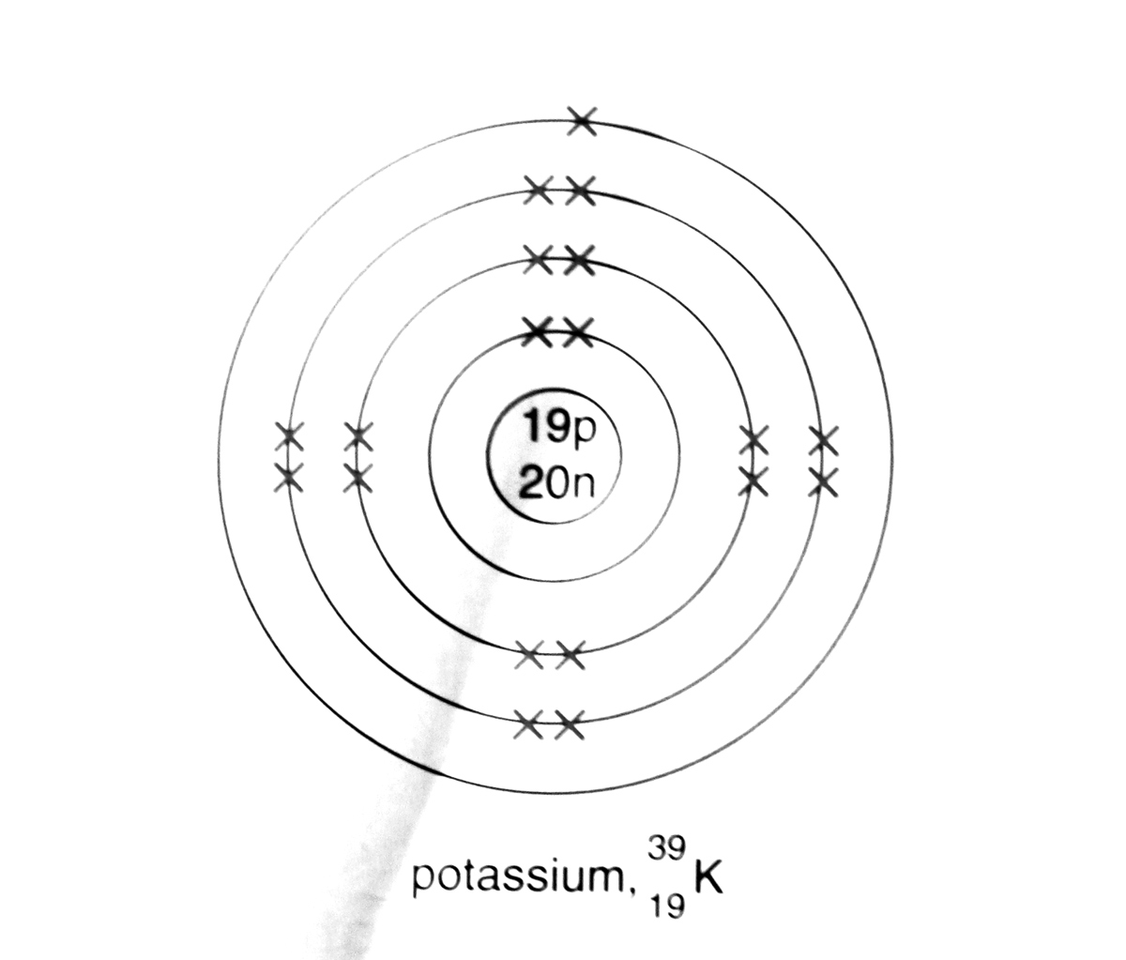
Example: Draw the electronic configuration of potassium.
Answer: The electronic configuration of potassium is
K (2,8,8,1). This is drawn as shown below:

Slide 12
Questions: Represent the electronic configuration of the following atoms using both a shell diagram and writing:
Hydrogen
Boron
Oxygen
Sodium
Argon
Calcium

Slide 13
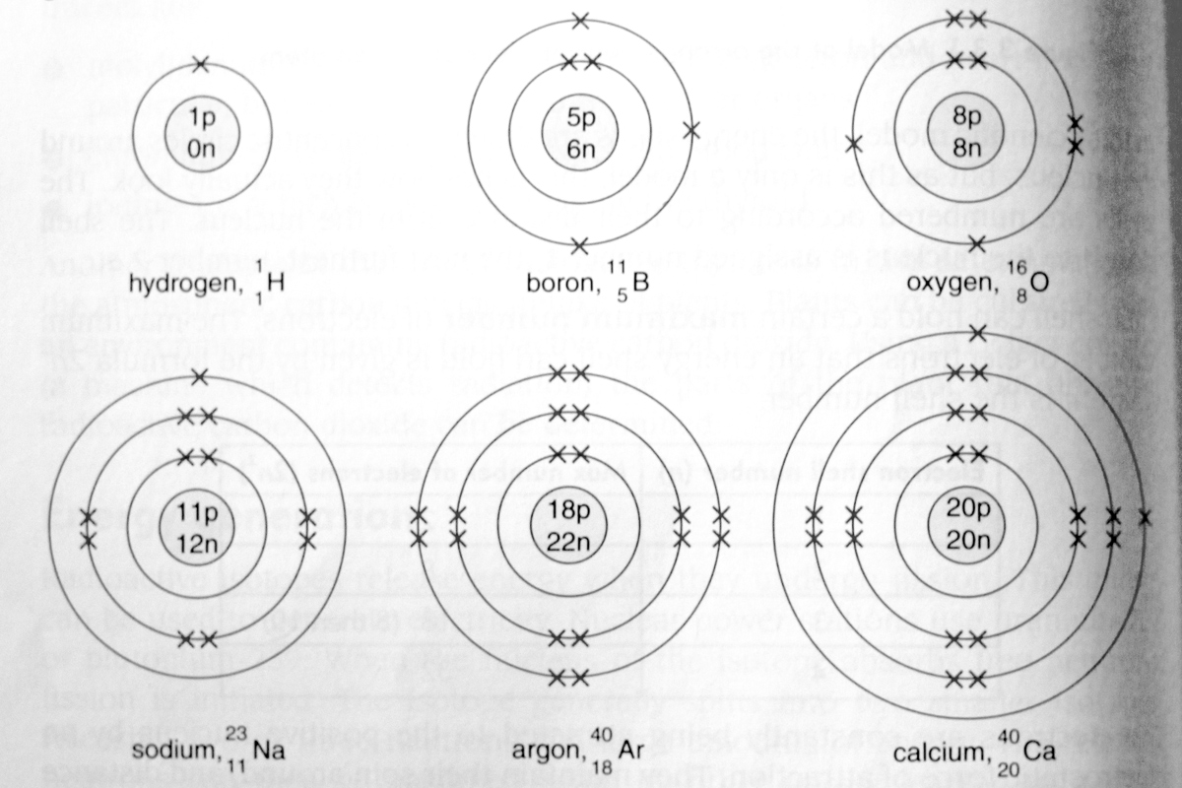
Answers

Slide 14
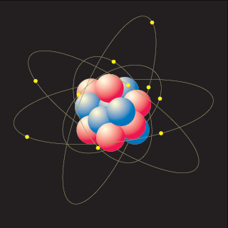
Valence Electrons
The electrons in the outermost energy shell are known as the valence electrons.
For example, potassium, K (2,8,8,1), has 1 valence electron.
The outermost electrons are involved in chemical reactions, i.e. the valence electrons.

Slide 15
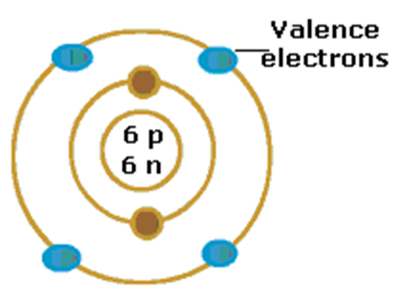
Question: Name the element depicted below and state the number of valence electrons for this element.
Answer: The element is carbon and it has 4 valence electrons.

Slide 16
Valence Electrons
A diagram of an atom can also be drawn which only shows the valence electrons. Examples of these are given in the diagram below.

Slide 17
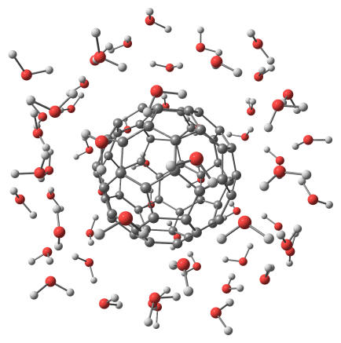
Structure & Bonding

Slide 18
Recap of Atomic Structure
Activity: Fill in the blanks to recap your knowledge of atomic structure.
Atoms have a central nucleus surrounded by __________. The electrons around the nucleus are arranged in _________.
The electron configuration is the number of _________in each occupied shell.
For example, an atom of _______ contains 11 electrons and the electron configuration of the _______ atom is 2.8.1.
An atom with a full outermost electron shell is an atom of a ________ gas, such as helium, argon or neon.

Slide 19
Answers
Atoms have a central nucleus surrounded by electrons. The electrons around the nucleus are arranged in shells.
The electron configuration is the number of electrons in each occupied shell.
For example, an atom of sodium contains 11 electrons and the electron configuration of the sodium atom is 2.8.1.
An atom with a full outermost electron shell is an atom of a noble gas, such as helium, argon or neon.

Slide 20
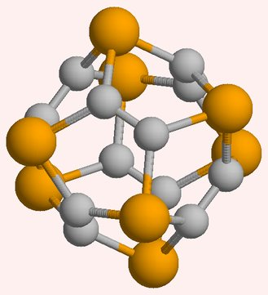
Stable Electronic Structures

Slide 21
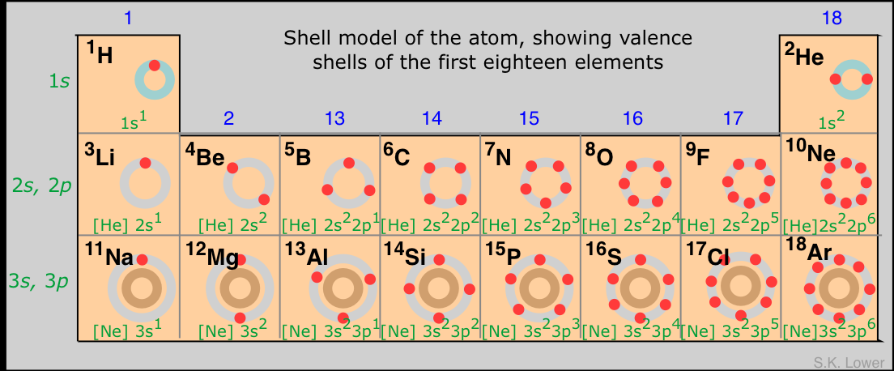
Stable Electronic Structures
Activity: Look at your copy of the Periodic Table.

Slide 22
Stable Electronic Structures
What happens to the number of electrons in the outer shell as you move from left to right across a period?
It increases across a period until the shell becomes full at the right-hand end of the period.
What is the name of the group of elements with full outer shells?
The noble gases.
Scientists have found that the noble gases are very unreactive. What does this tell you about a full outer shell of electrons?
It provides stability; therefore, atoms of elements in other groups may also seek to attain a full outer shell of electrons.

Slide 23
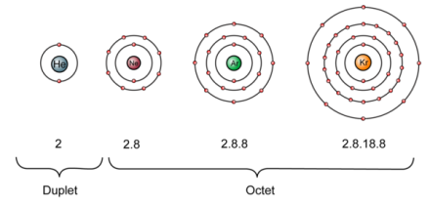
Stable Electronic Structures
Noble gases exist as single atoms because the full outer shell makes each atom stable.

Slide 24
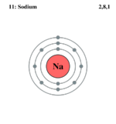
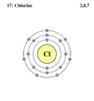
Stable Electronic Structures
Atoms of other elements do not have full outer shells.
Examples:
What would atoms of these other elements have to do to achieve a full outer shell?
Sodium
2, 8, 1
Chlorine
2, 8, 7

Slide 25
Stable Electronic Structures
Atoms gain stability if they obtain the noble gas configuration of the nearest noble gas to them in the periodic table.

Slide 26
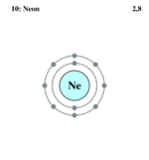
Stable Electronic Structures
Example 1: What is the nearest noble gas to sodium?
What would sodium have to do in order to attain the electronic configuration of neon?

Slide 27
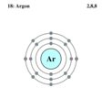
Stable Electronic Structures
Example 2: What is the nearest noble gas to chlorine?
What would chlorine have to do in order to attain the electronic configuration of argon?

Slide 28
Stable Electronic Structures
Atoms can obtain the noble gas configuration of the nearest noble gas to them in the periodic table during the following chemical changes. They can:
donate one or more electrons to another atom
2. gain one or more electrons from another atom
3. share electrons with another atom

Slide 29
Stable Electronic Structures
This chemical change is known as chemical bonding. A chemical bond is an electrostatic force of attraction between two or more atoms or ions.
There are three main types of chemical bonding:
ionic bonding – formed between metals and non-metals
2. covalent bonding – formed between two or more non-metals
3. metallic bonding – formed between metals

Slide 30
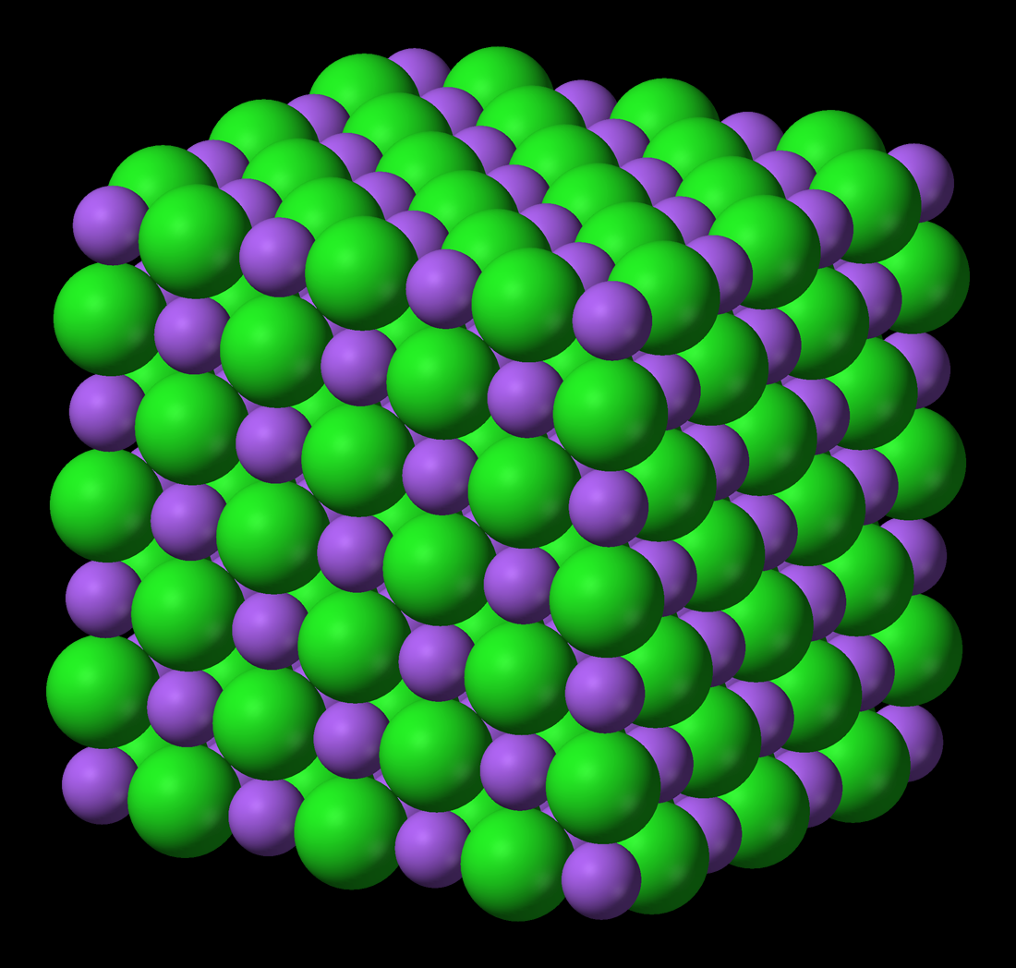
Ionic Bonding

Slide 31
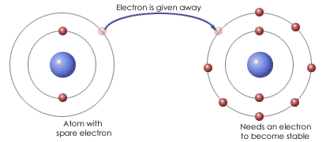
Ionic Bonding
Ionic bonding is a transfer of valence electrons between metal and non-metal atoms.
Usually the transfer is from the metal atom to the non-metal atom.

Slide 32
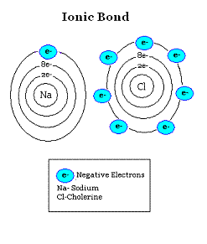
Ionic Bonding
Metals lie to the left of the periodic table; if they lose electrons they can attain noble gas configuration.
Non-metals lie to the right of the periodic table; if they gain electrons they can attain noble gas configuration.

Slide 33
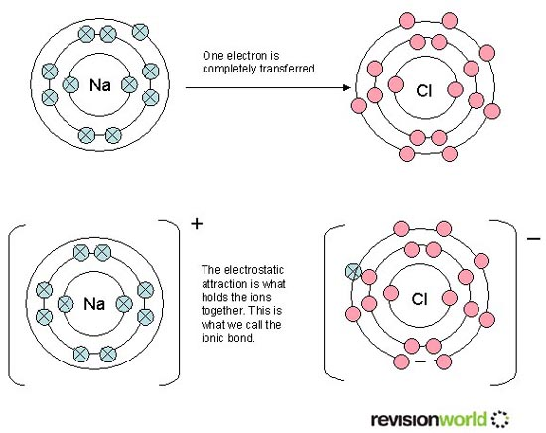
Ionic Bonding
When an atom loses or gains electrons it forms an ion.
The ions formed are now charged particles because they no longer contain the same number of protons and electrons.

Slide 34
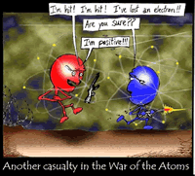
Cations & Anions

Slide 35
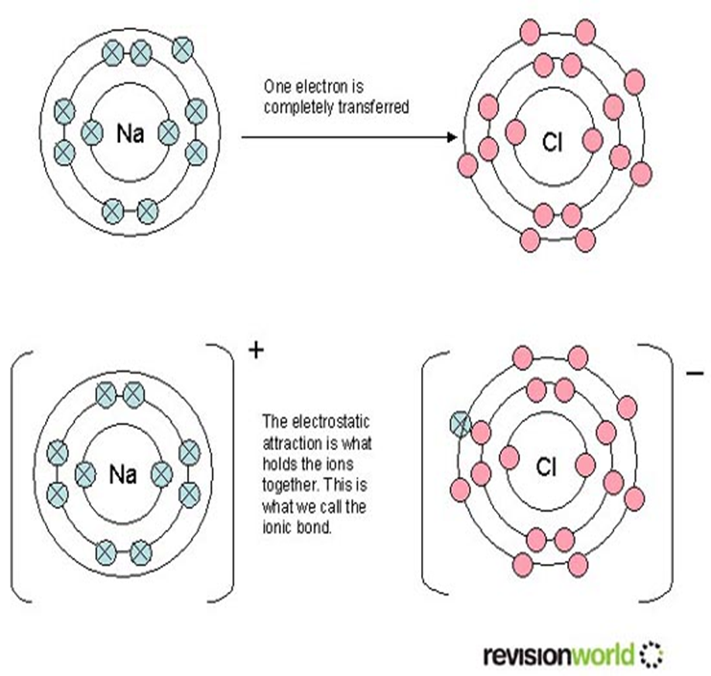
Cations & Anions
When a metal atom loses electrons it forms a positive ion called a cation.
When a non-metal atom gains electrons it forms a negative ion called an anion.

Slide 36
Losing & Gaining Electrons

Slide 37
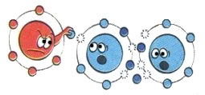
Losing Electrons – Group 1
One way to obtain a full outer orbital is to lose electrons from a partially filled orbital.
Atoms of elements in Group 1, and hydrogen, have a single electron in their outer orbital.
If this electron is lost then the full orbital beneath now becomes the full outer orbital.

Slide 38
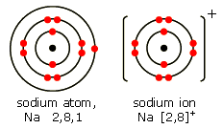
Losing Electrons
Example: Sodium
The chemical reaction is:
Na → Na⁺ + e⁻
An electron configuration of 2.8.1 becomes 2.8.

Slide 39
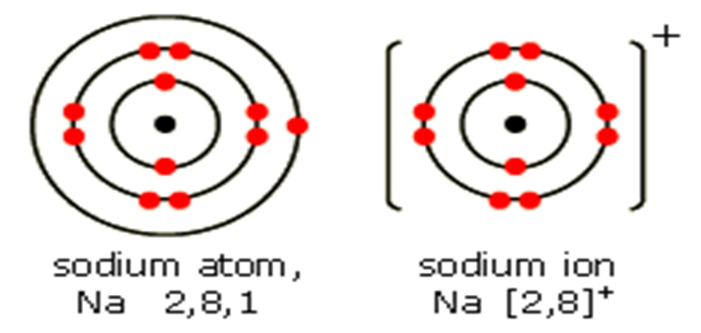
Losing Electrons
In an atom the number of electrons in the orbitals is equal to the number of protons in the nucleus.
If one electron is removed this leaves a net charge of +1; a sodium atom has become a sodium ion.

Slide 40
Losing Electrons – Group 2
Similarly Group 2 elements have two electrons in their outer orbital.
Example: Magnesium
Mg → Mg²⁺+2e⁻
An electron configuration of 2.8.2 becomes 2.8.
As the magnesium atom has lost two electrons, the magnesium ion carries a charge of +2.
2+

Slide 41
Losing Electrons – Group 3
It is possible for aluminium to produce the aluminium ion, Al³⁺, by losing three electrons.
Activity: Draw the electronic configuration of the aluminium atom and the electronic configuration of the aluminium ion.
Beyond this, it requires too much energy to remove four or more electrons so the elements from Group 4 and onwards do not form positively charged ions.

Slide 42
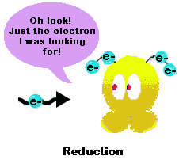
Gaining Electrons
As well as losing electrons, it is possible to obtain a full outer orbital by gaining electrons.

Slide 43
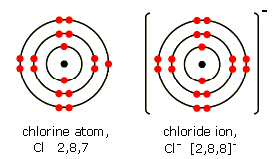
Gaining Electrons – Group 7
Atoms of the elements in Group 7 have seven electrons in their outer orbital.
They can attain a full outer orbital by gaining one more electron:
Cl + e⁻ → Cl⁻
An electron configuration of 2.8.7 becomes 2.8.8.

Slide 44
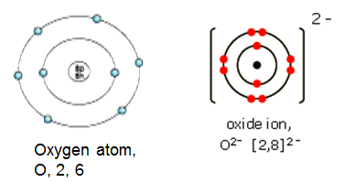
Gaining Electrons – Group 6
Group 6 elements need two electrons to attain a full outer orbital:
O + 2e⁻ → O²⁻
An electron configuration of 2.6 becomes 2.8.

Slide 45
Gaining Electrons – Group 5
It is possible for phosphorus to produce the phosphide ion, P³⁻, by gaining three electrons.
Activity: Draw the electronic configuration of the phosphorous atom and the electronic configuration of the phosphide ion.
Beyond this, gaining four or more electrons would make an atom too unstable so elements up to and including Group 4 do not form negatively charged ions.

Slide 46
Additional Information
When an atom forms a negative ion, the name of the ion ends with ‘-ide’,
e.g. chloride, bromide, iodide, oxide, sulphide.
Also, some groups of two or more atoms combine to form a negative ion, which we see in compounds such as hydroxide, OH⁻, nitrate, NO₃⁻, and sulphate, SO₄²⁻.

Slide 47
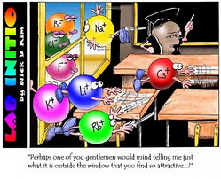
Attraction between Positive & Negative Ions

Slide 48
Attraction between Positive & Negative Ions
Positively charged ions and negatively charged ions are attracted to each other and this attraction is the basis of ionic bonding.

Slide 49
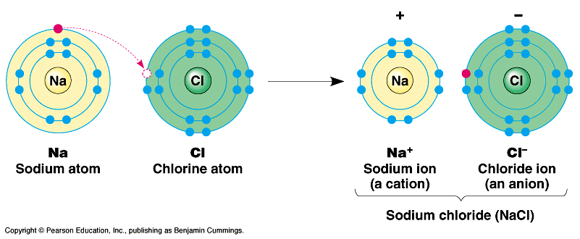
Attraction between Positive & Negative Ions
In an ionic compound, the number of positive
charges must equal the number of negative charges, hence the compound is neutral overall.

Slide 50
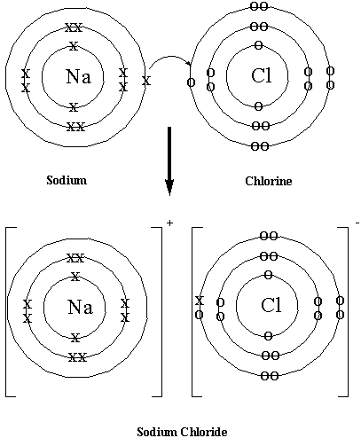
Using Shell Diagrams to Represent Ionic Bonding

Slide 51
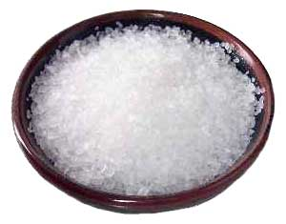
Example 1: Sodium Chloride
Sodium is a metal with one valence electron; therefore it loses this electron to form a positive sodium ion (Na⁺).
Chlorine is a non-metal with seven valence electrons; therefore it gains one electron to form a negative chloride ion (Cl⁻).

Slide 52
The diagram shows how to use shell diagrams to represent ionic bonding in sodium chloride.
Sodium atom
Chlorine atom
Sodium ion (Na⁺)
Chlorine
ion (Cl⁻)

Slide 53
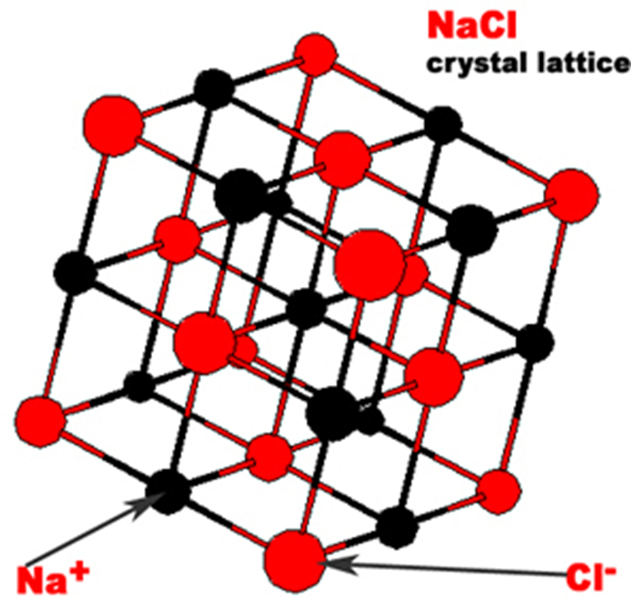
It is important to note that there is no separate entity such as NaCl.
Each Na⁺ ion is immediately surrounded by six Cl⁻ ions and each Cl⁻ ions is immediately surrounded by six Na⁺ ions.

Slide 54
NaCl is referred to as the formula unit or empirical formula of the ionic compound.
The ions attract each other forming a highly ordered arrangement known as a crystal lattice.
The attraction between each positive cation and each negative anion is known as an ionic bond.
Ionic bonds are strong bonds and their strength accounts for some of the properties of ionic compounds.

Slide 55
Example 2: Magnesium Fluoride
Magnesium is a metal with two valence electrons; magnesium will lose these two electrons, forming a magnesium ion (Mg2⁺).
Fluorine is a non-metal with seven valence electrons; fluorine will gain one electron, forming a fluoride ion (F⁻).
For each magnesium atom (that loses two valence electrons) there will need to be two fluorine atoms.
Each fluorine atom will accept one electron.

Slide 56
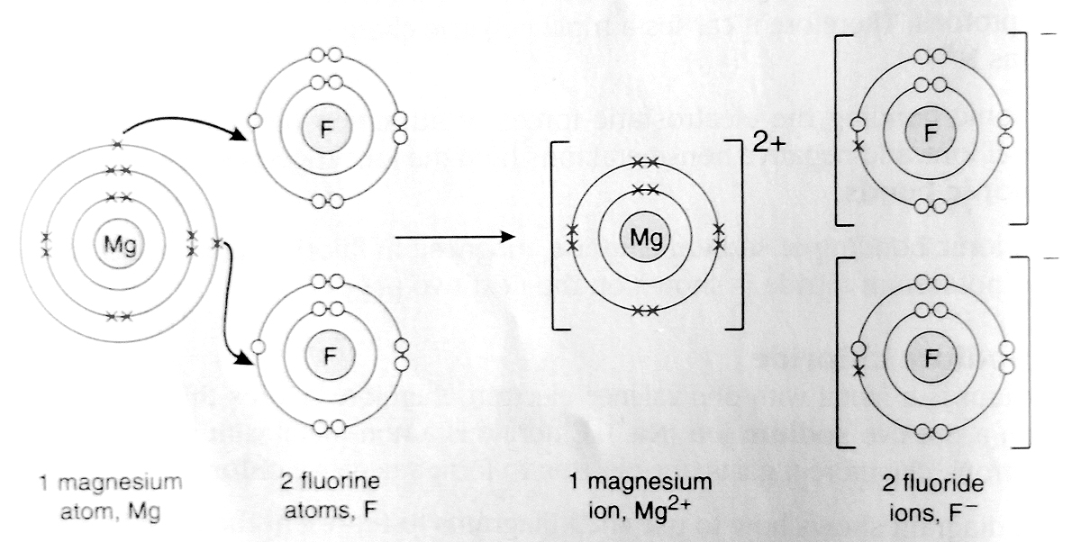
The diagram shows how to use shell diagrams to represent ionic bonding in magnesium fluoride.

Slide 57
Example 3: Aluminium Oxide
Aluminium is a metal with three valence electrons; aluminium will lose three electrons, forming an aluminium ion (Al³⁺).
Oxygen is a non-metal with six valence electrons; oxygen will gain two electrons, forming an oxide ion (O²⁻).
Two aluminium atoms will lose six electrons and three oxygen atoms are needed to accept these six electrons therefore the ratio of aluminium to oxygen will be 2:3.

Slide 58
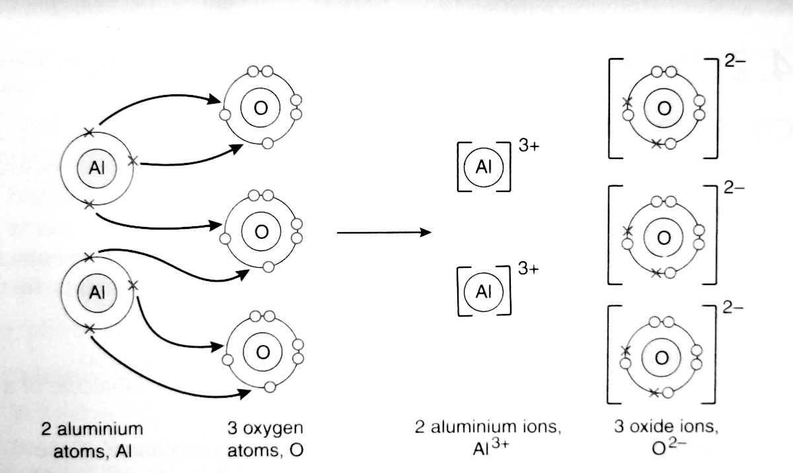
The diagram shows how to use shell diagrams to represent ionic bonding in aluminium oxide.

