Slide 1
Interconversion of mass, moles and number of atoms or molecules.

Slide 2
A Dozen Elephants & A Dozen Paper Clips
Would a dozen of each weigh the same amount? Give a reason for your answer.

Slide 3
Moles and Mass
The molar mass gives us the relationship between the number of moles and the mass of an element or compound.
We can use the molar mass to calculate the mass or number of moles of an element or compound.

Slide 4
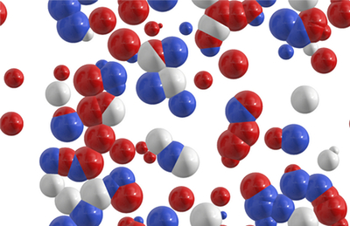
Simplified method for mole conversions

Slide 5
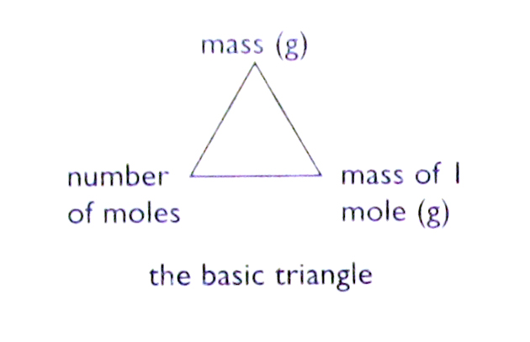
Formulae

Slide 6
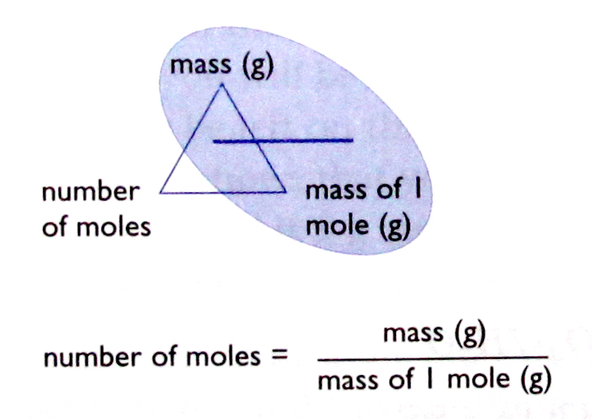
Formulae

Slide 7
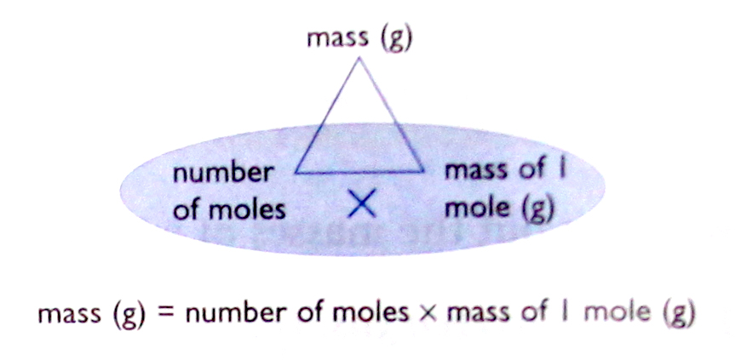
Formulae

Slide 8
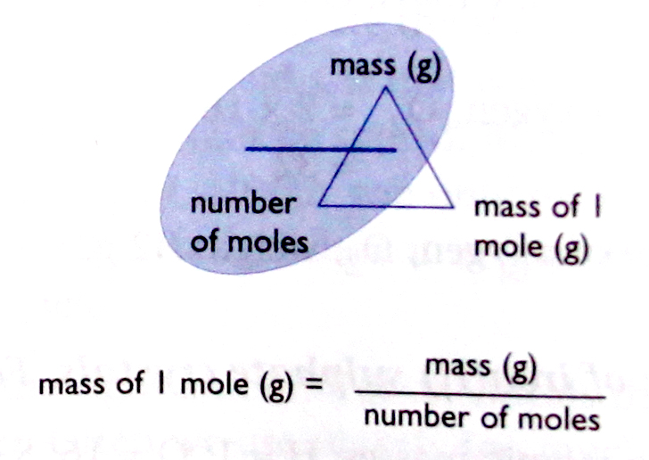
Formulae

Slide 9
Example 1 – Mass to moles
Calculate the number of moles in 10g of calcium carbonate, CaCO₃.
First, calculate the molar mass of CaCO₃
M(CaCO₃) = 40 + 12 + (3x16) = 100gmol⁻¹
i.e. mass of 1 mol CaCO₃ = 100g
So, number of moles in 10g = 10 ÷ 100
= 0.1 mol

Slide 10
Example 2 – Mass to moles
Calculate the number of moles in 54g of water, H₂O.
First, calculate the molar mass of H₂O
M(H₂O) = (2x1) + 16 = 18gmol⁻¹
i.e. mass of 1 mol H₂O = 18g
So, number of moles in 54g = 54 ÷ 18
= 3 mol

Slide 11
Example 3 – Moles to mass
Calculate the mass of 0.2 mol of sulphuric acid, H₂SO₄.
First, calculate the molar mass of H₂SO₄
M(H₂SO₄ ) = (2x1) + 32 + (4x16) = 98gmol⁻¹
i.e. mass of 1 mole = 98g
So, mass of 0.2 mol = 0.2 x 98g
= 19.6g

Slide 12
Example 4 – Moles to mass
Calculate the mass of 0.5 mol of sodium chloride, NaCl.
First, calculate the molar mass of NaCl
M(NaCl ) = 23 + 35.5 = 58.5gmol⁻¹
i.e. mass of 1 mole = 58.5g
So, mass of 0.5 mol = 0.5 x 58.5g
= 29.25g

Slide 13
Worksheet
How many moles are in 15 grams of lithium?
2. How many grams are in 2.4 moles of sulphur?
3. How many grams are in 4.5 moles of sodium fluoride, NaF?
4. How many moles are in 98.3 grams of aluminum hydroxide, Al(OH)₃?

Slide 14
Mass, moles and number of atoms or molecules
The number of atoms or molecules in one mole is known, i.e. 6.0 x 10²³, therefore we can calculate the number of particles in any number of moles.

Slide 15
Example 1
Calculate the number of atoms in 0.5 mol of copper, Cu.
1 mol Cu contains 6.0 x 10²³ atoms
So, 0.5 mol Cu contains 0.5 x 6.0 x 10²³
= 3.0 x 10²³ atoms

Slide 16
Example 2
Calculate the number of moles of calcium, Ca, that contains 2 x 10²³ calcium atoms.
1 mol Ca contains 6.0 x 10²³ atoms
So, number of moles in 2 x 10²³ atoms = 2 x 10²³
6.0 x 10²³
= 0.33 mol

Slide 17
Example 3
Calculate the number of molecules in 1.8g of water, H₂O.
M(H₂O ) = (2 x 1) + 16 = 18gmol⁻¹
i.e. mass of 1mol = 18g
So, no. of moles in 1.8g = 1.8 = 0.1mol
18
1 mol H₂O contains 6.0 x 10²³ molecules
So, 0.1 mol H₂O contains 0.1 x 6.0 x 10²³
= 6.0 x 10²² molecules

Slide 18
Example 4
Calculate the mass of 1.5 x 10²³ molecules of hydrogen chloride, HCl.
1 mol HCl contains 6.0 x 10²³ molecules
So, no. of moles in 1.5 x 10²³ molecules = 1.5 x 10²³
6.0 x 10²³
= 0.25mol
M(HCl) = 1 + 35.5 = 36.5gmol⁻¹
i.e. mass of 1 mol HCl = 36.5g
So, mass of 0.25mol HCl = 0.25 x 36.5g
= 9.13g

Slide 19
Example 5
Calculate the number of aluminium ions (Al³⁺) in 40.8g of aluminium oxide, Al₂O₃.
M(Al₂O₃) = (2 x 27) + (3 x 6) = 102gmol⁻¹
i.e. mass of 1 mol Al₂O₃ = 102g
So, no. of moles in 40.8g = 40.8 mol = 0.4mol
102
1 mol Al₂O₃ contains 6.0 x 10²³ formula units
So, 0.4 mol Al₂O₃ contains 0.4 x 6.0 x 10²³ formula units
= 2.4 x 10²³ formula units
1 Al₂O₃ formula units contains 2 Al³⁺ ions
So, 2.4 x 10²³ Al₂O₃ formula units contains 2 x 2.4 x 10²³ ions
= 4.8 x 10²³ Al³⁺ ions

Slide 20
Worksheet
How many moles are present in 2.45 x 10²³ molecules of CH₄?
2. How many grams are there in 7.4 x 10²³ molecules of AgNO₃?
3. Calculate the number of moles in 42.15g of magnesium carbonate.
4. Calculate the number of atoms in 1.5 mol HCl.
5. Calculate the mass of 1.5 x 10²³ formula units of MgSO₄.

Slide 21
Percentage Composition

Slide 22
Percentage Composition
The percentage composition of a compound indicates the percentage mass of each element in the compound.
For example, the percentage composition of water shows what percentage of the mass of a water molecule is made up of hydrogen and what percentage of the mass is made up of oxygen.

Slide 23
Calculating Percentage Composition
To calculate the percentage composition of a compound, divide the mass that each element contributes to one mole of the compound by the molar mass of the entire compound.
To calculate the percentage composition of a compound:
% by mass of element = total mass of element present in 1 mole x 100
molar mass of compound

Slide 24
Example 1
Calculate the percentage composition of H and O in H₂O.
M(H₂O) = (2x1) + 16 = 18gmol⁻¹
%H = 2 x 100 = 11.11%
18
%O = 16 x 100 = 88.89%
18

Slide 25
Example 2
Calculate the percentage of H₂O in CuSO₄.5H₂O
M(CuSO₄.5H₂O) = 160 + (5x18)
= 250gmol⁻¹
M(H₂O) = (2x1) + 16
= 18gmol⁻¹
% H₂O = 5x18 x 100
250
= 36.0%

Slide 26
Percent Composition Worksheets
Worksheet 1
Worksheet 2

Slide 27
Empirical and Molecular Formula
The empirical formula is defined as the ratio between the atoms in a molecule or ions in an ionic compound. We can generalize and state that the subscripts of an empirical formula represent the smallest whole number ratio of the atoms or ions in a compound.
The mole ratio between the elements is used to determine the empirical formula, which then gives us the atom or ion ratios. The mole ratios are obtained from the percentage composition of each atom or ion in the compound.

Slide 28
The molecular formula of a compound represents the actual numbers of atoms of each element in a single molecule of that compound. The molecular formula could be the same as the empirical formula or some whole number multiple of the empirical formula. The formula of an ionic compound represents the smallest whole number ratio of ions that will result in a neutral compound. Therefore the formula of an ionic compound is the same as the empirical formula.

Slide 29
If the empirical formula and the molar mass of the molecular formula are known, the molecular formula can be determined from the ratio between the molar mass of the molecular formula and the molar mass of the empirical formula.

Slide 30
Examples of Empirical & Molecular Formulae
Empirical Formula | Molecular Formula | Name
CH₂ | C₂H₄ | ethene
CH₂O | C₆H₁₂O₆ | glucose
NO₂ | N₂O₄ | dinitrogen tetroxide

Slide 31
Example 1
A sample of a solid is decomposed and found to consist of 6.52g of potassium, 4.34g of chromium and 5.34g of oxygen. What is the empirical formula?

Slide 32
Answer
 | K | Cr | O
mass (in grams) | 6.52 | 4.34 | 5.34
molar mass (in gmol⁻¹) | 39 | 52 | 16
number of moles | 6.52 = 0.167 39 | 4.34 = 0.083 52 | 5.34 = 0.333 16
÷ by smallest number to get whole number ratio, i.e. ÷ 0.083 | 2 | 1 | 4
The empirical formula is K₂CrO₄

Slide 33
Example 2
Glucose is a sugar that is metabolised by the body to produce energy. Glucose is composed of hydrogen, carbon and oxygen. The percentage composition is 40% C, 6.7% H and 53.3% O. The molar mass of glucose is 180gmol⁻¹. Calculate the empircal and molecular formula.

Slide 34
Answer
 | C | H | O
mass (in grams) | 40 | 6.7 | 53.3
molar mass (in gmol⁻¹) | 12 | 1 | 16
number of moles | 40 = 3.3 12 | 6.7 = 6.7 1 | 53.3 = 3.3 16
÷ by smallest number to get whole number ratio, i.e. ÷ 0.083 | 1 | 2 | 1
The empirical formula is CH₂O
M(CH₂O) = 12 + (2x1) + 16 = 30gmol⁻¹
M(Glucose) = 180gmol⁻¹
Ratio between glucose and CH₂O = 180 = 6
30
So, molecular formula is C₆H₁₂O₆

Slide 35
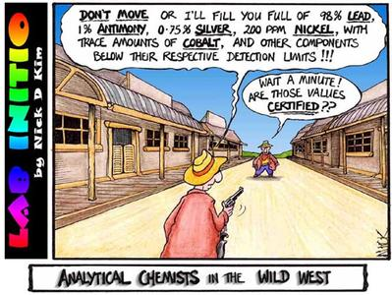
Empirical & Molecular Formula Worksheet
Empirical & Molecular Formula Worksheet

Slide 36
Percentage Purity
Percentage purity of a substance can be calculated by dividing the mass of the pure chemical by the total mass of the sample, and then multiplying this number by 100.

Slide 37
Example - Percentage Purity
A 12.00g sample of a crystallised pharmaceutical product was found to contain 11.57g of the active drug. Calculate the % purity of the sample of the drug.
% purity = actual amount of desired material x 100
total amount of material
% purity = 11.57 x 100 = 96.4% (to 1dp)
12

