Slide 1
Diffusion & Osmosis

Slide 2
Why are diffusion and osmosis important?
Diffusion and osmosis are important because they provide evidence for the existence and movement of particles, that is, they provide evidence for the particulate nature of matter.

Slide 3
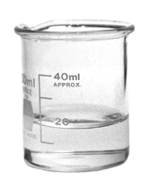
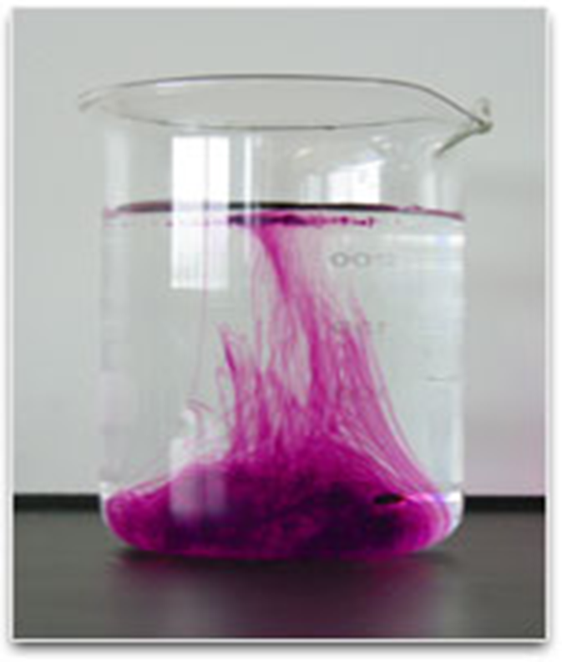
Diffusion
What would happen if we dropped purple ink into a beaker of water?
What would eventually happen to the beaker on the right?

Slide 4
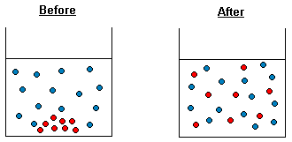
What is diffusion?
Diffusion is the movement of particles (liquid or gas) from an area of higher concentration to an area of lower concentration.
Example

Slide 5
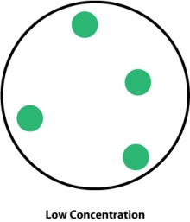
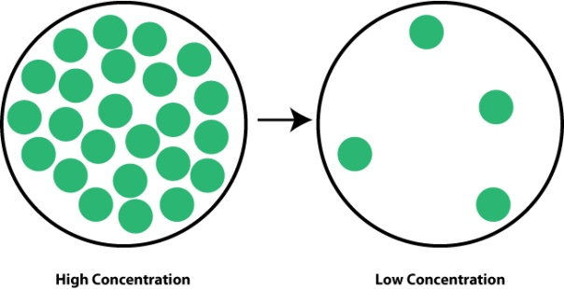
Diffusion and concentration
A place where there are a lot of particles is called a high concentration.
A place where there are a few particles is called a low concentration
Particles will diffuse from a high concentration
to a low concentration

Slide 6
Everyday examples of Diffusion
Some everyday examples of diffusion are:
Smelling your mother’s cooking from the kitchen while you are studying in the living room.
Smelling garbage on the street before you can see the garbage truck.
Smelling someone’s perfume.
A drop of ink spreading to colour the water in a beaker, without stirring.
Rust spreading from a rusty can into a white tile.

Slide 7
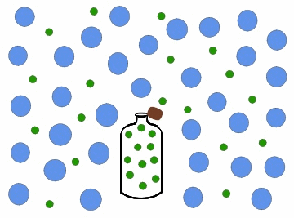
Diffusion in Gases

Slide 8
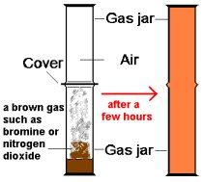
Example 1: Diffusion of Bromine Gas

Slide 9
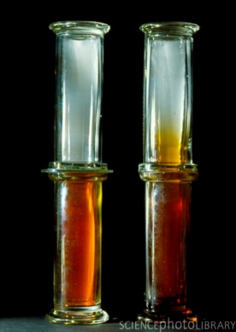
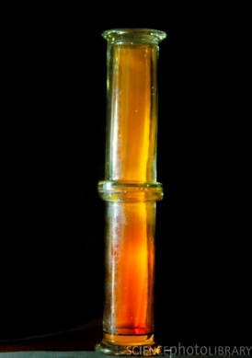
Example 1: Diffusion of Bromine Gas
1 2 3

Slide 10
Example 2: Diffusion of Ammonia & Hydrogen Chloride

Slide 11
Example 2: Diffusion of Ammonia & Hydrogen Chloride
The ammonia and hydrogen chloride particles move through the air in the glass tube towards each other.
When ammonia and hydrogen chloride combine they react to form a white solid known as ammonium chloride.
In the experiment above the ammonium chloride forms a ring inside the glass tube.
The ammonia gas particles are much lighter than the hydrogen chloride particles which allows them to move much faster than the hydrogen chloride particles through the air. Therefore, the ammonium chloride forms closer to the source of the hydrogen chloride.

Slide 12
Example 2: Diffusion of Ammonia & Hydrogen Chloride
We can represent the reaction between the ammonia and the hydrogen chloride as a chemical equation:
ammonia + hydrogen chloride ammonium chloride
NH_{3(g)} + HCl_{(g)} NH₄Cl_{(s)}
This experiment provides evidence that particles are able to move and that there are spaces between particles.

Slide 13
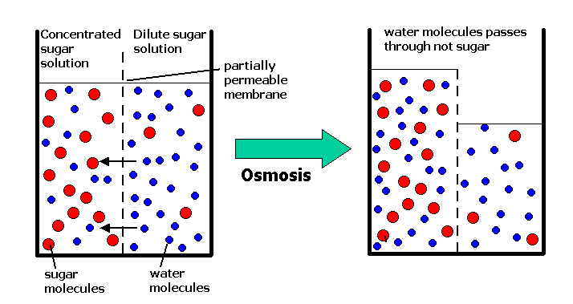
Osmosis

Slide 14
What is Osmosis?
Osmosis is a special case of diffusion.
Osmosis is the movement of water molecules through a selectively permeable membrane from a region with a lot of water molecules, e.g. a dilute solution or pure water, to a region with fewer water molecules, e.g. a concentrated solution.

Slide 15
Activity: Osmosis in Paw-Paw
Six pieces of green paw-paw were cut into strips of equal length.
Three strips of paw-paw were placed into a beaker of distilled water and the other three strips were placed into a beaker of saturated sodium chloride solution.
They remained in the solutions for an hour.
When they were removed, the strips which were placed in the distilled water were more rigid and increased in length whereas the strips which were placed in the saturated sodium chloride solution wilted, became softer and decreased in length.
Explain these results.

Slide 16
Explanation
The cell membranes of the paw-paw cells act as selectively permeable membranes.
Water can pass through the cell membranes, either into or out of the cells.
Distilled water has a higher water content than the paw-paw cells, therefore water will move into the cells, resulting in a more rigid and longer paw-paw strip.
With the saturated sodium chloride solution, water will move from the cells through the cell membrane into the sodium chloride solution, resulting in the paw-paw becoming softer and shorter.

Slide 17
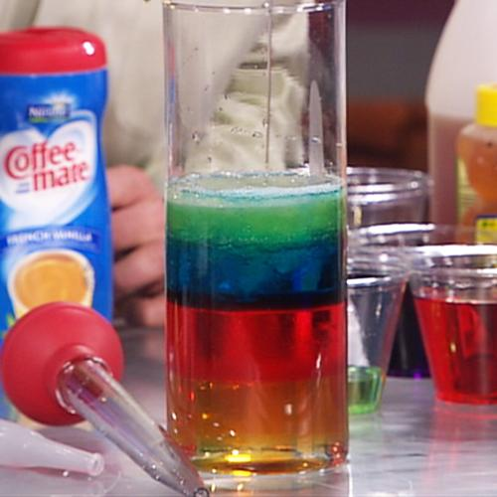
Chemical & Physical Properties

Slide 18
Chemical & Physical Properties
Properties
Chemical Properties
Physical Properties
Only observable during a chemical reaction
Readily observable. Examples:
color, size, luster, or smell.

Slide 19
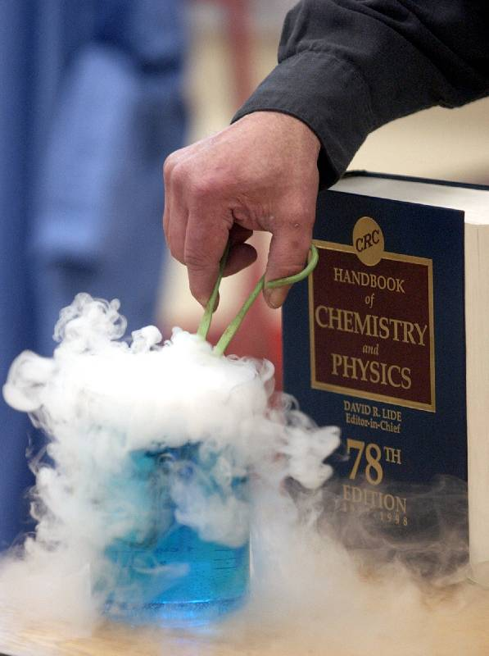
Changes In Matter – Chemical & Physical Changes

Slide 20
Chemical Changes
Look at the picture of the candle burning.
Is the wax of the candle changing?
What is it changing into?

Slide 21
The wax of a candle burns into ash and smoke.
The original materials are changing into something different.
Changes that create a new material are called chemical changes.
Examples of Chemical Changes:
Burning, Rusting & Photosynthesis

Slide 22
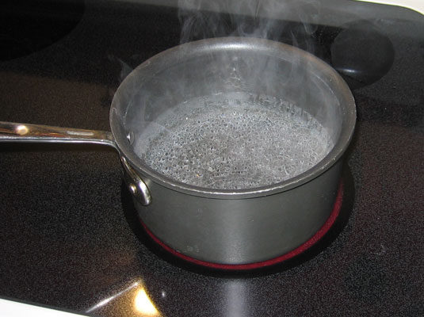
Physical Changes
Look at the picture of water boiling.
Is the water changing?
What is it changing into?

Slide 23
Steam is another form of water.
Heating water did not create a new material.
In changing the water from a liquid to a gas, only the state of the water changed.
Changes in the shape, size, or state of a material are called physical changes.

Slide 24
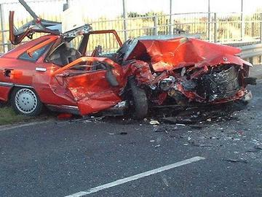
Activity 1: Classify the changes below as chemical or physical.
A car wreck
Answer: Physical Change (change in shape)

Slide 25
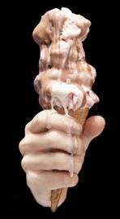
2. Ice Cream Melting
Answer: Physical Change (change in state)

Slide 26
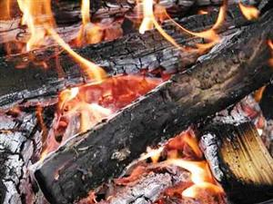
3. Wood burning
Answer: Chemical Change (into ash and smoke)

Slide 27
Activity 3: Think about one change you have observed at home and say whether it is chemical or physical.

Slide 28
Summary
In this lesson, we covered the following:
Definitions: chemistry, matter & energy
The Particulate Nature of Matter
The Differences between the States of Matter in terms of Particle Arrangement and Energy

Slide 29
Diffusion and Osmosis
The Properties of Matter
The Differences between Chemical and Physical Properties and Changes
Classification of Matter

