Slide 1
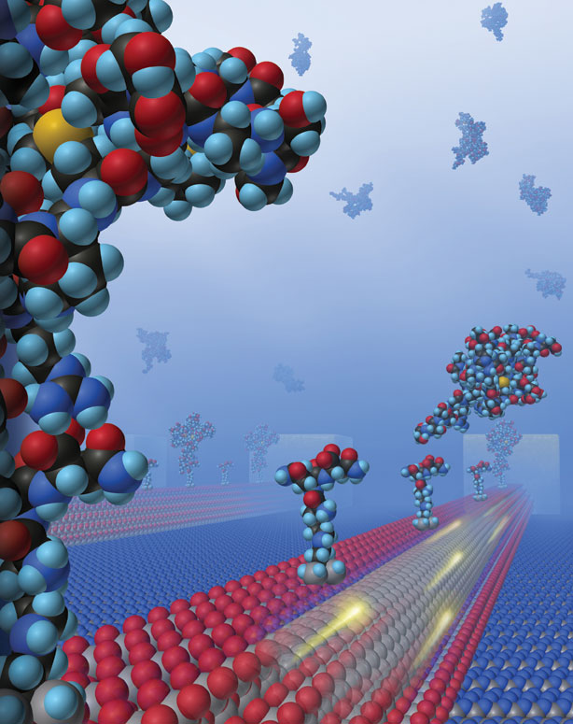
The Nature of Matter

Slide 2
Definitions

Slide 3
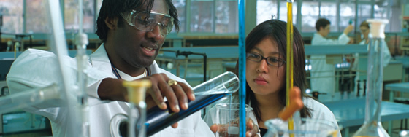
What is Chemistry?
Chemistry is the study of the structure and behaviour of matter.

Slide 4
What is matter?
Any substance which has mass and occupies space.
is
Matter
exists in various states
examples
Air
Sand
Human Beings
Animals
Solid
Liquid
Gas

Slide 5
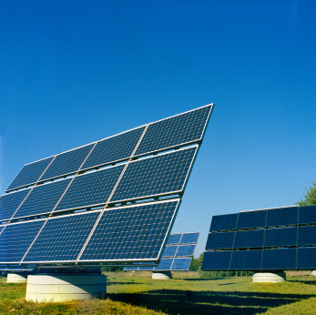
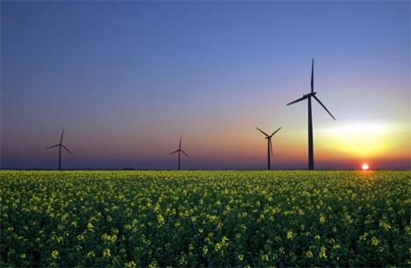
What is energy?
Energy is the ability to do work.

Slide 6
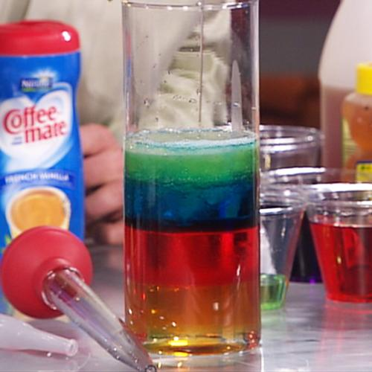
Chemical & Physical Properties

Slide 7
Chemical & Physical Properties
Properties
Chemical Properties
Physical Properties
Only observable during a chemical reaction
Readily observable. Examples:
color, size, luster, or smell.

Slide 8
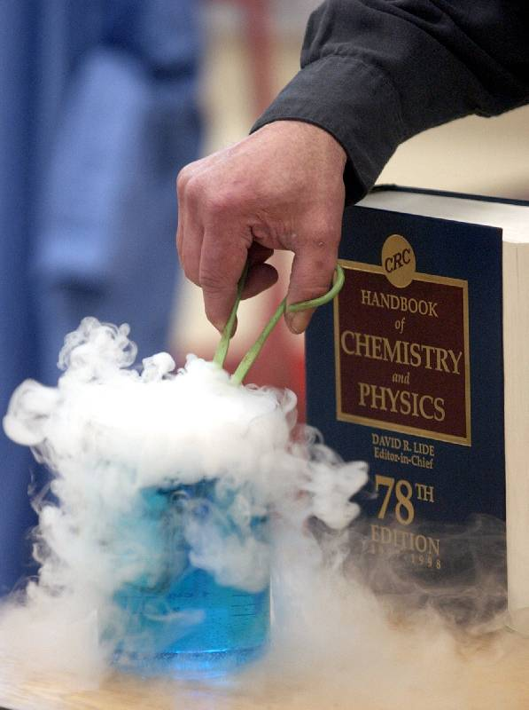
Changes In Matter – Chemical & Physical Changes

Slide 9
Chemical Changes
Look at the picture of the candle burning.
Is the wax of the candle changing?
What is it changing into?

Slide 10
The wax of a candle burns into ash and smoke.
The original materials are changing into something different.
Changes that create a new material are called chemical changes.
Examples of Chemical Changes:
Burning, Rusting & Photosynthesis

Slide 11
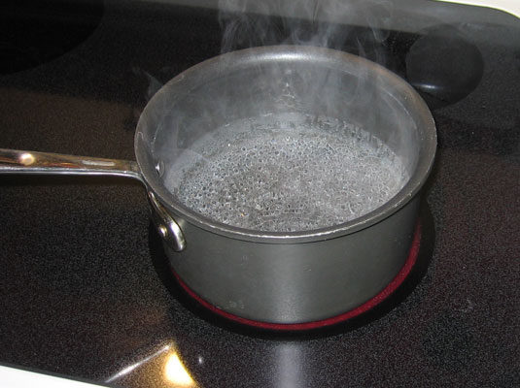
Physical Changes
Look at the picture of water boiling.
Is the water changing?
What is it changing into?

Slide 12
Steam is another form of water.
Heating water did not create a new material.
In changing the water from a liquid to a gas, only the state of the water changed.
Changes in the shape, size, or state of a material are called physical changes.

Slide 13
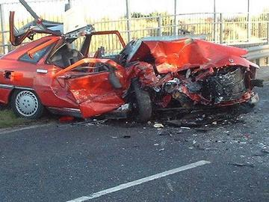
Activity 1: Classify the changes below as chemical or physical.
A car wreck
Answer: Physical Change (change in shape)

Slide 14
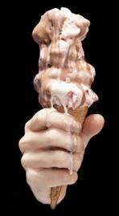
2. Ice Cream Melting
Answer: Physical Change (change in state)

Slide 15
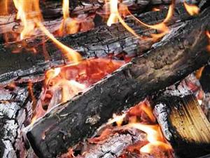
3. Wood burning
Answer: Chemical Change (into ash and smoke)

Slide 16
Activity 2: Think about one change you have observed at home and say whether it is chemical or physical.

Slide 17
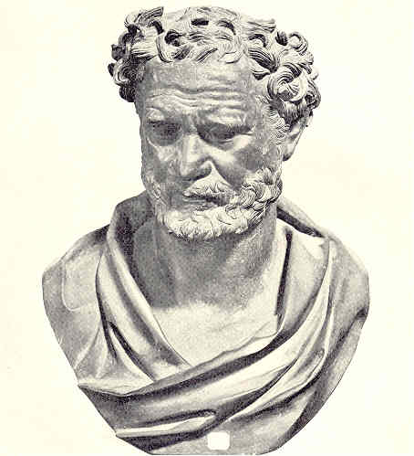
The Particulate Nature of Matter
Around 460 BC a Greek philosopher, Democritus, developed the idea that matter consisted of particles.
Today scientists have added to Democritus’ idea and now describe matter and its properties using the particle theory of matter.

Slide 18
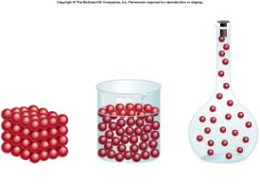
What Is The Particle Theory Of Matter?
The particle theory of matter is a very useful model which helps to explain both the physical properties of matter and also the differences between the three states of matter.

Slide 19
What Are The Main Ideas In The Particle Theory of Matter?
All matter is made up of particles
There are spaces between the particles
The particles are in constant random motion
Particle Theory of Matter
There are forces of attraction and repulsion between the particles

Slide 20
Physical Phenomena That The Particle Theory Of Matter Helps To Explain
The differences in density of solids and liquids, e.g. why ice floats on water
Surface tension in liquids, e.g. how certain insects can ‘walk’ on water
How cooling a liquid can cause it to change into a solid
Why a smell can move throughout a room
Why the pressure in a gas increases with an increase in temperature, e.g. car tyres get harder as you drive

Slide 21
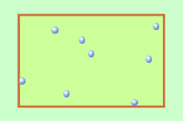
Temperature & Kinetic Energy
Increasing the temperature of a substance increases the kinetic energy of the particles in the substance.
The greater the kinetic energy of a particle, the greater the speed at which the particle moves.

Slide 23
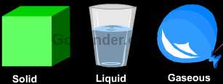
States of Matter

Slide 24
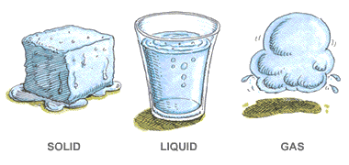
Matter can exist in various forms or states.
The three states of matter that are the most common are the solid, liquid and gaseous states.

Slide 25
Changing From One State To Another
Matter can change from one physical state to another without changing its chemical properties.
Example
Water as a solid (ice) has the same particles as water as a liquid as does water as a gas (water vapour).
The only difference is the arrangement and energy of the particles as a result of changes in temperature.

Slide 26
Particles in Solids, Liquids & Gases
Solids
Particles packed together tightly.
Solids have a definite shape.
Even though a solid does not appear to move, the particles are constantly vibrating in place.
Liquids
Particles in contact with each other, but not as close as in solids.
Particles slip and slide past one another. Because this, liquids take the shape of their container.
Gases
Very large spaces between particles.
Particles can move freely in all directions, this is why gases always spread out or diffuse to fill their container.

Slide 27
Activity 3: List three examples each of solids, liquids and gases that are in the classroom right now.
Solids | Liquids | Gases

Slide 28
Summary
In this lesson, we covered the following:
Definitions: chemistry, matter & energy
Chemical & physical properties & changes
Classification of matter
The law of constant composition
States of matter

