Slide 1
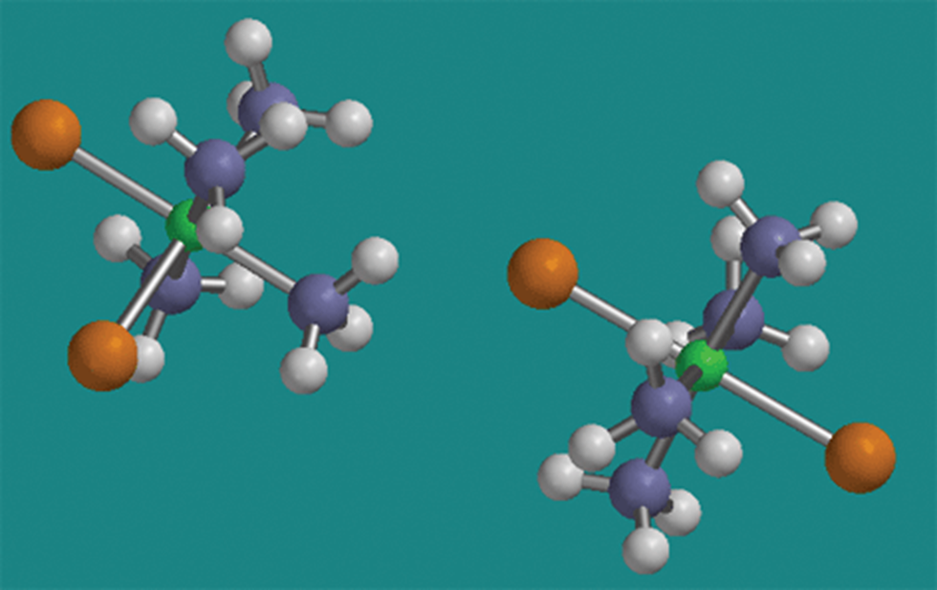
Structural Isomerism

Slide 2
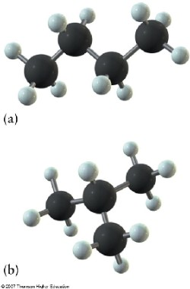
Structural Isomerism
Structural isomers are molecules with the same molecular formula, but with different structural formulae.

Slide 3
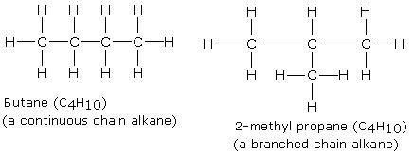
Example 1: Structural Isomers of butane, C₄H₁₀

Slide 4
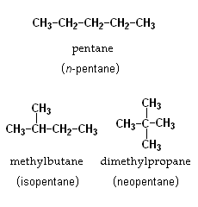
Example 2: Structural Isomers of pentane, C₅H₁₂

Slide 5
Example 3: Structural Isomers of butene, C₄H₈
but-2-ene
but-1-ene
2-methylpropene

Slide 6
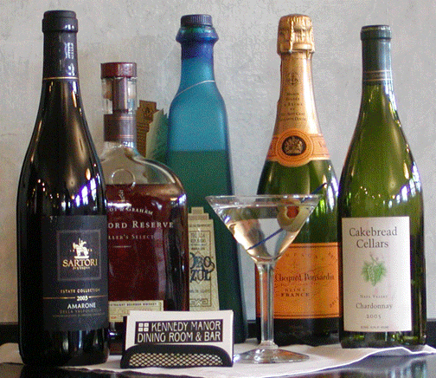
Alcohols

Slide 7
Alcohols
What everybody knows as ‘alcohol’ is just one member of a large family (homologous series) of similar compounds.
Alcohols all contain an –OH group covalently bonded onto a carbon chain.
General formula of alcohols: C_{n}H_{2n+1}OH

Slide 8
Names of some alcohols
Number of carbons | Molecular Formula | Name
1 | CH₃OH | methanol
2 | C₂H₅OH | ethanol
3 | C₃H₇OH | propanol
4 | C₄H₉OH | butanol
5 | C₅H₁₁OH | pentanol
6 | C₆H₁₃OH | hexanol
7 | C₇H₁₅OH | heptanol
8 | C₈H₁₇OH | octanol
9 | C₉H₁₉OH | nonanol
10 | C₁₀H₂₁OH | decanol

Slide 9
Drawings of alcohols
Methanol, CH₃OH 2. Ethanol, C₂H₅OH
3. Propanol, C₃H₇OH 4. Butanol, C₄H₉OH

Slide 10
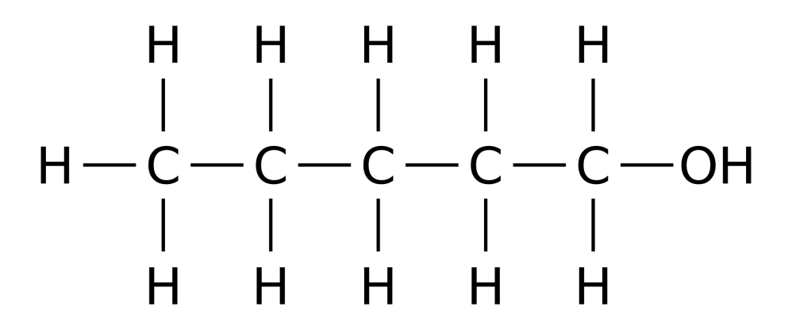
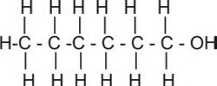
5. Pentanol, C₅H₁₁OH 6. Hexanol, C₆H₁₃OH
7. Heptanol, C₇H₁₅OH

Slide 11
Activity: Draw the Structural Formula of each
Compound listed below.
8. Octanol, C₈H₁₇OH
9. Nonanol, C₉H₁₉OH
10. Decanol, C₁₀H₂₁OH

Slide 12
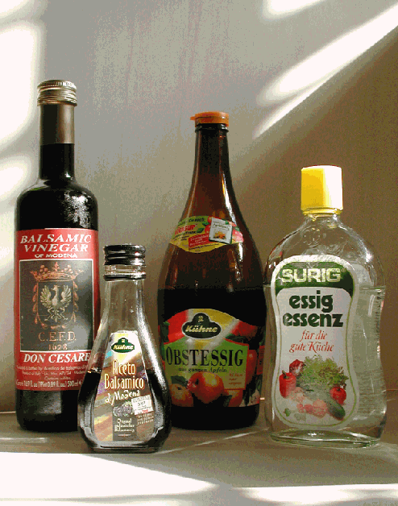
Carboxylic Acids

Slide 13
Carboxylic Acids
Carboxylic acids are organic compounds with the carboxyl functional group –COOH.
The carboxyl group can also be represented as:
The general formula for the carboxylic acids which contain one –COOH group is C_{n}H_{2n+1}COOH

Slide 14
Names of some carboxylic acids
Number of carbons | Molecular Formula | Name
1 | HCOOH | methanoic acid
2 | CH₃COOH | ethanoic acid
3 | C₂H₅COOH | propanoic acid
4 | C₃H₇COOH | butanoic acid
5 | C₄H₉COOH | pentanoic acid
6 | C₅H₁₁COOH | hexanoic acid
7 | C₆H₁₃COOH | heptanoic acid
8 | C₇H₁₅COOH | octanoic acid
9 | C₈H₁₇COOH | nonanoic acid
10 | C₉H₁₉COOH | decanoic acid

Slide 15
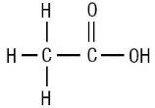
Drawings of carboxylic acids
Methanoic acid , HCOOH
2. Ethanoic acid, CH₃COOH

Slide 16
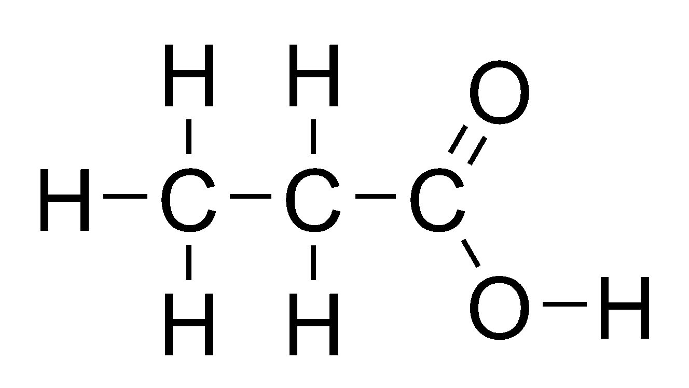
3. Propanoic acid , C₂H₅COOH
4. Butanoic acid, C₃H₇COOH

Slide 17
5. Pentanoic acid , C₄H₉COOH

Slide 18
Activity: Draw the Structural Formula of each
Compound listed below.
6. Hexanoic Acid, C₅H₁₁COOH
7. Heptanoic Acid, C₆H₁₃COOH
8. Octanoic Acid, C₇H₁₅COOH
9. Nonanoic Acid, C₈H₁₇COOH
10. Decanoic Acid, C₉H₁₉COOH

