Slide 1
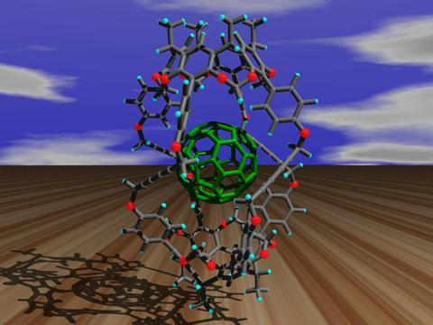
Organic Chemistry

Slide 2
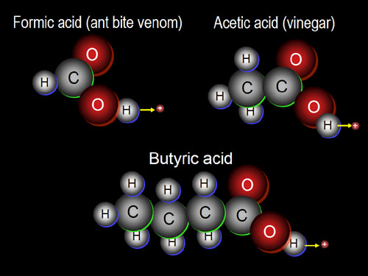
What is organic chemistry?
Organic chemistry is the branch of chemistry in which carbon compounds are studied.

Slide 3
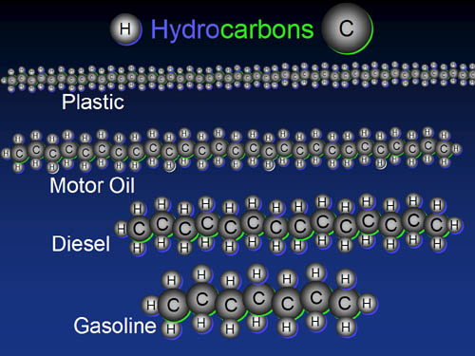
What are hydrocarbons?
All organic compounds contain carbon. Those that contain only carbon and hydrogen are called hydrocarbons.

Slide 4
Remember: When Forming Bonds…
Carbon, C, forms 4 bonds.
Hydrogen, H, forms 1 bond.
Oxygen, O, forms 2 bonds.

Slide 5
Classification of Organic Compounds
Organic compounds may be classified on the basis of the type of bonds that are in the compound.
Compounds in which only single bonds occur between carbon atoms are called saturated compounds, while those with double or triple bonds are known as unsaturated compounds.

Slide 6
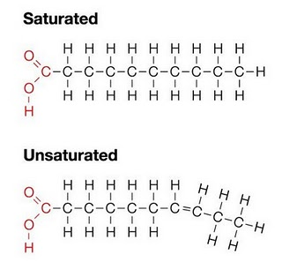
Saturated & Unsaturated Organic Compounds

Slide 7
Functional Groups
Organic compounds are classified into groups based on the functional group which they contain.
A functional group contains a particular bond between two carbon atoms, e.g. a double bond, or is a particular atom or a particular group of atoms.
All members of a group contain the same functional group which determines the properties of that group. The group is known as a homologous series.

Slide 8
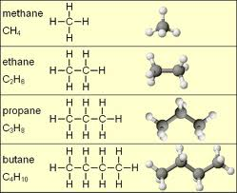
Homologous Series
A homologous series is a group of compounds which all possess the same functional group. Members of homologous series all have the same general formula.

Slide 9
Characteristics of a homologous series
All members of the series can be represented by the same general formula
Each member of the series differs from the members before or after it by a – CH₂- functional group
All members of the series possess similar chemical properties
All members of the series show a gradual change in their physical properties as their molecular mass increases. In general, as molar mass increases, melting point, boiling point and density increase

Slide 10
Types of formulae for organic compounds

Slide 11
Molecular Formulae
A molecular formula simply counts the numbers of each sort of atom present in the molecule, but tells you nothing about the way they are joined together.
For example the molecular formula of propane is C₃H₈, and the molecular formula of ethene is C₂H₄.
Molecular formulae are very rarely used in organic chemistry, because they don’t give any useful information about the bonding in the molecule.

Slide 12
Structural Formulae
A structural formula shows how the atoms are joined up.
There are two ways of representing structural formulae – they can be drawn as a displayed formula or they can be written out.
Example: propane
Structural Formula Displayed Formula
CH₃CH₂CH₃

Slide 13
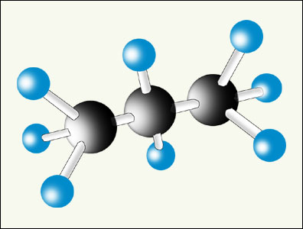
Displayed Formulae
A displayed formula shows all the bonds in the molecule as individual lines. Each line represents a pair of shared electrons.
Model of Propane Displayed Formula of Propane
The way the displayed formula is drawn bears no resemblance to the shape of the actual molecule. Displayed formulae are always drawn with the molecule straightened out and flattened. They show exactly how all the atoms are joined together.

Slide 14
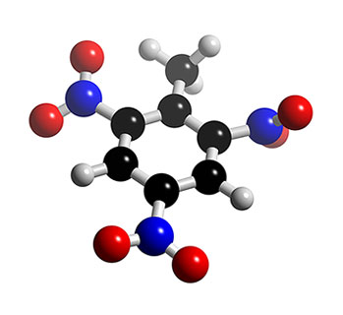
Naming Organic Compounds
The process of naming chemical compounds is known as chemical nomenclature.
The main function of chemical nomenclature is to ensure that when a person reads a chemical name there is no ambiguity as to which chemical compound it refers.

Slide 15
Naming straight chain members of a homologous series
The names of straight chain members of a homologous series consists of two parts:
The first part or stem, depends on the total number of carbon atoms present in the chain of carbon atoms.
The second part, or suffix, depends on the functional group present in the molecule.

Slide 16
Stem names for organic compounds up to ten carbon atoms in size
Number of carbon atoms | Stem name
1 | meth-
2 | eth-
3 | prop-
4 | but-
5 | pent-
6 | hex-
7 | hept-
8 | oct-
9 | non-
10 | dec-

Slide 17
Suffixes for the homologous series you will be studying
Name of homologous series | General formula | ‘Suffix’
Alkane | C_{n}H_{2n+2} | -ane
Alkene | C_{n}H_{2n} | -ene
Alcohol | C_{n}H_{2n+1}OH | -anol
Carboxylic Acid | C_{n}H_{2n+1}COOH | -anoic acid

Slide 18
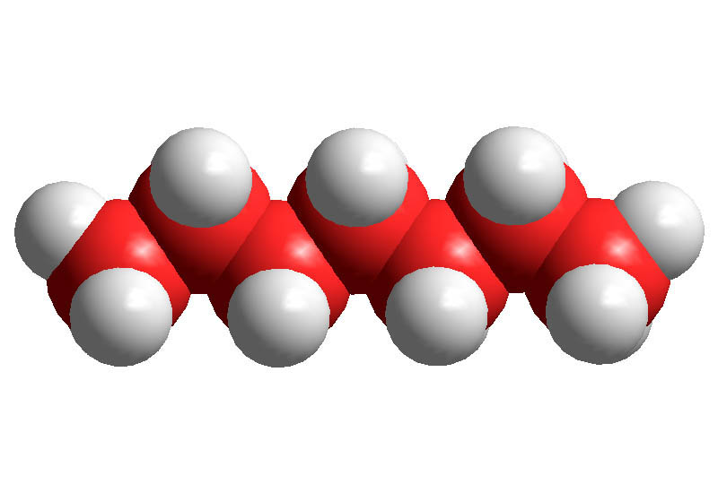
Alkanes
Alkanes are hydrocarbons in which all the carbons are joined to each other with single covalent bonds.
Compounds like this are coded with the ending ‘ane’.
General Formula: C_{n}H_{2n+2}

Slide 19
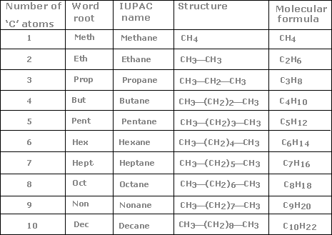
Names of some straight-chain alkanes

Slide 20
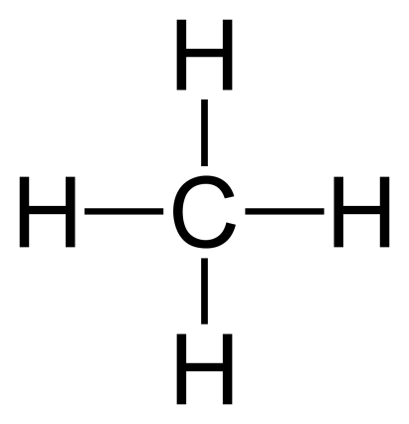
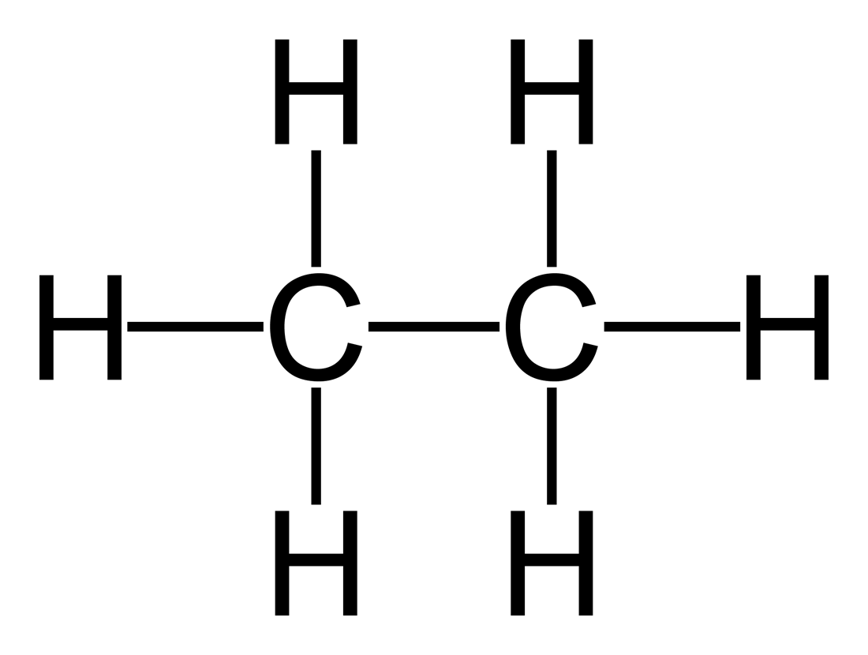
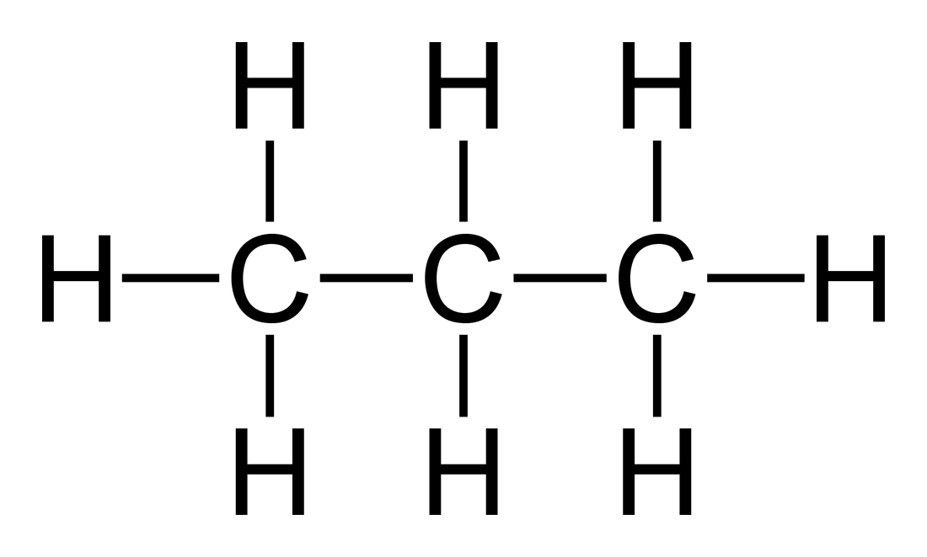
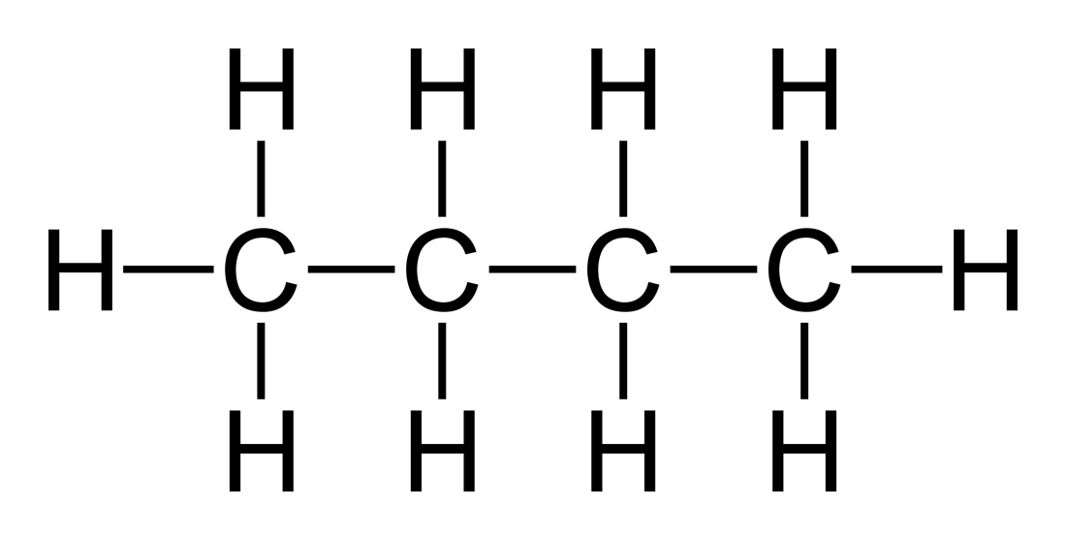
Drawings of alkanes
Methane, CH₄ 2. Ethane, C₂H₆
3. Propane, C₃H₈ 4. Butane, C₄H₁₀

Slide 21
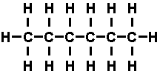
5. Pentane, C₅H₁₂ 6. Hexane, C₆H₁₄
7. Heptane, C₇H₁₆ 8. Octane, C₈H₁₈

Slide 22
9. Nonane, C₉H₂₀
10. Decane, C₁₀H₂₂

Slide 23
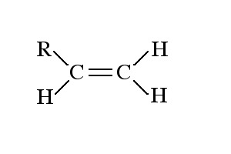
Alkenes
Alkenes contain a carbon-carbon double bond.
This is shown in their name by the ending ‘ene’.
General Formula: C_{n}H_{2n}

Slide 24
Names of some alkenes
Number of carbons | Molecular Formula | Name
2 | C₂H₄ | ethene
3 | C₃H₆ | propene
4 | C₄H₈ | butene
5 | C₅H₁₀ | pentene
6 | C₆H₁₂ | hexene
7 | C₇H₁₄ | heptene
8 | C₈H₁₆ | octene
9 | C₉H₁₈ | nonene
10 | C₁₀H₂₀ | decene

Slide 25
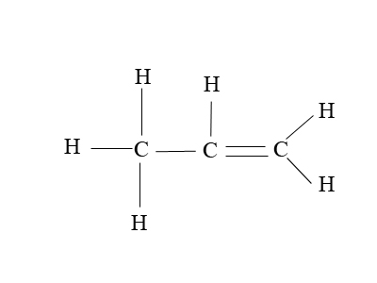
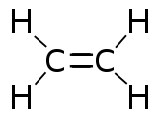
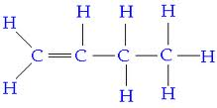
Drawings of alkenes
Ethene, C₂H₄ 2. Propene, C₃H₆
3. Butene, C₄H₈ 4. Pentene, C₅H₁₀
(but-1-ene) (pent-1-ene)

Slide 26
Activity: Draw the Structural Formula of each
Compound listed below.
5. Hexene, C₆H₁₂ 6. Heptene, C₇H₁₄
(hex-1-ene) (hept-1-ene)
7. Octene, C₈H₁₆ 8. Nonene, C₉H₁₈
(oct-1-ene) (non-1-ene)
9. Decene, C₁₀H₂₀
(dec-1-ene)

Slide 27
Position of the double bond in alkenes
Ethene is a 2-carbon chain containing a carbon-carbon double bond, CH₂=CH₂.
With longer chains, the position of the double bond could vary in the chain.
Example: butene
This is shown by numbering the chain and noting which carbon atom the double bond starts from.
The compounds above would be named but-1-ene and but-2-ene.

Slide 28
How do you know which end of the chain to number from?
Rule: You number from the end which produces the smaller numbers in the name.
Example: Name the alkene below.
Answer: pent-1-ene NOT pent-4-ene!

