Slide 1
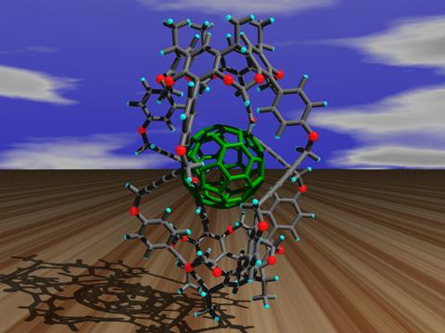
Organic Chemistry

Slide 2
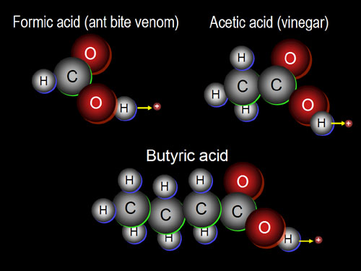
What is organic chemistry?
Organic chemistry is the branch of chemistry in which carbon compounds are studied.

Slide 3
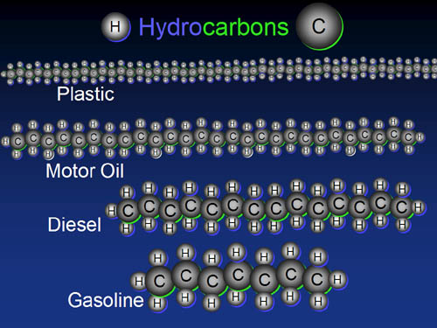
What are hydrocarbons?
All organic compounds contain carbon. Those that contain only carbon and hydrogen are called hydrocarbons.

Slide 4
Remember: When Forming Bonds…
Carbon, C, forms 4 bonds.
Hydrogen, H, forms 1 bond.
Oxygen, O, forms 2 bonds.

Slide 5
Classification of Organic Compounds
Organic compounds may be classified on the basis of the type of bonds that are in the compound.
Compounds in which only single bonds occur between carbon atoms are called saturated compounds, while those with double or triple bonds are known as unsaturated compounds.

Slide 6
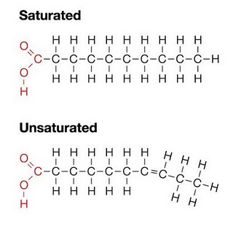
Saturated & Unsaturated Organic Compounds

Slide 7
Functional Groups
Organic compounds are classified into groups based on the functional group which they contain.
A functional group contains a particular bond between two carbon atoms, e.g. a double bond, or is a particular atom or a particular group of atoms.
All members of a group contain the same functional group which determines the properties of that group. The group is known as a homologous series.

Slide 8
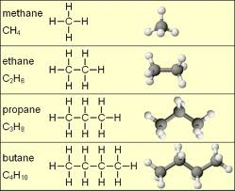
Homologous Series
A homologous series is a group of compounds which all possess the same functional group. Members of homologous series all have the same general formula.

Slide 9
Characteristics of a homologous series
All members of the series can be represented by the same general formula
Each member of the series differs from the members before or after it by a – CH₂- functional group
All members of the series possess similar chemical properties
All members of the series show a gradual change in their physical properties as their molecular mass increases. In general, as molar mass increases, melting point, boiling point and density increase

Slide 10
Types of formulae for organic compounds

Slide 11
Molecular Formulae
A molecular formula simply counts the numbers of each sort of atom present in the molecule, but tells you nothing about the way they are joined together.
For example the molecular formula of propane is C₃H₈, and the molecular formula of ethene is C₂H₄.
Molecular formulae are very rarely used in organic chemistry, because they don’t give any useful information about the bonding in the molecule.

Slide 12
Structural Formulae
A structural formula shows how the atoms are joined up.
There are two ways of representing structural formulae – they can be drawn as a displayed formula or they can be written out.
Example: propane
Structural Formula Displayed Formula
CH₃CH₂CH₃

Slide 13
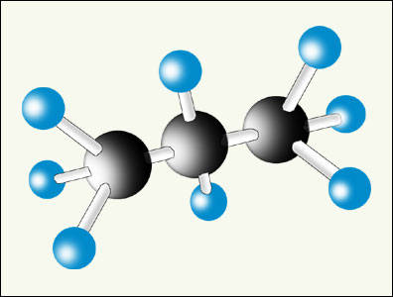
Displayed Formulae
A displayed formula shows all the bonds in the molecule as individual lines. Each line represents a pair of shared electrons.
Model of Propane Displayed Formula of Propane
The way the displayed formula is drawn bears no resemblance to the shape of the actual molecule. Displayed formulae are always drawn with the molecule straightened out and flattened. They show exactly how all the atoms are joined together.

Slide 14
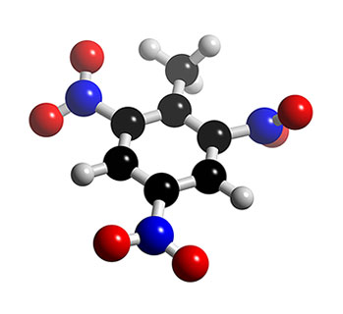
Naming Organic Compounds
The process of naming chemical compounds is known as chemical nomenclature.
The main function of chemical nomenclature is to ensure that when a person reads a chemical name there is no ambiguity as to which chemical compound it refers.

Slide 15
Naming straight chain members of a homologous series
The names of straight chain members of a homologous series consists of two parts:
The first part or stem, depends on the total number of carbon atoms present in the chain of carbon atoms.
The second part, or suffix, depends on the functional group present in the molecule.

Slide 16
Stem names for organic compounds up to ten carbon atoms in size
Number of carbon atoms | Stem name
1 | meth-
2 | eth-
3 | prop-
4 | but-
5 | pent-
6 | hex-
7 | hept-
8 | oct-
9 | non-
10 | dec-

Slide 17
Suffixes for the homologous series you will be studying
Name of homologous series | General formula | ‘Suffix’
Alkane | C_{n}H_{2n+2} | -ane
Alkene | C_{n}H_{2n} | -ene
Alcohol | C_{n}H_{2n+1}OH | -anol
Carboxylic Acid | C_{n}H_{2n+1}COOH | -anoic acid

Slide 18
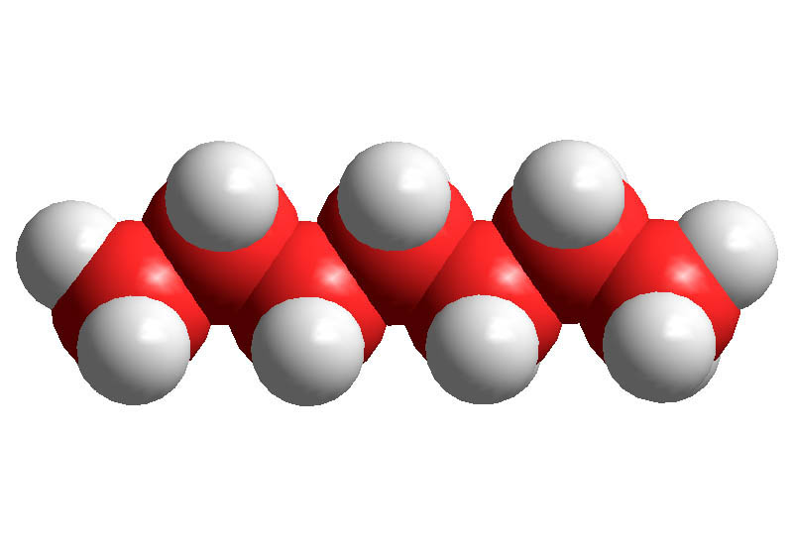
Alkanes
Alkanes are hydrocarbons in which all the carbons are joined to each other with single covalent bonds.
Compounds like this are coded with the ending ‘ane’.
General Formula: C_{n}H_{2n+2}

Slide 19
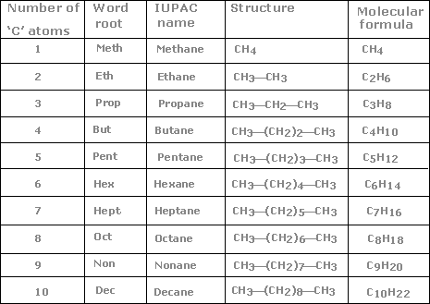
Names of some straight-chain alkanes

Slide 20
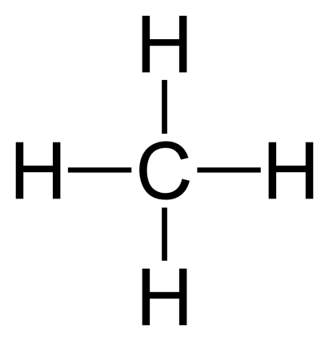
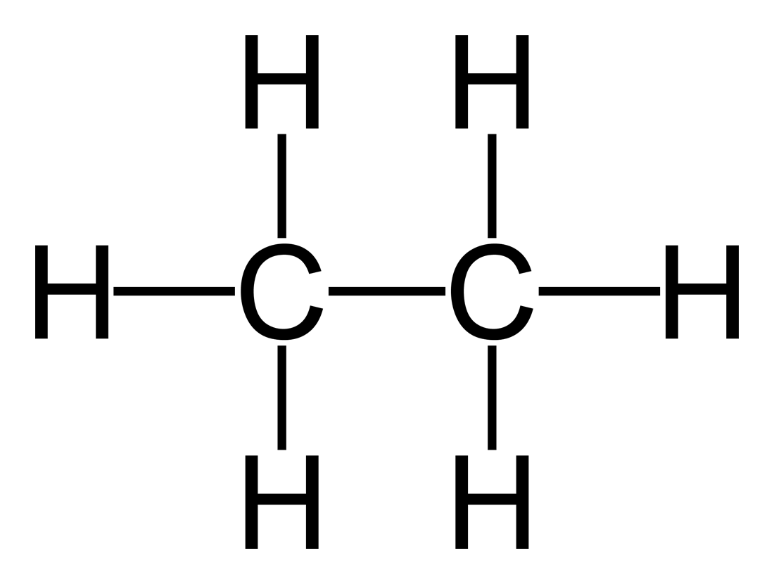
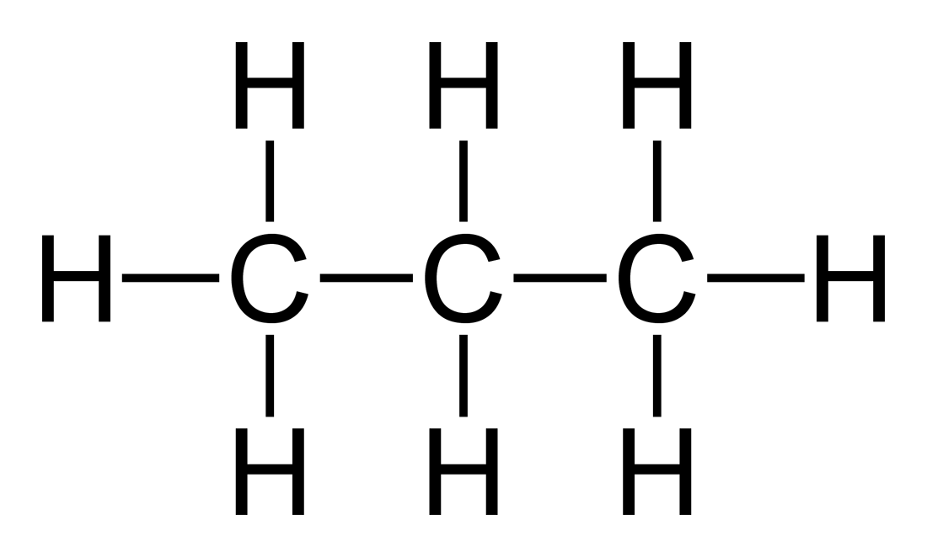
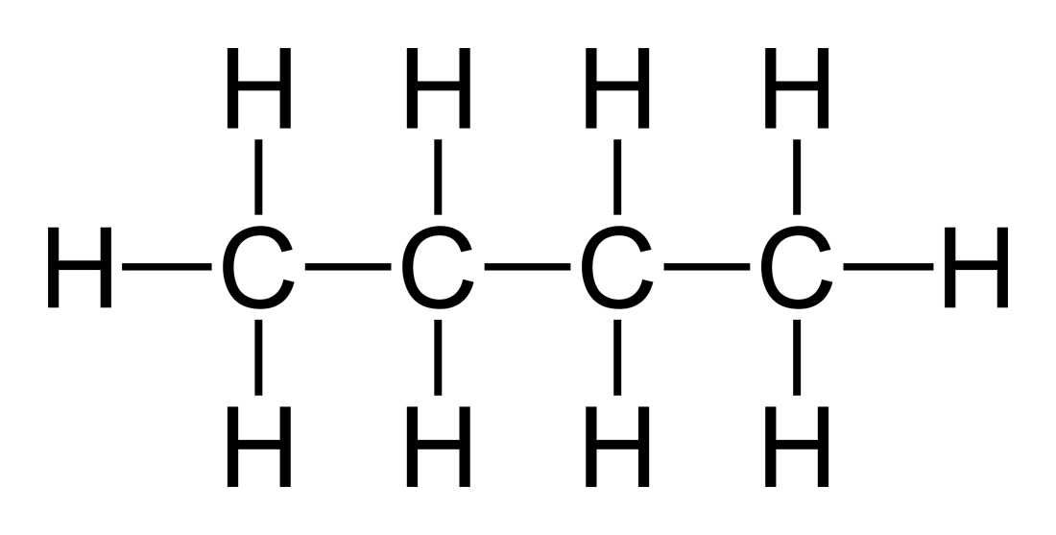
Drawings of alkanes
Methane, CH₄ 2. Ethane, C₂H₆
3. Propane, C₃H₈ 4. Butane, C₄H₁₀

Slide 21
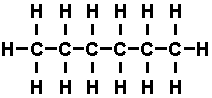
5. Pentane, C₅H₁₂ 6. Hexane, C₆H₁₄
7. Heptane, C₇H₁₆ 8. Octane, C₈H₁₈

Slide 22
9. Nonane, C₉H₂₀
10. Decane, C₁₀H₂₂

Slide 23
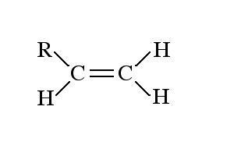
Alkenes
Alkenes contain a carbon-carbon double bond.
This is shown in their name by the ending ‘ene’.
General Formula: C_{n}H_{2n}

Slide 24
Names of some alkenes
Number of carbons | Molecular Formula | Name
2 | C₂H₄ | ethene
3 | C₃H₆ | propene
4 | C₄H₈ | butene
5 | C₅H₁₀ | pentene
6 | C₆H₁₂ | hexene
7 | C₇H₁₄ | heptene
8 | C₈H₁₆ | octene
9 | C₉H₁₈ | nonene
10 | C₁₀H₂₀ | decene

Slide 25
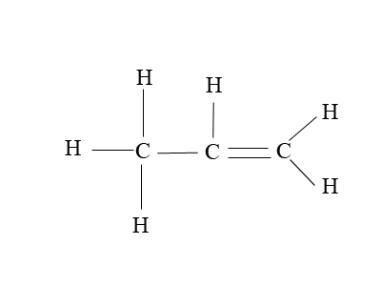
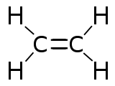
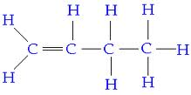
Drawings of alkenes
Ethene, C₂H₄ 2. Propene, C₃H₆
3. Butene, C₄H₈ 4. Pentene, C₅H₁₀
(but-1-ene) (pent-1-ene)

Slide 26
Activity: Draw the Structural Formula of each
Compound listed below.
5. Hexene, C₆H₁₂ 6. Heptene, C₇H₁₄
(hex-1-ene) (hept-1-ene)
7. Octene, C₈H₁₆ 8. Nonene, C₉H₁₈
(oct-1-ene) (non-1-ene)
9. Decene, C₁₀H₂₀
(dec-1-ene)

Slide 27
Position of the double bond in alkenes
Ethene is a 2-carbon chain containing a carbon-carbon double bond, CH₂=CH₂.
With longer chains, the position of the double bond could vary in the chain.
Example: butene
This is shown by numbering the chain and noting which carbon atom the double bond starts from.
The compounds above would be named but-1-ene and but-2-ene.

Slide 28
How do you know which end of the chain to number from?
Rule: You number from the end which produces the smaller numbers in the name.
Example: Name the alkene below.
Answer: pent-1-ene NOT pent-4-ene!

Slide 29
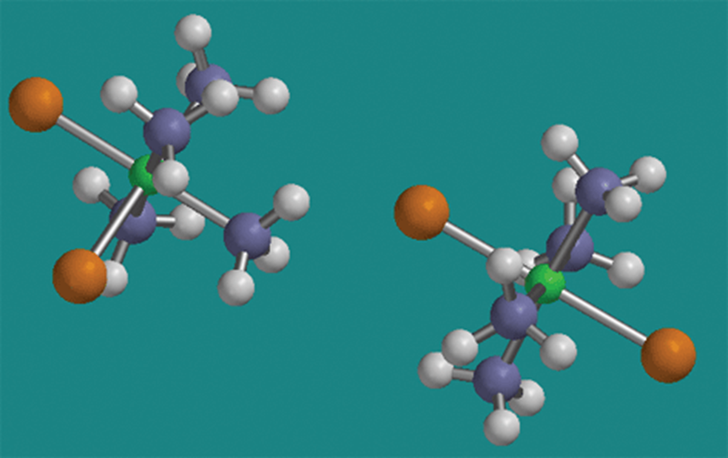
Structural Isomerism

Slide 30
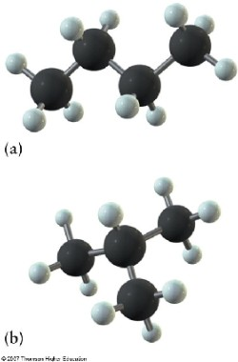
Structural Isomerism
Structural isomers are molecules with the same molecular formula, but with different structural formulae.

Slide 31
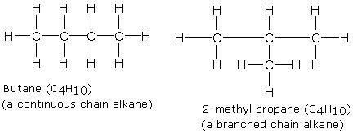
Example 1: Structural Isomers of butane, C₄H₁₀

Slide 32
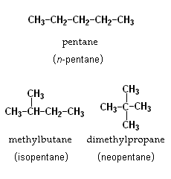
Example 2: Structural Isomers of pentane, C₅H₁₂

Slide 33
Example 3: Structural Isomers of butene, C₄H₈
but-2-ene
but-1-ene
2-methylpropene

Slide 34
Alcohols

Slide 35
Alcohols
What everybody knows as ‘alcohol’ is just one member of a large family (homologous series) of similar compounds.
Alcohols all contain an –OH group covalently bonded onto a carbon chain.
General formula of alcohols: C_{n}H_{2n+1}OH

Slide 36
Names of some alcohols
Number of carbons | Molecular Formula | Name
1 | CH₃OH | methanol
2 | C₂H₅OH | ethanol
3 | C₃H₇OH | propanol
4 | C₄H₉OH | butanol
5 | C₅H₁₁OH | pentanol
6 | C₆H₁₃OH | hexanol
7 | C₇H₁₅OH | heptanol
8 | C₈H₁₇OH | octanol
9 | C₉H₁₉OH | nonanol
10 | C₁₀H₂₁OH | decanol

Slide 37
Drawings of alcohols
Methanol, CH₃OH 2. Ethanol, C₂H₅OH
3. Propanol, C₃H₇OH 4. Butanol, C₄H₉OH

Slide 38
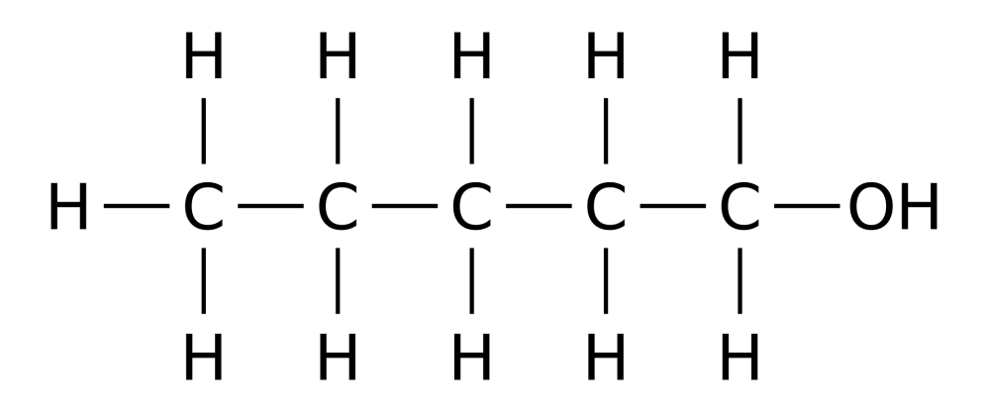
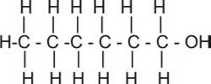
5. Pentanol, C₅H₁₁OH 6. Hexanol, C₆H₁₃OH
7. Heptanol, C₇H₁₅OH

Slide 39
Activity: Draw the Structural Formula of each
Compound listed below.
8. Octanol, C₈H₁₇OH
9. Nonanol, C₉H₁₉OH
10. Decanol, C₁₀H₂₁OH

Slide 40
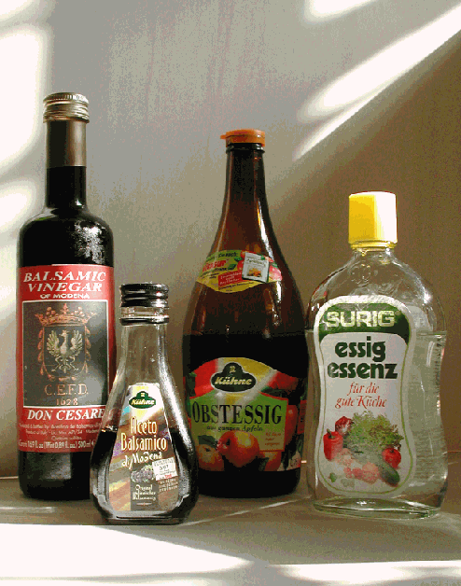
Carboxylic Acids

Slide 41
Carboxylic Acids
Carboxylic acids are organic compounds with the carboxyl functional group –COOH.
The carboxyl group can also be represented as:
The general formula for the carboxylic acids which contain one –COOH group is C_{n}H_{2n+1}COOH

Slide 42
Names of some carboxylic acids
Number of carbons | Molecular Formula | Name
1 | HCOOH | methanoic acid
2 | CH₃COOH | ethanoic acid
3 | C₂H₅COOH | propanoic acid
4 | C₃H₇COOH | butanoic acid
5 | C₄H₉COOH | pentanoic acid
6 | C₅H₁₁COOH | hexanoic acid
7 | C₆H₁₃COOH | heptanoic acid
8 | C₇H₁₅COOH | octanoic acid
9 | C₈H₁₇COOH | nonanoic acid
10 | C₉H₁₉COOH | decanoic acid

Slide 43
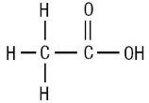
Drawings of carboxylic acids
Methanoic acid , HCOOH
2. Ethanoic acid, CH₃COOH

Slide 44
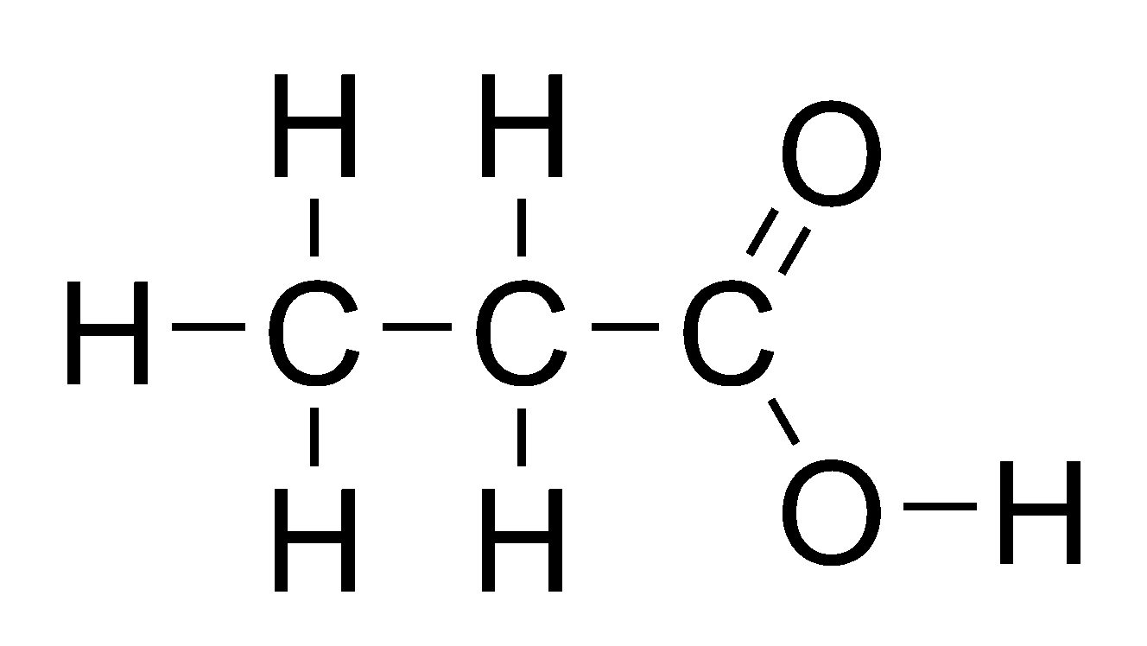
3. Propanoic acid , C₂H₅COOH
4. Butanoic acid, C₃H₇COOH

Slide 45
5. Pentanoic acid , C₄H₉COOH

Slide 46
Activity: Draw the Structural Formula of each
Compound listed below.
6. Hexanoic Acid, C₅H₁₁COOH
7. Heptanoic Acid, C₆H₁₃COOH
8. Octanoic Acid, C₇H₁₅COOH
9. Nonanoic Acid, C₈H₁₇COOH
10. Decanoic Acid, C₉H₁₉COOH

Slide 47
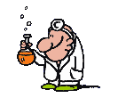
Summary
In this lesson we learnt how to:
Define organic chemistry & identify organic compounds
Explain the existence of numerous organic compounds
3. Recognize the importance of organic compounds

Slide 48
Summary
4. Define and identify functional groups
5. Name organic compounds: alkanes, alkenes, alkynes, alcohols & carboxylic acids up to 10 carbon atoms.
6. Draw structural formula of organic compounds
7. Identify structural isomers of organic compounds
8. Discuss and predict the physical and chemical characteristics of given homologous series.

