Slide 1
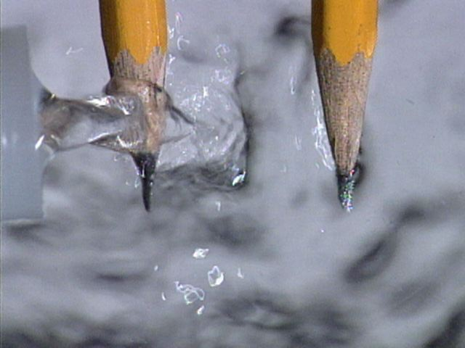
The Electrolysis of Aqueous Solutions

Slide 2
The electrolysis of aqueous solutions
Aqueous solutions are solutions in water.
Water is a very weak electrolyte. It ionises very slightly to give hydrogen ions and hydroxide ions.
H₂O_{(l)} H⁺_{(aq)} + OH⁻_{(aq)}
Solutions, therefore, always contain H⁺ and OH⁻ ions.
Whenever you have water present, you have to consider these ions as well as the ions in the compound you are electrolysing.

Slide 3
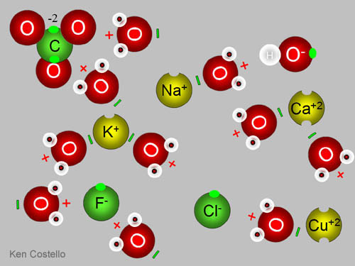
Preferential Discharge of Ions
In the electrolysis of compounds which contain more than one type of anion or cation, one type of ion will be discharged in preference to the other. This is known as preferential discharge of ions.

Slide 4
Factors which influence the preferential discharge of ions
1. The position of the ion in the electrochemical series.
The ions that are lower in the electrochemical series get discharged in preference to the ones above them. This is true for both the cations and the anions.
Example: If a solution contains Cu²⁺ ions these will be discharged in preference to H⁺ ions. But if a solution contains Na⁺, the H⁺ ions will be discharged in preference to the Na⁺ ions.

Slide 5
2. The concentration of the aqueous solution.
The concentration of the solution has an impact on which ions are preferentially discharged.
There is a tendency to promote the discharge of the most concentrated ion present.
This rule of concentration really only applies when comparing the anions, especially in solutions containing halide ions (Cl⁻, Br⁻, I⁻) and does not usually apply to the cations.

Slide 6
3. The nature of the electrodes: active and inert electrodes.
The type of electrodes chosen for the electrolysis also affects the reactions occurring at the electrodes, especially the anode.
Inert and active electrodes can be distinguished by the fact that inert electrodes do not take part in the chemical reaction whereas active electrodes do.
An example of an active electrode is copper, whereas graphite and platinum are examples of inert electrodes.

Slide 7
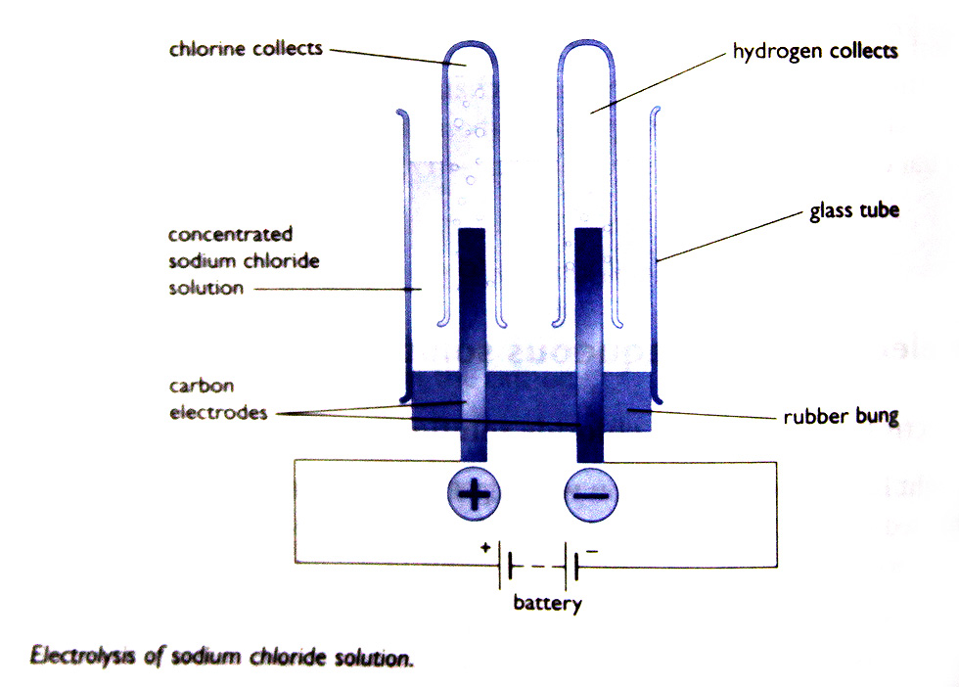
The electrolysis of concentrated sodium chloride solution

Slide 8
At the cathode:
The solution contains Na⁺_{(aq)} and H⁺_{(aq)} and these are both attracted to the negative cathode.
The H⁺_{(aq)} gets discharged because it is much easier to persuade a hydrogen ion to accept an electron than it is a sodium ion.
Each hydrogen atom formed combines with another one to make a hydrogen molecule.
2H⁺_{(aq)} + 2e⁻ → H_{2(g)}

Slide 9
At the anode:
Cl⁻_{(aq)} and OH⁻_{(aq)} are both attracted by the positive anode.
The hydroxide ion is slightly easier to discharge than the chloride ion is, but there isn't that much difference.
There are far, far more chloride ions present in the solution, and so it is mainly these which get discharged.
2Cl⁻_{(aq)} → Cl_{2(g)} + 2e⁻

Slide 10
The electrolysis of dilute sodium chloride solution
In a dilute solution there are fewer chloride ions and a different product is made.
Water ionises a little to give both hydrogen ions (H⁺) and hydroxide ions (OH⁻).
In a dilute solution it is the hydroxide ions that are discharged at the anode.
Hydroxide ions turn into water and oxygen gas. At the anode (+) oxygen gas bubbles off.

Slide 11
Position of ions in the electrochemical series
The position of an ion in the series tells us what the likely products of electrolysis will be.
Carbonate ion These ions are not discharged,
Nitrate ion we get oxygen instead.
Sulphate ion
Hydroxide ion from Halogens are discharged
the water (when concentrated) and
Chloride halide ions stay in solution.
Bromide
Iodide

Slide 12
Summary of the electrolysis of solutions using carbon electrodes
If the metal is high in the Reactivity Series, hydrogen is produced instead of the metal.
If the metal is below hydrogen in the Reactivity Series, the metal is produced.
If you have reasonably concentrated solutions of halides (chlorides, bromides of iodides) the halogen (chlorine, bromine or iodine) is produced. With other common negative ions, oxygen is produced.

Slide 13
Special Cases
Example: If you have a moderately reactive metal like zinc.
Reasonably concentrated solutions will give you the metal.
Very dilute solutions will give you mainly hydrogen.
In between, you will get both.

Slide 14
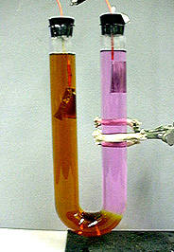
The electrolysis of some other solutions using carbon electrodes
KI_{(aq)}
Cathode Equation:
2H⁺_{(aq)} + 2e⁻ → H_{2(g)}
Anode Equation:
2I⁻ _{(aq)} → I_{2(aq)} + 2e⁻

Slide 15
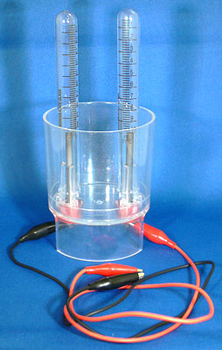
The electrolysis of some other solutions using carbon electrodes
MgBr_{2(aq)}
Cathode Equation:
2H⁺_{(aq)} + 2e⁻ → H_{2(g)}
Anode Equation:
2Br⁻ _{(aq)} → Br_{2(aq)} + 2e⁻

Slide 16
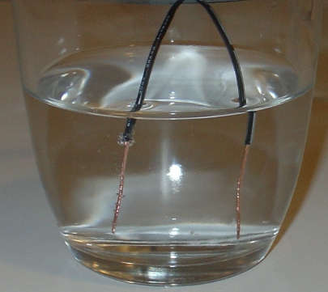
The electrolysis of some other solutions using carbon electrodes
H₂SO_{4(aq)}
Cathode Equation:
2H⁺_{(aq)} + 2e⁻ → H_{2(g)}
Anode Equation:
4OH⁻ _{(aq)} → 2H₂O_{(l)} + O_{2(g)} + 4e⁻

Slide 17
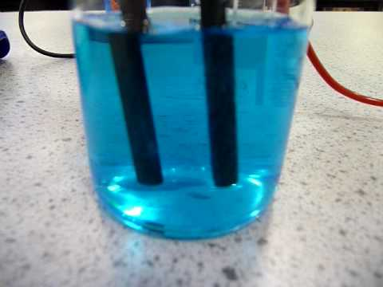
The electrolysis of some other solutions using carbon electrodes
CuSO_{4(aq)}
Cathode Equation:
Cu²⁺_{(aq)} + 2e⁻ → Cu_{(s)}
Anode Equation:
4OH⁻ _{(aq)} → 2H₂O_{(l)} + O_{2(g)} + 4e⁻

Slide 18
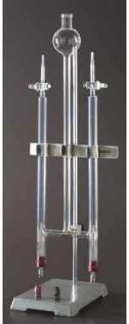
The electrolysis of some other solutions using carbon electrodes
HCl_{(aq)} (concentrated)
Cathode Equation:
2H⁺_{(aq)} + 2e⁻ → H_{2(g)}
Anode Equation:
2Cl⁻ _{(aq)} → Cl_{2(aq)} + 2e⁻

Slide 19
Active Electrodes
If you use metal electrodes rather than carbon, different things can happen at the anode, unless the metal is extremely unreactive – like platinum.
Positive ions are turned into atoms by taking electrons from the cathode. Electrons are pumped around the circuit from the anode to replace them. The reactions at the anode act as a source of these electrons.
So far, these electrons have come from negative ions giving up electrons to the anode, but there is another possibility. They can come from atoms in the electrode itself if that is an easier process.

Slide 20
The electrolysis of copper(II) sulphate solution using copper electrodes
A copper atom breaks away from the electrode forming a copper(II) ion, leaving its electrons behind on the electrode.
Those electrons can then be pumped away by the power source around the circuit to the cathode.
Cu_{(s)} → Cu²⁺_{(aq)} + 2e⁻

Slide 21
For every copper(II) ion that breaks away from the anode, two electrons are made available to pump around the circuit.
That’s exactly what you need to discharge a copper(II) ion arriving at the cathode.
Cu²⁺_{(aq)} + 2e⁻ → Cu_{(s)}

Slide 22
The overall effect is that:
the anode loses mass
the cathode gains exactly the same mass
the number of copper(II) ions in solution doesn’t change at all. For every one that is discharged at the cathode, another one goes into solution at the anode.

Slide 23
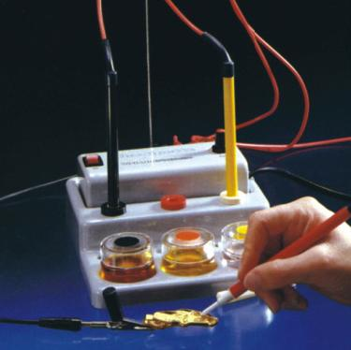
Electroplating

Slide 24
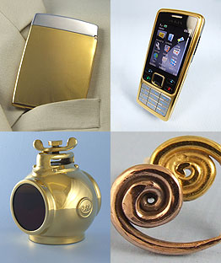
Electroplating
Electroplating consists of depositing a thin layer of one metal on top of another, either to protect the inner layer or for the sake of appearance.
The object which is being electroplated can be made of any metal, but most often it is made of brass, nickel or steel.

Slide 25
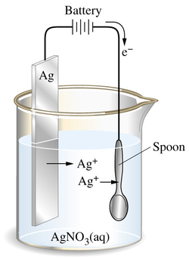
Example 1 – Silver Plating Electroplating A Spoon with Silver

Slide 26
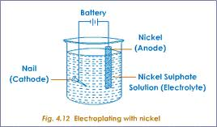
Example 2 – Nickel Plating Electroplating A Nail with Nickel

Slide 27
Electroplating Procedure
The object to be electroplated is made the cathode, i.e. it is connected to the negative terminal of the battery.
The anode is usually a pure sample of the metal which is being used for plating. The anode is therefore active and ionises.
The electrolyte must contain ions of the metal which is being used for plating.
Examples of electroplating are chromium plating, silver plating and nickel plating.

Slide 28
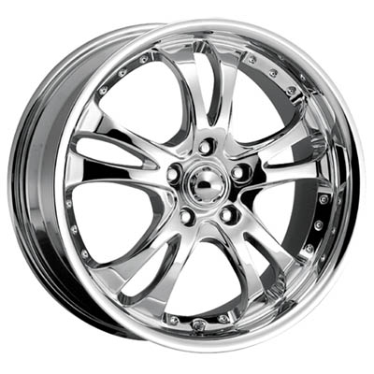
Example 3 -Chromium Plating

Slide 29
Chromium Plating
Chromium plating makes use of a steel cathode and a pure chromium anode.
The electrolyte is a mixture of chromium(III) sulphate and a wetting agent.
The wetting agent facilitates optimal bonding of the chromium to the steel object, preventing the chromium layer from flaking off easily.
Chromium plating improves the look and strength of the steel object as well as protecting the steel layer from corrosion.

Slide 30
Chromium Plating
The reaction at the anode is:
Cr_{(s)} → Cr³⁺_{(aq)} + 3e⁻
The reaction at the cathode is:
Cr³⁺_{(aq)} + 3e⁻ → Cr_{(s)}

