Slide 1
Sample Preparation – IR spectroscopy
Solid samples can be run as either KBr disks, Nujol mulls on NaCl plate, Film on NaCl plate or in CCl₄ solution

Slide 2
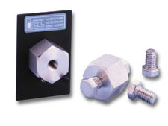
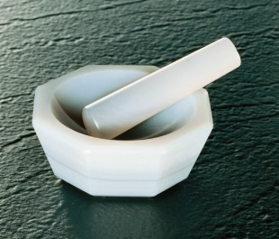
Preparation of KBr disks
Advantage to KBr disk: no overlapping signals from the matrix (KBr)
Disadvantage: may take practice to prepare good quality disks
Equipment required:
Agate mortar & pestle
Press, threaded anvils & sample holder

Slide 3
Sample Preparation Procedure:
Place a few mg (< 300 mg) of dry IR-grade KBr in an agate mortar. An amount of KBr sufficient to cover an area of about 20 mm² to a depth of 1 mm is sufficient.
Grind the KBr in the mortar until there is no evidence of crystallinity. A normal lab mortar will produce contamination of the pellet. An agate mortar avoids contamination.
Add a very small quantity of sample, about 1 to 2 mg is sufficient or about about 1 to 2% sample to KBr ratio.
Grind the sample into the KBr until it is uniformly distributed throughout the KBr.
Remove the press body and threaded anvils from the oven. Take care in the oven not to scratch the polished anvil surfaces.

Slide 4
Screw one anvil about half way into the body and then placing the KBr/sample matrix into the threaded hole in the body so that it covers the face of the anvil. Doing so while the body & anvils are still hot will reduce cloudiness in the pellet.
Then the body is either mounted in a vice while the other threaded anvil is turned against the stationary anvil on which the sample has been placed, or two wrenches are used to tighten the bolt style anvils simultaneously.
Apply pressure for about 1 minute, then remove bolts.
The bolts are then removed & the body is placed into a sample holder for analysis.
Afterwards, the sample is washed out of the body with water. The body is rinsed with acetone & returned to the oven.

Slide 5
Preparation of Nujol Mull for IR
Nujol is a mixture of alkanes and therefore contains only C-C and C-H bonds;
The principal absorptions of Nujol are associated with C-H vibrations. These absorptions should be subtracted from the final spectrum to obtain the spectrum of the solid.
IR spectrum of Nujol

Slide 6
Preparation of the Mull
First record the spectrum of PURE Nujol as a background: place a drop of Nujol between two sodium chloride plates. Rotate the plates to insure that Nujol is evenly distributed. Record the spectrum & afterwards clean the plates using Kimwipes and hexanes (or another solvent which you know to be free of water).
Now prepare the sample: a small amount is placed in the agate mortar and ground thoroughly to a very fine powder.
A small drop of Nujol is added & the mixture ground again to give a thick paste.
The paste is placed on the polished face of a sodium chloride plate.
Distribute the paste between the NaCl plates, as before
Record the spectrum, and clean up as before.
Please remember: contact w/ water will ruin the NaCl plates!

Slide 7
Preparation of Film for IR
Easiest method, always use for an oil.
Drop of liquid on NaCl plate
Measure spectrum
Clean plates with dry solvent

Slide 8
Preparation of Samples for Mass Spectra
Use Gas Chromatogram-Mass Spectrometer (GC-MS)
Mass spectrometry: requires analyte to enter gas phase, where it’s ionized. This is done using the GC.
If molecular weight too great (> 200 Daltons), then this is difficult using a GC-MS
Sample: ~ 1 mg/mL, or less, in sample vial
Use high purity solvents
Useful information from MS: M^{+•} (molecular formula); fragments lost from M+, presence of halogens, even/odd number of N atoms.

Slide 9
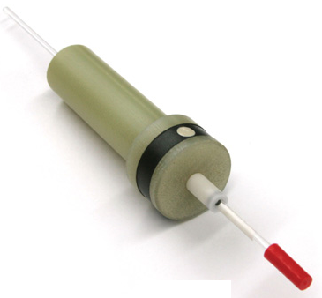
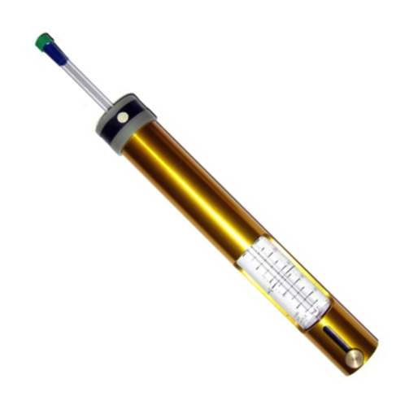
Sample Prep’n for NMR spectroscopy
Always use deuterated solvents: CDCl₃ & DMSO-D₆.
Deuterated solvents = very expensive, so only use what you need; dispensed from ampules.
Fill 5 mm diameter NMR tube to ~ 0.7 mL (“three fingers”)
Clean outside of tube with “normal” solvent & Kimwipe; failure to wipe grease and other chemicals off of the outside of the NMR tube will contaminate the spinner and may even cause the spinner to fail to grip the tube properly!!
Varian NMR Turbine
Varian Depth Gauge

Slide 10
Position tube in turbine with help of “Depth Gauge” If NMR tube slides up and down too easily in the turbine, then somebody has already contaminated the turbine (or it is old).
Cleaning NMR tubes: The best way is to rinse the tube a couple of times with HPLC-grade acetone. Either air-dry the tube (upside down!) or place it flat in a drying oven for ten minutes. Do NOT leave NMR tubes in a drying oven for extended periods of time – this causes them to warp under the force of gravity, thus making them non-cylindrical (which will make it more difficult to tune your sample).
NMR spectrometers are expensive & delicate. Misusing or abusing them can cause thousands of $s worth of damage. Most damage is avoidable. If you understand how the instrument works, you will also develop some feeling for why things should be done a specific way. Otherwise, you may damage the instrument so that you & everyone else will not be able to use it for an extended period of time.

