Slide 1
Chemical Equilibrium

Slide 2
Lessons 3 & 4 Objectives
Students should be able to:
1. Use the equilibrium constant expressed in terms of partial pressures (Kp) and relate Kp to Kc.
2. Describe heterogeneous equilibria and write their equilibrium constants.
3. Use the relationship between thermodynamics and equilibrium.
4. Estimate equilibrium constants at different temperatures.
5. Relate the variation of Gibbs free energy to pressure for an ideal gas.

Slide 3
6. Relate the variation of Gibbs free energy to temperature for an ideal gas
7. Use the free energy to determine the position of phase equilibria
8. Summarize the Clapeyron and the Clausius-Clapeyron equation for two phase systems
9. Use Raoult’s Law to define ideal solutions.

Slide 4
Partial Pressures & The Equilibrium Constant
It is often more convenient to measure pressures rather than concentrations of gases.

Slide 5
K_{p}
For reactions in which all substances that appear in the equilibrium constant expression are gases, we sometimes prefer to express the equilibrium constant in terms of partial pressures in atomospheres (K_{p}) rather than in terms of concentration (K_{c}).
aA(g) + bB(g) cC(g) + dD(g)
Kp = (P_{C})^{c}(P_{D})^{d}
(P_{A})ª(P_{B})^{b}

Slide 6
Group Calculations – Calculation of K_{p}
Review Examples 17-13
Work on Exercises 70 & 73

Slide 7
Relationship Between K_{p} & K_{c}
K_{p} = = K_{c} (RT)^{Δn} or K_{c} =K_{p}(RT)^{-Δn}
Δn = (n_{gas prod}) – (n_{gas react})
For reactions in which equal numbers of moles of gases appear on both sides of the equation, Δn = 0 and K_{p} = K_{c}.
For gas-phase reactions, we can calculate the amounts of substances present at equilibrium using either K_{p} or K_{c}.
The results are the same by either method (when they are both expressed in the same terms).

Slide 8
Group Calculations – Calculations with K_{c} and K_{p}
Review Examples 17-14
Work on Exercises 75 & 78

Slide 9
Heterogeneous Equilibria
Heterogeneous equilibria involve species in more than one phase.
Example: Consider the following reversible reaction at 25⁰C:
2HgO(s) 2Hg(l) + O₂(g)
Neither solids nor liquids are affected by changes in pressure.
For any pure solid or pure liquid, the activity is taken as 1, so terms for pure liquids and pure solids do not appear in the K expressions for heterogeneous equilibria.
Thus, for the example above,
K_{c} = [O₂] and K_{p} = P_{O2}

Slide 10
Group Calculations – K_{c} and K_{p} for Heterogenous Equilibria
Review Examples 17-15 & 17-16
Work on Exercises 80 & 91

Slide 11
Relationship Between ΔG⁰_{rxn} & Equilibrium Constant
The relationship between the standard free energy change and the thermodynamic equilibrium constant is:
ΔG⁰_{rxn} = -RT ln K

Slide 12
Relationship Between ΔG⁰_{rxn} & Equilibrium Constant
ΔG⁰_{rxn} = -RT ln K
When the relationship ΔG⁰_{rxn} = -RT ln K is used with:
all gaseous reactants and products, K represents K_{p};
all solution reactants and products K represents K_{c};
a mixture of solution and gaseous reactants, K represents the thermodynamic equilibrium constant, and we do not make the distinction between K_{p} and K_{c}.

Slide 13
Group Calculations – K Versus ΔGº_{rxn}
Review Examples 17-17, 17-18 & 17-19
Work on Exercises 84, 86 & 88(a)

Slide 14
Evaluation of Equilibrium Constants at Different Temperatures
If we determine the equilibrium constant, K_{T}, for a reaction at one temperature, T₁, and also its ΔH⁰, we can then estimate the equilibrium constant at a second temperature, T₂, using the van’t Hoff equation.
Thus, if we know ΔH⁰ for a reaction and K at a given temperature (say 298K), we can use the van’t Hoff equation to calculate the value of K at any other temperature.

Slide 15
Group Calculations – K Versus ΔGº_{rxn}
Review Examples 17-20
Work on Exercises 88(b-f)

Slide 16
Gibbs Free Energy: Temperature & Pressure Dependance

Slide 17
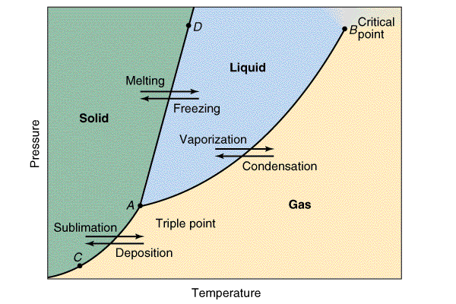
Phase Equilibria

Slide 18
Phase Equilibria
WRITE (individually):
The derivation of the Clapeyron and the Clausius-Clapeyron equation for two phase systems.
2. An explanation of how Raoult’s Law is used to define ideal solutions

Slide 19
Assignment
READ:
General Chemistry (9th Edition)
Chapter 17: Chemical Equilibrium, pages 685 – 702
- Chapter 18: Ionic Equilibria I: Acids and Bases, pages 703 – 742

Slide 20
References
1. General Chemistry (9th Edition)
Kenneth W. Whitten
Raymond E. Davis
M. Larry Peck
George G. Stanley
ISBN-13:978-0-495-39163-0
ISBN-10:0-495-39163-8

