Slide 1
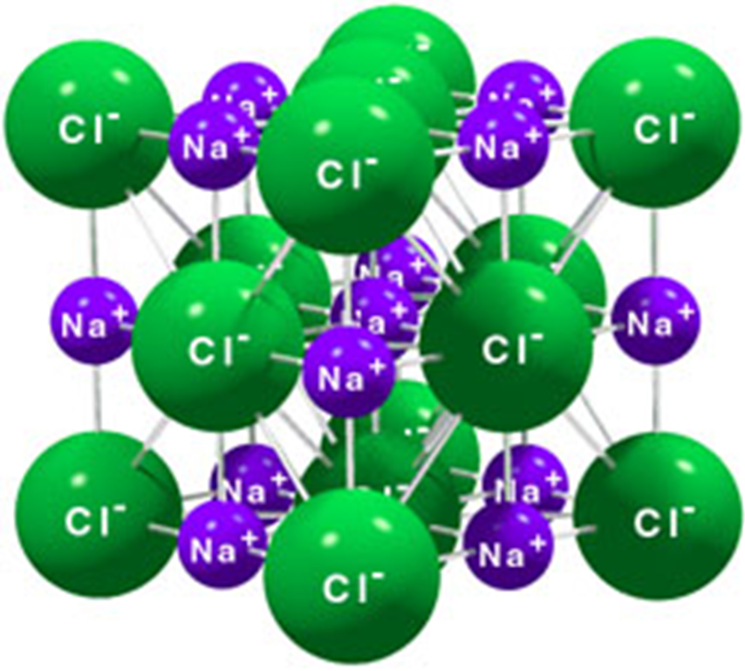
Giant Ionic Structures

Slide 2
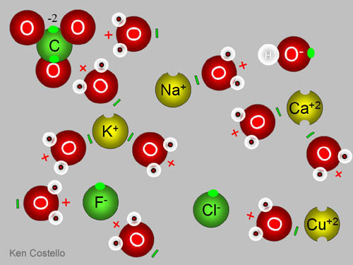
What are ions?
An ion is an atom or group of atoms which carries an electrical charge – either positive or negative.

Slide 3
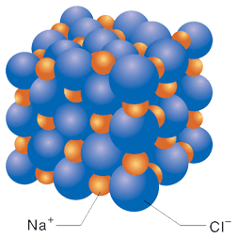
What are Giant Ionic Structures?
All ionic compounds consist of huge lattices of positive and negative ions packed together in a regular way.

Slide 4
What is a lattice?
A lattice is a regular array of particles.

Slide 5
How is the lattice held together?
The lattice is held together by the strong attractions between the positively and negatively charged ions.

Slide 6
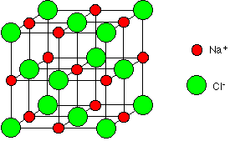
The structure of sodium chloride, NaCl

Slide 7
The structure of sodium chloride, NaCl
Only ions joined by lines in the diagram are actually touching.

Slide 8
The structure of sodium chloride, NaCl
Each sodium ion is touched by six chloride ions. In turn, each chloride ion is touched by six sodium ions. You have to remember that this structure repeats itself over vast numbers of ions.

Slide 9
The structure of sodium chloride, NaCl
Important Note: The lines in the diagram are NOT covalent bonds. They are just there to help to show the arrangement of the ions. Those ions joined by the lines are touching each other.

Slide 10
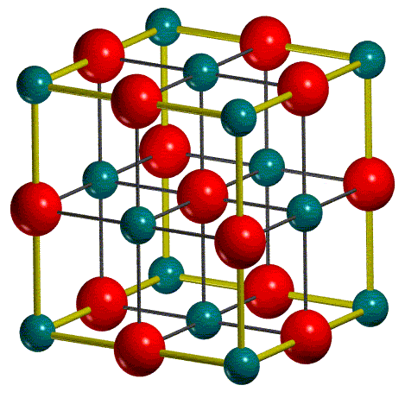
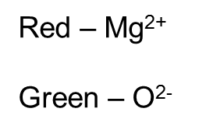
The structure of magnesium oxide, MgO

Slide 11
The structure of magnesium oxide, MgO
Magnesium oxide, MgO, contains magnesium ions, Mg²⁺, and oxide ions, O²⁻. It has exactly the same structure as sodium chloride.

Slide 12
The structure of magnesium oxide, MgO
The only difference is that the magnesium oxide lattice is held together by stronger forces of attraction.

Slide 13
The structure of magnesium oxide, MgO
This is because in magnesium oxide, 2+ ions are attracting 2- ions. In sodium chloride, the attractions are weaker because they are only between 1+ and 1- ions.

Slide 14
The Simple Physical Properties of Ionic Substances

Slide 15
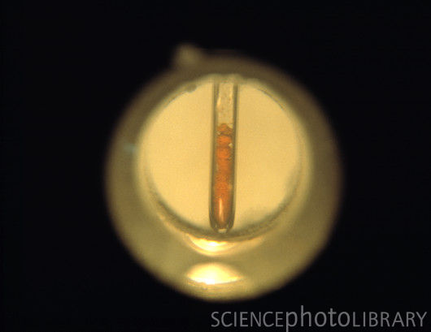
1. Ionic Compounds have High Melting Points & Boiling Points
Ionic compounds have high melting and boiling points because of the strong forces holding the lattices together.

Slide 16
Magnesium oxide has much higher melting and boiling points than sodium chloride because the attractive forces are much stronger.
Red – Mg²⁺
Green – O²⁻

Slide 17
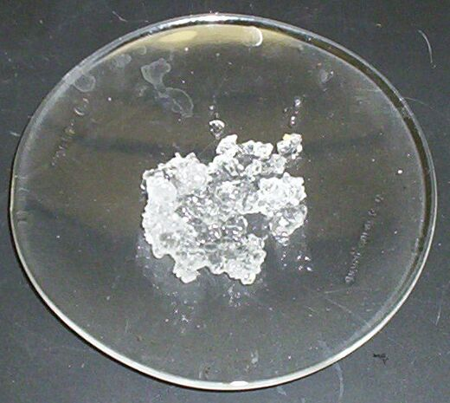
2. Ionic Compounds tend to be Crystalline
This reflects the regular arrangement of ions in the lattice.

Slide 18
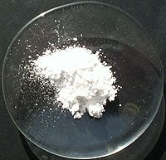
Sometimes the crystals are too small to be seen except under powerful microscopes. Magnesium oxide, for example, is always seen as a white powder because the individual crystals are too small to be seen with the naked eye.

Slide 19
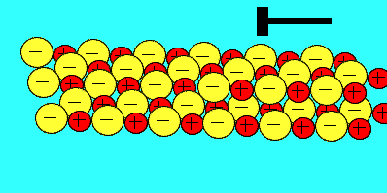
3. Ionic Crystals tend to be Brittle

Slide 20
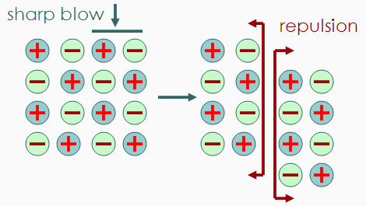
This is because any small distortion of a crystal will bring ions with the same charge alongside each other. Like charges repel and so the crystal splits itself apart.

Slide 21
4. Ionic Substances tend to be Soluble in Water
Although water is a covalent molecule, the electrons in the bond are attracted towards the oxygen end of the bond. This makes the oxygen slightly negative. It leaves the hydrogen slightly short of electrons and therefore slightly positive.

Slide 22
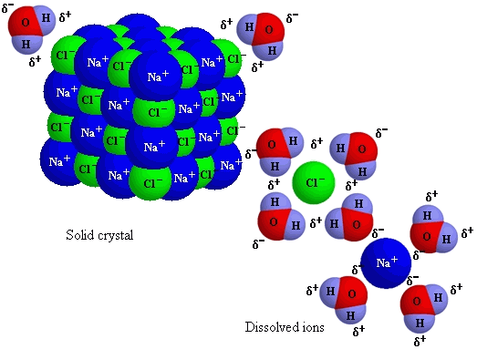
Because of this electrical distortion, water is described as a polar molecule. There are quite strong attractions between the polar water molecules and the ions in the lattice.

Slide 23
The slightly positive hydrogens in the water molecules cluster around the negative ions, and the slightly negative oxygens are attracted to the the positive ions.

Slide 24
The water molecules then literally pull the crystal apart.

Slide 25
Magnesium oxide is not soluble in water because the attractions between the water molecules and the ions are not strong enough to break the very powerful ionic bonds between magnesium and oxide ions.

Slide 26
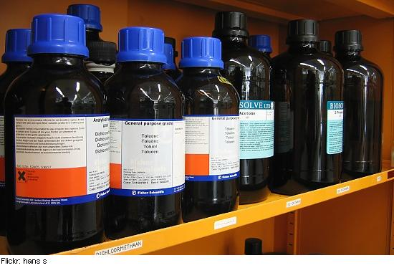
5. Ionic Substances tend to be Insoluble in Organic Solvents
Organic solvents contain molecules which have much less electrical distortion than there is in water – their molecules are less polar.

Slide 27
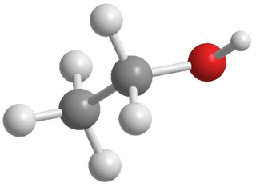
There is not enough attraction between these molecules and the ions in the crystal to break the strong forces holding the lattice together.

Slide 28
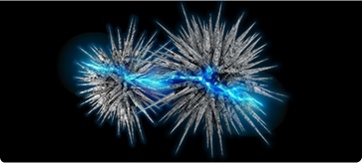
6. The Electrical Behaviour of Ionic Substances
Ionic compounds do not conduct electricity when they are solid, because they do not contain any mobile electrons.

Slide 29
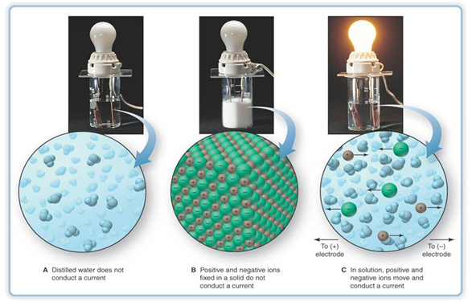
They do, however, conduct electricity when they melt, or if they are dissolved in water. This happens because the ions then become free to move around.

Slide 30
Summary
In this lesson we learnt about the following giant structures:
Metallic
Ionic: Lattice Structures

