Slide 1
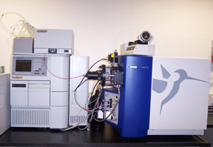
Mass Spectrometry

Slide 2
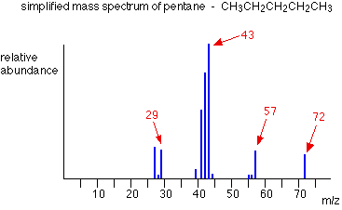
What is Mass Spectrometry?
Mass spectrometry is an analytical tool that makes use of the mass to charge ratio of particles to determine the molecular formula of a compound.
In the lab, this tool can be immensely powerful in making sure what you make is actually what you want to make.

Slide 3
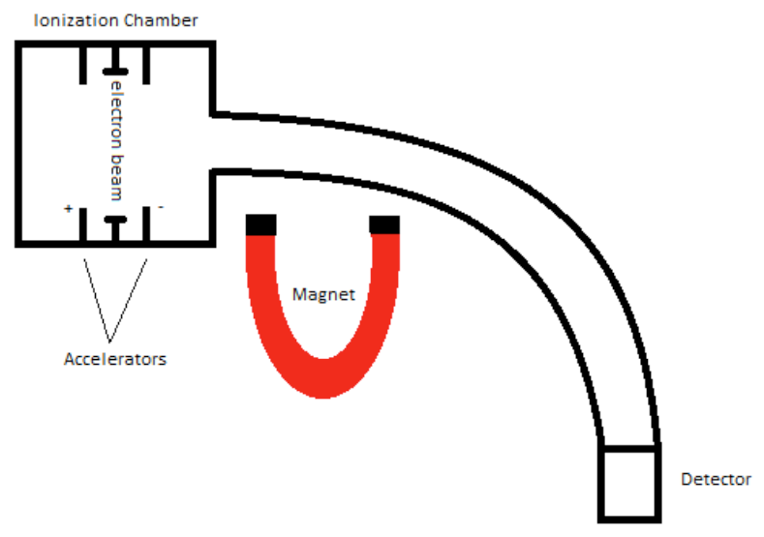
Basic Mass Spectrometer

Slide 4
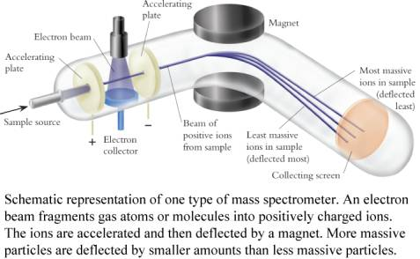
How Does A Mass Spectrometer Work?

Slide 5
How Does A Mass Spectrometer Work?
As was mentioned before, mass spectrometry uses mass to charge ratios to determine molecular weights.
To go from a sample of substance to something that can be analyzed, the mass spectrometer must first vaporize the sample and ionize it (give it a charge).
In our context, this ionization occurs by slamming the gas particles of our sample with a beam of electrons.
This beam will inevitably knock off an electron from the gas particles and form positively charged ions.

Slide 6
How Does A Mass Spectrometer Work?
Now, to keep everything simple, we want to ensure that every particle has only a +1 charge.
Remember that this is because we are using the mass to charge ratio, so if the charge is a constant 1, then determining mass is made that much simpler.
So in order to ensure that things don’t get too ionized (we only want +1 charged particles), we can put magnets that will accelerate the molecules as soon as they are ionized, as shown in the diagram.

Slide 7
How Does A Mass Spectrometer Work?
The accelerated particles are then directed into a
magnetic field that will cause its flight trajectory to curve.
The degree of curvature is dependent on how much mass each molecular ion has. The more mass an ion has, the less curvature its trajectory will experience.
The ions then slam into a detector and its mass can
be recorded.

Slide 8
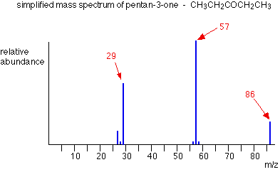
Reading the Spectra

Slide 9
Reading the Spectra
How does one go about reading all the lines on the graph?
In order to read the graph, we must first understand the basics of the graph itself.

Slide 10
The x-axis of our graph is the mass-to-charge ratio (m/z for short), and because the charge of the ions is 1, our mass-to-charge ratio will be simply mass divided by 1, or more simply put our mass.
The y-axis—on the other hand—is the relative ion abundance of our molecule at different weights.
Relative abundance means that the abundances are based off of the most prevalent ion, not how many ions there are in total.
Now that we know what the graph means, how do
we find M, M+1 and M+2 from our spectra?

Slide 11
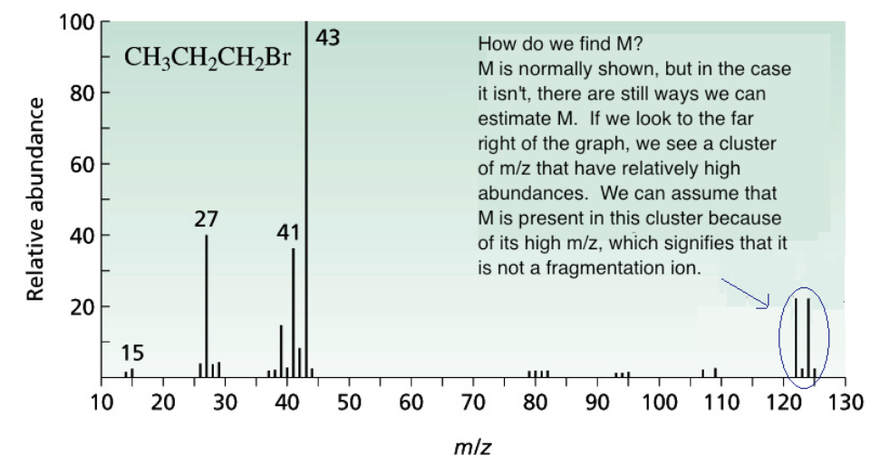
How Do We Find M?

Slide 12
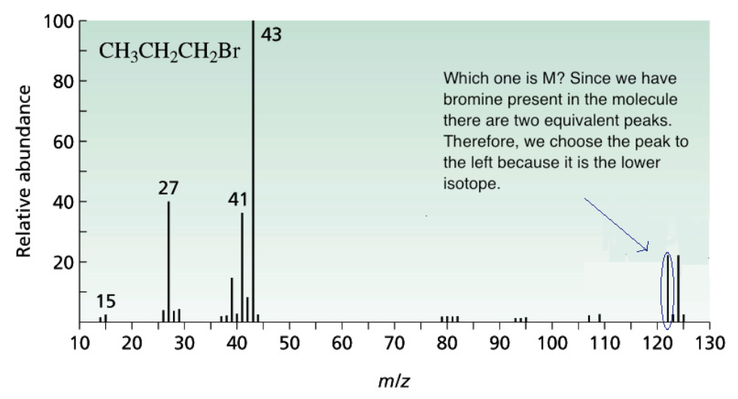
How Do We Find M?

Slide 13
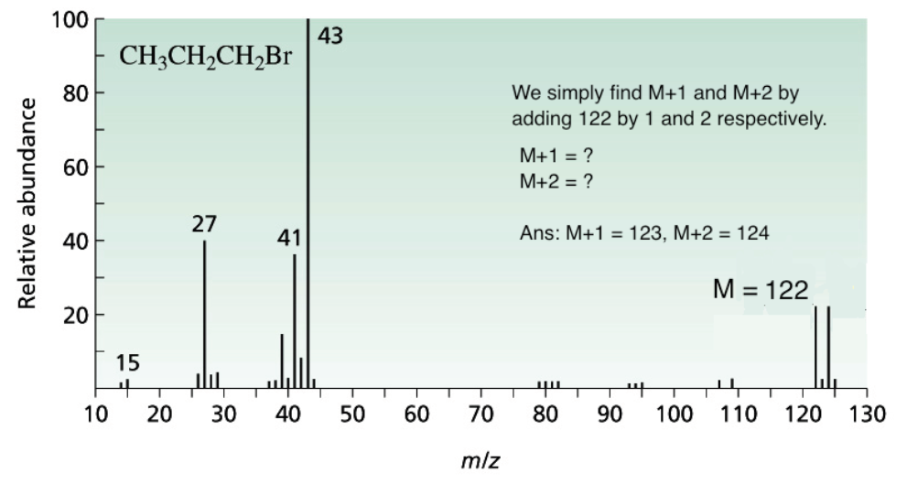
How Do We Find M?

Slide 14
What are M, M+1, and M+2?
M is simply defined as the mass of the molecule with the lowest isotopes for each atom that comprises this molecule.
M+1 is the molecular mass plus one. M+2 is… you get
the point.

Slide 15
What do we use M, M+1, and M+2 for?
M is used to give us the molecular weight of the molecule.
M+1 is used to determine the number of carbons within the molecule, and M+2 can be used to find the
presence of sulfur, chlorine, or bromine.

