Slide 1
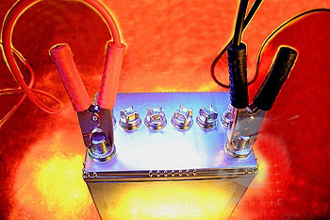
Electrochemistry

Slide 2
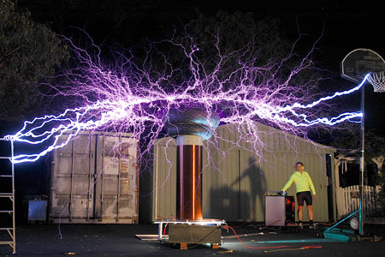
Important Background Information
Conductors and non-conductors
Conductors are materials that conduct electricity.
Non-conductors or insulators are materials that do not conduct electricity.

Slide 3
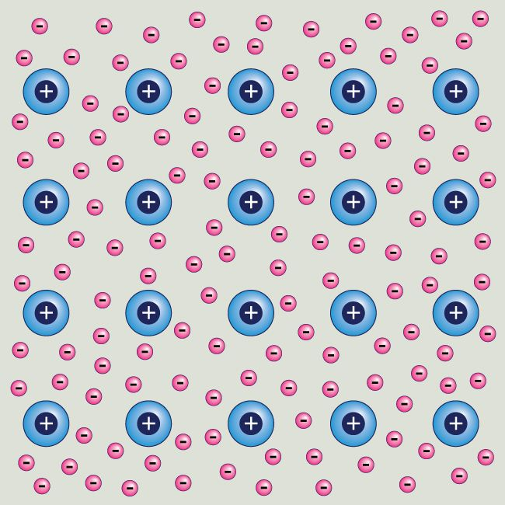
Mobile Outer Shell Electrons in Metals & Carbon

Slide 4
The conduction of electricity by metals and carbon
In a metal or carbon, electricity is simply a flow of electrons.
The movement of the electrons doesn’t produce any chemical change in the metal or the carbon.
Metals and carbon contain mobile electrons, and it is these that move.
In an electrical circuit, you can think of a battery or a power pack as an ‘electron pump’, pushing the electrons through the various bits of metal or carbon.

Slide 5
Passing electricity through compounds - electrolysis
Hardly any solid compounds conduct electricity.
On the other hand, lots of compounds will conduct electricity when they are molten or when they are dissolved in water.
All of these show signs of a chemical reaction when they are conducting.

Slide 6
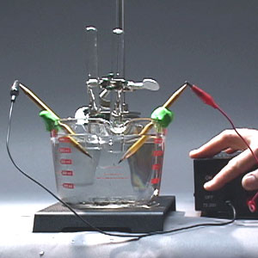
Definition of Electrolysis
The passage of an electric current through an electrolyte resulting in a chemical change in the electrolyte is called electrolysis.

Slide 7
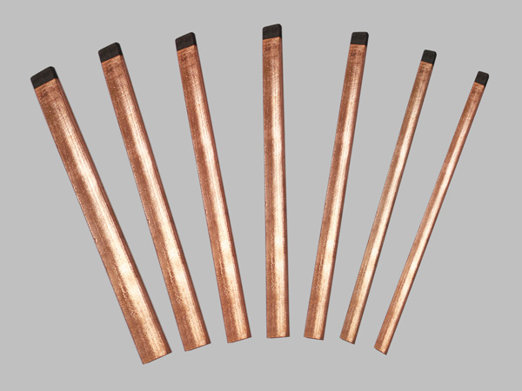
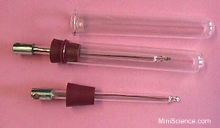
Electrodes
Electrodes are electrical conductors which connect the battery to the electrolyte for conduction of an electric current.
Electrodes are usually made out of an inert material, e.g. graphite (carbon) or platinum.

Slide 8
Cathode (-ve) & Anode(+ve)
The electrode which is attached to the negative terminal of the battery, and which supplies electrons to the electrolyte, is called the cathode.
The electrode which is attached to the positive terminal of the battery, and which removes electrons from the electrolyte, is called the anode.
When an electric current passes through an electrolyte, the ions move towards the electrodes.

Slide 9
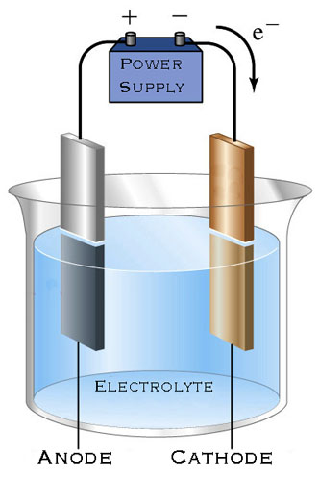
Cathode & Anode

Slide 10
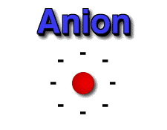
Anions
Anions are negative ions.
Which electrode would the anions be attracted to? (Remember: Cathode (-); Anode (+))

Slide 11
Anions
The anions (negative ions) move towards the anode (positive electrode).
The anions lose electrons to the anode to form ions.
The ions undergo oxidation and are said to have been discharged:
A^{n-} → A + ne⁻
The electrons travel through the electric circuit from the anode to the cathode.

Slide 12
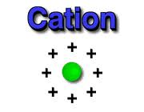
Cations
Cations are positive ions.
Which electrode would the cations be attracted to? (Remember: Cathode (-); Anode (+))

Slide 13
Cations
The cations (positive ions) move towards the cathode (negative electrode).
The cations gain electrons from the cathode forming atoms. The cations undergo reduction and have also been discharged:
C^{n+} + ne⁻ → C

Slide 14
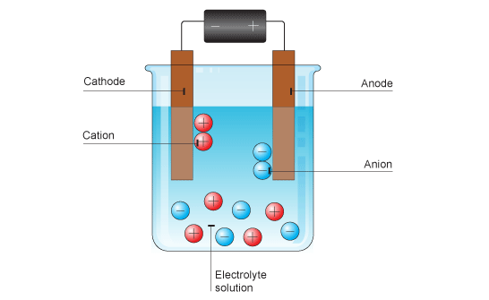
Movement of ions during electrolysis

Slide 15
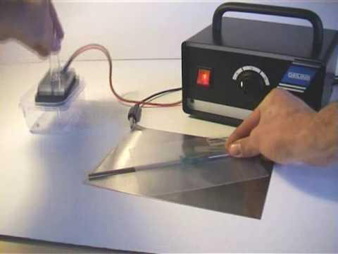
The electrochemical series
This series is another way to compare metals. Each metal is placed in a circuit and combined with a standard electrode called the hydrogen electrode. The voltages produced give an order known as the electrochemical series.

Slide 16
The electrochemical series
Metal | Voltage/ volts
K | -2.92
Ca | -2.87
Na | -2.71
Mg | -2.37
Al | -1.66
Zn | -0.76
Fe | -0.44
Pb | -0.13
H (not a metal) | 0.00
Cu | +0.34
Au | +1.50
The most reactive metals are at the top.
Note that calcium and sodium have changed places when compared to the chemical reactivity series of metals.

Slide 17
Electrolysis of a molten salt
During the electrolysis of a molten salt, the only ions present are those of the molten salt.

Slide 18
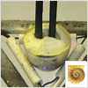
Example – Electrolysing molten anhydrous lead bromide, PbBr₂

Slide 19
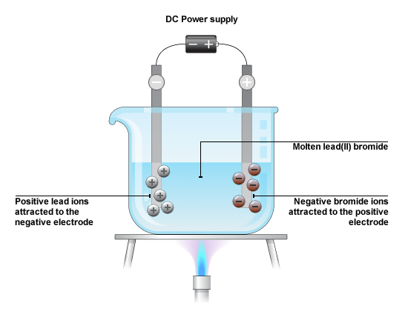
Molten lead(II) bromide consists of Pb²⁺ ions and Br⁻ ions:
PbBr_{2(l)} → Pb²⁺_{(l)} + 2Br⁻_{(l)}
When an electric current is passed through the molten lead(II) bromide, the Pb²⁺ ions (cations) migrate towards the negative electrode (cathode) and the Br⁻ ions (anions) migrate to the positive electrode (anode).

Slide 20
The Br⁻ ions give up their electrons to the anode, i.e. the bromide ions undergo oxidation:
2Br⁻_{(l)} → Br_{2(g)} + 2e⁻
Brown fumes of bomine are seen forming at the anode.
The electrons travel through the electric circuit from the anode to the cathode.
The Pb²⁺ ions accept electrons from the cathode, i.e. the lead ions undergo reduction:
Pb²⁺_{(l)} + 2e⁻ → Pb_{(l)}
Molten lead is seen forming at the cathode.

Slide 21
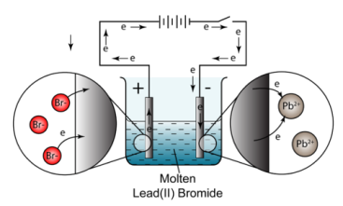
Electrolysing molten anhydrous lead bromide, PbBr₂

Slide 22
The electrolysis of other molten substances
In each case, positive ions are attracted to the negative cathode, where they are discharged by gaining electrons.
Positive ions are known as cations because they are attracted to the cathode.
Negative ions move to the anode, where they are discharged by giving electrons to the electrode.
Negative ions are known as anions because they are attracted to the anode.

Slide 23
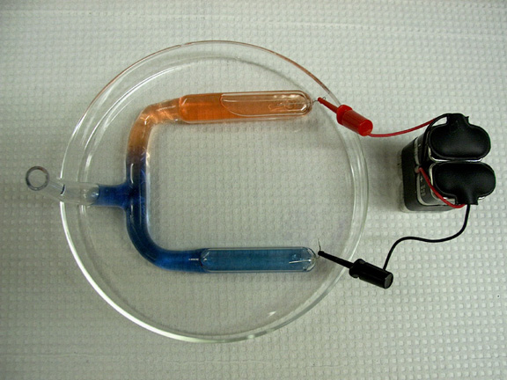
Not all ionic compounds can be electrolysed molten. Some break up into simpler substances before their melting point.
Other ionic compounds have such high melting points that it isn’t possible to melt them in the lab, although it can be done industrially.

Slide 24
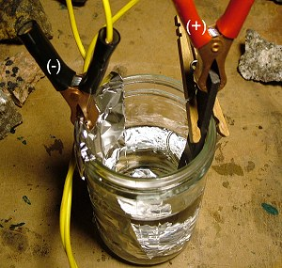
Which ions are discharged from a molten substance during electrolysis?
Reactive metals lose electrons easily and are less likely to be discharged in electrolysis. The discharge reaction involves gain of electrons:
metal ion + electron/electrons → metal atom

Slide 25
Metals that are low in the electrochemical series gain electrons more easily than those near the top.
The concentration of the ions in solution also makes a difference. Ions present in high concentrations may be discharged more easily than others that are lower in the electrochemical series.
The nature of the electrodes can change the products of electrolysis. In the electrolysis of copper sulphate, carbon electrodes give oxygen at the anode but copper anodes dissolve.

