Slide 1
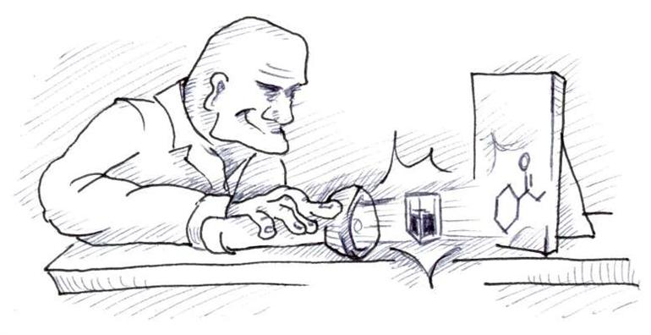
Introduction to Spectrochemical Methods

Slide 2
Lessons 8 Objectives
Students should be able to:
1. Explain the properties of electromagnetic radiation.
2. Explain the interaction of radiation and matter.
3. Explain radiation absorption and the processes involved.
4. Demonstrate of the limits of Beer’s law.
5. Explain the emission of electromagnetic radiation.
6. Describe the instrument used in optical spectrometry including: optical materials, spectroscopic sources, wavelength selectors, detecting and measuring radiant energy, signal processors and readout.

Slide 3
7. Discuss the ultraviolet-visible photometers and spectrophotometers using a single, double instruments and the multichannel instrument.
8. Discuss the use of infared spectrometers.

Slide 4
What is electromagnetic radiation?
Electromagnetic radiation is a form of energy that is transmitted through space at enormous velocities.
We call electromagnetic radiation in the UV/visible and sometimes in the IR region as light, although strictly speaking the term refers only to visible radiation.
Electromagnetic radiation can be described as a wave with properties of wavelength, frequency, velocity and amplitude.

Slide 5
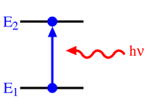
Interaction of Radiation & Matter
The most interesting types of interactions in spectroscopy involve transitions between different energy levels of chemical species.

Slide 6
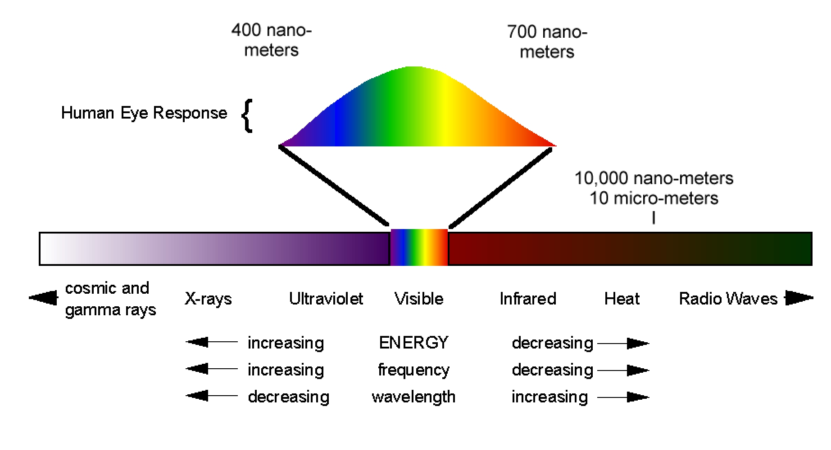
The Electromagnetic Spectrum
The electromagnetic spectrum covers an enormous range of energies (frequencies) and thus wavelengths. Useful frequencies vary from > 1019 Hz (γ-ray) to 103 Hz (radio waves).

Slide 7
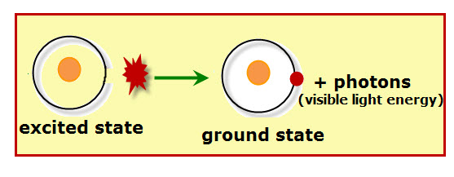
Spectroscopic Measurement
Spectroscopists use the interactions of radiation and matter to obtain information about a sample.
The sample is usually stimulated in some way by applying energy in the form of heat, electrical energy, light, particles, or a chemical reaction.
The stimulus causes some of the analyte species to undergo a transition from the ground state to the excited state.

Slide 8
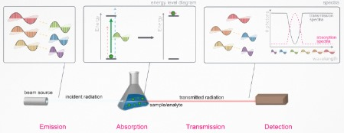
Radiation Absorption
Every molecular species is capable of absorbing its own characteristic frequencies of electromagnetic radiation.
This process transfers energy to the molecule and results in a decrease in the intensity of the incident electromagnetic radiation.

Slide 9
Beer-Lambert Law
The absorption law, also known as the Beer-Lambert law or just Beer’s law, tells us quantitatively how the amount of attenuation depends on the concentration of the absorbing molecules and the path length over which absorption occurs.
N.B. Absorbance = - log Transmittance (A = - log T)

Slide 10
Using Beer’s Law
A 7.25 x 10-5 M solution of potassium permanganate has a transmittance of 44.1% when measured in a 2.10-cm cell at a wavelength of 525 nm.
Calculate
the absorbance of this solution; (b) the molar absorptivity of KMnO₄.
Answers
(a) A = - log T = - log 0.441 = 0.355
(b) E = A/bc = 0.355 / (2.10 cm x 7.25 x 10⁻⁵ mol L⁻¹)
= 2.33 x 10³ L mol⁻¹ cm⁻¹

Slide 11
Limits to Beer’s Law
There are few exceptions to the linear relationship between absorbance and path length at a fixed concentration.
Some of these deviations, called real deviations, are fundamental and represent real limitations to the law.
Others are a result of the method that we use to make absorbance measurements (instrumental deviations) or a result of chemical changes that occur when the concentration changes (chemical deviations).

Slide 12
Limits to Beer’s Law
Group Activity: Complete the concept map below to show the limits to Beer’s Law.
Real Deviations
Chemical Deviations
Limits to Beer’s Law
occurs
when
occurs
when
Instrument Deviations
occurs
when

Slide 13
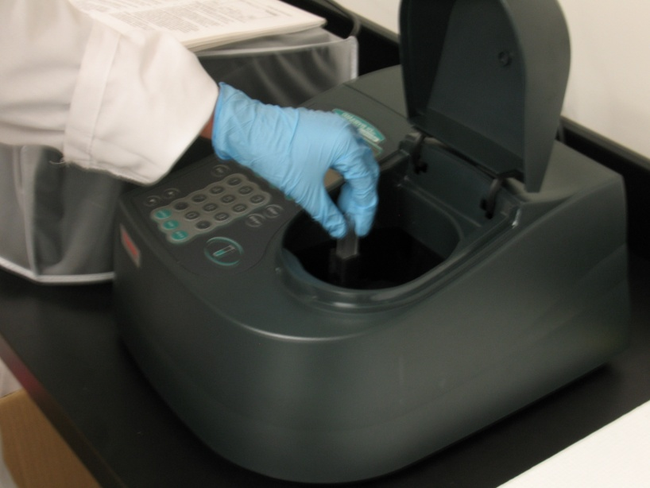
Ultraviolet-Visible Photometers & Spectrophotometers

Slide 14
Ultraviolet-Visible Photometers & Spectrophotometers
Spectrometers are spectroscopic instruments that use a monochromator or a polychomator in conjunction with a transducer to convert the radiant intensities into electrical signals.
Spectrophotometers are spectrometers that allow measurement of the ratio of the radiant powers of two beams, a requirement to measure absorbance.
Photometers use a filter for wavelength selection in conjunction with a suitable radiation transducer.

Slide 15
Ultraviolet-Visible Photometers & Spectrophotometers
Make short notes on single-beam, double beam and multichannel instruments.
Include:
Spectral Range
Wavelenth Accuracy
Possibility of instrument being interfaced to computer
Type of measurements instrument is suitable for
Advangates

Slide 16
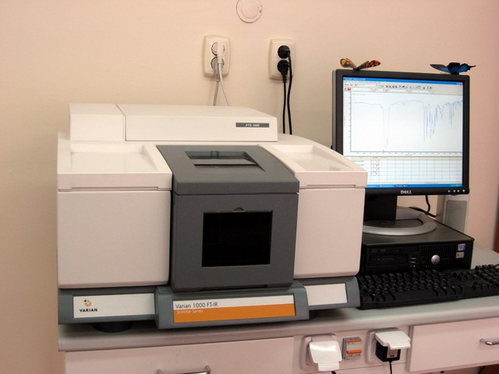
Infrared Spectrophotometers

Slide 17
Infrared Spectrophotometers
The two types of spectrometers used in IR spectroscopy are the dispersive type and the Fourier transform variety.
Individual Activity: Write an essay comparing the dispersive type of infrared spectrophotometers to the Fourier transform variety.

Slide 18
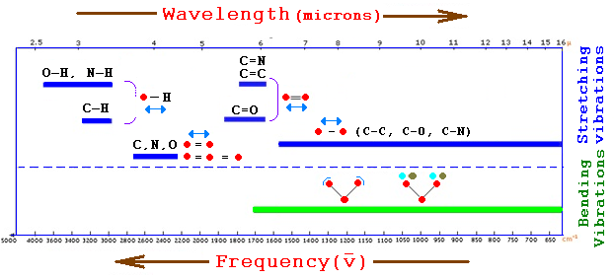
Video: Reading Infrared Spectra

Slide 19
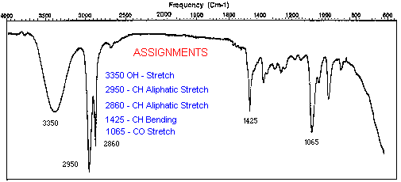
Video: Questions on Reading Infrared Spectra

Slide 20
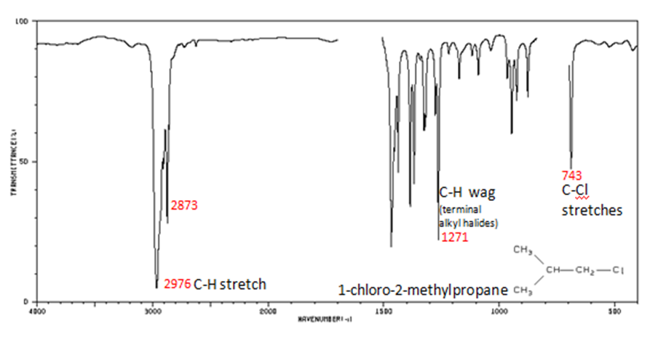
Worksheet: Reading Infrared Spectra

Slide 21
Assignment
READ:
Fundamentals of Analytical Chemistry (8th Edition)
Chapter 26: Molecular Absorption Spectrometry, pages 784 – 824, pages 337 – 367

Slide 22
References
1. Fundamentals of Analytical Chemistry (8th Edition)
Douglas A. Skoog
Donald M.West
F. James Holler
Stanley R. Crouch

