Slide 1
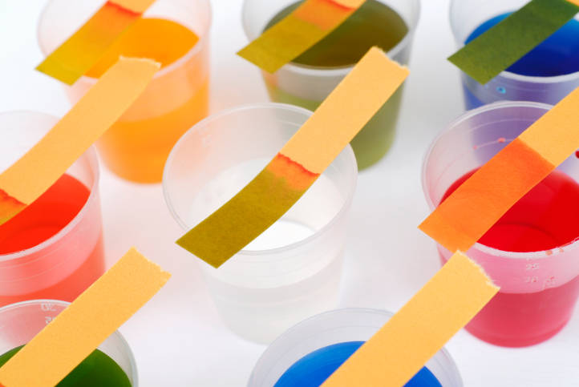
Ionic Equilibria II: Buffers & Titration Curves

Slide 2
Lesson 7 Objectives
Students should be able to:
1. Explain the common ion effect and give illustrations of its operation.
2. Describe buffer solutions and outline their chemistry.
3. Outline how to prepare a buffer solution of a specified pH.
4. Carry out calculations related to buffer solutions and their action.
5. Explain what acid-base indicators are and how they function.

Slide 3
6. Identify what species are present at various stages of titration curves for (a) strong acids and strong bases, (b) weak acids and strong basses, and (c) weak acids and weak bases.
7. Carry out calculations based on titration curves for (a) strong acids and strong bases and (b) weak acids and strong bases.

Slide 4
Buffer Solutions
A buffer solution contains a conjugate acid-base pair with both the acid and base in reasonable concentrations.
The acidic component reacts with added strong bases.
The basic component reacts with added strong acids.

Slide 5
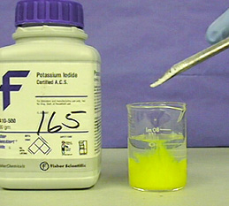
The Common Ion Effect
When a solution of a weak electrolyte is altered by adding one of its ions from another source, the ionization of the weak electrolyte is suppressed.
This behaviour is termed the common ion effect.

Slide 6
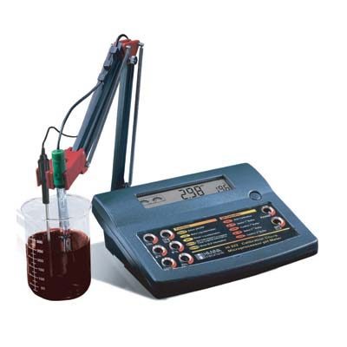
Weak Acids Plus Salts of Weak Acids
Solutions that contain a weak acid plus a salt of the weak acid are always less acidic than solutions that contain the same concentration of the weak acid alone.

Slide 7
Example Calculations
Example 19-1: Weak Acid/Salt of Weak Acid Buffer Solution
Exercise – 10

Slide 8
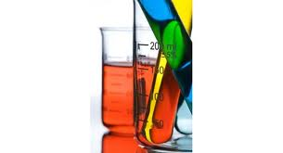
The Henderson-Hasselbalch Equation
pH = pka + log [conjugate base (salt)]
[acid]

Slide 9
Example Calculations
Example 19-2: Weak Acid/Salt of Weak Acid Buffer Solution (via the Henderson-Hasselbalch Equation)
Exercise – 11

Slide 10
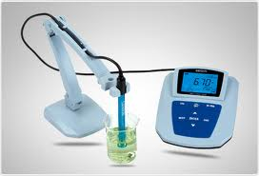
Weak Bases Plus Salts of Weak Bases
Solutions that contain a weak base plus a salt of the weak base are always less basic than solutions that contain the same concentration of the weak base alone.

Slide 11
Example Calculations
Example 19-3: Weak Base/Salt of Weak Base Buffer Solution
Exercises – 12

Slide 12
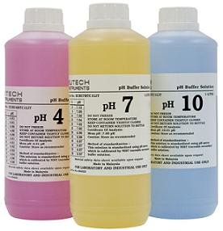
Buffering Action
A buffer solution is able to react with either H₃O⁺ or OH⁻ ions, whichever is added, to keep the pH approximately the same.

Slide 13
Example Calculations
Example 19-4: Buffering Action
Exercises – 24

Slide 14
Preparation of Buffer Solutions
Buffer solutions can be prepared by mixing other solutions.
When solutions are mixed, the volume in which each solute is contained increases, so solute concentrations change.
These changes in concentration must be considered.
If the solutions are dilute, we may assume that their volumes are additive.

Slide 15
Example Calculations
Example 19-5: pH of a Buffer Solution
Example 19-6: Buffer Preparation by Addition of a Salt
Exercise – 36 & 39

Slide 16
Buffer Preparation By Partial Neutralization
In practice, a common method of preparing a buffer solution is by partial neutralization of a weak acid solution by adding a strong base solution.
For example:
HA + NaOH → NaF + H₂O (partial)
If an appreciable amount of the weak acid remains unneutralized, then this solution contains significant concentrations of a weak acid and its conjugate base, just as though we had added the salt from a separate solution; thus, it is a buffer solution.

Slide 17
Example Calculations
Example 19-7: Buffer Preparation By Partial Neutralization
Exercises – 54b – 54f

Slide 18
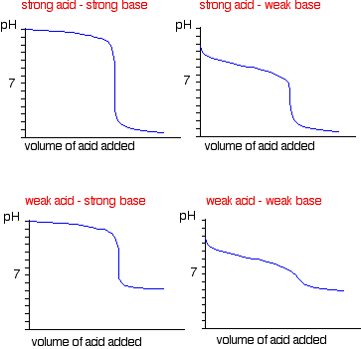
Assignment 2 - Titration Curves (20% of Assignment Mark)
1. Write short notes on the different types of titration curves.
Include labeled diagrams of the different types of titration curves.

Slide 19
Assignment
READ:
General Chemistry (9th Edition)
Chapter 19: Ionic Equilibria II: Buffers and Titration Curves, pages 743 – 770
Chapter 20: Ionic Equilibria III: The Solubility Product Principle, pages 771 – 793

Slide 20
References
1. General Chemistry (9th Edition)
Kenneth W. Whitten
Raymond E. Davis
M. Larry Peck
George G. Stanley
ISBN-13:978-0-495-39163-0
ISBN-10:0-495-39163-8

