Slide 1
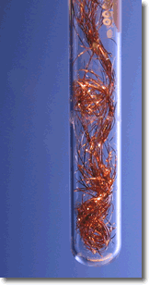
Oxidation-reduction reactions

Slide 2
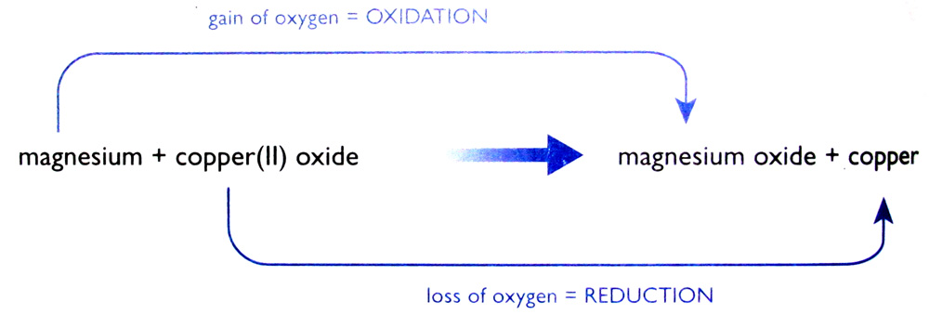
Oxidation and reduction
Oxidation and reduction – oxygen transer
A substance has been oxidised if it gains oxygen. Oxidation is gain of oxygen.
A substance has been reduced if it loses oxygen. Reduction is loss of oxygen.

Slide 3
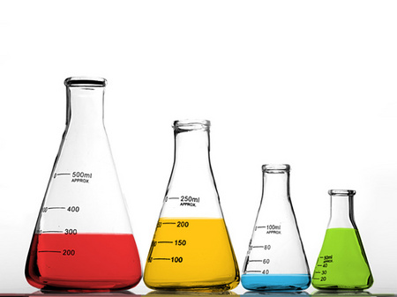
Redox Reactions
A redox reaction is one in which both reduction and oxidation are occurring.
Oxidation and reduction always go hand-in-hand.

Slide 4
Reducing & Oxidising Agents
A reducing agent is a substance that reduces something else. In this case the magnesium is the reducing agent.
An oxidising agent is a substance that oxidises something else. The copper(II) oxide is the oxidising agent in this reaction.

Slide 5
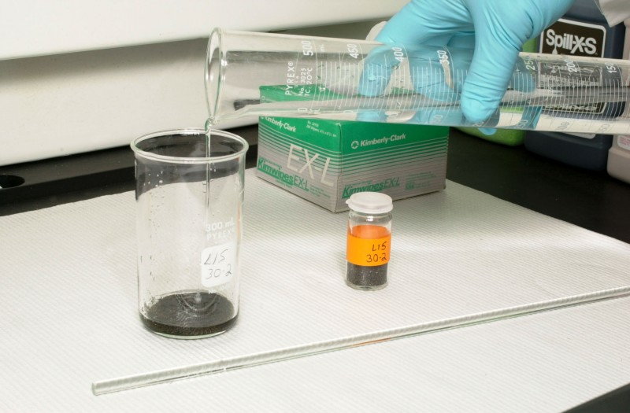
Hydrogen Peroxide (H₂O₂)
Hydrogen peroxide is unusual. It can act as both an oxidising agent and as a reducing agent.
Example 1: H₂O₂ as an oxidising agent
PbS + 4H₂O₂ → PbSO₄+ 4H₂O
Example 1: H₂O₂ as a reducing agent
2MnO₄⁻ + 5H₂O₂ + 6H⁺ → 2Mn₂⁺+ 8H₂O + 5O₂

Slide 6
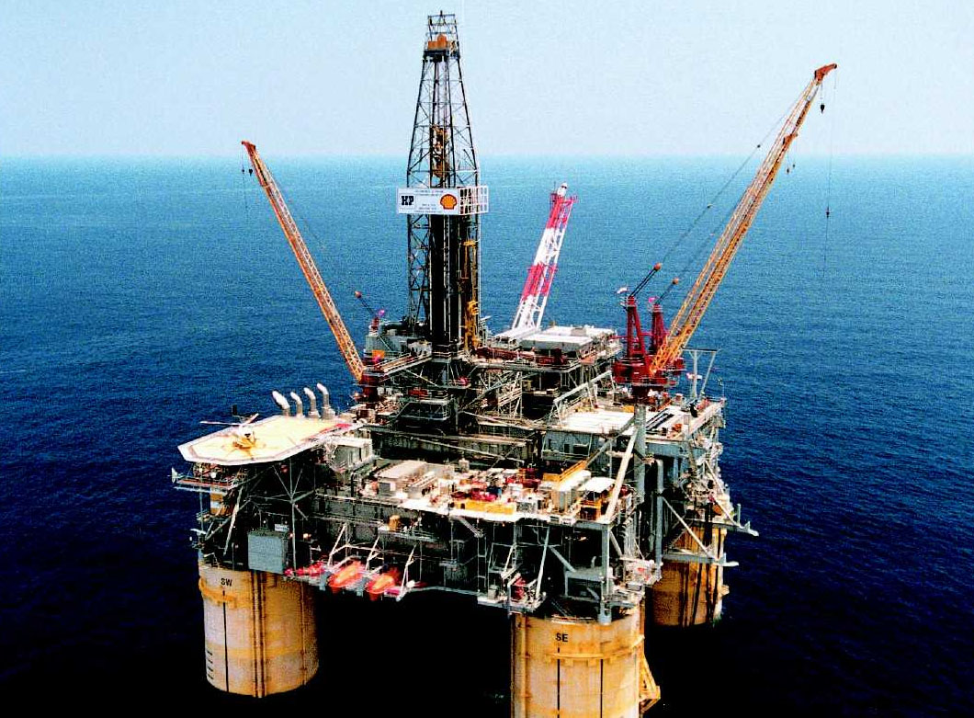
Oxidation and reduction
Oxidation and reduction – electron transfer
Oxidation Is Loss of electrons
Reduction Is Gain of electons
(Remember: OILRIG)

Slide 7
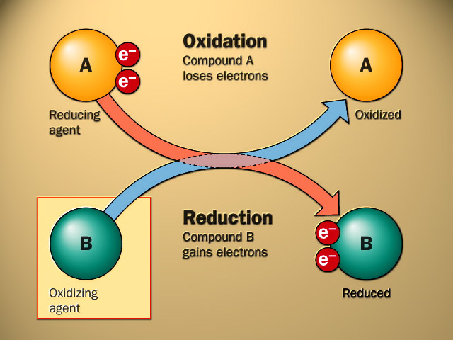
Oxidation and reduction – electron transfer

Slide 8
Oxidation Numbers
Example 1
Determine the oxidation number of S in SO₂
S + 2(O) = 0
S + 2(-2) = 0
S + (-4) = 0
S – 4 = 0
S = +4
Therefore the oxidation number of S = +4
The compound SO₂ can be called sulphur(IV) oxide because of the oxidatioin state of the sulphur in the compound.

Slide 9
Example 2
Determine the oxidation number of N in NO₃⁻
N + 3(O) = -1
N + 3(-2) = -1
N + (-6) = -1
N – 6 = -1
N = -1 + 6 = +5
Therefore the oxidation number of N = +5
The name of this ion is the nitrate(V) ion because of the oxidation state of nitrogen in the ion.

Slide 10
Example 3
Determine the oxidation number of C in H₂CO₃
2(H) + 1(C) + 3(O) = 0
2(+1) + 1(C) + 3(-2) = 0
+2 + C + (-6) = 0
+2 + C - 6 = 0
C = +6 - 2
C = +4
Therefore the oxidation number of C = +4

Slide 11
Example 4
Determine the oxidation number of Mn in MnO₄⁻
1(Mn) + 4(O) = -1
Mn + 4(-2) = -1
Mn + (-8) = -1
Mn - 8 = -1
Mn = -1 + 8
Mn = +7
Therefore the oxidation number of Mn = +7
The name of this ion is the manganate(VII) ion because of the oxidation state of manganese in this ion.

Slide 12
Example 5
Determine the oxidation number of Cr in K₂Cr₂O₇
2(K) + 2(Cr) + 7(O) = 0
2(+1) + 2(Cr) + 7(-2) = 0
+2 + 2Cr + (-14) = 0
+2 + 2Cr – 14 = 0
2Cr = +14 – 2 = +12
Cr = +6
Therefore the oxidation number of Cr = +6
The name of this compound is potassium dichromate(VI) because of the oxidation state of the chromium.

Slide 13
Example 6
Determine the oxidation number of P in Mg₃(PO₄)₂
3(Mg) + 2(P) + 8(O) = 0
3(+2) + 2(P) + 8(-2) = 0
+6 + 2P + (-16) = 0
+6 + 2P – 16 = 0
2P = +16 – 6 = +10
P = +5
Therefore the oxidation number of P = +5

Slide 14
Example
Reaction between magnesium and copper(II) oxide
Mg_{(s)} + CuO_{(s)} → MgO_{(s)} + Cu_{(s)}
Ionic Equation:
Mg_{(s)} + Cu²⁺_{(s)} + O²⁻_{(s)} →Mg²⁺_{(s)} + O²⁻_{(s)} + Cu_{(s)}
Removing spectator ions, we get:
Mg_{(s)} + Cu²⁺_{(s)} → Mg²⁺_{(s)} + Cu_{(s)}
The ionic equation shows that the reaction has nothing to do with oxygen.

Slide 15
What is actually happening is that magnesium atoms are turning into magnesium ions.
The magnesium atoms lose electrons to form magnesium ions.
Mg_{(s)} → Mg²⁺_{(s)}+ 2e⁻ (Mg is oxidised)
Those electrons have been gained by the copper(II) ions to make the atoms present in metallic copper.
Cu²⁺_{(s)}+ 2e⁻ → Cu_{(s)} (Cu²⁺ is reduced)
(Remember: OILRIG)

Slide 17
Using hydrogen as a reducing agent
The reduction of copper(II) oxide to copper
Copper won’t react with water because copper is below hydrogen in the Reactivity Series, but that means that you can get a reaction between hydrogen and copper(II) oxide.
The hydrogen removes the oxygen from the copper(II) oxide, so that hydrogen is a reducing agent.

Slide 18
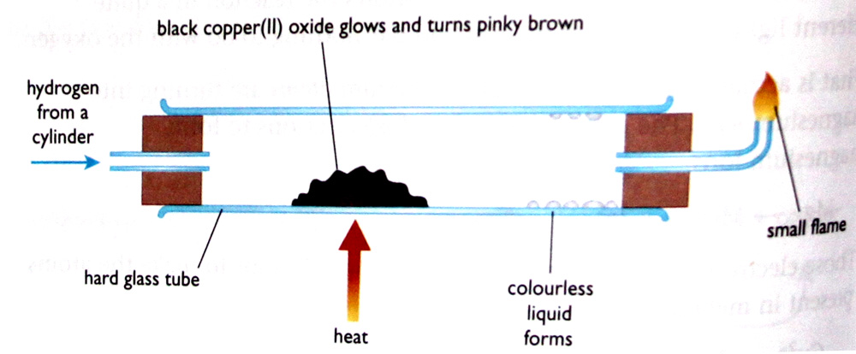
Experiment
Hydrogen is passed over hot copper(II) oxide. The oxide glows red hot and continues glowing, even if you remove the Bunsen burner. Lots of heat is released during the reaction.
Colourless liquid – water
Pinky brown solid – copper
Small flame at end – excess hydrogen being burned off

Slide 19
Displacement reactions involving solutions of salts
The reaction between zinc and copper(II) sulphate solution
Zn_{(s)} + CuSO_{4(aq)} → ZnSO_{4(aq)} + Cu_{(s)}
Ionic Equation:
Zn_{(s)} + Cu²⁺_{(aq)} + SO₄²⁻_{(aq)} →Zn²⁺_{(aq)} + SO₄²⁻_{(aq)} + Cu_{(s)}
Removing Spectator Ions:
Zn_{(s)} + Cu²⁺_{(aq)} →Zn²⁺_{(aq)} + Cu_{(s)}
This is a redox reaction.

Slide 20
The reaction between zinc and copper(II) sulphate solution

Slide 21
The reaction between copper and silver nitrate solution
Cu_{(s)} + 2AgNO_{3(aq)} → Cu(NO₃)_{2(aq)} + 2Ag_{(s)}
Ionic Equation:
Cu_{(s)} + 2Ag⁺_{(s)} + 2NO₃⁻_{(aq)} →Cu²⁺_{(aq)} + 2NO₃⁻_{(aq)} + 2Ag_{(s)}
Removing Spectator Ions:
Cu_{(s)} + 2Ag⁺_{(s)} → Cu²⁺_{(aq)} + 2Ag_{(s)}
This is a redox reaction.

Slide 22
The reaction between copper and silver nitrate solution

