Slide 1
pH

Slide 2
The pH Scale
The pH scale runs from about 0 to about 14 and tells you how acidic or how alkaline a solution is.

Slide 3
Measuring pH
pH can be measured using the following:
Universal Indicator – can measure the pH from 1 to 14 but it is not very accurate.
pH Meter - can measure the pH from 1 to 14 accurately.
Simple Indicators – examples litmus, methyl orange, phenolphthalein. Not accurate.

Slide 4
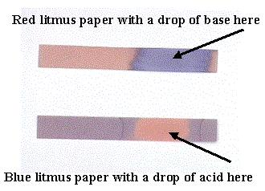
Simple Indicators
Colour changes for simple indicators
Indicator | Colour in acid | Colour in alkali
litmus | red | blue
methyl orange | red | yellow
phenolphthalein | colourless | red

Slide 5
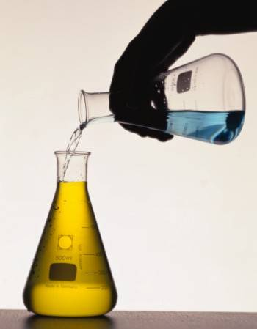
Reactions with Acids

Slide 6
Reacting Metals with Acids
Simple dilute acids react with metals depending on their position in the reactivity series.
Metals below hydrogen in the series don’t react with dilute acids.
Metals above hydrogen in the series react to produce hydrogen gas.
The higher the metal is in the reactivity series, the more vigorous the reaction.

Slide 7
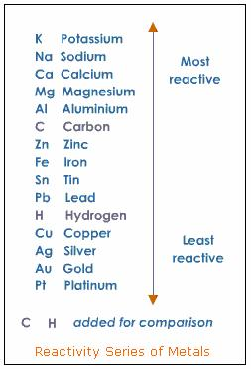
The Reactivity Series of Metals

Slide 8
Remembering the Reactivity Series of Metals
Peter - Potassium Smith - Sodium Caught - Calcium My - Magnesium Aunt - Aluminium Zeena - Zinc In - Iron The - Tin Larder - Lead
High-hydrogen Crunching - Copper
Munching -mercury Seven - Silver Green - Gold Peppers - Platinum

Slide 9
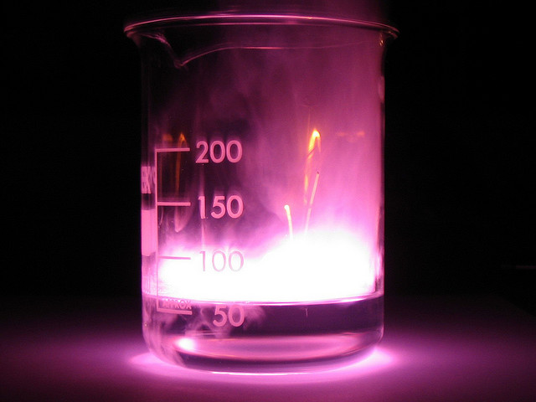
Reaction of metals with acids
metal + acid → salt + hydrogen

Slide 10
Salts
All simple acids contain hydrogen. When that hydrogen is replaced by a metal, the compound formed is called a salt.
Parent Acid | Salt
sulphuric acid | sulphates
hydrochloric acid | chlorides
nitric acid | nitrates
phosphoric acid | phosphates
ethanoic acid | ethanoates
carbonic acid | carbonates

Slide 11
Reaction of magnesium with acids
1. Magnesium + dilute sulphuric acid
Mg_{(s)} + H₂SO_{4(aq)} → MgSO_{4(aq)} + H_{2(g)}
Ionic equation:
Mg_{(s)} + 2H⁺_{(aq)} + SO₄²⁻_{(aq)} → Mg²⁺_{(aq)} + SO₄²⁻_{(aq)} + H_{2(g)}
The sulphate ion is a spectator ion. Leaving out the spectator ion gives:
Mg_{(s)} + 2H⁺_{(aq)} → Mg²⁺_{(aq)} + H_{2(g)}

Slide 12
2. Magnesium + dilute hydrochloric acid
Mg_{(s)} + 2HCl_{(aq)} → MgCl_{2(aq)} + H_{2(g)}
Ionic equation:
Mg_{(s)} + 2H⁺_{(aq)} + 2Cl⁻_{(aq)} → Mg²⁺_{(aq)} + 2Cl⁻_{(aq)} + H_{2(g)}
The chloride ion is a spectator ion. Leaving out the spectator ion gives:
Mg_{(s)} + 2H⁺_{(aq)} → Mg²⁺_{(aq)} + H_{2(g)}
The simplified ionic equations look the same because the are the same! Magnesium will react with any simple dilute acid in the same way. The sulphate and chloride ions are called spectator ions as they are unchanged during the reaction.

Slide 13
Reaction of zinc with acids
The full equations for the reaction of zinc with sulphuric acid and hydrochloric acid are:
Zn_{(s)} + H₂SO_{4(aq)} → ZnSO_{4(aq)} + H_{2(g)}
Zn_{(s)} + 2HCl_{(aq)} → ZnCl_{2(aq)} + H_{2(g)}
The sulphate and chloride ions are spectator ions. Leaving out the spectator ion gives:
Zn_{(s)} + 2H⁺_{(aq)} → Zn²⁺_{(aq)} + H_{2(g)}
Again, the ionic equation is the same for both reactions since the sulphate and chloride ions are spectator ions.

Slide 14
Questions
Write balanced chemical equations for the following reactions (metals with acids):
(a) The reaction of calcium with hydrochloric acid
(b) The reaction of cobalt with hydrochloric acid
(c) The reaction of iron with sulphuric acid
2. Write the ionic equations for the following reactions (metals with acids):
(a) The reaction of calcium with hydrochloric acid
(b) The reaction of cobalt with hydrochloric acid
(c) The reaction of iron with sulphuric acid

Slide 15
Reaction of metal oxides with acids
metal oxide + acid → salt + water

Slide 16
Reaction of copper(II) oxide with dilute sulphuric acid
CuO_{(s)} + H₂SO_{4(aq)} → CuSO_{4(aq)} + H₂O_{(l)}
Ionic equation:
Cu²⁺_{(s)} + O²⁻_{(s)} + 2H⁺_{(aq)} + SO₄²⁻_{(aq)} → Cu²⁺_{(aq)} + SO₄²⁻_{(aq)} + H₂O_{(l)}
Both the sulphate ion and the Cu²⁺ are spectator ions. Leaving out the spectator ions gives:
O²⁻_{(s)} + 2H⁺_{(aq)} → H₂O_{(l)}
This equation would be true for any simple metal oxide reacting with any acid.

Slide 17
Questions
1.Write balanced chemical equations for the following reactions (metal oxides with acids):
(a) The reaction of iron(II) oxide with sulphuric acid
(b) The reaction of iron(II) oxide with nitric acid
(c) The reaction of copper(II) oxide with sulphuric acid
2. Write the ionic equations for the following reactions (metal oxides with acids):
(a) The reaction of iron(II) oxide with sulphuric acid
(b) The reaction of iron(II) oxide with nitric acid
(c) The reaction of copper(II) oxide with sulphuric acid

Slide 18
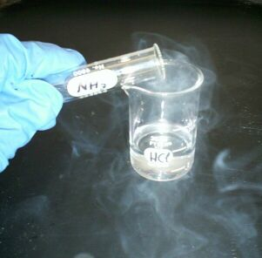
Reaction of metal hydroxides with acids
metal hydroxide + acid → salt + water

Slide 19
Reaction of sodium hydroxide with dilute hydrochloric acid
NaOH_{(aq)} + HCl_{(aq)} → NaCl_{(aq)} + H₂O_{(l)}
Ionic equation:
Na⁺_{(aq)} + OH⁻_{(aq)} + H⁺_{(aq)} + Cl⁻_{(aq)} → Na⁺ _{(aq)} + Cl⁻_{(aq)} + H₂O_{(l)}
Both the Na⁺ ion and the Cl⁻ ion are spectator ions. Leaving out the spectator ions gives:
OH⁻_{(aq)} + H⁺_{(aq)} → + H₂O_{(l)}
This equation would be true for any simple metal hydroxide reacting with any acid.

Slide 20
Questions
1. Write balanced chemical equations for the following reactions (metal hydroxides with acids):
(a) The reaction of potassium hydroxide with hydrochloric acid
(b) The reaction of calcium hydroxide with hydrochloric acid
(c) The reaction of magnesium hydroxide with hydrochloric acid
2. Write the ionic equations for the following reactions (metal hydroxides with acids):
(a) The reaction of potassium hydroxide with hydrochloric acid
(b) The reaction of calcium hydroxide with hydrochloric acid
(c) The reaction of magnesium hydroxide with hydrochloric acid

Slide 21
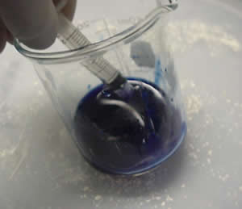
Reaction of carbonates with acids
carbonate + acid → salt + carbon dioxide + water

Slide 22
Reaction of copper (II) carbonate with dilute sulphuric acid
CuCO_{3(s)} + H₂SO_{4(aq)} → CuSO_{4(aq)} + CO_{2(g)} + H₂O_{(l)}
Ionic equation:
Cu²⁺_{(s)} + CO₃²⁻_{(s)} + 2H⁺_{(aq)} + SO₄²⁻ _{(aq)} → Cu²⁺_{(aq)} + SO₄²⁻ _{(aq)} + CO_{2(g)} + H₂O_{(l)}
Both the Cu²⁺ and the SO₄²⁻ are spectator ions. Leaving out the spectator ions gives:
CO₃²⁻_{(s)} + 2H⁺_{(aq)} → CO_{2(g)} + H₂O_{(l)}
This equation would be true for any simple metal carbonate reacting with any acid.

Slide 23
Questions
1. Write balanced chemical equations for the following reactions (carbonates with acids)
(a) The reaction of copper(II) carbonate with hydrochloric acid
(b) The reaction of calcium carbonate with nitric acid
(c) The reaction of magnesium carbonate with sulphuric acid
2. Write the ionic equations for the following reactions (carbonates with acids)
(a) The reaction of copper(II) carbonate with hydrochloric acid
(b) The reaction of calcium carbonate with nitric acid
(c) The reaction of magnesium carbonate with sulphuric acid

Slide 24
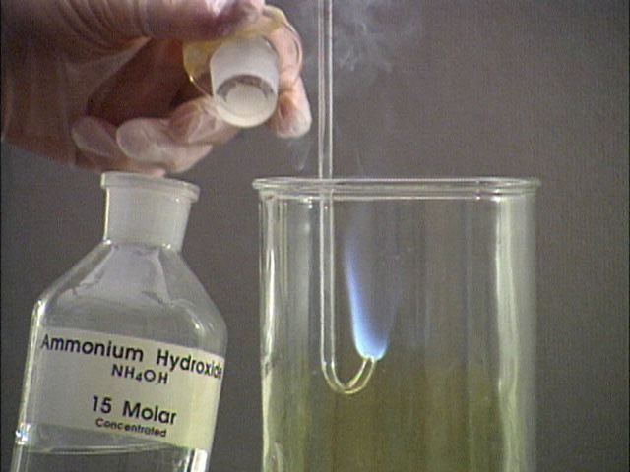
Reaction of bases with ammonium salts
any ammonium salt + base → ammonia gas

Slide 25
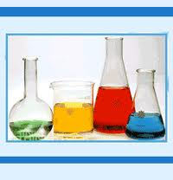
The Bronsted –Lowry Theory
An acid is a proton (hydrogen ion) donor
A base is a proton (hydrogen ion) acceptor

Slide 26
Bronsted Lowry Theory – hydrogen chloride dissolving in water to give hydrochloric acid
There is a transfer of a proton from the HCl to the water.
H₂O_{(l)} + HCl_{(g)} → H₃O⁺_{(aq)} + Cl⁻_{(aq)}
The H₃O⁺ ion is called a hydroxonium ion.

Slide 27
Bronsted Lowry Theory – hydrogen chloride gas reacting with ammonia gas to produce ammonium chloride.
The ammonia acts as a base by accepting the proton; the HCl acts as an acid by donating it.
NH_{3(g)} + HCl_{(g)} → NH₄⁺_{(s)} + Cl⁻_{(s)}

Slide 28
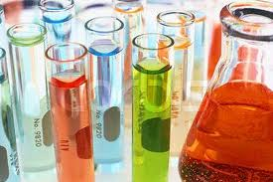
Strong and weak acids and alkalis

Slide 29
Strong Acids
Hydrochloric acid is a strong acid. This means that when hydrogen chloride gas comes into contact with water, it reacts completely to give hydroxonium ions and chloride ions.
H₂O_{(l)} + HCl_{(g)} → H₃O⁺_{(aq)} + Cl⁻_{(aq)}
Sulphuric acid and nitric acid are also strong acids. There are no un-ionised acid molecules left in their solutions. An acid which is 100% ionised in solution is called a strong acid.

Slide 30
Weak Acids
An acid which is only partially ionised in solution is called a weak acid. Examples – ethanoic acid, citric acid and carbonic acid.
In dilute ethanoic acid only about 1% of the ethanoic acid molecules have actually formed ions at any one time. As fast as the molecules react with water to produce ions, the ions react back again to give the original molecules. The reaction is reversible.
CH₃COOH_{(aq)} + H₂O_{(l)} H₃O⁺_{(aq)} + CH₃COO⁻_{(aq)}

Slide 31
Recognising strong and weak acids
Strong acids have lower pHs than weak acids of the same concentration
Strong acids react faster than weak acids of the same concentration
Be careful to distinguish between the words strong and weak as opposed to the words concentrated and dilute.
Concentrated and dilute – the amount of acid in solution
Strong and weak – the proportion of acid which has reacted with water to form ions.

Slide 32
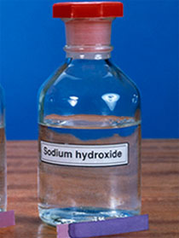
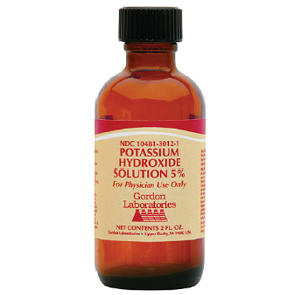
Strong Alkalis
A strong alkali is one which is fully ionised in solution.
Examples – sodium hydroxide and potassium hydroxide.

Slide 33
Weak Alkalis
The simplest example of a weak alkali is ammonia, NH₃, in solution.
When ammonia dissolves in water, a very small proportion of it (typically about 1%) reacts.
NH_{3(g)} + H₂O_{(l)} NH₄⁺_{(aq)} + OH⁻_{(aq)}

Slide 34
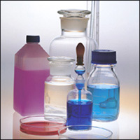
Salts

Slide 35
Soluble & Insoluble Salts
All sodium, potassium and ammonium compounds are soluble.
All nitrates are soluble
All common ethanoates (also called acetates) are soluble
Most common chlorides are soluble, except lead(II) chloride and silver chloride
Most common sulphates are soluble, except lead(II) sulphate, barium sulphate and calcium sulphate
Most common carbonates are insoluble, except sodium, potassium and ammonium carbonates
Most metal hydroxides are insoluble, except sodium, potassium and ammonium hydroxides

Slide 36
Preparation of Insoluble Salts
The general method for preparing insoluble salts:
1. Choose the two solutions, one containing the cations required to make the salt and the other containing the anions.
2. Mix the two solutions to form the insoluble salt as a precipitate.
3. Filter the mixture and collect the precipitate as the residue.
4. Wash the residue with distilled water and leave to dry.

Slide 37
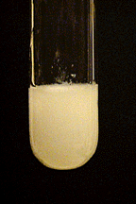
Example - Preparation of an Insoluble Salt
BaCl_{2(aq)} + Na₂SO_{4(aq)} → BaSO_{4(s)} + 2NaCl_{(aq)}
Ionic Equation: Ba²⁺_{(aq)} + SO₄²⁻_{(aq)} → BaSO_{4(s)}

Slide 38
Preparation of Soluble Salts
There are three main methods of preparing soluble salts:
Direct combination.
The reaction of an acid with a metal, an insoluble base or an insoluble carbonate.
The reaction between an acid and a soluble base (alkali).

Slide 39
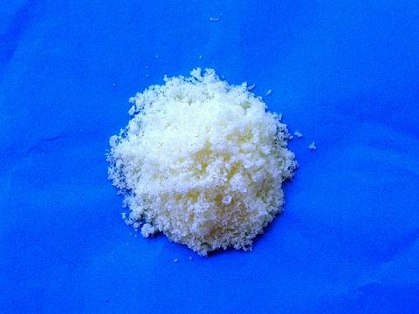
(a) Direct Combination
Salts composed of two simple ions such as metal chlorides can be prepared by reacting two elements, a metal and a non-metal, directly with each other. The metal supplies the cations and the non-metal supplies the anions.
Example:
2Al_{(s)} + 3Cl_{2(g)} → 2AlCl_{3(s)}

Slide 40
(b) Reaction with an acid
Soluble salts can be prepared by the reaction between and acid and:
a reactive metal
Mg_{(s)} + 2HCl_{(aq)} → MgCl_{2(aq)} + H_{2(g)}
an insoluble carbonate
CaCO_{3(s)} + 2HCl_{(aq)} → CaCl_{2(aq)} + H₂O_{(l)} + CO_{2(g)}
an insoluble base
CuO_{(s)} + H₂SO_{4(aq)} → CuSO_{4(aq)} + H₂O_{(l)}
In these reactions, the final product will only be a pure solution of the required salt in water if the reaction has reached completion and no acid remains.

Slide 41
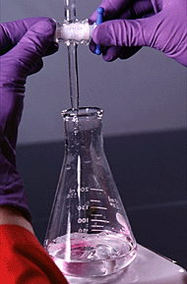
(c) Reaction between an acid and a soluble alkali
Potassium, sodium and ammonium salts are prepared by titrating an acid with an aqueous alkali. In this preparation method, the acid is added to the alkali and the reaction reaches completion when the solution is just neutral. The colour change of an indicator is used to determine the neutralisation point.

Slide 42
Questions
1. Sort the following compounds into two lists – those which are soluble in water, and those which are insoluble.
sodium chloride, lead(II) sulphate, zinc nitrate, calcium carbonate, iron(III) sulphate, lead(II) chloride, potassium sulphate, copper(II) carbonate, silver chloride, aluminium nitrate, barium sulphate, ammonium chloride, magnesium nitrate, calcium sulphate, sodium phosphate, nickel(II) carbonate, chromium(III) hydroxide, potassium dichromate(VI).

Slide 43
Summary
In this lesson we learnt about:
Aqueous Solutions
pH
Reaction is Aqueous Solution
Strong and Weak Acids and Alkalis
Extent of Ionization
Solubility Guidelines for Compounds in Aqueous Solution

