Slide 1
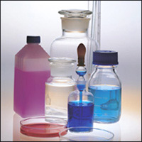
Salts

Slide 2
Soluble & Insoluble Salts
All sodium, potassium and ammonium compounds are soluble.
All nitrates are soluble
All common ethanoates (also called acetates) are soluble
Most common chlorides are soluble, except lead(II) chloride and silver chloride
Most common sulphates are soluble, except lead(II) sulphate, barium sulphate and calcium sulphate
Most common carbonates are insoluble, except sodium, potassium and ammonium carbonates
Most metal hydroxides are insoluble, except sodium, potassium and ammonium hydroxides

Slide 3
Preparation of Insoluble Salts
The general method for preparing insoluble salts:
1. Choose the two solutions, one containing the cations required to make the salt and the other containing the anions.
2. Mix the two solutions to form the insoluble salt as a precipitate.
3. Filter the mixture and collect the precipitate as the residue.
4. Wash the residue with distilled water and leave to dry.

Slide 4
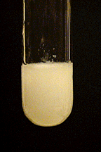
Example - Preparation of an Insoluble Salt
BaCl_{2(aq)} + Na₂SO_{4(aq)} → BaSO_{4(s)} + 2NaCl_{(aq)}
Ionic Equation: Ba²⁺_{(aq)} + SO₄²⁻_{(aq)} → BaSO_{4(s)}

Slide 5
Preparation of Soluble Salts
There are three main methods of preparing soluble salts:
Direct combination.
The reaction of an acid with a metal, an insoluble base or an insoluble carbonate.
The reaction between an acid and a soluble base (alkali).

Slide 6
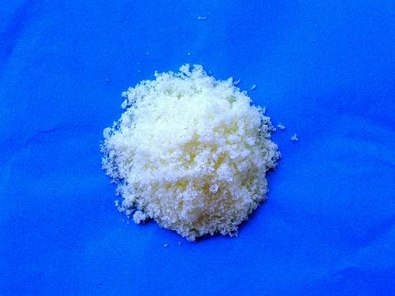
(a) Direct Combination
Salts composed of two simple ions such as metal chlorides can be prepared by reacting two elements, a metal and a non-metal, directly with each other. The metal supplies the cations and the non-metal supplies the anions.
Example:
2Al_{(s)} + 3Cl_{2(g)} → 2AlCl_{3(s)}

Slide 7
(b) Reaction with an acid
Soluble salts can be prepared by the reaction between and acid and:
a reactive metal
Mg_{(s)} + 2HCl_{(aq)} → MgCl_{2(aq)} + H_{2(g)}
an insoluble carbonate
CaCO_{3(s)} + 2HCl_{(aq)} → CaCl_{2(aq)} + H₂O_{(l)} + CO_{2(g)}
an insoluble base
CuO_{(s)} + H₂SO_{4(aq)} → CuSO_{4(aq)} + H₂O_{(l)}
In these reactions, the final product will only be a pure solution of the required salt in water if the reaction has reached completion and no acid remains.

Slide 8
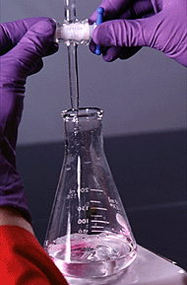
(c) Reaction between an acid and a soluble alkali
Potassium, sodium and ammonium salts are prepared by titrating an acid with an aqueous alkali. In this preparation method, the acid is added to the alkali and the reaction reaches completion when the solution is just neutral. The colour change of an indicator is used to determine the neutralisation point.

Slide 9
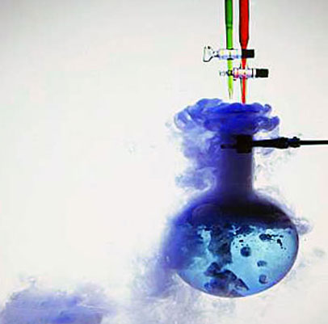
Some Types of Chemical Reactions

Slide 10
Can you spot three (3) differences?

Slide 11
Can you spot the differences in the reactions?
(1)2Mg_{(s)} + O_{2(g)} → 2MgO_{(s)}
(2) CaCO_{3(s)} → CaO_{(s)} + CO_{2(g)}
(3) NaOH_{(aq)} + HCl_{(aq)} → NaCl_{(aq)} + H₂O_{(l)}
(4) 2Al_{(s)} + 3CuSO_{4(aq)} → Al₂(SO₄)_{3(aq)} + 3Cu_{(s)}
(5) AgNO_{3(aq)} + KBr_{(aq)} → AgBr_{(s)} + KNO_{3(aq)}
(6) Zn_{(s)} + CuSO_{4(aq)} → ZnSO_{4(aq)} + Cu_{(s)}
(7) NH₄Cl_{(s)} NH_{3(g)} + HCl_{(g)}

Slide 12
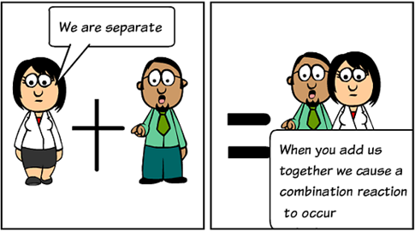
1. Combination Reactions

Slide 13
Combination Reactions
A combination reaction is any reaction in which two or more substances combine to form a single product.

Slide 14
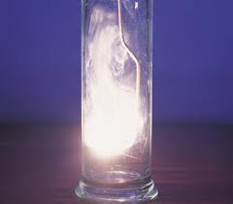
Examples of Combination Reactions
Example 1:
magnesium + oxygen → magnesium oxide
2Mg_{(s)} + O_{2(g)} → 2MgO_{(s)}

Slide 15
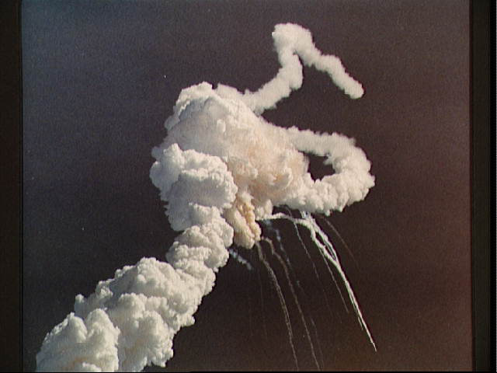
Example 2:
hydrogen + oxygen → water
2H_{2(g)} + O_{2(g)} → 2H₂O_{(g)}

Slide 16
2. Decomposition Reactions

Slide 17
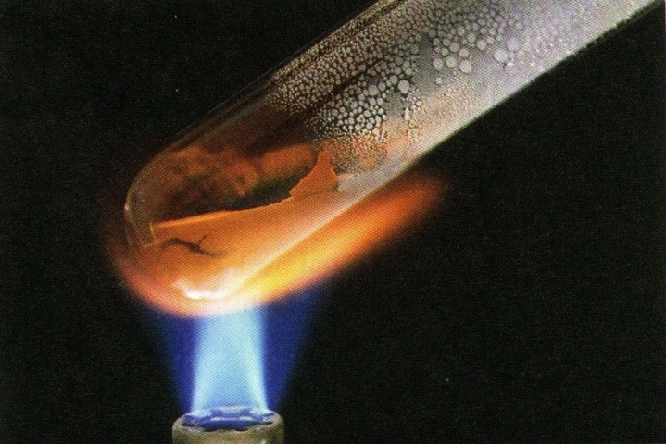
Decomposition Reactions
A decomposition reaction is any reaction where a single reactant is broken down into two or more products. A decomposition reaction will take place if the compound is unstable, if the compound is heated or if an electrical current is passed through it.

Slide 18
Examples of Decomposition Reactions
A decomposition reaction is generally symbolised by:
AB → A + B
Example 1:
calcium carbonate calcium oxide + carbon dioxide
CaCO_{3(s)} CaO_{(s)} + CO_{2(g)}
Example 2:
potassium chlorate e potassium chloride + oxygen
2KClO_{3(s)} 2KCl_{(s)} + 3O_{2(g)}

Slide 19
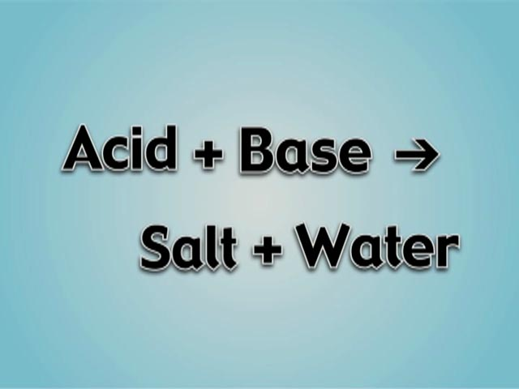
3. Neutralisation Reactions

Slide 20
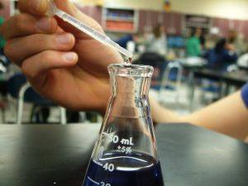
Neutralisation Reactions
Neutralization reactions are reactions between a base (or an alkali) and an acid. The acid is neutralized by the base (or alkali) and the products formed are a salt and water.

Slide 21
Examples of Neutralization Reactions
Example 1: Reaction between sodium hydroxide and hydrochloric acid
NaOH_{(aq)} + HCl_{(aq)} → NaCl_{(aq)} + H₂O_{(l)}
Ionic Equation:
OH⁻_{(aq)} + H⁺_{(aq)} → H₂O_{(l)}
Example 2: Reaction between copper(II) oxide and dilute sulphuric acid
CuO_{(s)} + H₂SO_{4(aq)} → CuSO_{4(aq)} + H₂O_{(l)}
Ionic Equation:
O²⁻_{(s)} + 2H⁺_{(aq)} → H₂O_{(l)}

Slide 22
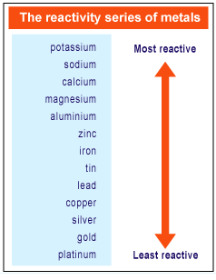
The Reactivity Series
The Reactivity Series lists elements (mainly metals) in order of decreasing reactivity.

Slide 23
4. Single Displacement Reactions

Slide 24
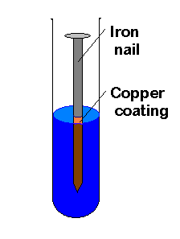
Single Displacement Reactions
A single displacement reaction involves the reaction between an element and a compound where the element takes the place of (displaces) another element from the compound.
Any metal higher in the series will displace one lower down from a compound.

Slide 25
Examples of Single Displacement Reactions
A single displacement reaction is generally symbolised by:
A + BC → AC + B
Example 1
aluminium + copper sulphate → aluminium sulphate + copper
2Al_{(s)} + 3CuSO_{4(aq)} → Al₂(SO₄)_{3(aq)} + 3Cu_{(s)}
Ionic Equation: 2Al_{(s)} + 3Cu²⁺_{(aq)} → Al³⁺_{(aq)} + 3Cu_{(s)}
Example 2
Carbon + copper(II) oxide → carbon dioxide + copper
C_{(s)} + 2CuO_{(s)} → CO_{2(g)} + 2Cu_{(s)}
Ionic Equation: C_{(s)} + Cu²⁺_{(aq)} → C²⁺_{(aq)} + Cu_{(s)}

Slide 26
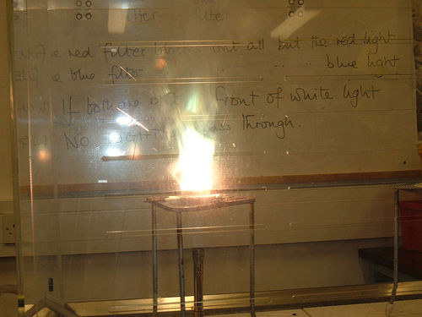
Example 3
Magnesium + zinc oxide → magnesium oxide + zinc
Mg_{(s)} + ZnO_{(s)} → MgO_{(s)} + Zn_{(s)}
Ionic Equation: Mg_{(s)} + Zn²⁺_{(aq)} → Mg²⁺_{(aq)} + Zn_{(s)}

Slide 27
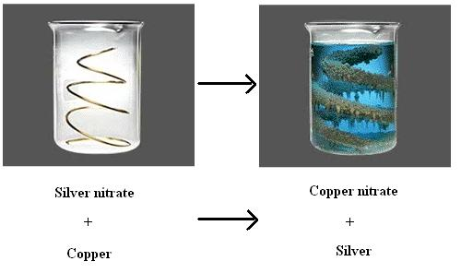
Example 4
Copper + silver nitrate → copper(II) nitrate + silver
Cu_{(s)} + 2AgNO_{3(aq)} → Cu(NO₃)_{2(aq)} + 2Ag_{(s)}
Ionic Equation: Cu_{(s)} + 2Ag⁺_{(aq)} → Cu²⁺_{(aq)} + Ag_{(s)}

Slide 28
5. Double Displacement / Ionic Precipitation Reactions

Slide 29
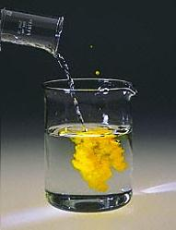
Ionic Precipitation Reactions
Ionic precipitation reactions are sometimes referred to as double displacement reactions. They mostly involve compounds which are in solution, where the compounds exchange ions.

Slide 30
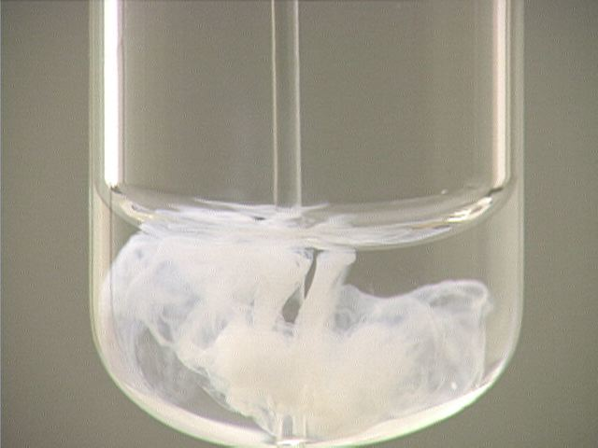
An ionic precipitation reaction is generally symbolised by:
AB + CD → AD + CB
To have a successful ionic precipitation reaction, one or both of the products must be incapable of undergoing the reverse reaction, generally because they form an insoluble precipitate.

Slide 31
Examples of Ionic Precipitation Reactions
Example 1:
AgNO_{3(aq)} + KBr_{(aq)} → AgBr_{(s)} + KNO_{3(aq)}
Ionic Equation: Ag⁺_{(aq)} + Br⁻_{(aq)} → AgBr_{(s)}
Example 2:
BaCl_{2(aq)} + Na₂SO_{4(aq)} → BaSO_{4(s)} + 2NaCl_{(aq)}
Ionic Equation: Ba²⁺_{(aq)} + SO₄²⁻_{(aq)} → BaSO_{4(s)}

Slide 32
6. Redox Reactions

Slide 33
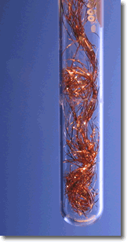
Redox Reactions
Redox reactions or oxidation-reduction reactions are chemical reactions in which one reactant is oxidised and the other is reduced or both change is oxidation number.

Slide 34
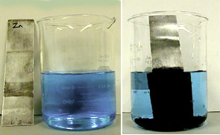
Example of a Redox Reaction
One of many examples is when zinc metal is placed in a solution of copper sulphate, the copper is reduced and appears as a black coating on the zinc.

Slide 35
7. Reversible Chemical Reactions

Slide 36
7. Reversible Chemical Reactions
There are certain chemical reactions which, under certain conditions, are reversible, i.e. the products can react to produce the original reactants again. These are known as reversible chemical reactions.
Most reactions are not reversible; they can only proceed in one direction.
If a reaction is reversible a double arrow ( )is used. In a reversible reaction we refer to the forward reaction as proceeding from left to right and the reverse reaction as proceeding from right to left.

Slide 37
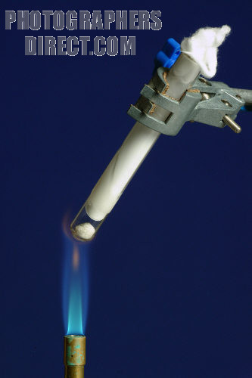
Example of a Reversible Chemical Reaction
When ammonium chloride solid is heated it sublimes into ammonia and hydrogen chloride gas. On cooling the two gases recombine to from ammonium chloride again.
NH₄Cl_{(s)} NH_{3(g)} + HCl_{(g)}

Slide 38
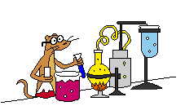
Making Predictions using the Reactivity Series
You can make predictions about unfamiliar metals if you know their position in the reactivity series.

Slide 39
A problem involving manganese
Manganese, Mn, lies between aluminium and zinc in the Reactivity Series and forms a 2+ ion. Solutions of manganese(II) salts are very, very pale pink (almost colourless).
Use the Reactivity Series to predict whether manganese will react with copper(II) sulphate solution. If it will react, describe what you would see, name the products and write an equation for the reaction.
Explain why you would expect manganese to react with steam. Name the products of the reaction and write the equation.

Slide 40
Answer
Manganese is above copper in the Reactivity Series and so will displace it from the copper(II) sulphate.
A brown deposit of copper will be formed. The colour of the solution will fade from blue and leave a very pale pink (virtually colourless) solution of manganese(II) sulphate.
Mn_{(s)} + CuSO_{4(aq)} → MnSO_{4(aq)} + Cu_{(s)}

Slide 41
(b) Manganese is above hydrogen in the Reactivity Series and so reacts with steam to give hydrogen and the metal oxide – in this case, manganese(II) oxide.
You couldn’t predict the colour of the manganese(II) oxide and the question doesn’t ask you to do it.
Mn_{(s)} + H₂O_{(g)} → MnO_{(aq)} + H_{2(g)}

