Slide 1
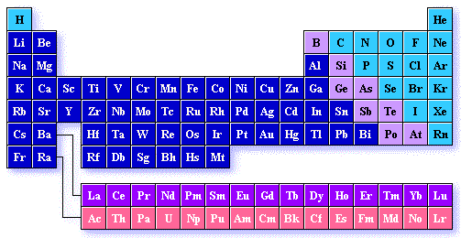
The Periodic Table

Slide 2
Activity: Use the basic periodic table you completed as your homework project to answer the questions in Worksheet 1.

Slide 3
Worksheet 1
1. Which elements had complete outer shells? Give the name and symbol for each.
What do you notice about the location of these elements?
2. Which elements had only one valence electron? Give the name and symbol for each.
What do you notice about the location of these elements?

Slide 4
3. What do you notice about the number of valence electrons as you move from left to right across a row or period in the periodic table?
(Na→ Mg→ Al→ Si→ P→ S→ Cl→ Ar)
4. What do you notice about the number of energy levels or shells as you move down a group or column in the periodic table?
(H→ Li→ Na)

Slide 5
5. Write the name of each family at the top of the columns on your periodic table using the following information:
Alkali Metals – 1 valence electron
Alkaline Earth Metals – 2 valence electrons
Boron Family – 3 valence electrons
Carbon Family – 4 valence electrons
Nitrogen Family – 5 valence electrons
Oxygen Family – 6 valence electrons
Halogens – 7 valence electrons
Noble Gases – complete outer shells

Slide 6
6. What do you notice about the location of the elements in each family?
7. In which family would you classify hydrogen? Explain your choice.
8. In what family would each of these elements be classified?
Radium –
Iodine –
Tin –
Cesium -

Slide 7
9. Predict the number of valence electrons for each element based on its location in the Period Table of Elements. You will need to use the table in your textbook.
Barium –
Lead –
Bismuth –
Potassium -

Slide 8
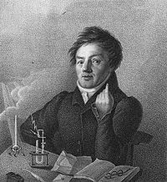
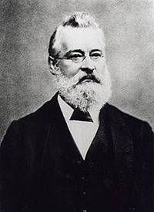
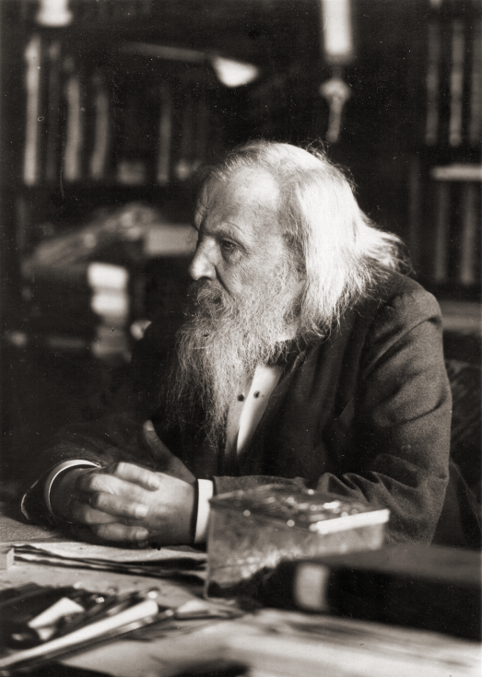
The History of the Periodic Table
Johann
Wolfgang
Dobereiner
John Newlands
Dimitri Mendeleev

Slide 9
Johann Wolfgang Dobereiner
In work beginning 1817, Dobereiner investigated some groups of three elements with similar chemical properties – for example, lithium, sodium and potassium.
He noticed that the atomic weight (what we would now call the relative atomic mass) of the middle one was the average of the other two:
lithium: 7 sodium: 23 potassium: 39
23 = (7 + 39) ÷ 2

Slide 10
He found similar patterns with calcium, strontium and barium; with sulphur, selenium and tellurium; and with chlorine, bromine and iodine.
These became known as Dobereiner’s triads.
At the same time, this was no more than a curiosity, but the real advances some 50 years later were again based on patterns in atomic weights.

Slide 11
John Newlands
In 1864-65, Newlands noticed that by arranging the known elements into atomic weight order, elements with similar properties recurred at regular intervals.
Every eight element was similar.
He proposed a law which said that ‘The properties of the elements are a periodic function of their atomic weights’.
By drawing an analogy with music, his law became known as the ‘Law of Octaves’.

Slide 12
John Newlands’ Table
1 | 2 | 3 | 4 | 5 | 6 | 7
H | Li | Be | B | C | N | O
F | Na | Mg | Al | Si | P | S
Cl | K | Ca | Cr | Ti | Mn | Fe
This works up to a point, but it soon goes wrong.
For example, there is no similarity at all between the metal manganese, Mn, and the non-metals nitrogen and phosphorous in Newlands’ sixth group.

Slide 13
Criticism of John Newlands’ Table
Newlands’ ideas were greeted with ridicule at the time. One of his critics suggested that he might as well have arranged his elements in alphabetical order. With hindsight his theory was bound to fail.
There were lots of undiscovered elements, and some of the known ones had been given the wrong atomic weights.
We also know that the patterns get more complicated when you get beyond calcium.

Slide 14
Dimitri Mendeleev
In 1869, only a few years after Newlands, Mendeleev used the same idea but improved it almost beyond recognition.
He arranged the elements in atomic weight order, but accepted that the pattern was going to be more complicated than Newlands suggested. Where necessary he left gaps in the table to be filled by as yet undiscovered elements.
He also had the confidence to challenge existing values for atomic weight where they forced an element into the wrong position in his Periodic Table.

Slide 15
And he was right!
One of Mendeleev’s early triumphs was to leave a gap underneath silicon in the table for a new element which he called ‘ekasilicon’.
He predicted what the properties of this element and its compounds would be.
When what we now call germanium was isolated in 1886, it proved to have almost exactly the properties that Mendeleev predicted.

Slide 16
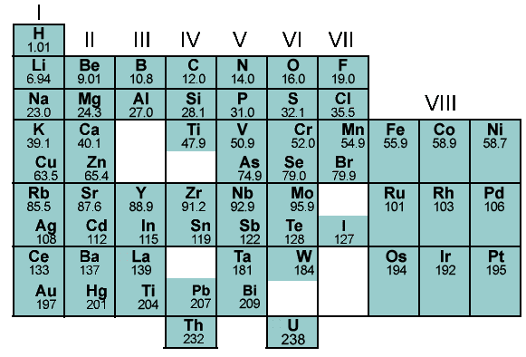
Part of Mendeleev’s Table

Slide 17
Comparing the Modern Periodic Table with Mendeleev’s Table
You might notice that the noble gases (helium, neon, argon and the rest) are missing – they were not known at this time. When argon was discovered in 1894, it was obvious that it did not fit anywhere in the existing table.
Argon was put into a new group – Group 0. This suggested that there must be other members of this group, and helium, neon, krypton and xenon were quickly found over the next four years.

Slide 18
Problems with Mendeleev’s Table
There were some residual problems in Mendeleev’s Table which had to be left for later. The atomic weight order was not exactly followed.
For example, tellurium, Te, has a slightly higher atomic weight than iodine – but iodine obviously has to go where it is in the Table because its properties are very similar to chlorine and bromine.

Slide 19
Problems with Mendeleev’s Table – The Tellurium / Iodine Issue
Group 6 | Group 7
O | F
S | Cl
Cr Se | Mn Br
Mo I | * Te
Group 6 | Group 7
O | F
S | Cl
Cr Se | Mn Br
Mo Te | * I
correct order in terms of atomic weight
Mendeleev swapped Te and I so that their properties matched the rest of the group

Slide 20
Another Problems with Mendeleev’s Table – The Argon / Potassium Issue
Group 0 | Group 1
He | Li
Ne | Na
K | Ar
Argon’s atomic weight is slightly higher than potassium’s. Putting elements in their correct order of increasing atomic weight would put argon into the same group as lithium and sodium, and potassium in with gases like neon. That’s obviously wrong!

Slide 21
Last Problems with Mendeleev’s Table – The need for sub-groups
The need for sub-groups (starting in Period 4) is also awkward.
For example, lithium, sodium, potassium and rubidium are described as being in Group 1a; copper and silver are in Group 1b. There’s not much resemblance between the two sub-groups.
These problems are completely overcome in the modern version of the Periodic Table.

Slide 22
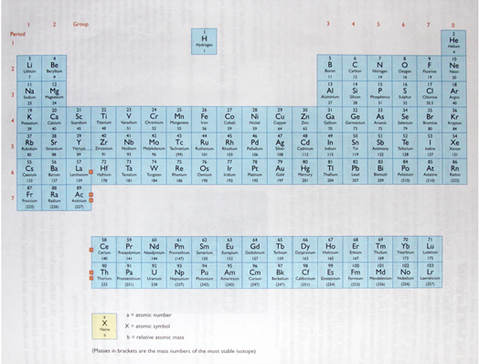
The Modern Periodic Table

Slide 23
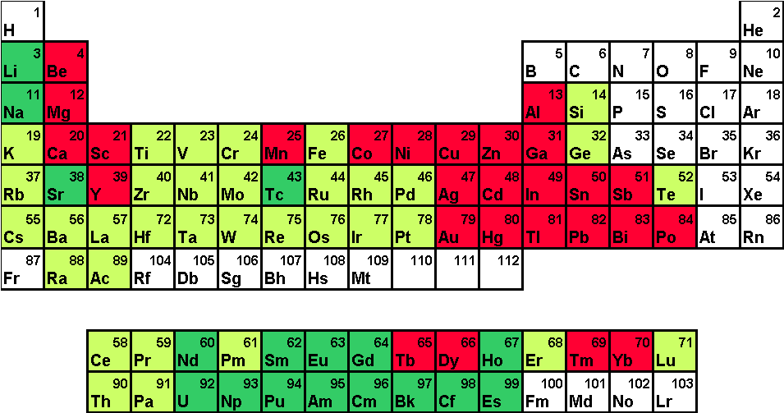
The Periodic Table
There are 103 different elements in the periodic table, arranged in order of increasing atomic number.

Slide 24
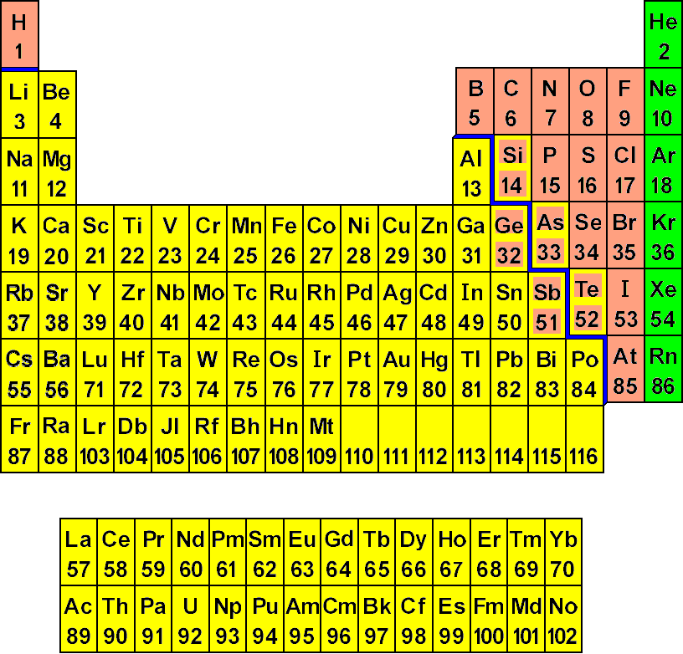
Elements in the Periodic Table
Elements in the Periodic Table can be divided into metals and non-metals, with the metalloids being those elements which border these two groups of elements.

Slide 25
Location of Metals, Non-Metals and Metalloids in the Periodic Table
Look at the Periodic Table.
The solid line which runs from above aluminium stepping down to astatine divides the metals and the non-metals.
All those elements to the left of the line, excluding hydrogen, are metals and those to the right of the line, including hydrogen, are non-metals.
Those elements which border the line, eg silicon, arsenic and germanium are metalloids.

Slide 26
Groups and Periods in the Periodic Table
The Periodic Table consists of vertical columns called groups and horizontal rows called periods.

Slide 27
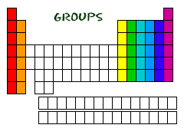
Groups in the Periodic Table
Look at your copy of the Periodic Table.
How many groups are there?

Slide 28
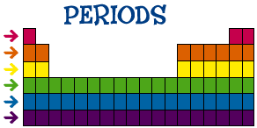
Periods in the Periodic Table
Look at your copy of the Periodic Table.
How many periods are there?

Slide 29
Groups and Periods in the Periodic Table
There are 18 groups in the Periodic Table, but only 8 of the groups are numbered; the first two and the last six.
The columns that lie between Group II and Group III are known as the transition elements (or metals).
Elements in the same group show similar properties and because of this, they have been assigned special names.

Slide 30
Groups and Periods in The Modern Periodic Table
Look at your copy of the Periodic Table.
Where are the groups?
They are the vertical columns that run from top to bottom.
Where are the periods?
They are the horizontal rows that run from left to right.
Which element is found in period 3 of group 3?
Aluminium, Al
Which element is found in period 2 of group 7?
Fluorine, F

Slide 31
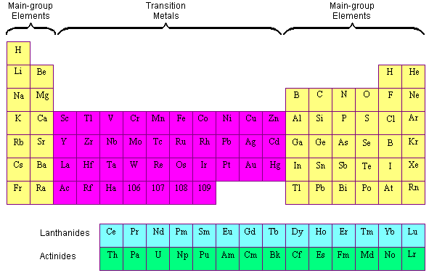
The Transition Elements

Slide 32
Position of the Transition Elements in the Modern Periodic Table
The position of the transition elements are shown below.
Look at your periodic table. What are some examples of transition elements?

Slide 33
Position of the Transition Elements in the Modern Periodic Table
The inner transition elements are usually dropped out of their proper places, and written separately at the bottom of the Periodic Table.
The reason for this is not very subtle. If you put them where they should be, everything has to be drawn slightly smaller to fit on the page.
That makes it more difficult to read.

Slide 34
Most periodic tables stop at the end of the second inner transition series.
Some continue beyond that to include a small number of more recently discovered elements.
New elements are still being discovered, although they are highly radioactive and have incredibly short existences. Knowing where they are in the Periodic Table, however, means that you can make good predictions about what their properties would be.

