Slide 1

Atomic Structure

Slide 2
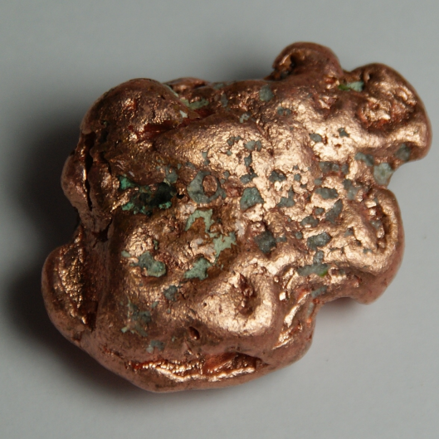
The Structure of the Atom
Copper is an element.
If you tried to chop it up into smaller and smaller bits, eventually you would end up with the smallest possible piece of copper.
At that point you would have an individual copper atom.
You can, of course, split that into still smaller pieces (protons, neutrons and electrons), but you would no longer have copper.

Slide 3
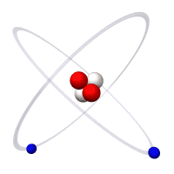
What is an Atom?
An atom is the smallest part of an element that can exist and still exhibit the properties of the element.
Each element can be represented by an atomic symbol which represents one atom of the element.

Slide 4
Atomic Symbols of Common Elements
(Refer to Periodic Table)
Element | Atomic Symbol
Aluminium | Al
Calcium | Ca
Gold | Au
Iron | Fe
Boron | B
Chlorine | Cl
Oxygen | O

Slide 5
Activity 1: Locate the following elements on the periodic table and write their atomic symbol
Barium – 6. Bromine -
Copper - 7. Carbon -
Lead – 8. Phosphorous -
Mercury - 9. Silicon -
Silver - 10. Sulphur -

Slide 6
Subatomic Particles

Slide 7
Subatomic Particles
Atoms are made up of protons, neutrons and electrons.
Protons and neutrons are found in the centre of the atom in an area known as the nucleus. Nearly all of the mass of an atom is concentrated in the nucleus.
Electrons are found at quite a distance from the nucleus, spinning in a series of levels known as energy shells. Most of the atom is in fact empty space, but the movement of the electrons around the nucleus constitutes the volume of the atom.

Slide 8

Subatomic Particles

Slide 9
Charge of Subatomic Particles
Protons are positively charged particles and electrons are negatively charged particles.
The charge on a proton is equal to the charge on an electron.
Neutrons are electrically neutral.
In an atom, the number of protons is equal to the number of electrons.

Slide 10
Mass of Subatomic Particles
The mass of a proton is equal to the mass of a neutron.
The mass of a proton is equal to the mass of a neutron. The mass of a proton is very small, only 1.67 x 10⁻²⁴g.
The mass of an electron is even smaller. Comparing the mass of a proton to that of an electron, a proton is about 1836 times heavier than an electron.

Slide 11
Summary - Mass and Charge of Subatomic Particles
Subatomic Particle | Relative Charge | Relative Mass
Proton | +1 | 1
Neutron | 0 | 1
Electron | -1 | 1/1836

Slide 12
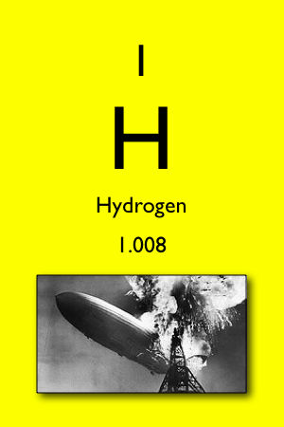
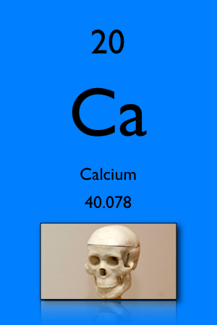
Atomic Number
The number of protons in an atom is known as the atomic number, with symbol Z.
The atomic number is unique to a particular element, i.e. there are no two elements in the world which have the same atomic number.
Examples:

Slide 13
Atomic Number
The atomic number for hydrogen is 1, which means that hydrogen has 1 proton.
The atomic number for calcium is 20 which means that it has 20 protons.
In an atom, the number of electrons will be equal to the atomic number.
Questions:
How many electrons are in a hydrogen atom?
How many electrons are in a calcium atom?

Slide 14
Mass Number
The number of protons and neutrons is known as the mass number, with symbol A.
The number of neutrons can be calculated by subtracting the atomic number from the mass number, i.e. A – Z.
The mass number is not unique to the particular atom.

Slide 15
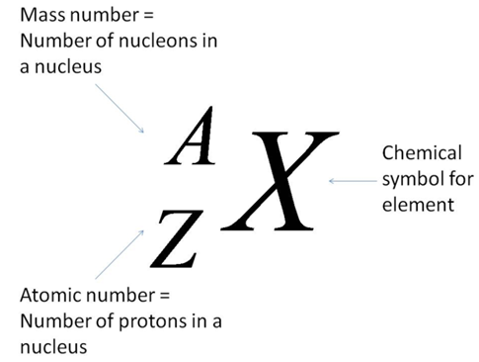
Nuclear Notation
We can represent an atom (or ion) of an element using nuclear notation:
This notation is very useful because it allows the number of protons, neutrons and electrons in an atom or an ion to be calculated.

Slide 16



Using Nuclear Notation
Element | Nuclear Notation | Number of
 |  | Protons (Z) | Neutrons (A – Z) | Electrons
Helium |  | 2 | 2 | 2
Sodium |  | 11 | 12 | 11
Chlorine |  | 17 | 20 | 17

Slide 17
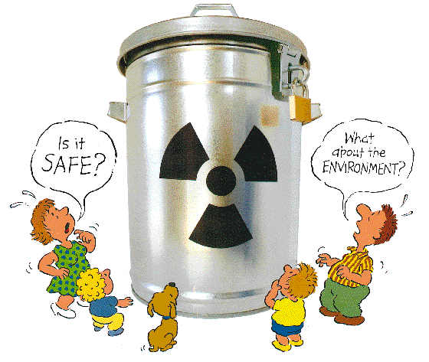
Isotopes & Radioactivity

Slide 18

Isotopes & Radioactivity
The atomic number is unique to a particular element.
For example, all atoms of chlorine will have an atomic number of 17.
But the number of neutrons in atoms of the same element is not unique; there are some chlorine atoms with 18 neutrons and others with 20.

Slide 19

What are isotopes?
Isotopes are different atoms of the same element which have the same number of protons but different numbers of neutrons.
The number of electrons in the different isotopes of the same element is the same.

Slide 20
Properties of Isotopes
Isotopes of an element have the same chemical and electrical properties but different physical properties.
If the different isotopes of magnesium had to react with oxygen, the chemical reaction would be the same, i.e. they have the same chemical properties.
Most elements have more than one isotope, but not all of these isotopes are stable, i.e. they decay into other isotopes

Slide 21
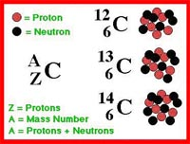
Example 1: Isotopes of Carbon
Carbon, with an atomic number of 6, has three isotopes; one with a mass number of 12, one with a mass number of 13 and one with a mass number of 14.

Slide 22

There are two main methods of representing these isotopes:
Using Nuclear Notation:
By Name:
carbon-12 or C-12
carbon-13 or C-13
carbon-14 or C-14

Slide 23
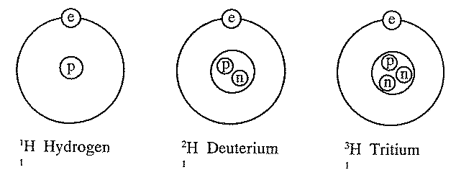
Example 2: Isotopes of Hydrogen
Hydrogen also has three isotopes.
The deuterium isotope is heavier than the hydrogen isotope since it has an extra neutron.
Water produced from this isotope is known as “heavy” water, which is used in nuclear reactors to absorb neutrons.

Slide 24

Radioactivity

Slide 25

Radioactivity
Some isotopes have unstable nuclei. These are known as radioactive isotopes. They eject particles and radiation from their nuclei.
Radioactive isotopes eject these particles to become more stable, but in the process they may produce an atom of a different element.

Slide 26
Uses of Radioactive Isotopes
Carbon-14 dating
Radiotherapy
Tracers
Energy Generation
Pacemakers

Slide 27

Electronic Configuration of an Atom
Electrons spin around the nucleus of the atom in a series of levels known as energy shells.
The electrons are grouped together in a specific arrangement.
We can represent the arrangement of electrons in an atom, known as the electronic configuration, using the scientific model.

Slide 28
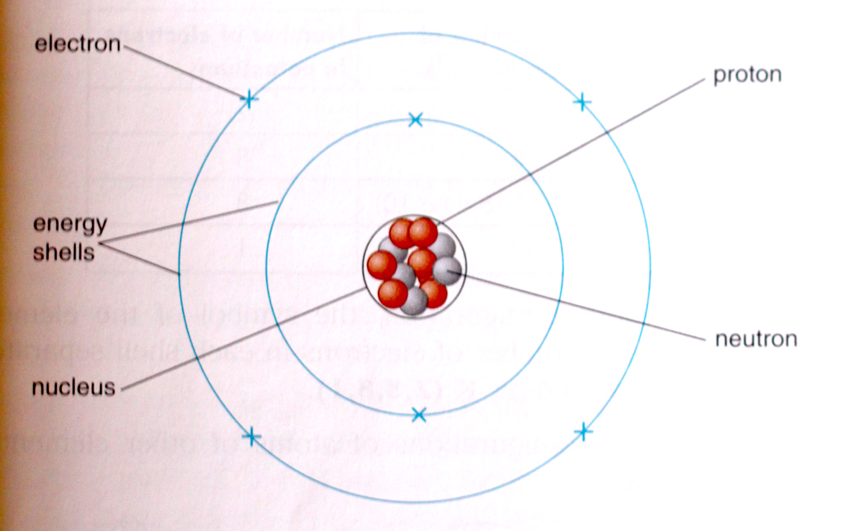
Model of the Arrangement of Electrons in an Atom

Slide 29
In this scientific model, the energy shells are drawn as concentric circles around the nucleus, but as this is only a model, this in not how they actually look.
The shells are numbered according to their distance from the nucleus.
The shell closest to the nucleus is assigned number 1, the next furthest, number 2 etc.
Each shell can hold a certain maximum number of electrons. The maximum number of electrons that an energy shell can hold is given by the formula 2n² where n is the shell number.

Slide 30
Maximum Number of Electrons in Each Shell
Electron Shell Number (n) | Maximum Number of Electrons (2n²)
1 | 2
2 | 8
3 | 18 (8 then 10)
4 | 32

Slide 31
The electrons are constantly being attracted to the positive nucleus by an electrostatic force of attraction.
They maintain their spin around, and distance from, the nucleus because of the energy they possess.
Electrons in a lower shell (closer to the nucleus) have less energy than those in a higher shell (further from the nucleus).
In fact, electrons can only occupy a specific shell if they have the required energy.

Slide 32

Electronic Configuration
The electronic configuration (or structure) of an atom of an element can be represented by drawing a shell diagram, or in writing using numbers.
When drawing the electronic configuration of an atom using a shell diagram, there are certain rules that must be followed.

Slide 33
Rules for Drawing Electronic Configuration
1. First you need to know the number of electrons in the atom of the element. This is the same as the number of protons or the atomic number.
2. Electrons will always fill up the shells in order, i.e. electrons fill up shell 1 and when that is full, they start filling up shell 2 and so on.

Slide 34
3. There is something unusual that occurs in shell number 3. When 8 electrons have been placed in shell number 3, the next 2 electrons are placed in shell number 4. Only after these 2 electrons have been placed in shell number 4 are the remaining 10 electrons placed in shell number 3.
4. To represent the electronic configuration, concentric circles are drawn around a central point (the nucleus of the atom). Crosses or dots are used to represent the electrons in the shells. The number of concentric circles is determined by the number of shells that are going to be filled (or partially filled).

Slide 35
Example: What is the electronic configuration of potassium?
Answer: Potassium has 19 electrons.
When writing the electronic configuration, the symbol of the element is written first, followed by the number of electrons in each shell separated by commas.
For potassium it would be K (2,8,8,1)
Shell Number (n) | Max number of electrons (2n²) | Number of electrons in potassium
1 | 2 | 2
2 | 8 | 8
3 | 18 (8 then 10) | 8
4 | 32 | 1

Slide 36
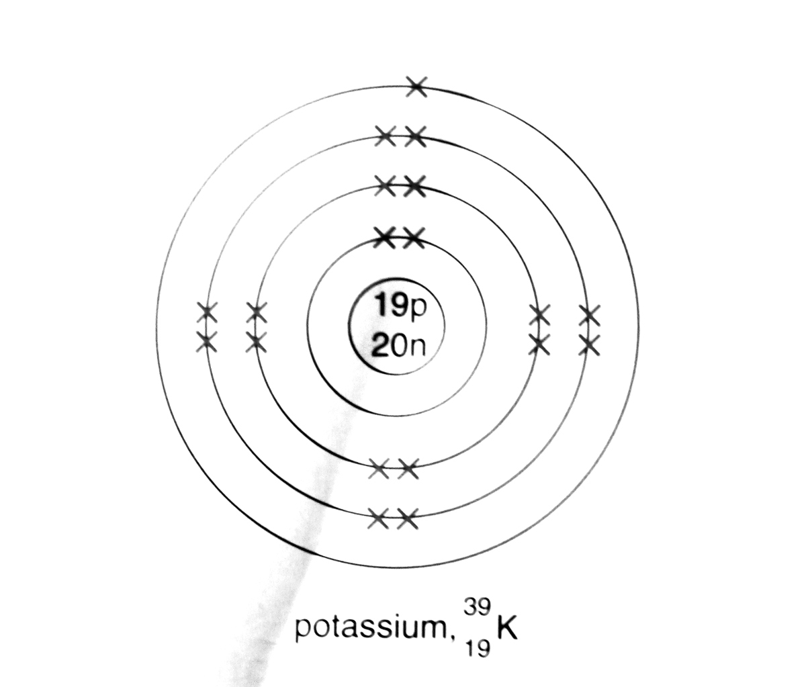
Example: Draw the electronic configuration of potassium.
Answer: The electronic configuration of potassium is
K (2,8,8,1). This is drawn as shown below:

Slide 37
Questions: Represent the electronic configuration of the following atoms using both a shell diagram and writing:
Hydrogen
Boron
Oxygen
Sodium
Argon
Calcium

Slide 38
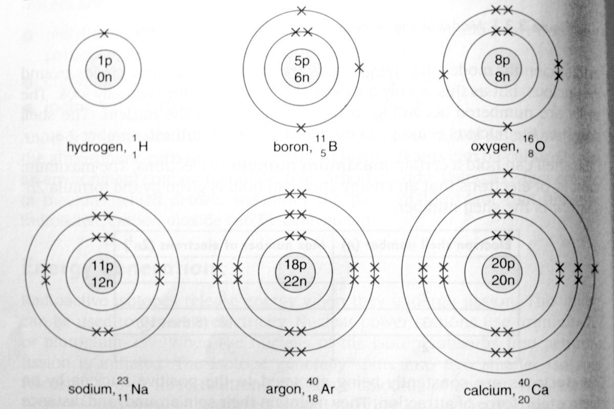
Answers

Slide 39
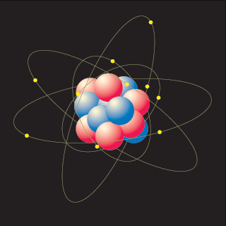
Valence Electrons
The electrons in the outermost energy shell are known as the valence electrons.
For example, potassium, K (2,8,8,1), has 1 valence electron.
The outermost electrons are involved in chemical reactions, i.e. the valence electrons.

Slide 40
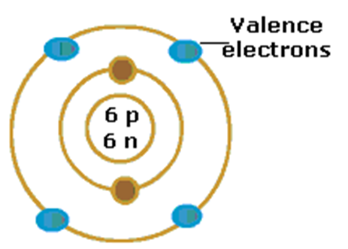
Question: Name the element depicted below and state the number of valence electrons for this element.
Answer: The element is carbon and it has 4 valence electrons.

Slide 41
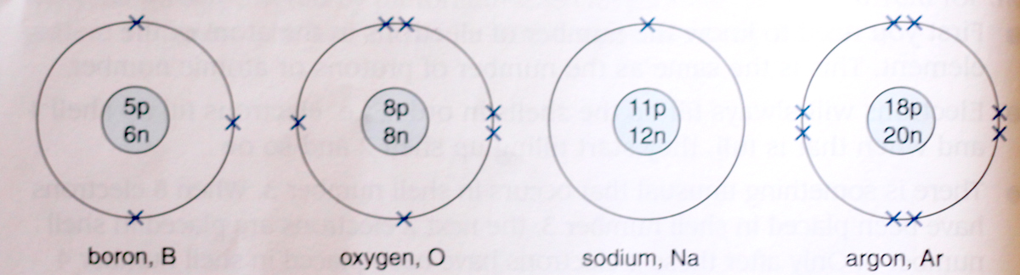
Valence Electrons
A diagram of an atom can also be drawn which only shows the valence electrons. Examples of these are given in the diagram below.

Slide 42
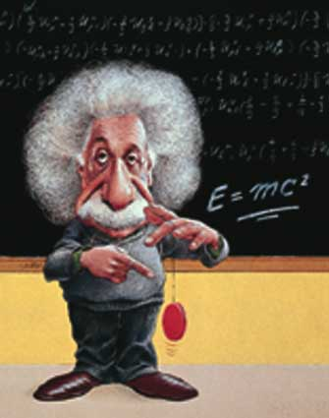
Summary
In this lesson we learnt about:
The structure of the atom
Atomic number and mass number
The arrangement of the electrons and filled shells
Drawing diagrams of electronic arrangements

Slide 43
Worksheet
1. Which particle(s) in the atom is/are responsible for the:
(a) mass of the atom;
(b) volume of the atom?
2. Define the following terms:
atomic number, mass number.
3. For each of the following nuclear notations, give the number of protons, electrons and neutrons.
(a) ¹¹₅ B (b) ²³₁₁ Na (c) ⁴⁰₂₀ Ca
4. Define the term isotope.
5. Give the formula used to determine the maximum number of electrons allowed in an electron shell.

Slide 44
4. Define the term isotope.
5. Give the formula used to determine the maximum number of electrons allowed in an electron shell.
6. (a) Represent the electronic configuration of the following atoms using both a shell diagram and writing:
(i) magnesium which has 12 electrons (ii) chlorine which has 17 electrons
(iii) neon which has 10 electons
(b) For each of the elements in question 6 (a) give the number of valence electrons.

Slide 45
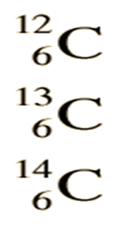

7. Represent the electronic diagram of the following atoms of carbon using both a shell diagram and writing:
8. Represent the electronic diagram of the following atoms of chlorine using both a shell diagram and writing:

Slide 46
9. Use your knowledge of atomic calculations to complete the chart below.

