Slide 1
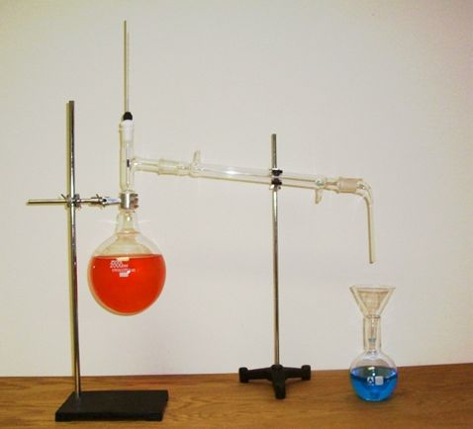
Method 3: Simple Distillation

Slide 2
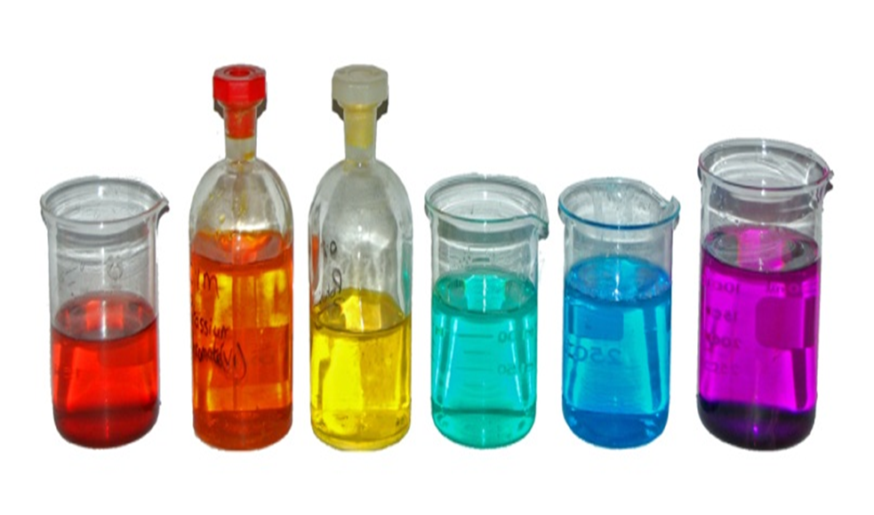
When is simple distillation used?
Simple distillation is also used to separate a solution of a solid dissolved in a liquid, and it allows both the solid and the liquid to be collected.

Slide 3
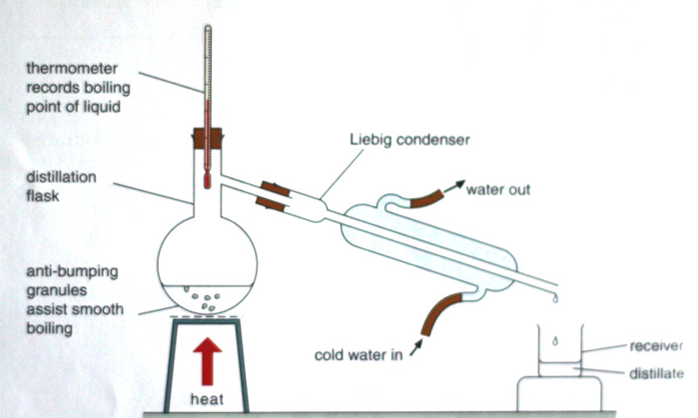
Simple Distillation Apparatus

Slide 4
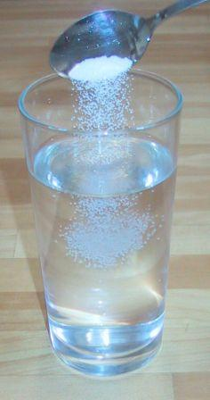
Mixtures that can be separated by Simple Distillation
Simple distillation is only an appropriate method of separation if the liquid has a lower boiling point than the solid, i.e. the liquid becomes a vapour before the solid.
Distillation can therefore be used to separate a mixture of salt and water.

Slide 5
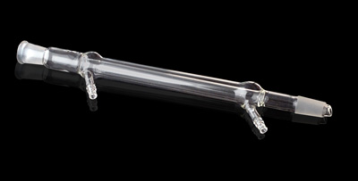
The Liebig Condenser
One of the key components of the apparatus used in distillation is the Liebig condenser.

Slide 6
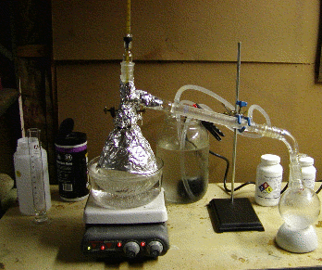
Method by which simple distillation works
The method by which the distillation apparatus works is:
The mixture is heated in the distillation flask until vaporisation occurs

Slide 7
Method by which simple distillation works
The vapour rises up the distillation flask and as it passes into the Liebig condenser it begins to cool and condenses back to a liquid. This liquid passes down the condenser and can be collected.

Slide 8
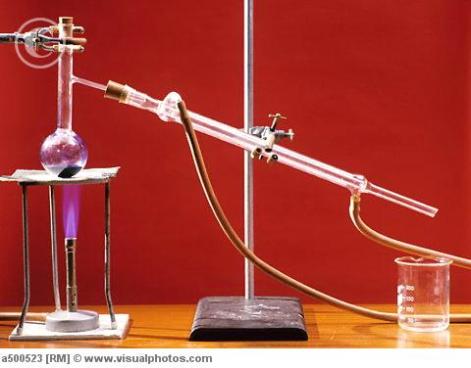
Simple Distillation Facts
Anti-bumping crystals are added to the mixture to assist with smooth boiling.
The liquid that passes through the Liebig condenser is known as the distillate.

Slide 9
When is simple distillation useful?
Simple distillation is a very useful method of separation if you need to collect both the solid and the liquid after separation.

Slide 10
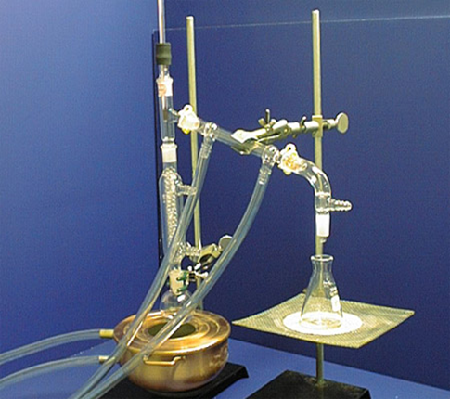
Method 4: Fractional Distillation

Slide 11
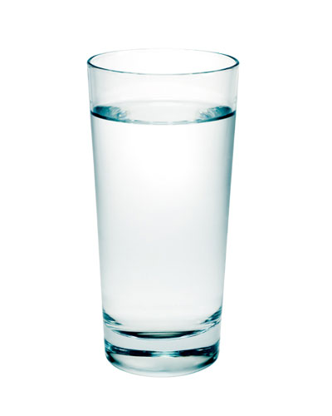
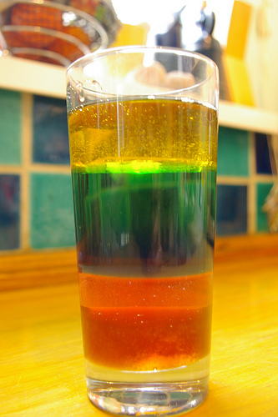
Miscible & Immiscible
Miscible liquids are liquids which are able to mix.
Immiscible liquids are liquids which are unable to mix.

Slide 12
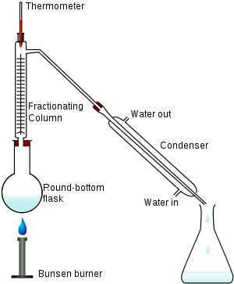
When is fractional distillation used?
Fractional distillation is used to separate a mixture of two or more liquids which are miscible and have different boiling points which are close together.

Slide 13
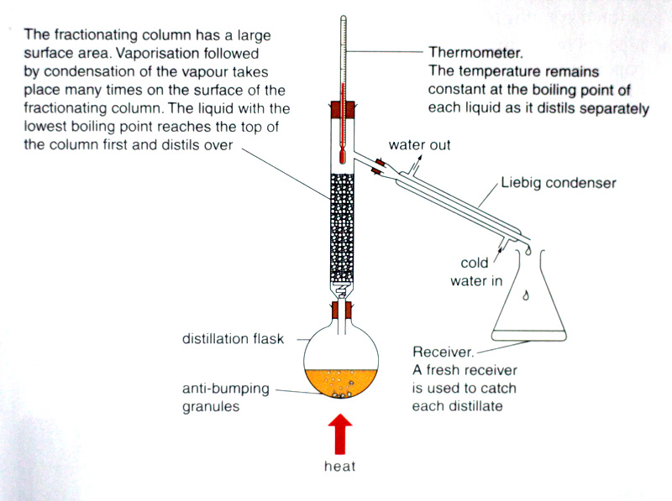
Fractional Distillation Apparatus
Questions: How is the apparatus used in fractional distillation different from that used in simple distillation? How is it similar?

Slide 14
Fractional Distillation Apparatus
The apparatus used in fractional distillation is similar to that used in simple distillation.
A fractionating column is attached to a round bottomed flask which is then attached to a Liebig condenser.
Fractional distillation can be used to separate a mixture of methanol and water, since the boiling point of methanol is 58⁰C and that of water is 100⁰C.

Slide 15
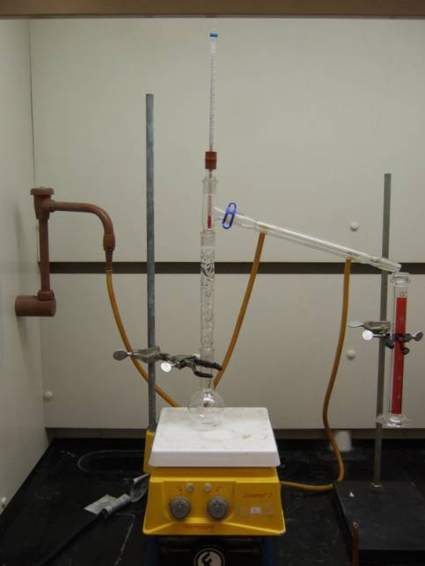
Method of Fractional Distillation
The method by which the apparatus for fractional distillation works is:
1. The mixture boils and vapours of both liquids enter the fractionating column.

Slide 16
2. Vapour from the liquid with the higher boiling point condenses in the fractionating column and returns to the flask.
3. Vapour from the liquid with the lower boiling point reaches the top of the fractionating column, enters the condenser and condenses.

Slide 17
4. Condensed liquid drips into flask. This is the distillate.
5. Each fraction of the mixture is collected in a separate container.

