Slide 1
Why does chlorine form molecules?
Whenever a bond is formed (of whatever kind), energy is released; that makes the things involved more stable than they were before.
The more bonds an atom can form, the more energy is released and the more stable the system becomes.
In the chlorine case, each chlorine atom only has one electron to share, so it can only form one covalent bond.
The Cl₂ molecule is much more stable than two separate chlorine atoms.

Slide 2
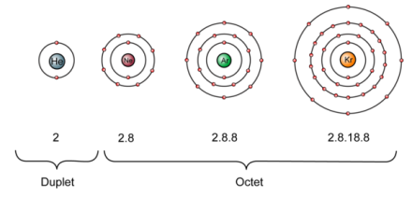
The significance of noble gas structures in covalent bonding
What is the arrangement of the electrons around each chlorine atom in Cl₂?
2, 8, 8
This is the same as the electron configuration of an atom of which noble gas?
Argon

Slide 3
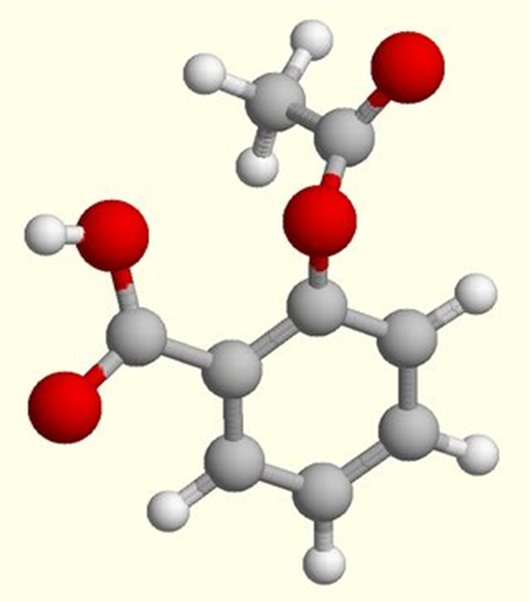
When atoms bond covalently, they often produce outer electronic structures the same as noble gases – in other words, with four pairs of electrons (or one pair in the case of helium).
There are, however, lots of examples where different numbers of pairs are formed, producing structures which are quite unlike noble gases.

Slide 4
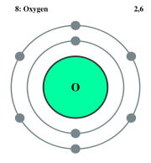
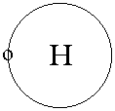
Example 2: Water
Hydrogen, a non-metal with one electron in its outer electron shell, needs one electron to complete its outer electron shell.
Oxygen, a non-metal with six electrons in its outer electron shell, needs two electrons to complete its outer shell.
Question: How many hydrogen and oxygen atoms will be covalently bonded together?

Slide 5
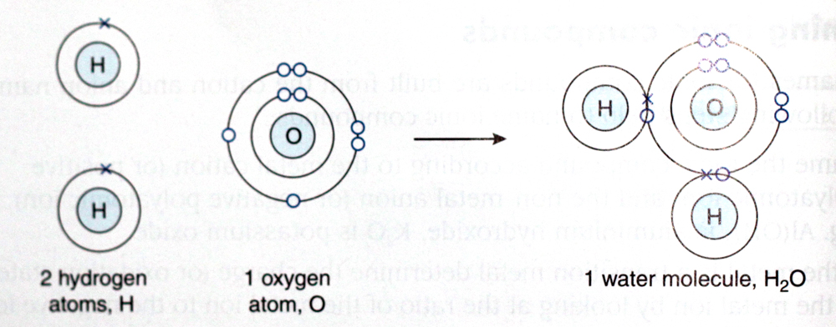
Two hydrogen atoms are needed to provide the two electrons required by oxygen.
Each hydrogen atom shares one electron pair with an oxygen atom.

Slide 6
The formula for water is H₂O.

Slide 7
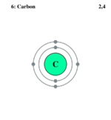
Example 3: Methane
Carbon is a non-metal with four electrons in its outer electron shell. Carbon needs four electrons to complete its outer electron shell.
Hydrogen is a non-metal with one electron in its outer electron shell. Hydrogen needs on electron to complete its outer electron shell.

Slide 8
Questions
1. How many hydrogen and carbon atoms will be covalently bonded together in a methane molecule?
2. Draw the electronic configuration of a methane molecule.

Slide 9
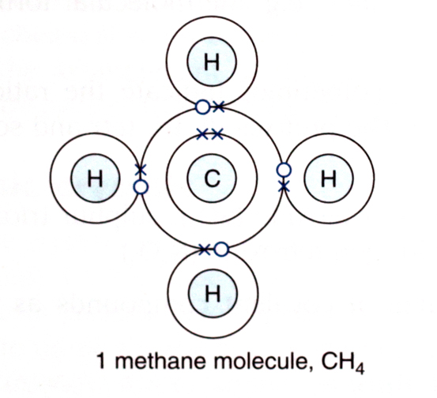
Answer Electronic Configuration of a Methane Molecule

Slide 10
Example 4: Oxygen Gas
Oxygen needs two electrons to have a completed outer shell.
Questions
1. How many oxygen atoms will be covalently bonded together in an oxygen molecule?
2. Draw the electronic configuration of an oxygen molecule.

Slide 11
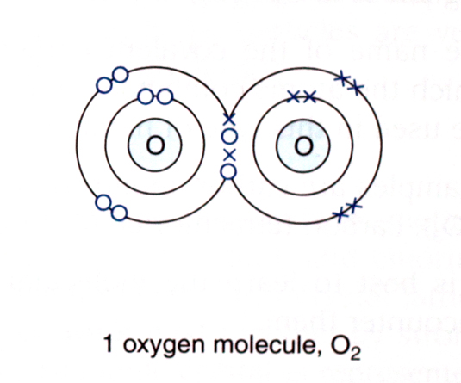
Answer
Two oxygen atoms come close enough for their outer electron shells to overlap.
The two atoms share two electron pairs between them, forming a double covalent bond.

Slide 12
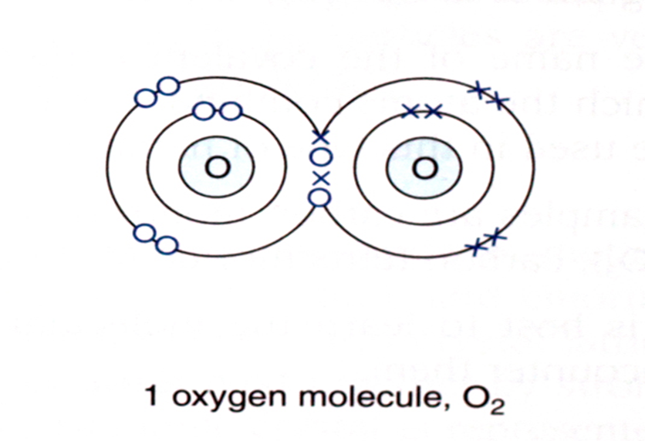
Answer
The formula for oxygen gas is O₂.
The double covalent bond is represented as O=O.

Slide 13
Example 4: Carbon Dioxide
Carbon needs four electrons and oxygen needs two electrons to complete their outer electron shells.
Questions
1. How many carbon atoms will be covalently bonded to oxygen atoms in a carbon dioxide molecule?
2. Draw the electronic configuration of a carbon dioxide molecule.

Slide 14
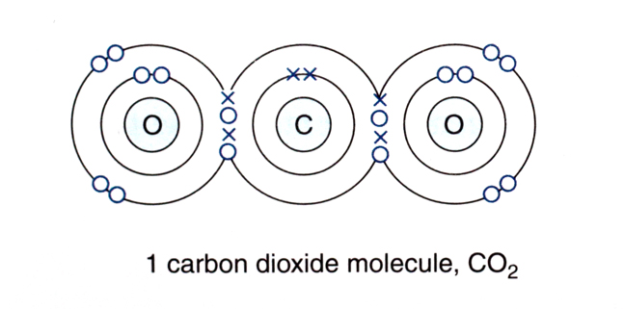
Two oxygen atoms are needed to provide the four electrons required by carbon.
Each oxygen atom shares two electron pairs with a carbon atom, forming a double covalent bond.

Slide 15
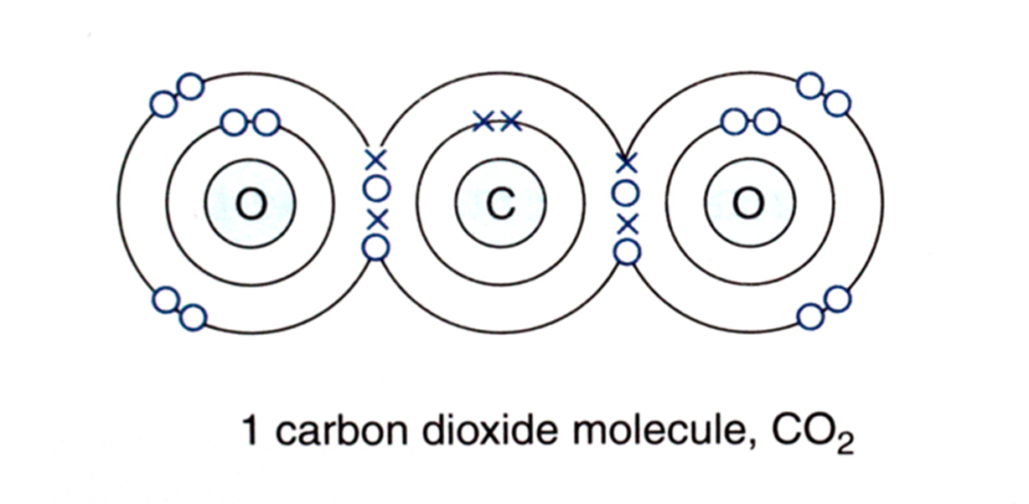
The formula for carbon dioxide is CO₂.
The double covalent bonds are represented as O=C=O

Slide 16
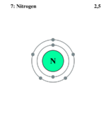
Example 5: Nitrogen
Nitrogen in Group 5, needs three electrons to complete its outer electron shell.
Questions
1. How many nitrogen atoms will be covalently bonded to each other in a nitrogen molecule?
2. Draw the electronic configuration of a nitrogen molecule.

Slide 17
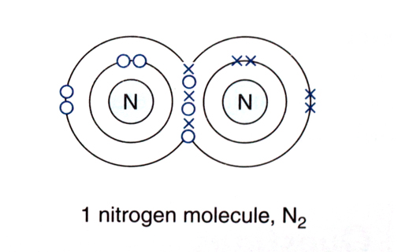
Two nitrogen atoms come close enough for their outer electron shells to overlap.
The two atoms share three electron pairs between them, forming a triple covalent bond.

Slide 18
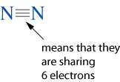
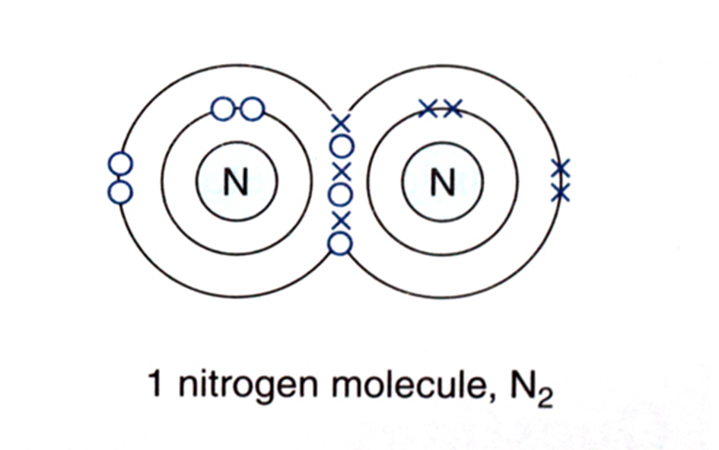
The formula for nitrogen gas is N₂.
The triple covalent bond is represented as

Slide 19
Dot-and-cross Diagrams Using Valence Electrons Only
The drawing of dot-and-cross diagrams to represent covalent bonding can be simplified by indicating only the electrons which are involved in bonding, i.e. only drawing the electrons in the outermost shell.

Slide 20
Formulae of Covalent Compounds
The formula of a covalent compound gives the exact number of atoms per molecule.
In some covalent compounds the molecular formula and the ratio of the elements are the same, e.g. water (H₂O), carbon dioxide (CO₂) and ammonia (NH₃).
In others they are not the same, e.g. the molecular formula of glucose is C₆H₁₂O₆, and ethane is C₂H₆.

Slide 21
Names of Covalent Compounds
The names of covalent compounds can sometimes indicate the ratio in which the atoms combine with each other.
The prefixes di, tri, tetr and so on are used in this kind of naming.
Prefix | Number of Atoms
mono | 1
di | 2
tri | 3
tetr | 4
pent | 5
hex | 6

Slide 22
Names of Covalent Compounds
Examples
carbon monoxide (CO)
sulphur dioxide (SO₂)
sulphur trioxide (SO₃)
carbon tetrachloride (CCl₄)
dinitrogen tetroxide (N₂O₄)
It is best to learn the molecular formulae of covalent compounds as you encounter them.
Prefix | Number of Atoms
mono | 1
di | 2
tri | 3
tetr | 4
pent | 5
hex | 6

Slide 23
Summary
In this lesson we learnt about:
Definitions and appropriate examples of atoms, molecules and compounds.
Dalton’s atomic theory; including contributions by Rutherford, Moseley, Thompson and Chadwick.
The properties of protons, neutrons & electrons.

Slide 24
The concept of isotopes and their relative abundance with reference to chlorine, carbon & oxygen.
The difference of atoms of elements: examples including transition elements.
The Octet rule.
Ionic and covalent bonding.

