Slide 1
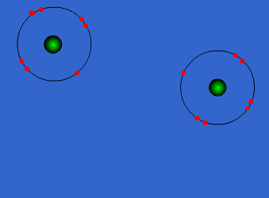
Atoms, Molecules & Bonding

Slide 2
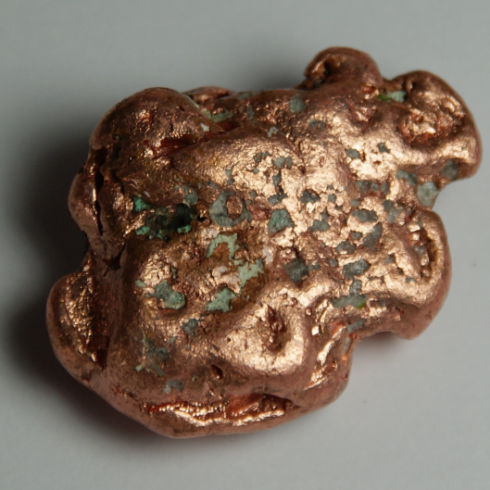
The Structure of the Atom
Copper is an element.
If you tried to chop it up into smaller and smaller bits, eventually you would end up with the smallest possible piece of copper.
At that point you would have an individual copper atom.
You can, of course, split that into still smaller pieces (protons, neutrons and electrons), but you would no longer have copper.

Slide 3
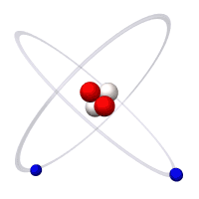
What is an Atom?
An atom is the smallest part of an element that can exist and still exhibit the properties of the element.
Each element can be represented by an atomic symbol which represents one atom of the element.

Slide 4
Atomic Symbols of Common Elements (Refer to Periodic Table)
Element | Atomic Symbol
Aluminium | Al
Calcium | Ca
Gold | Au
Iron | Fe
Boron | B
Chlorine | Cl
Oxygen | O

Slide 5
Activity: Locate the following elements on the periodic table and write their atomic symbol
Barium – 6. Bromine -
Copper - 7. Carbon -
Lead – 8. Phosphorous -
Mercury - 9. Silicon -
Silver - 10. Sulphur -

Slide 6
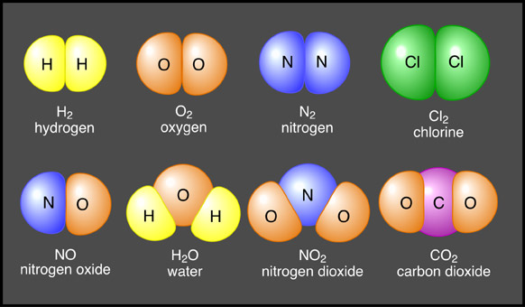
What is a Molecule?
A molecule is made up of two or more atoms, either of the same element or of two or more different elements.

Slide 7
What is a Compound?
A compound is a pure substance that contains two or more different types of element which are chemically combined in such a way that their properties change.
Compounds are composed of more than one kind of atom, which will always be in the same proportion by mass.
A compound can be represented by a formula which indicates the elements that the compound is made up of, and the ratio in which they have combined.
Question: What is the difference between a compound and a molecule?

Slide 8
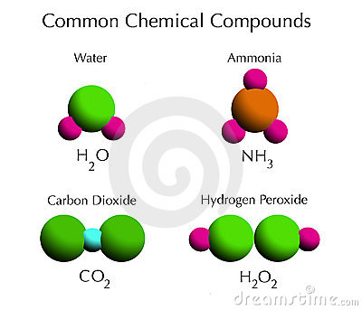
Examples of Compounds

Slide 9
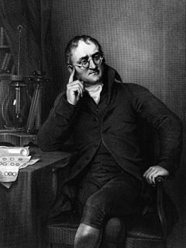
Dalton’s Atomic Theory

Slide 10
Dalton’s Atomic Theory
1803 A.D. – John Dalton
John Dalton was the first scientist to postulate an actual “atomic theory,” one which dealt specifically with solid atoms, all of which were spherical in shape and governed by a property known as the atomic mass, a measurement created by Dalton himself.
Dalton’s ideas are extremely complex, but can be broken down to several simple points.

Slide 11
Dalton’s Atomic Theory
1. He believed that elements are made of atoms, which is basically the same thing we believe today.
2.He believed that the atoms of an element are equal in their masses. This is now known to be incorrect, due to the existence of isotopes.
3. Dalton believed that atoms of different elements have different masses; this was a refinement to an idea originally developed by the Greeks.
4. Dalton proposed that the combination of atoms could be measured in simplistic, whole number ratios.

Slide 12
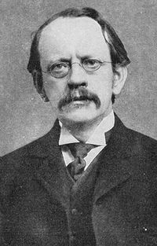
J.J. Thompson
1897 A.D. – J. J. Thomson
J. J. Thomson, an unassuming, mild-mannered English physicist, can possibly be described as a man whose accomplishments did more to shape the human understanding of the atom than any other in history.

Slide 13
It was Thomson’s discoveries that finally shattered the preordained concept of the heavy, solid, absolutely indivisible atom and replaced it with the concept that the atom was in fact itself comprised of smaller particles, a concept that we still study to this day.
Thomson’s breakthroughs began with his studies what was known as the cathode ray, which was created using a strange device known as a cathode ray tube, which had first been invented more than thirty years earlier.

Slide 14
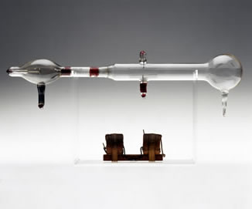
Cathode rays were not widely understood in Thomson’s time, and eventually, Thomson’s experiments led him to make a brash, and, in some cases, shocking scientific claim.
Thomson proposed that cathode rays were made up of particles much smaller in size than an atom that were in fact fractions (or, as he called them, “corpuscles”) of an atom; these particles, Thomson claimed, were roughly 1000 times smaller than an actual atom in size.

Slide 15
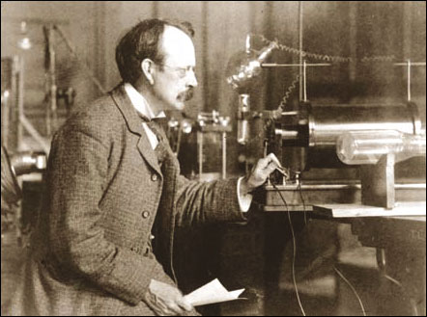
He further suggested that these corpuscles might even comprise all matter within at atom.
For the scientific community of the time, which regarded the atom as a fundamental and indivisible unit of matter, this was truly a shocking claim, and Thomson’s colleagues regarded his theories with doubt.

Slide 16
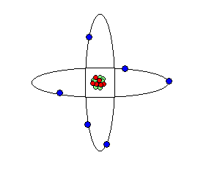
By 1899, however, others had also adopted Thomson’s theories, and history would soon prove Thomson correct; the extremely small particles which had discovered and referred to as corpuscles were actually electrons, negatively charged particles that stand as one of the primary components of the atom, and for possessing the courage to break with conventional thinking J.J. Thomson is remembered as the discoverer, and perhaps even the “father,” of the electron.

Slide 17
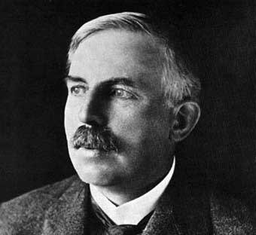
Ernest Rutherford
1911 A.D. – Ernest Rutherford
Ernest Rutherford, like John Dalton and J. J. Thomson before him, stands as one of the giants in atomic research; it was this English scientist, originally hailing from New Zealand, who discovered not only the positively charged particle that we now know of as the proton, but also the fact that the atom actually possesses a nucleus.

Slide 18
He specialized in physics, and is probably best known for his creation of a classification system used to organize different types of rays; Rutherford christened particle rays as alpha or beta, and created a different category for gamma rays, which derive from high energy electromagnetic radiation.
After observing the fact that radioactivity halves over time, an effect that Frederick Soddy had called “half life,” Rutherford was then awarded the Nobel Prize in Chemistry in 1908 for proposing that the atom was, in fact, nuclear.

Slide 19
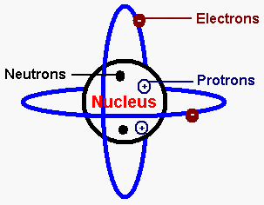
By 1914, Rutherford had realized that in order for simple rays to be created, a positively charged particle must exist; Rutherford named this positively charged particle the proton.

Slide 20
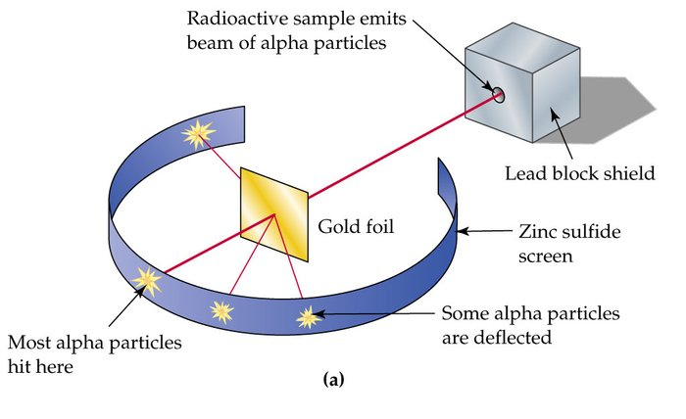
But Ernest Rutherford’s most enduring fame came from his discovery of the nucleus of an atom; he achieved this through his gold foil experiment.
By using alpha particles almost as projectiles, Rutherford was able to reflect some of the alpha rays backwards, even with the use of only an extremely thin piece of gold foil.

Slide 21
Thus, Rutherford came to the conclusion that nearly all of the atom’s mass was concentrated in an area that was actually a thousand times smaller than an actual atom.
Rutherford called this area the nucleus, and with its discovery, the nuclear model of the atom had originated.

Slide 22
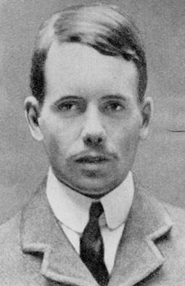
H.G.J. Moseley
1914 A.D. – H. G. J. Moseley
Everyone who uses a periodic table in present times has something to owe to H. G. J. Moseley, a brilliant physicist who became a British lieutenant in the First World War, a war which he later became a victim of.

Slide 23
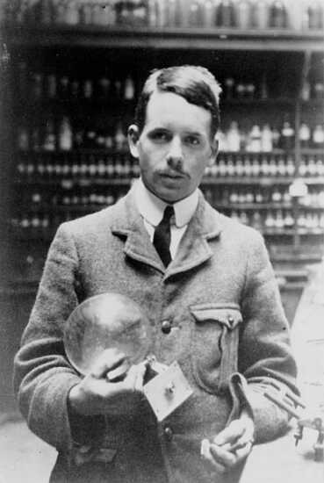
Moseley became a part of Ernest Rutherford’s research group at Cambridge University in 1910, and together with Rutherford and others Moseley was instrumental in sorting out and uncovering much of the structure of the atom.
Moseley’s breakthroughs involved the use of X-rays; he used cathode rays to bombard elemental samples, and was then able to photograph the X-rays that resulted.

Slide 24
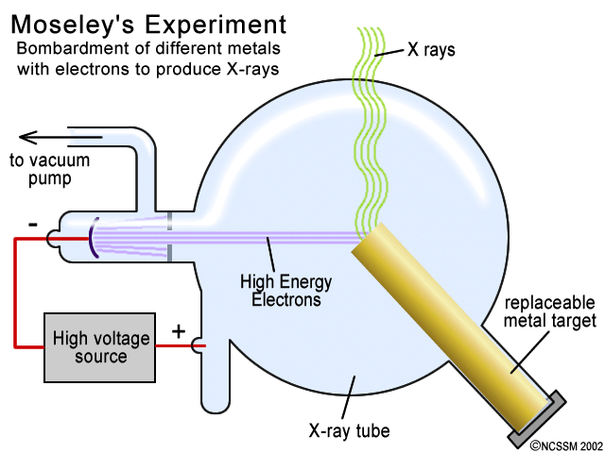
This allowed Moseley to postulate that an atom could be identified by the charge on its nucleus; by observing that the paths of certain lines in the x-ray spectrum moved when the atomic number was increased, Moseley also discovered that the atomic number can be used to supply the number of protons within the nucleus of an atom.

Slide 25
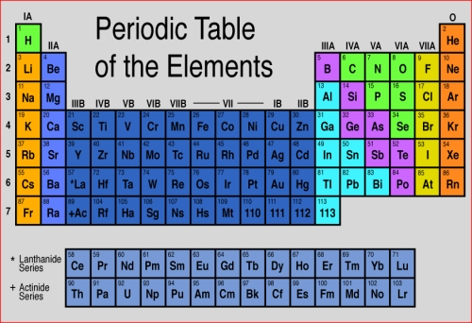
Moseley then went on the reorganize the periodic table, which had previously been based upon atomic number, rather than atomic mass.

Slide 26
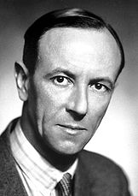
James Chadwick
1932 A.D. – James Chadwick
Like Ernest Rutherford and J. J. Thomson before him, Sir James Chadwick stands as one of the most influential researchers in the field of atomic theory, as his discoveries did much to advance the burgeoning human understanding of the atom’s structure.

Slide 27
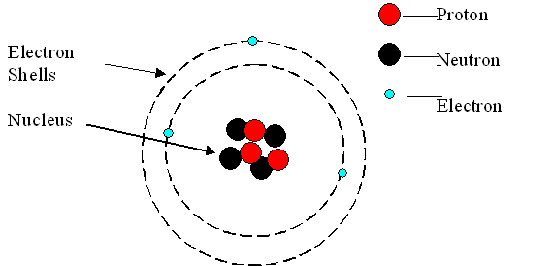
Chadwick studied under Lord Ernest Rutherford at the University of Cambridge; it was while at Cambridge that he made his most important breakthrough; the discovery of the neutron.
Before 1932, the atom was believed to be essentially comprised of the positively charged nucleus, which contained nearly all of the mass of the atom, and which was surrounded by orbital tracts containing varying numbers of electrons.

Slide 28
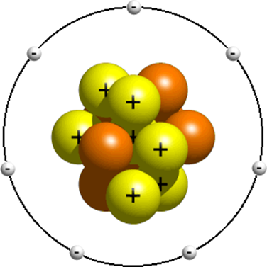
However, with Chadwick’s discovery came knowledge of the third basic component of the atom, which was capable of increasing an atom’s mass while providing no electrical charge.
For his work, Chadwick was awarded the Nobel Prize for Physics in 1935, and was knighted a decade later.

Slide 29
Subatomic Particles

Slide 30
Subatomic Particles
Atoms are made up of protons, neutrons and electrons.
Protons and neutrons are found in the centre of the atom in an area known as the nucleus. Nearly all of the mass of an atom is concentrated in the nucleus.
Electrons are found at quite a distance from the nucleus, spinning in a series of levels known as energy shells. Most of the atom is in fact empty space, but the movement of the electrons around the nucleus constitutes the volume of the atom.

Slide 31
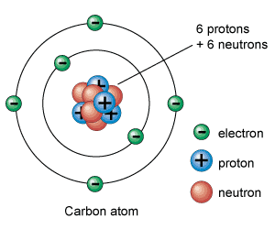
Subatomic Particles

Slide 32
Charge of Subatomic Particles
Protons are positively charged particles and electrons are negatively charged particles.
The charge on a proton is equal to the charge on an electron.
Neutrons are electrically neutral.
In an atom, the number of protons is equal to the number of electrons.

Slide 33
Mass of Subatomic Particles
The mass of a proton is equal to the mass of a neutron.
The mass of a proton is equal to the mass of a neutron. The mass of a proton is very small, only 1.67 x 10⁻²⁴g.
The mass of an electron is even smaller. Comparing the mass of a proton to that of an electron, a proton is about 1836 times heavier than an electron.

Slide 34
Activity – Complete the Table Below Showing The Masses and Charges of Subatomic Particles
Subatomic Particle | Relative Charge | Relative Mass
Proton
Neutron
Electron

Slide 35
Summary - Mass and Charge of Subatomic Particles
Subatomic Particle | Relative Charge | Relative Mass
Proton | +1 | 1
Neutron | 0 | 1
Electron | -1 | 1/1836

Slide 36
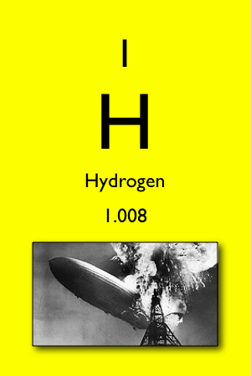
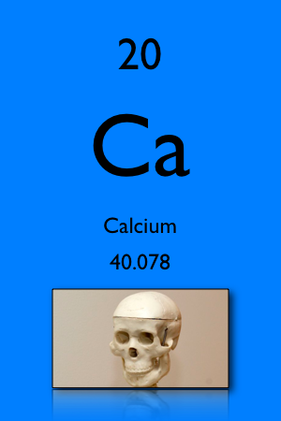
Atomic Number
The number of protons in an atom is known as the atomic number, with symbol Z.
The atomic number is unique to a particular element, i.e. there are no two elements in the world which have the same atomic number.
Examples:

Slide 37
Atomic Number
The atomic number for hydrogen is 1, which means that hydrogen has 1 proton.
The atomic number for calcium is 20 which means that it has 20 protons.
In an atom, the number of electrons will be equal to the atomic number.
Questions:
How many electrons are in a hydrogen atom?
How many electrons are in a calcium atom?

Slide 38
Mass Number
The number of protons and neutrons is known as the mass number, with symbol A.
The number of neutrons can be calculated by subtracting the atomic number from the mass number, i.e. A – Z.
The mass number is not unique to the particular atom.

Slide 39
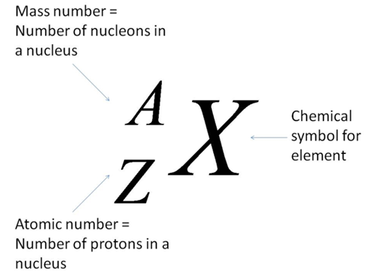
Nuclear Notation
We can represent an atom (or ion) of an element using nuclear notation:
This notation is very useful because it allows the number of protons, neutrons and electrons in an atom or an ion to be calculated.

Slide 40
Using Nuclear Notation
Element | Nuclear Notation | Number of
 |  | Protons (Z) | Neutrons (A – Z) | Electrons
Helium |  | 2 | 2 | 2
Sodium |  | 11 | 12 | 11
Chlorine |  | 17 | 20 | 17

Slide 41
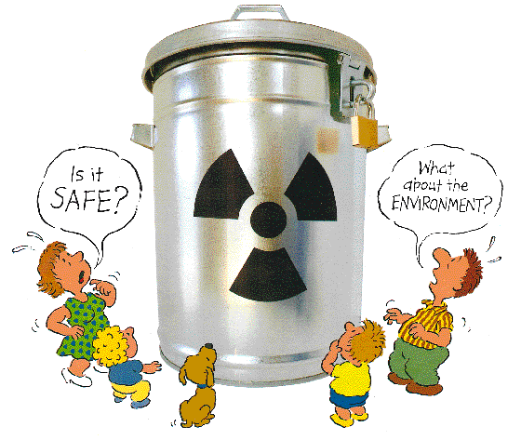
Isotopes & Radioactivity

Slide 42
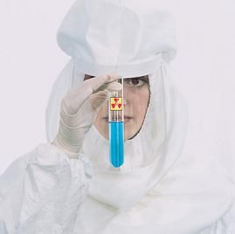
Isotopes & Radioactivity
The atomic number is unique to a particular element.
For example, all atoms of chlorine will have an atomic number of 17.
But the number of neutrons in atoms of the same element is not unique; there are some chlorine atoms with 18 neutrons and others with 20.

Slide 43
What are isotopes?
Isotopes are different atoms of the same element which have the same number of protons but different numbers of neutrons.
The number of electrons in the different isotopes of the same element is the same.

Slide 44
Properties of Isotopes
Isotopes of an element have the same chemical and electrical properties but different physical properties.
If the different isotopes of magnesium had to react with oxygen, the chemical reaction would be the same, i.e. they have the same chemical properties.
Most elements have more than one isotope, but not all of these isotopes are stable, i.e. they decay into other isotopes

Slide 45
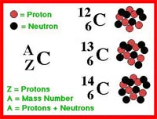
Example 1: Isotopes of Carbon
Carbon, with an atomic number of 6, has three isotopes; one with a mass number of 12, one with a mass number of 13 and one with a mass number of 14.

Slide 46
There are two main methods of representing these isotopes:
Using Nuclear Notation:
By Name:
carbon-12 or C-12
carbon-13 or C-13
carbon-14 or C-14

Slide 47
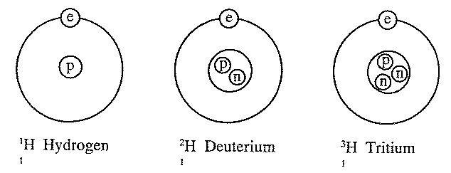
Example 2: Isotopes of Hydrogen
Hydrogen also has three isotopes.
The deuterium isotope is heavier than the hydrogen isotope since it has an extra neutron.
Water produced from this isotope is known as “heavy” water, which is used in nuclear reactors to absorb neutrons.

Slide 48
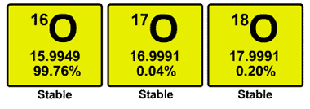
Example 3: Isotopes of Oxygen
Naturally occurring oxygen is composed of three stable isotopes, ¹⁶₈O, ¹⁷₈O, and ¹⁸₈O, with ¹⁶₈O being the most abundant.

Slide 49
Activity: Complete the table below.
Isotope of Oxygen | Number of Protons | Number of Neutrons | Number of Electrons
¹⁶₈O
¹⁷₈O
¹⁸₈O

Slide 50
Radioactivity

Slide 51
Radioactivity
Some isotopes have unstable nuclei. These are known as radioactive isotopes. They eject particles and radiation from their nuclei.
Radioactive isotopes eject these particles to become more stable, but in the process they may produce an atom of a different element.

Slide 52
Uses of Radioactive Isotopes
Carbon-14 dating
Radiotherapy
Tracers
Energy Generation
Pacemakers

