Slide 1
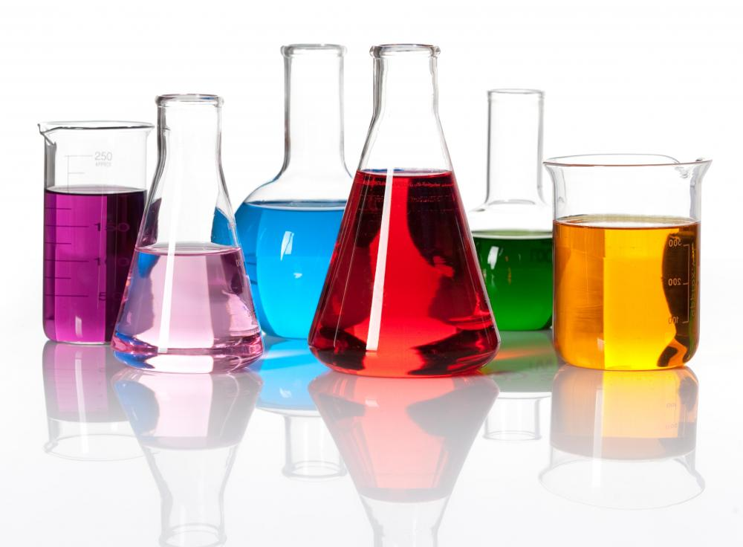
Introduction to Analytical Chemistry

Slide 2
Lesson 1 Objectives
Students should be able to:
1. Define and differentiate the following terms: Qualitative analysis, Quantitative analysis & Analytes.
2. Define the role of analytical chemistry.
3. Define quantitative analytical methods.
4. Define the following terms: Heterogeneous materials, an assay, Replicate samples, Interference, Specific and Selective techniques and reactions, sample matrices and calibration.
5. Discuss the process of quantitative analysis.

Slide 3
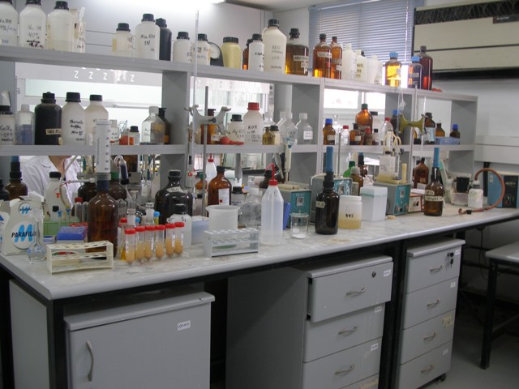
The Analytical Chemistry Laboratory

Slide 4
What is Analytical Chemistry?
Analytical Chemistry provides the methods and tools needed for insight into our material world…for answering four basic questions about a material sample:
What?
Where?
How much?
What arrangement, structure or form?

Slide 5
Areas of Chemical Analysis and Questions They Answer
Detection:
Does the sample contain substance X?
Separation:
How can the species of interest be separated from the sample matrix for better quantitation and identification?
Quantitation:
How much of substance X is in the sample?
Identification:
What is the identity of the substance in the sample?

Slide 6
What is the Role of Analytical Chemistry?
Analytical chemistry is applied throughout industry, medicine, and all the sciences.
Examples:
To determine the concentration of oxygen and carbon dioxide in blood samples to diagnose and treat illnesses.
Determination of nitrogen in foods establishes their protein content and thus their nutritional value.
Home Work: What are three (3) other examples?

Slide 7
Definitions

Slide 8
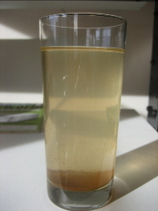
Heterogeneous Materials
A heterogeneous mixture is a mixture where the components of the mixture are not uniform or have localized regions with different properties.

Slide 9
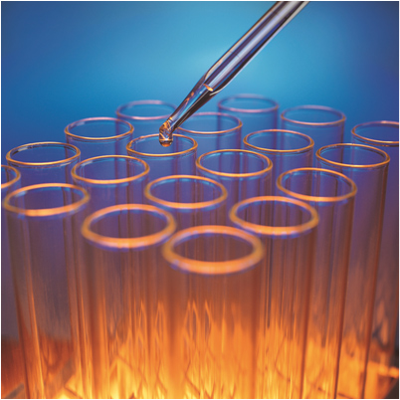
Assay
The process of determining how much of a given sample is the material indicated by its name.

Slide 10
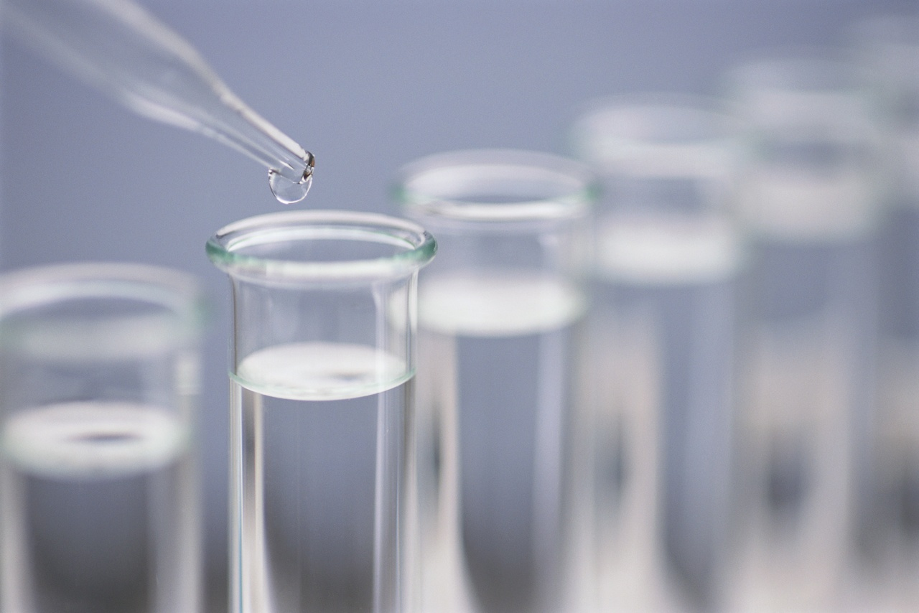
Replicate Samples
Portions of a material, of approximately the same size, that are carried through an analysis at the same time and in the same way.

Slide 11
Interferences
Species that affect the signal on which an analysis is based.

Slide 12
Specificity
Refers to methods or reagents that respond or react with one and only one analyte.

Slide 13
Selectivity
The tendency for a reagent or an instrumental method to react with or respond similarly to only a few species.

Slide 14
Sample Matrix
The medium that contains an analyte.

Slide 15
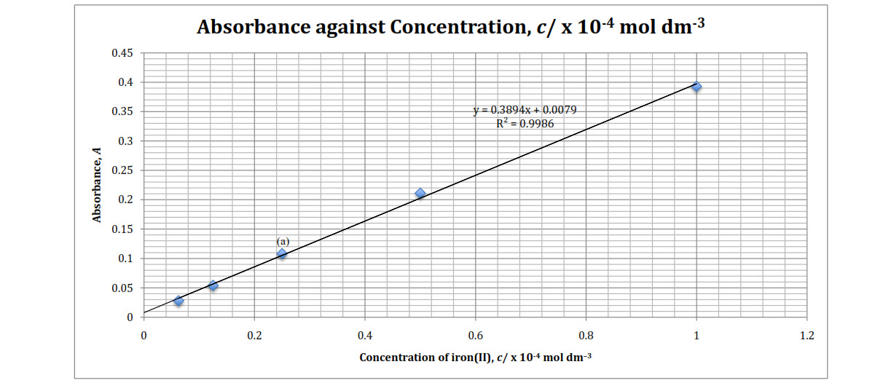
Calibration
The empirical determination of the relationship between a measured quantity and a known reference or standard value.

Slide 16
Analyte
The analyte is the sample being analysed.

Slide 17
What is the difference between qualitative and quantitative analysis?
Two main types of chemical analysis:
Qualitative: branch of chemistry that deals with the identification of elements or grouping of elements present in a sample
Quantitative: branch of chemistry that deals with the determination of the amount or percentage of one or more constituents of a sample.
Qualitative analysis is what.
Quantitative analysis is how much.

Slide 18
Types of qualitative and quantitative analysis
Qualitative Analysis
qualitative inorganic analysis
qualitative organic analysis
Quantitative Analysis
Chemical
Physical

Slide 19
Qualitative Inorganic Analysis
A solution is treated with various reagents to test for reactions characteristic of certain ions, which may cause color change, solid forming and other obviously visible changes.

Slide 20
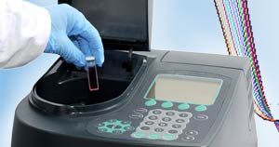
Qualitative Organic Analysis
Organic compounds are analysed using all or some of the following methods:
(1) Analysis of physical properties
(2) Classification by solubility
(3) Spectroscopic analysis
(4) Classification tests for functional groups
(5) Synthesis of solid derivatives

Slide 21
Quantitative Chemical Analysis
Main methods:
Gravimetric: includes all methods of analysis in which the final stage of the analysis involves weighing.
Titrimetric: volumetrically measures the amount of reagent, often called a titrant, required to complete a chemical reaction with the analyte.
Electroanalytical: involves the measurement of electrical properties in relation to the concentration of analyte in the sample.
Spectroscopic: based on measurement of the interaction between electromagnetic radiation and the analyte.

Slide 22
The Process of Quantitative Analysis
The analytical process begins with a question such as "Is this water safe to drink?
A scientist translates such questions into the need for particular measurements.
An analytical chemist then must choose or invent a procedure to carry out those measurements.
The analyst must translate the results of the completed analysis into terms that can be understood preferably by the general public.
A most important feature of any results is its limitations- which reflect the reliability of the results.
The results and their limitations are used to draw conclusions and reach decisions.

Slide 23
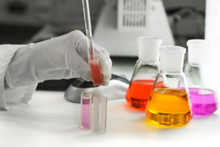
The Process of Chemical Analysis
Let us look at this process in a bit more detail…

Slide 24
Data Analysis
Since analytical chemistry is the science of making quantitative measurements, understanding the difference between accuracy and precision is vital.
Also, it is important that raw data is manipulated and reported correctly to give a realistic estimate of the uncertainty in a result.
Presentation of data in the form of graphs is extremely useful.

Slide 25
Accuracy and precision
Accuracy is how close a measured value is to the actual (true) value.
Precision is how close the measured values are to each other.
Study the diagrams below. The target is the centre. Which diagram(s) show high accuracy? Which show high precision?

Slide 26
Bias
Bias (don't let precision fool you!)
So, if you measure something several times and all values are close, they may still all be wrong if there is a "Bias"
Bias is a systematic (built in) error which makes all measurements wrong by a certain amount.
Examples of Bias
The scales read "1 kg" when there is no weight on them
You always measure your height wearing shoes with thick soles.
A stopwatch that takes half a second to stop when clicked

Slide 27
The Laboratory Notebook
Your Critical Record
Why must all data be recorded in ink when they are collected?
Saving Time:
don’t have to reorganize and rewrite data
more organized and prepared to carry out the analysis
Immediate record:
detect possible errors in measurements and calculations
data will not be lost or transferred incorrectly

Slide 28
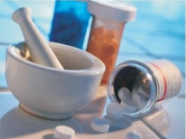
A Typical Quantitative Analysis
Group Discussion & Presentation.
Construct a flow diagram to show the steps
involved in a typical quantitative analysis.
Include considerations for each step.

Slide 29
Sampling
Individual Activity: Read Chapter 8 & the article on Environmental Sampling and make short notes on the following questions.
1. Describe the steps in a well-designed sampling plan.
2. What is the importance of a good sample?
3. What factors must be considered when obtaining a sample?
4. What factors must be considered when storing and transporting a sample?

Slide 30
Assignment
READ:
Fundamentals of Analytical Chemistry (8th Edition)
- Chapter 1: The Nature of Analytical Chemistry, pages 2 – 16,
Chapter 2: Chemicals, Apparatus, and Unit Operations in Analytical Chemistry, pages 20 – 53
Chapter 4: Calculations Used in Analytical Chemistry, pages 71 – 89
Chapter 8: Sampling, Standardization and Calibration, pages 175 – 191

Slide 31
References
1. Fundamentals of Analytical Chemistry (8th Edition)
Douglas A. Skoog
Donald M.West
F. James Holler
Stanley R. Crouch

