Slide 1
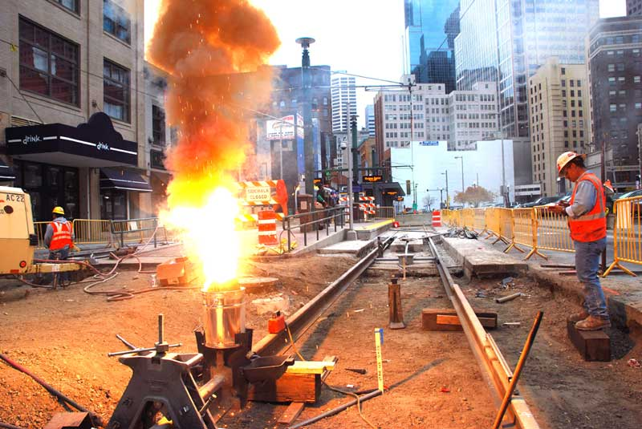
Chemical Thermodynamics

Slide 2
Lesson 1 Objectives
Students should be able to:
1. Use the First Law of Thermodynamics to relate heat, work and energy changes.
2. Use bond energies to estimate heats of reaction for gas phase reactions; use ΔH values for gas phase reactions to find bond energies.
3. Discuss changes in Internal Energy, ΔE, and its relationship to heat and work.
4. Discuss the relationship between ΔH and ΔE at constant temperature and pressure.
5. Distinguish between product-favoured (spontaneous) processes and reactant-favoured (nonspontaneous) processes.

Slide 3
6. Outline the relationship of entropy to the dispersal of energy and matter (disorder) in a system.
7. Use tabulated values of absolute entropies to calculate the entropy changes, ΔS.
8. Explain how the spontaneity of a process is related to entropy changes – the Second Law of Thermodynamics.
9. Calculate changes in Gibbs free energy, ΔG, by two methods: (a) from values of ΔH and ΔS and (b) from tabulated values of standard molar free energies of formation and know when to use each type of calculation.
10. Discuss the temperature dependence of spontaneity.

Slide 4
The First Law of Thermodynamics
The combined amount of matter and energy in the universe is constant.
The Law of Conservation of Energy is just another statement of the First Law of Thermodynamics, i.e., energy is neither created nor destroyed in chemical reactions and physical changes.

Slide 5
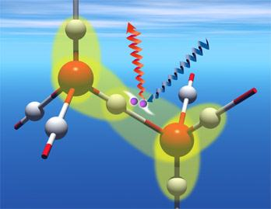
Bond Energies

Slide 6
Bond Energies
The bond energy (B.E.) is the amount of energy necessary to break one mole of bonds in a gaseous covalent substance to form products in the gaseous state at constant temperature and pressure.
The greater the bond energy, the more stable (stronger) the bond is, and the harder it is to break. Thus bond energy is a measure of bond strengths.

Slide 7
Example - The Bond Energy
Consider the following reaction:
H₂(g) → 2H(g)
ΔH^{O}_{rxn} = ΔH_{H-H} = +436 kJ/mol H-H bonds
The bond energy of the hydrogen-hydrogen bond is 436 kJ/mol of bonds.
In other words, 436 kJ of energy must be absorbed for every mole of H-H bonds that are broken.
This endothermic reaction (ΔH^{O}_{rxn} is positive) can be written:
H₂(g) + 436kJ → 2H(g)

Slide 8
A Special Case of Hess’s Law
A special case of Hess’s Law involves the use of bond energies to estimate heats of reaction.
In general terms, ΔH^{O}_{rxn} is related to the bond energies of the reactants and products in gas phase reactions by the following version of Hess’s Law:
ΔH^{O}_{rxn} = Σ B.E._{reacatants} – Σ B.E._{products} (in gas phase reactions only)

Slide 9
Group Calculations – Bond Energies
Review Examples 15-11 & 15-12
Work on Exercises 48, 50 & 52

Slide 10
Limitation of Bond Energies
The definition of bond energies is limited to the bond-breaking process only, and does not include any provision for changes of state.
Thus it is valid only for calculations in the gaseous state.

Slide 11
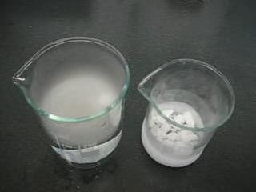
Changes in Internal Energy, ΔE

Slide 12
Changes in Internal Energy, ΔE
The internal energy, E, of a specific amount of substance represents all the energy contained within the substance.
The difference between the internal energy of the
products and the internal energy of the reactants of
a chemical reaction or physical change, ΔE, is
given by the equation:
ΔE = E_{final} – E_{initial}
= E_{products} – E_{reactants}
= q + w

Slide 13
Changes in Internal Energy, ΔE
ΔE = E_{final} – E_{initial}
= E_{products} – E_{reactants}
= q + w
The terms q and w represent heat and work, respectively.
Therefore,
ΔE = (amount of heat absorbed by system) +
(amount of work done on system)

Slide 14
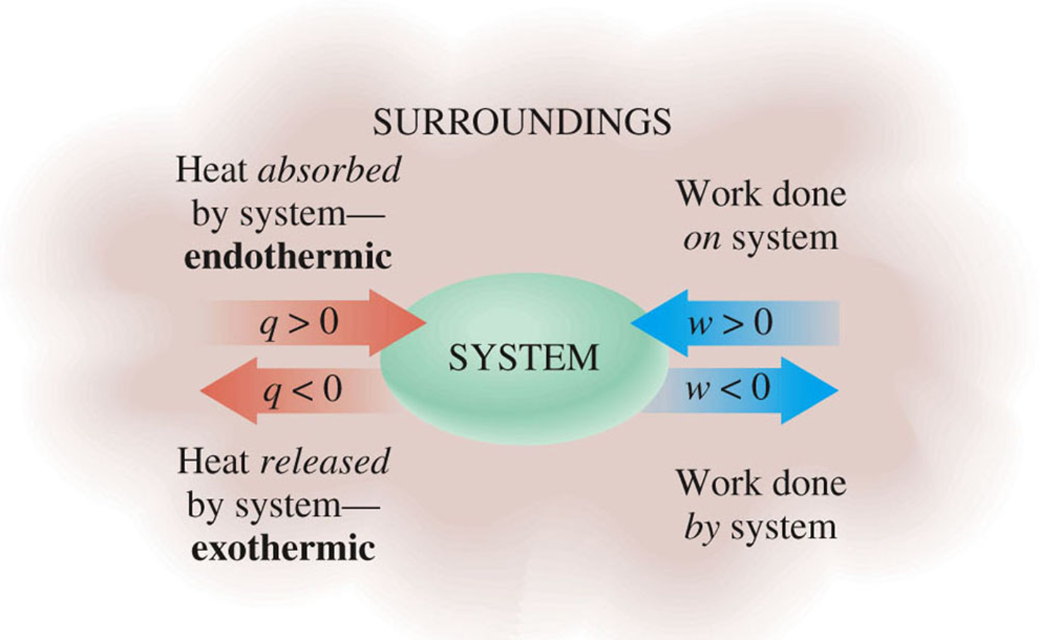
Sign Conventions for q and w

Slide 15
Sign Conventions for q and w
q is positive: Heat is absorbed by the system from the surroundings (endothermic)
q is negative: Heat is released by the system to the surroundings (exothermic)
w is positive: Work is done on the system by the surroundings.
w is negative: Work is done by the system on the surroundings.

Slide 16
Group Calculations – Predicting the Sign of Work
Review Examples 15-13 & 15-14
Work on Exercises 77, 78, 66 & 67

Slide 17
Relationship between ΔH and ΔE

Slide 18
Relationship between ΔH and ΔE
The fundamental definition of enthalpy, H, is
H = E + PV
For a process at constant temperature and pressure,
ΔH = ΔE + P ΔV (constant T and P)
We know that ΔE = q + w, so
ΔH = q + w + P ΔV (constant T and P)
At constant pressure, w = - P ΔV, so
ΔH = q + (- P ΔV) + P ΔV (constant T and P)
ΔH = q_{p} (constant T and P)

Slide 19
Difference between ΔH and ΔE
The difference between ΔE and ΔH is the amount of expansion work (P ΔV work) that the system can do.
Unless there is a change in the number of moles of gas present, this difference is extremely small and can usually be neglected.
For an ideal gas, PV = nRT. At constant temperature and pressure, P ΔV = (Δn)RT, a work term. Substituting gives:
ΔH = ΔE + (Δn)RT
OR
ΔE = ΔH – (Δn)RT (constant T and P)

Slide 20
Spontaneity of Physical & Chemical Changes
Group Discussion & Presentation.
Summarize the two aspects of spontaneity.
What are the two factors which affect the spontaneity of any physical or chemical change?
Support your answer with relevant examples.

Slide 21
Summary - Spontaneity of Physical & Chemical Changes
Two factors affect the spontaneity of any physical or chemical change:
Spontaneity is favored when heat is released during the change (exothermic).
Spontaneity is favored when the change causes an increase in the dispersal of energy and matter.

Slide 22
The Dispersal of Energy and Matter
Group Discussion & Presentation.
Summarize the dispersal of energy and matter.
How does the dispersal of energy in a system affect the distribution of energy in that system?
What factors affect the dispersal of energy in a system?
What factors influence the dispersal of matter in a system?

Slide 23
Summary – The Dispersal of Energy & Matter
The dispersal of energy in a system results in the energy being spread over many particles rather than being concentrated in just a few.

Slide 24
If energy can be dispersed over a larger number of particles, it will be.
The greater the number of molecules and the higher the total energy of the system, the less likely the energy will be concentrated in a few molecules. Therefore, the energy will be more dispersed.
So, the final state of a system can be more probable than its initial state in either or both of two ways:
Energy can be dispersed over a greater number and variety of molecules
The particles of the system can be more dispersed (more disordered)

Slide 25
Entropy, S, and Entropy Change, ΔS

Slide 26
Entropy, S
The dispersal of energy and matter is described by the thermodynamic state function entropy, S.

Slide 27
Entropy, S, and Entropy Change, ΔS
The Third Law of Thermodynamics establishes the zero of the entropy scale. The entropy of a pure, perfect crystalline substance (perfectly ordered) is zero at absolute zero (0 K).
The standard entropy change, ΔSº, of a reaction can be determined from the absolute entropies of reactants and products.
ΔSº_{rxn} = Σ n Sº_{products} – Σ n Sº_{reactants}

Slide 28
Entropy, S, and Entropy Change, ΔS
The Third Law of Thermodynamics establishes the zero of the entropy scale. The entropy of a pure, perfect crystalline substance (perfectly ordered) is zero at absolute zero (0 K).
The standard entropy change, ΔSº, of a reaction can be determined from the absolute entropies of reactants and products.
ΔSº_{rxn} = Σ n Sº_{products} – Σ n Sº_{reactants}

Slide 29
Factors Affecting Entropy, S

Slide 30
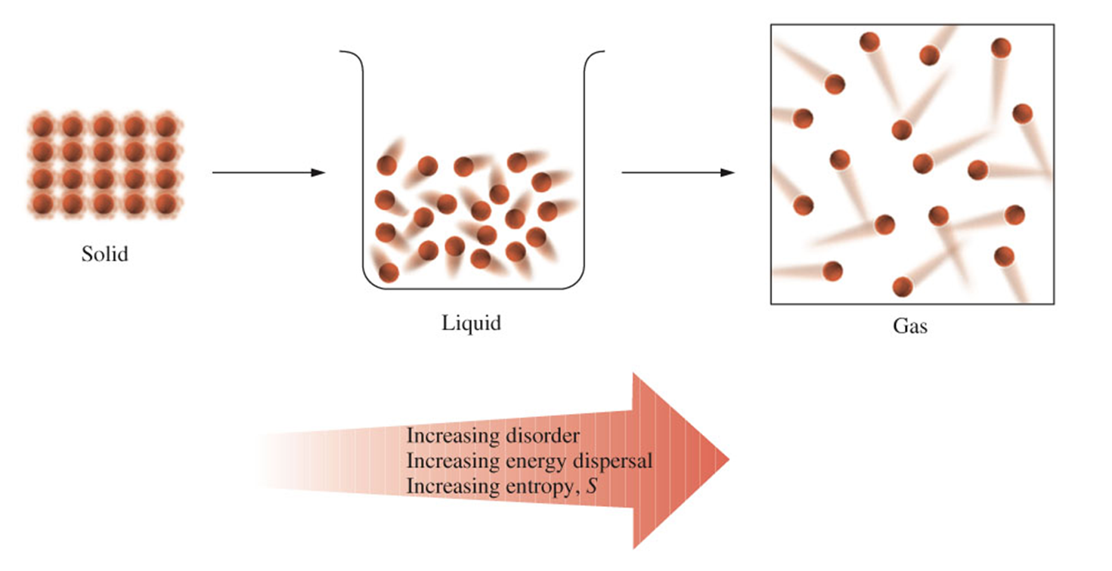
1. Effect of Phase Changes on Entropy
For any substance, entropy increases in the order
Solid < Liquid < Gas
Melting, vaporization, and sublimation always have S_{system} > 0.
Freezing, condensation, and deposition always have S_{system} < 0.

Slide 31
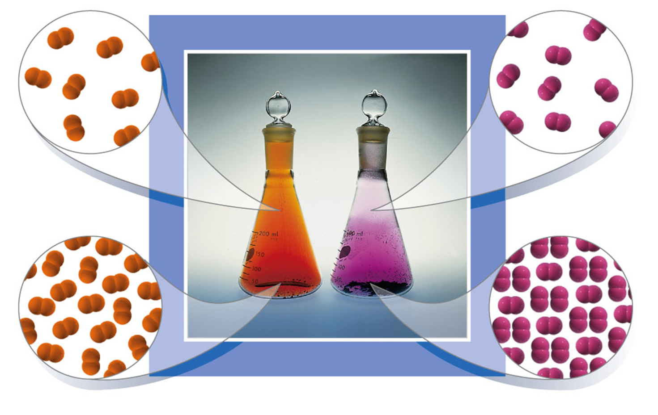
2. Effect of Temperature on Entropy
The entropy of any sample increases as its temperature increases.

Slide 32
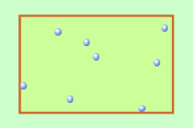
3. Effect of Volume on Entropy
The entropy of a gas increases as its volume increases.
For an increase in gas volume, S_{system} > 0.

Slide 33
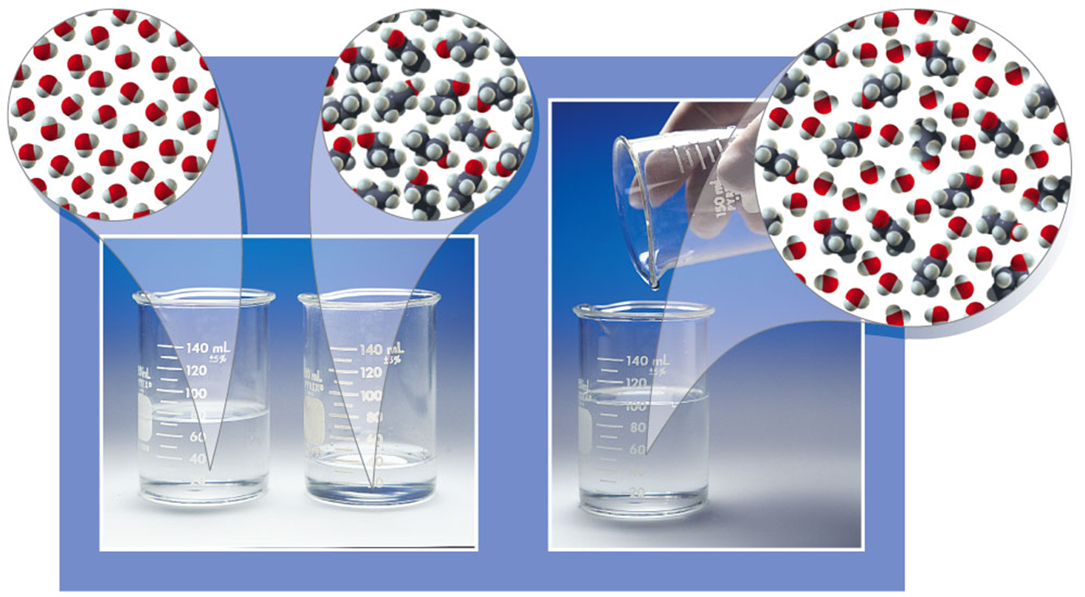
4. Effect of Mixing on Entropy
Mixing of substances or dissolving a solid in a liquid causes an increase in entropy, S_{system} > 0.

Slide 34
5. Effect of Increasing Number of Particles on Entropy
Increasing the number of particles causes an increase in entropy, S_{system} > 0.

Slide 35
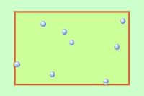
6. Effect of Increasing Number of Moles of Gaseous Substances
Increasing the number of moles of gaseous substances causes an increase in entropy, S_{system} > 0.

Slide 36
Group Calculations – ΔS & ΔSº_{rxn}
Review Examples 15-15 15-16, 15-17 & 15-18
Work on Exercises 104, 100 & 98

Slide 37
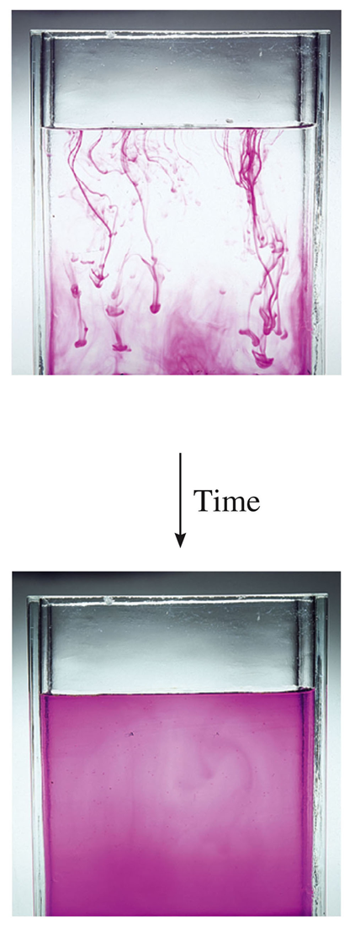
The Second Law of Thermodynamics

Slide 38
The Second Law of Thermodynamics
In any spontaneous change, the universe tends towards a state of increasing entropy, ΔS_{universe} > 0.

Slide 39
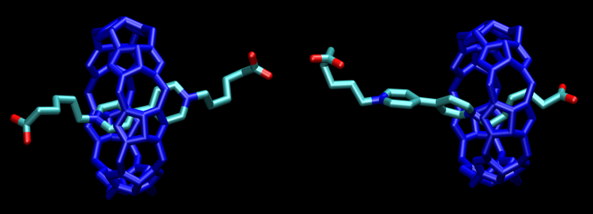
Free Energy Change, ΔG, and Spontaneitiy

Slide 40
Free Energy Change, ΔG, and Spontaneitiy
The Gibbs free energy change, ΔG, at constant temperature and pressure, is
ΔG = ΔH – T ΔS
For a standard reaction, ΔGº_{rxn}, at constant temperature and pressure, is
ΔGº_{rxn} = Σ n ΔGº_{f products} - Σ n ΔGº_{f reactants}
(1 atm and 298 K only)

Slide 41
Group Calculations – Spontaneity of Standard Reaction
Review Examples 15-19 15-20
Work on Exercises 111 & 113

Slide 42
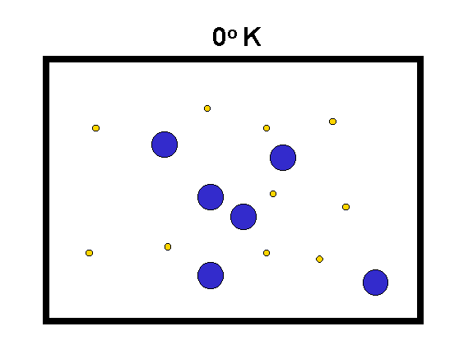
The Temperature Dependence of Spontaneity

Slide 43
The Temperature Dependence of Spontaneity
When a system is at equilibrium, ΔG = 0, therefore:
ΔG_{rxn} = ΔH_{rxn} – T ΔS_{rxn} or 0 = ΔH_{rxn} – T ΔS_{rxn}
So,
ΔH_{rxn} = T ΔS_{rxn} or T = ΔH_{rxn} (at equilibrium)
ΔS_{rxn}

Slide 44
Group Calculations – Spontaneity of Standard Reaction
Review Examples 15-21, 15-22 & 15-23
Work on Exercises 111, 113, 116 & 120

Slide 45
Assignment
READ:
General Chemistry (9th Edition)
– Chapter 15: Chemical Thermodynamics, pages 565 – 605
- Chapter 16: Chemical Kinetics, pages 606 - 659

Slide 46
References
1. General Chemistry (9th Edition)
Kenneth W. Whitten
Raymond E. Davis
M. Larry Peck
George G. Stanley
ISBN-13:978-0-495-39163-0
ISBN-10:0-495-39163-8

