Slide 1
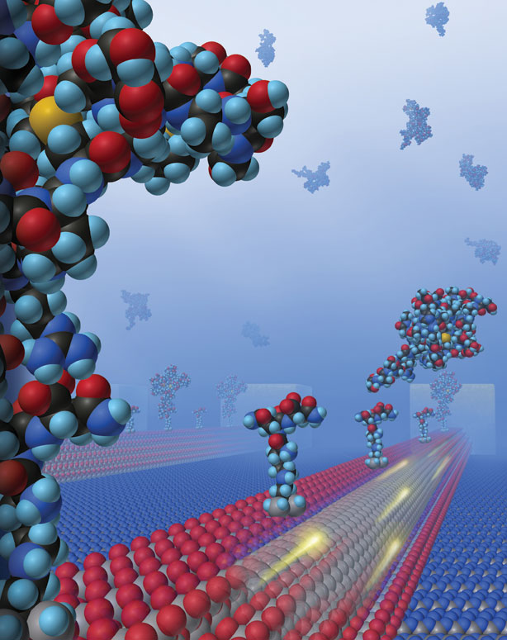
The Nature of Matter

Slide 2
Definitions

Slide 3
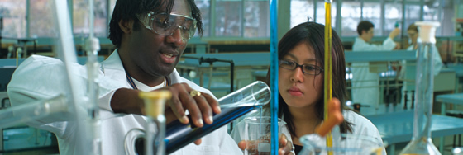
What is Chemistry?
Chemistry is the study of the structure and behaviour of matter.

Slide 4
What is matter?
Any substance which has mass and occupies space.
is
Matter
exists in various states
examples
Air
Sand
Human Beings
Animals
Solid
Liquid
Gas

Slide 5
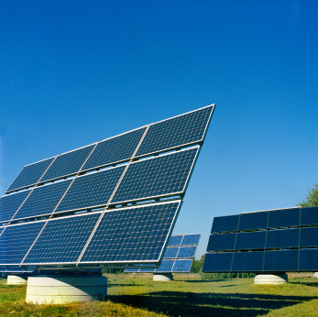
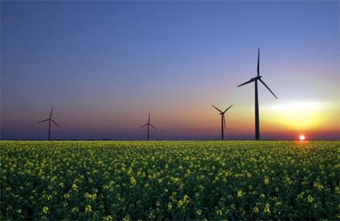
What is energy?
Energy is the ability to do work.

Slide 6
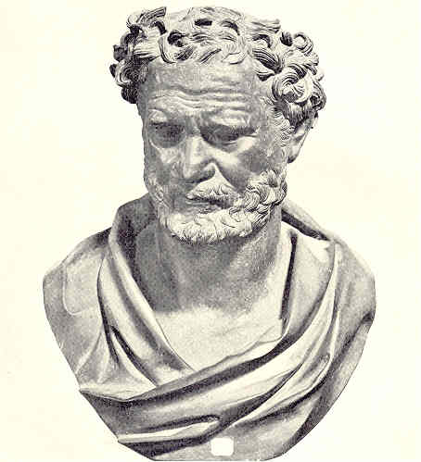
The Particulate Nature of Matter
Around 460 BC a Greek philosopher, Democritus, developed the idea that matter consisted of particles.
Today scientists have added to Democritus’ idea and now describe matter and its properties using the particle theory of matter.

Slide 7
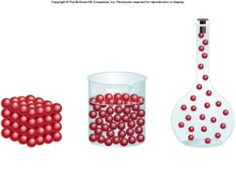
What Is The Particle Theory Of Matter?
The particle theory of matter is a very useful model which helps to explain both the physical properties of matter and also the differences between the three states of matter.

Slide 8
What Are The Main Ideas In The Particle Theory of Matter?
All matter is made up of particles
There are spaces between the particles
The particles are in constant random motion
Particle Theory of Matter
There are forces of attraction and repulsion between the particles

Slide 9
Physical Phenomena That The Particle Theory Of Matter Helps To Explain
The differences in density of solids and liquids, e.g. why ice floats on water
Surface tension in liquids, e.g. how certain insects can ‘walk’ on water
How cooling a liquid can cause it to change into a solid
Why a smell can move throughout a room
Why the pressure in a gas increases with an increase in temperature, e.g. car tyres get harder as you drive

Slide 10
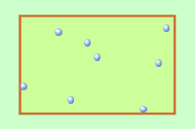
Temperature & Kinetic Energy
Increasing the temperature of a substance increases the kinetic energy of the particles in the substance.
The greater the kinetic energy of a particle, the greater the speed at which the particle moves.

Slide 11
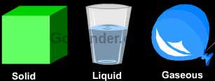
States of Matter

Slide 12
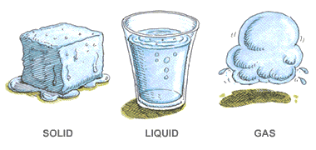
Matter can exist in various forms or states.
The three states of matter that are the most common are the solid, liquid and gaseous states.

Slide 13
Changing From One State To Another
Matter can change from one physical state to another without changing its chemical properties.
Example
Water as a solid (ice) has the same particles as water as a liquid as does water as a gas (water vapour).
The only difference is the arrangement and energy of the particles as a result of changes in temperature.

Slide 14
Particles in Solids, Liquids & Gases
Solids
Particles packed together tightly.
Solids have a definite shape.
Even though a solid does not appear to move, the particles are constantly vibrating in place.
Liquids
Particles in contact with each other, but not as close as in solids.
Particles slip and slide past one another. Because this, liquids take the shape of their container.
Gases
Very large spaces between particles.
Particles can move freely in all directions, this is why gases always spread out or diffuse to fill their container.

Slide 15
Activity 1(a): List three examples each of solids, liquids and gases that are in the classroom right now.
Solids | Liquids | Gases

Slide 16
Activity 1(b): Classify the following as solid, liquid or gas.
1. Milk- 2. Cookie -
3. oxygen - 4. fish –
5. pencil - 6. Jelly
7. shampoo - 8. carbon dioxide –
9. ice cube - 10. oil -
11. salt - 12. water vapor -
13. gasoline - 14. helium -

Slide 17
Activity 1(c): Complete each sentence with the word solid, liquid or gas.
A ___________ has a definite shape. It does not take the shape of its container. It also has a definite volume because it can be measured.
A ___________ does not have a definite shape. It takes the shape of its container. It does have a definite volume because it can be measured.
A ___________ does not have a definite shape. It sometimes takes the shape of its container and sometimes flies freely around you. These particles are not connected to each other and takes up whatever space is available.

Slide 18
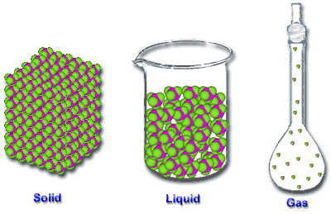
Movement of Particles in Different States

Slide 19
Activity 2: Representing The Three States of Matter
Steps:
Divide the class into three (3) groups.
Group 1 – Arrange yourselves to demonstrate the arrangement and movement of particles in a solid.
Group 2 – Arrange yourselves to demonstrate the arrangement and movement of particles in a liquid.
Group 3 – Arrange yourselves to demonstrate the arrangement and movement of particles in a gas.

Slide 20
Activity 3: The three states of water.
What are the three states of water?
How does water move from one state to another?
What do you think happens to the particles as water moves from one state to another?

Slide 21
Energy & Change of State
The three states of matter are solid, liquid and gas.
Matter can be changed from one state to another by heating or cooling.
A change of state is therefore caused by a change of temperature and consequently a change in the kinetic energy of the particles.

Slide 22
Energy Changes
We need to supply energy to make solids melt.
A pure solid always melts at the same temperature, the melting point (m.p.).
Example: The melting point of ice is 0⁰C.
More energy is needed to make liquids boil at their boiling point (b.p.).
Example: Pure water boils at 100⁰C at normal air pressure (one atmosphere pressure).

Slide 23
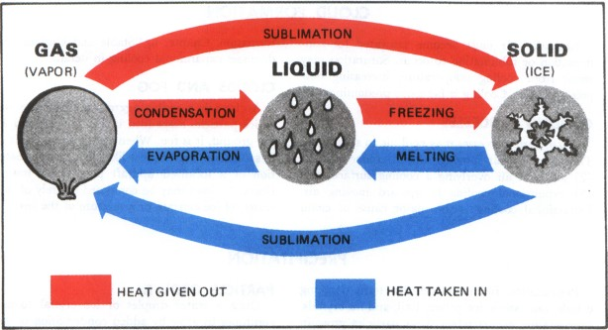
Summary of The Changes of State

Slide 24
The Three States & The Particle Theory of Matter
The three states have observable differences which can be explained by the particle theory of matter.
(see Table 1)

Slide 25
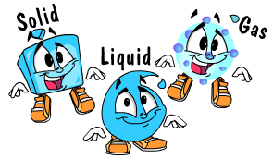
Changes of States of Matter

Slide 26
Changing State
To change from one state to another, a change in energy is required.
Example:
How do we make ice from water? How does the energy change?
To make ice from water, we need to put the water in the freezer, i.e. we need to remove heat energy.
The changes of state that will be explained in more detail are melting, evaporation, boiling, condensation, freezing and sublimation.

Slide 27
Melting

Slide 28
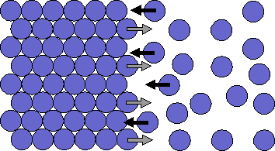
Melting
When a solid is heated, the particles gain kinetic energy and begin to vibrate more vigorously.
Eventually the particles are able to overcome the strong forces of attraction between them and move more freely and further apart forming a liquid.

Slide 29
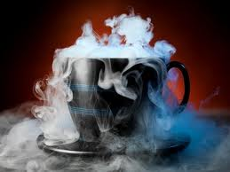
Evaporation

Slide 30
Evaporation

Slide 31
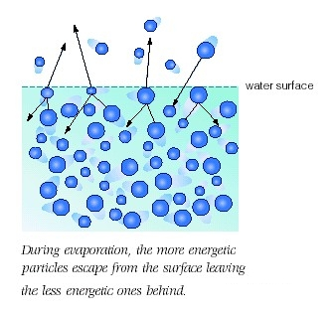
Evaporation

Slide 32
Evaporation
When a liquid is heated, the particles gain kinetic energy and move faster.
Some of the particles near the surface of the liquid have enough energy to overcome the forces of attraction and are able to leave the liquid and become a vapour.
These particles are said to have evaporated.
The particles which leave the liquid take lots of energy with them, leading to a cooling of the liquid.

Slide 33
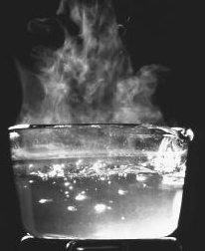
Boiling

Slide 34
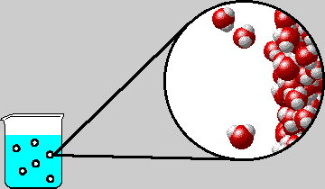
Boiling

Slide 35
Boiling
Boiling is different from evaporation in that it takes
place throughout the liquid.
Once a liquid has started to boil, the temperature
remains constant until all the liquid particles have
changed to a gas.
All the energy is used by the particles to overcome
the forces of attraction in the liquid to move further
apart and become a gas.

Slide 36
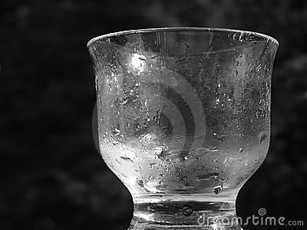
Condensation

Slide 37
Condensation

Slide 38
Condensation
When the temperature of a gas is lowered, the particles lose kinetic energy and begin to move more slowly.
The forces of attraction now become more significant causing the particles to move closer together forming a liquid.

Slide 39
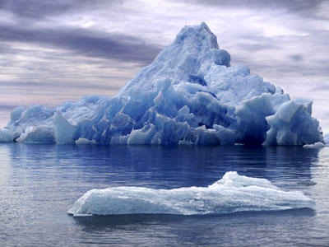
Freezing

Slide 40
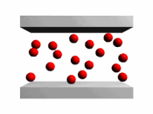
Freezing

Slide 41
Freezing
When the temperature of a liquid is lowered the particles lose kinetic energy and begin to move more slowly.
The forces of attraction between the particles become stronger causing the particles to move even closer together, forming a solid.

Slide 42
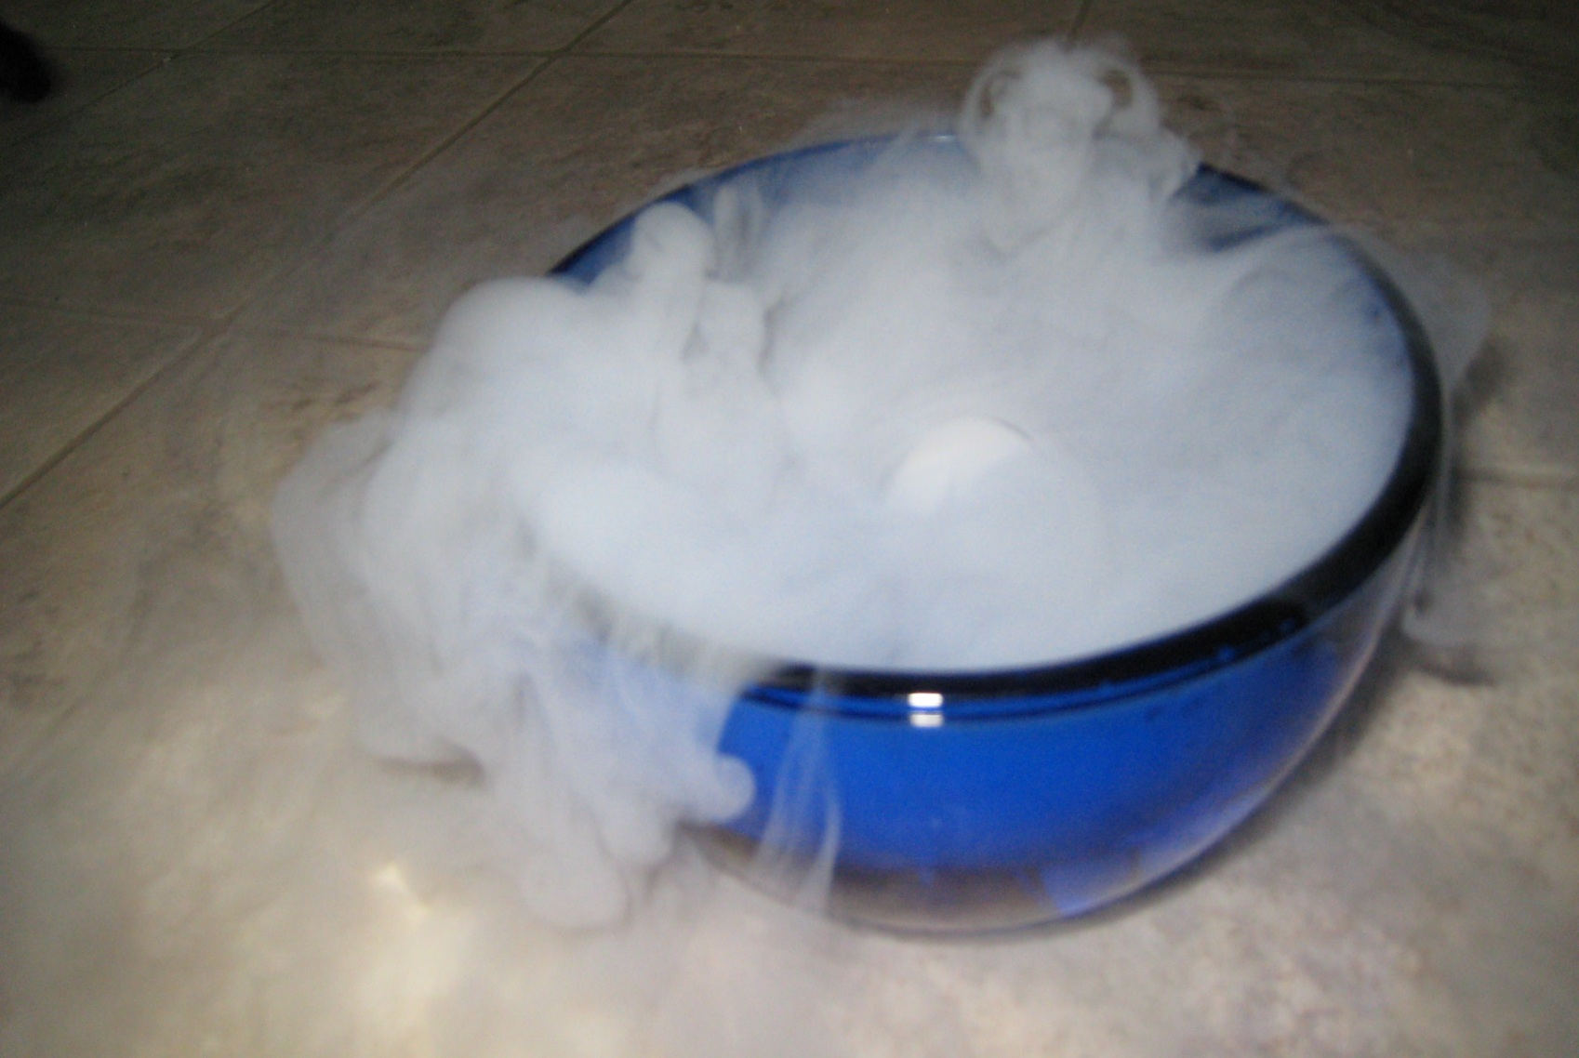
Sublimation

Slide 43
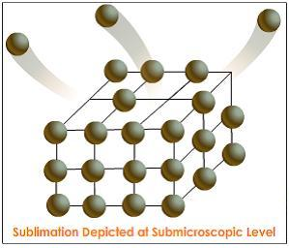
Sublimation

Slide 44
Sublimation
When the forces of attraction between the particles in a solid are weak, the addition of a small amount of heat can cause the solid to change directly into a gas, without passing through the liquid state.
If the gas is then cooled it will change directly back into a solid.
Changing directly from a solid to a gas or a gas to a solid is known as sublimation.

Slide 45
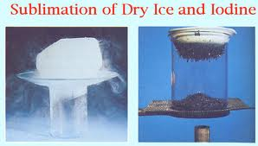
What are some examples of substances which undergo sublimation?
Iodine
Carbon dioxide (known as dry ice)

Slide 46
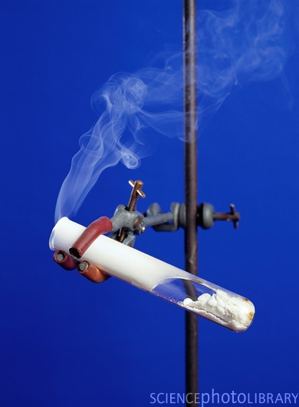
What are some examples of substances which undergo sublimation?
3. Ammonium chloride

Slide 47
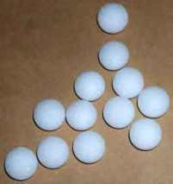
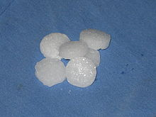
What are some examples of substances which undergo sublimation?
4. Naphthalene (moth balls or camphor balls are made out of naphthalene)

Slide 48
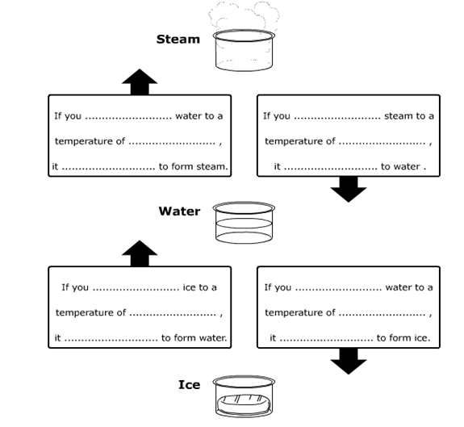
Activity 2: Use the words heat, cool, melts, freezes, condenses, evaporates, 0 ºC, 100 ºC to fill in the blanks.

