Slide 1
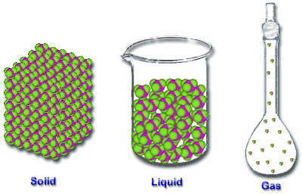
Movement of Particles in Different States

Slide 2
Activity 1: Representing The Three States of Matter
Steps:
Divide the class into three (3) groups.
Group 1 – Arrange yourselves to demonstrate the arrangement and movement of particles in a solid.
Group 2 – Arrange yourselves to demonstrate the arrangement and movement of particles in a liquid.
Group 3 – Arrange yourselves to demonstrate the arrangement and movement of particles in a gas.

Slide 3
Activity 2: The three states of water.
What are the three states of water?
How does water move from one state to another?
What do you think happens to the particles as water moves from one state to another?

Slide 4
Energy & Change of State
The three states of matter are solid, liquid and gas.
Matter can be changed from one state to another by heating or cooling.
A change of state is therefore caused by a change of temperature and consequently a change in the kinetic energy of the particles.

Slide 5
Energy Changes
We need to supply energy to make solids melt.
A pure solid always melts at the same temperature, the melting point (m.p.).
Example: The melting point of ice is 0⁰C.
More energy is needed to make liquids boil at their boiling point (b.p.).
Example: Pure water boils at 100⁰C at normal air pressure (one atmosphere pressure).

Slide 6
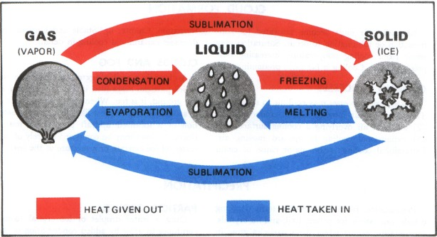
Summary of The Changes of State

Slide 7
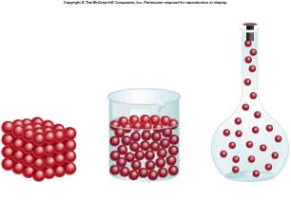
The Three States & The Particle Theory of Matter
The three states have observable differences which can be explained by the particle theory of matter.
(see Table 1)

Slide 8
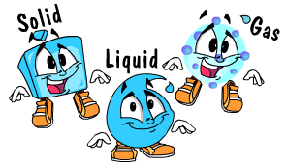
Changes of States of Matter

Slide 9
Changing State
To change from one state to another, a change in energy is required.
Example:
How do we make ice from water? How does the energy change?
To make ice from water, we need to put the water in the freezer, i.e. we need to remove heat energy.
The changes of state that will be explained in more detail are melting, evaporation, boiling, condensation, freezing and sublimation.

Slide 10
Melting

Slide 11
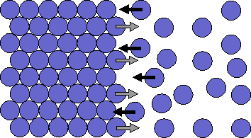
Melting
When a solid is heated, the particles gain kinetic energy and begin to vibrate more vigorously.
Eventually the particles are able to overcome the strong forces of attraction between them and move more freely and further apart forming a liquid.

Slide 12
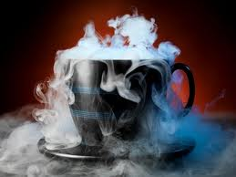
Evaporation

Slide 13
Evaporation

Slide 14
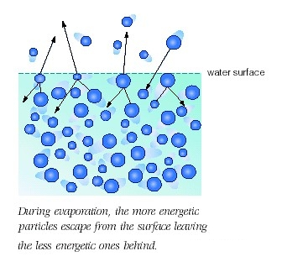
Evaporation

Slide 15
Evaporation
When a liquid is heated, the particles gain kinetic energy and move faster.
Some of the particles near the surface of the liquid have enough energy to overcome the forces of attraction and are able to leave the liquid and become a vapour.
These particles are said to have evaporated.
The particles which leave the liquid take lots of energy with them, leading to a cooling of the liquid.

Slide 16
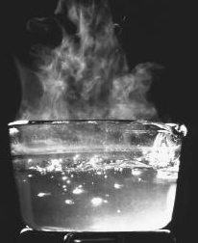
Boiling

Slide 17
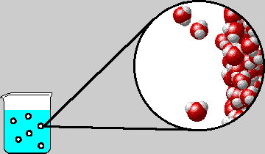
Boiling

Slide 18
Boiling
Boiling is different from evaporation in that it takes
place throughout the liquid.
Once a liquid has started to boil, the temperature
remains constant until all the liquid particles have
changed to a gas.
All the energy is used by the particles to overcome
the forces of attraction in the liquid to move further
apart and become a gas.

Slide 19
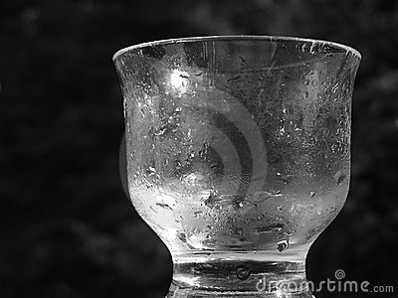
Condensation

Slide 20
Condensation

Slide 21
Condensation
When the temperature of a gas is lowered, the particles lose kinetic energy and begin to move more slowly.
The forces of attraction now become more significant causing the particles to move closer together forming a liquid.

Slide 22
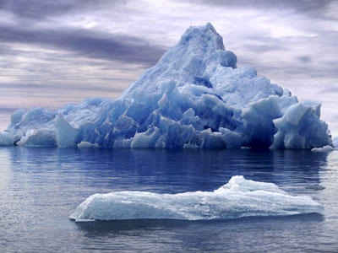
Freezing

Slide 23
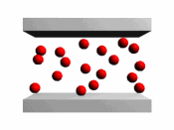
Freezing

Slide 24
Freezing
When the temperature of a liquid is lowered the particles lose kinetic energy and begin to move more slowly.
The forces of attraction between the particles become stronger causing the particles to move even closer together, forming a solid.

Slide 25
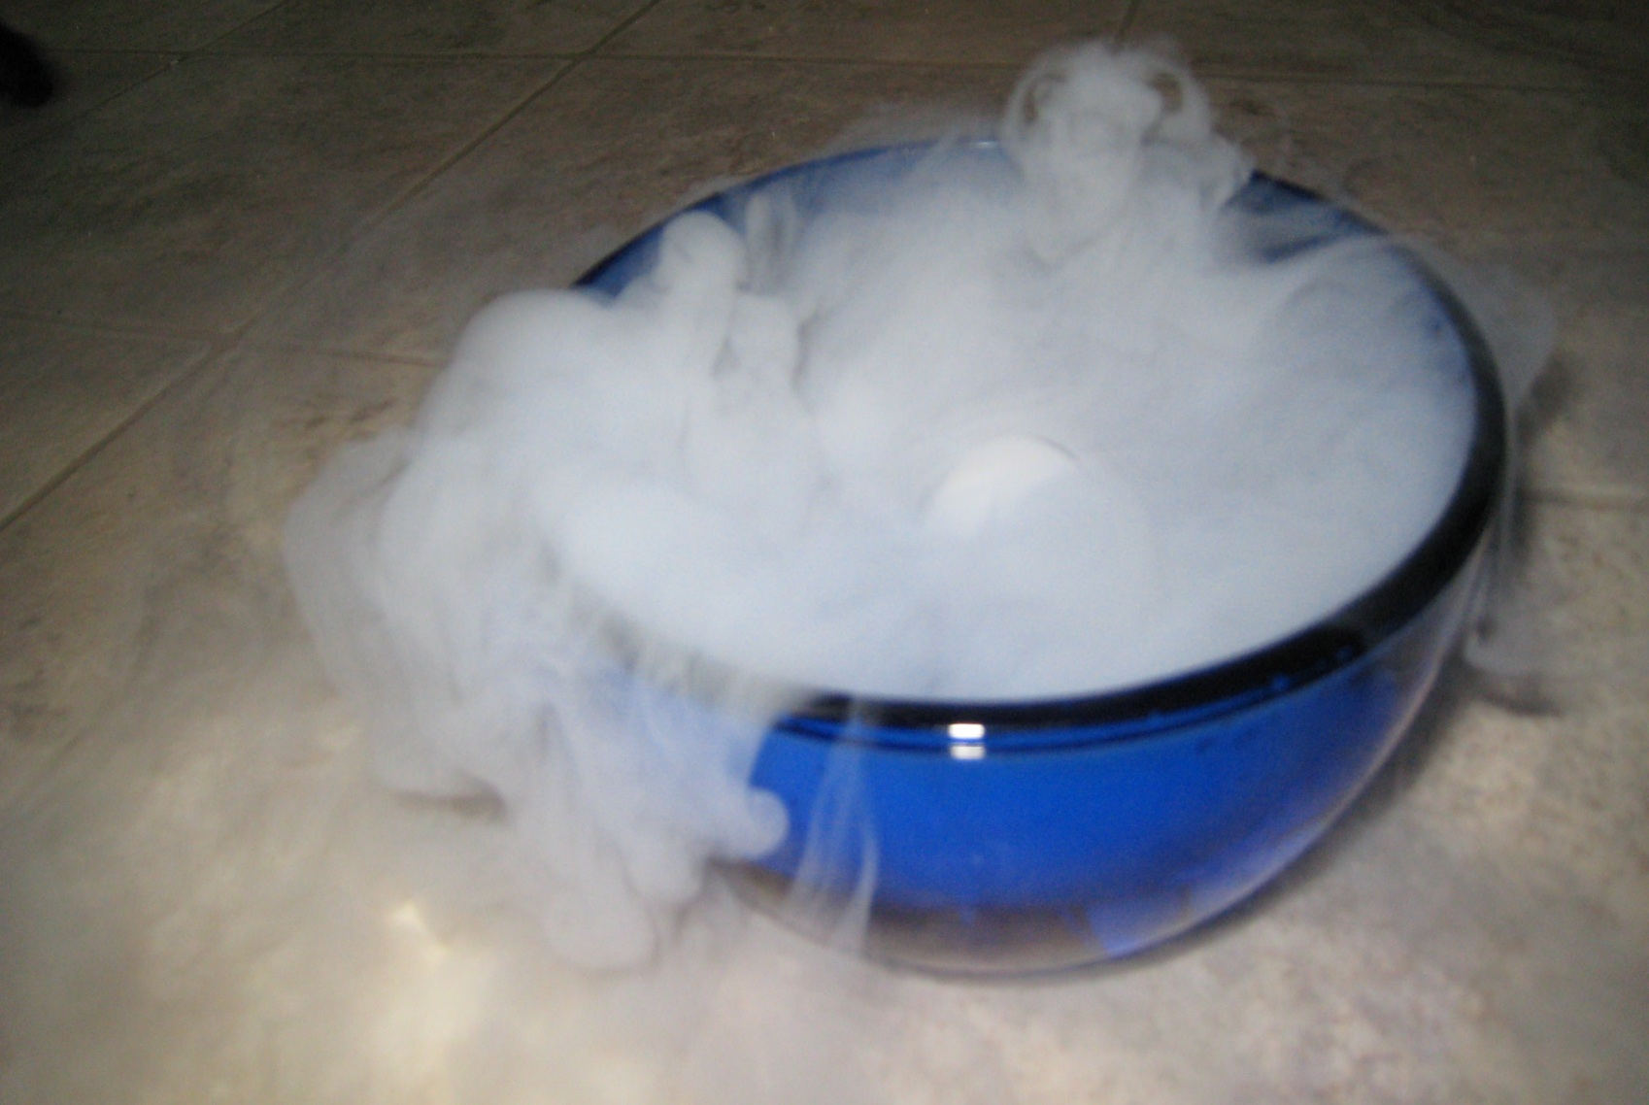
Sublimation

Slide 26
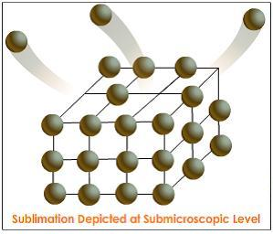
Sublimation

Slide 27
Sublimation
When the forces of attraction between the particles in a solid are weak, the addition of a small amount of heat can cause the solid to change directly into a gas, without passing through the liquid state.
If the gas is then cooled it will change directly back into a solid.
Changing directly from a solid to a gas or a gas to a solid is known as sublimation.

Slide 28
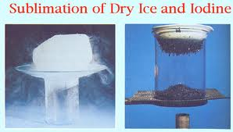
What are some examples of substances which undergo sublimation?
Iodine
Carbon dioxide (known as dry ice)

Slide 29
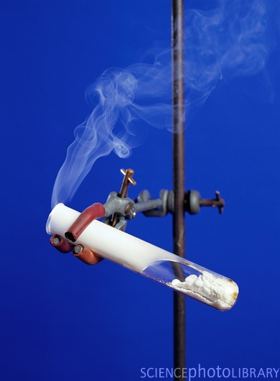
What are some examples of substances which undergo sublimation?
3. Ammonium chloride

Slide 30
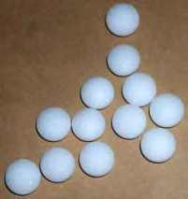
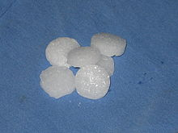
What are some examples of substances which undergo sublimation?
4. Naphthalene (moth balls or camphor balls are made out of naphthalene)

Slide 31
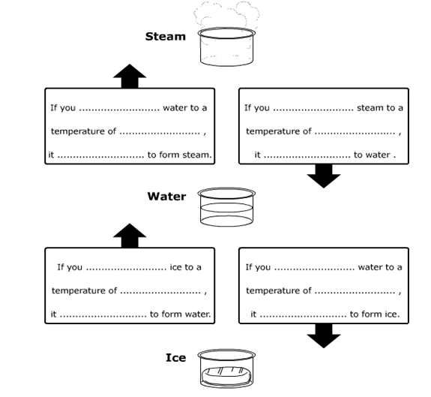
Activity 2: Use the words heat, cool, melts, freezes, condenses, evaporates, 0 ºC, 1ºC, 99ºC, 100 ºC to fill in the blanks.

Slide 32
Diffusion & Osmosis

Slide 33
Why are diffusion and osmosis important?
Diffusion and osmosis are important because they provide evidence for the existence and movement of particles, that is, they provide evidence for the particulate nature of matter.

Slide 34
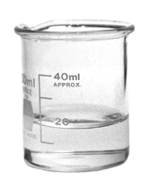
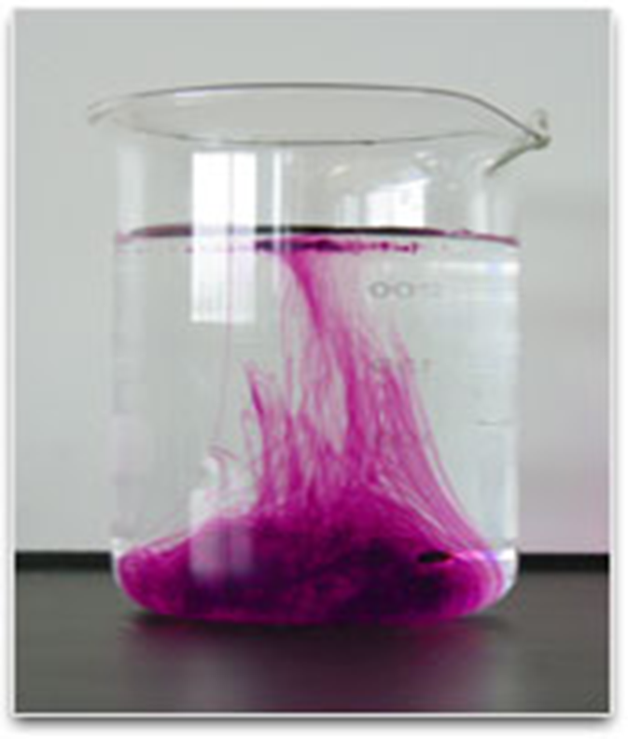
Diffusion
What would happen if we dropped purple ink into a beaker of water?
What would eventually happen to the beaker on the right?

Slide 35
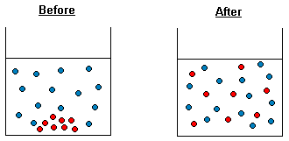
What is diffusion?
Diffusion is the movement of particles (liquid or gas) from an area of higher concentration to an area of lower concentration.
Example

Slide 36
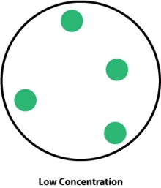
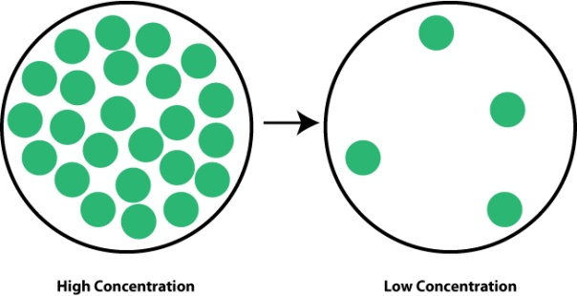
Diffusion and concentration
A place where there are a lot of particles is called a high concentration.
A place where there are a few particles is called a low concentration
Particles will diffuse from a high concentration
to a low concentration

Slide 37
Everyday examples of Diffusion
Some everyday examples of diffusion are:
Smelling your mother’s cooking from the kitchen while you are studying in the living room.
Smelling garbage on the street before you can see the garbage truck.
Smelling someone’s perfume.
A drop of ink spreading to colour the water in a beaker, without stirring.
Rust spreading from a rusty can into a white tile.

Slide 38
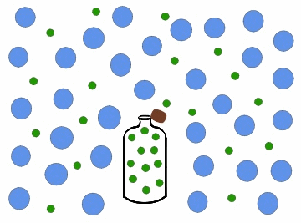
Diffusion in Gases

Slide 39
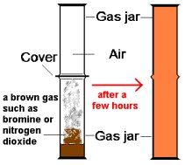
Example 1: Diffusion of Bromine Gas

Slide 40
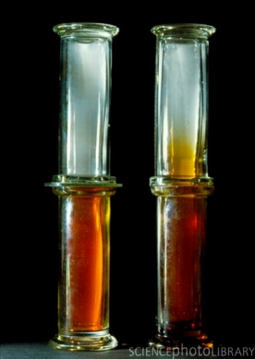
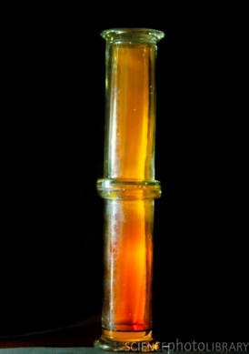
Example 1: Diffusion of Bromine Gas
1 2 3

Slide 41
Example 2: Diffusion of Ammonia & Hydrogen Chloride

Slide 42
Example 2: Diffusion of Ammonia & Hydrogen Chloride
The ammonia and hydrogen chloride particles move through the air in the glass tube towards each other.
When ammonia and hydrogen chloride combine they react to form a white solid known as ammonium chloride.
In the experiment above the ammonium chloride forms a ring inside the glass tube.
The ammonia gas particles are much lighter than the hydrogen chloride particles which allows them to move much faster than the hydrogen chloride particles through the air. Therefore, the ammonium chloride forms closer to the source of the hydrogen chloride.

Slide 43
Example 2: Diffusion of Ammonia & Hydrogen Chloride
We can represent the reaction between the ammonia and the hydrogen chloride as a chemical equation:
ammonia + hydrogen chloride ammonium chloride
NH_{3(g)} + HCl_{(g)} NH₄Cl_{(s)}
This experiment provides evidence that particles are able to move and that there are spaces between particles.

Slide 44
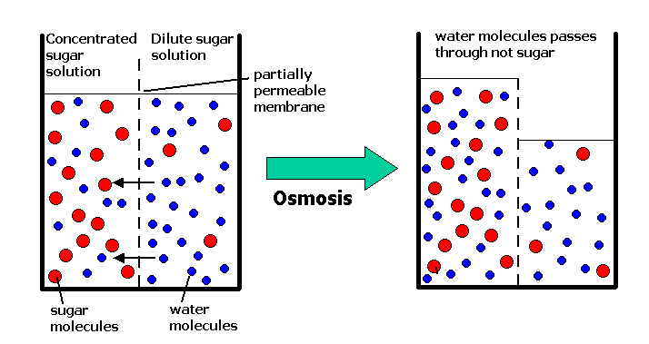
Osmosis

Slide 45
What is Osmosis?
Osmosis is a special case of diffusion.
Osmosis is the movement of water molecules through a selectively permeable membrane from a region with a lot of water molecules, e.g. a dilute solution or pure water, to a region with fewer water molecules, e.g. a concentrated solution.

Slide 46
Activity: Osmosis in Paw-Paw
Six pieces of green paw-paw were cut into strips of equal length.
Three strips of paw-paw were placed into a beaker of distilled water and the other three strips were placed into a beaker of saturated sodium chloride solution.
They remained in the solutions for an hour.
When they were removed, the strips which were placed in the distilled water were more rigid and increased in length whereas the strips which were placed in the saturated sodium chloride solution wilted, became softer and decreased in length.
Explain these results.

Slide 47
Explanation
The cell membranes of the paw-paw cells act as selectively permeable membranes.
Water can pass through the cell membranes, either into or out of the cells.
Distilled water has a higher water content than the paw-paw cells, therefore water will move into the cells, resulting in a more rigid and longer paw-paw strip.
With the saturated sodium chloride solution, water will move from the cells through the cell membrane into the sodium chloride solution, resulting in the paw-paw becoming softer and shorter.

Slide 48
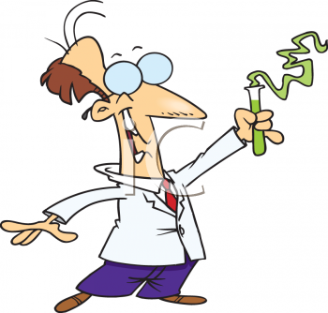
Example of Osmosis in the Kitchen

Slide 49
Summary
In this lesson we learnt about:
The movement of particles in different states
Changes of states of matter
Diffusion and Osmosis

