Slide 1
Chemical Equations

Slide 2
Laws
The Law of Conservation of Mass
In a chemical reaction the total mass of everything at the end of the reaction is the same as the total mass at the beginning.
The Law of Constant Composition
However you make a compound, it always contains the same elements in the same proportions by mass.

Slide 3
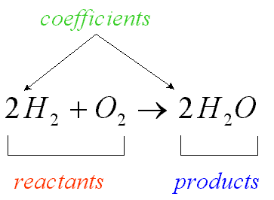
Chemical Equations
Chemical equations use symbols and formulae to represent chemical change.

Slide 4
Chemical Formula
Examples:
2H – 2 atoms of hydrogen, not bonded together.
The 2 is called a coefficient.
H₂ – 1 molecule of hydrogen, made up of 2 atoms of hydrogen bonded together.
2H₂ – 2 molecules of hydrogen, in total 4 atoms of hydrogen.

Slide 5
Chemical Formula
Examples:
Ca(OH)₂ – 1 Ca²⁺ and 2 OH⁻
So the amount of each element is 1Ca, 2O and 2H atoms.
3H₂SO₄ – consists of 6H, 3S and 12O atoms.

Slide 6
Writing Chemical Equations
The conventions which are used when writing chemical equations are:
The reactants are placed on the left side of the equation and the products are placed on the right side with an arrow (→) separating reactants from products.
A plus sign (+) separates each reactant or product.
The physical state of the chemical is usually written as a subscript. These physical states are:
(s) – solid, (l) – liquid, (g) – gas, (aq) – aqueous

Slide 7
Other chemicals and factors which are required for the reaction to occur but do not change during the reaction can be written above the arrow, e.g. catalysts, a specific temperature, a specific pressure.
If a reaction is reversible a double arrow is used :
When reading a chemical equation, each of the signs represents a word or statement.
Example: 2Fe_{(s)} + 3Cl_{(g)} → 2FeCl_{3(s)}
‘Solid iron reacts with chlorine gas to form solid iron (III) chloride’

Slide 8
Balancing Chemical Equations

Slide 9
When is a scale balanced?

Slide 10
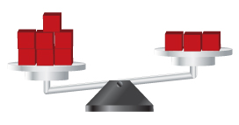
What do we need to do to balance the scale below?

Slide 11
Balancing Chemical Equations
Early chemists noticed that in a chemical reaction, the total mass of the reactants always equalled the total mass of the products. This led to the Law of Conservation of Mass which states that matter can neither be created nor destroyed.

Slide 12
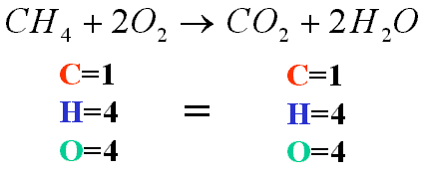
Atoms in a chemical equation are neither created nor destroyed; they are only rearranged. A chemical equation that conforms to this law is known as a balanced chemical equation.
In a balanced chemical equation there must be the same number of atoms of each element on the right hand side of the equation as there are on the left hand side.
When an equation is balanced, the mass of the reactants will equal the mass of the products.

Slide 13
Example 1
Balance the equation: Zn_{(s)} + HCl_{(aq)} → ZnCl_{2(aq)} + H_{2(g)}
To balance, we need 2 H and 2 Cl on the left. Therefore, we put a 2 in front of HCl.
We get, Zn_{(s)} + 2HCl_{(aq)} → ZnCl_{2(aq)} + H_{2(g)}
Atom | Zn + HCl | ZnCl₂ + H₂
Zn | 1 | 1
H | 1 | 2
Cl | 1 | 2
Atom | Zn + 2HCl | ZnCl₂ + H₂
Zn | 1 | 1
H | 2 | 2
Cl | 2 | 2

Slide 14
Example 2
Balance the equation: N_{2(g)} + H_{2(g)} → NH_{3(g)}
We need 2 N on the right, so we put a 2 in front of NH₃
We need 6 H on the left, so we put a 3 in front of H₂
We get, N_{2(g)} + 3H_{2(g)} → 2NH_{3(g)}
Atom | N₂ + H₂ | NH₃
N | 2 | 1
H | 2 | 3
Atom | N₂ + H₂ | 2NH₃
N | 2 | 2
H | 2 | 6
Atom | N₂ + 3H₂ | 2NH₃
N | 2 | 2
H | 6 | 6

Slide 15
Example 3
Balance the equation: Fe_{(s)} + H₂SO_{4(aq)} → Fe₂(SO₄)_{3(aq)} + H_{2(g)}
We need 2 Fe and 3 SO₄ on the left, so we put a 2 in front of Fe and a 3 in front of H₂SO₄
We need 6 H on the right, so we put a 3 in front of H₂
Atom | Fe + H₂SO₄ | Fe₂(SO₄)₃ + H₂
H | 2 | 2
Fe | 1 | 2
SO₄ | 1 | 3
Atom | 2Fe + 3H₂SO₄ | Fe₂(SO₄)₃ + H₂
H | 6 | 2
Fe | 2 | 2
SO₄ | 3 | 3
Atom | 2Fe + 3H₂SO₄ | Fe₂(SO₄)₃ + 3H₂
H | 6 | 6
Fe | 2 | 2
SO₄ | 3 | 3
We get, 2Fe_{(s)} + 3H₂SO_{4(aq)} → Fe₂(SO₄)_{3(aq)} + 3H_{2(g)}

Slide 16
Example 4
Balance the equation: C₃H_{8(g)} + O_{2(g)} → CO_{2(g)} + H₂O_{(g)}
To balance, put a 3 in front of CO₂ and a 4 in front of H₂O
To balance the O, put a 5 in front of O₂
Atom | C₃H₈ + O₂ | CO₂ + H₂O
C | 3 | 1
H | 8 | 2
O | 2 | 2 1
Atom | C₃H₈ + O₂ | 3CO₂ + 4H₂O
C | 3 | 3
H | 8 | 8
O | 2 | 6 4
Atom | C₃H₈ + 5O₂ | 3CO₂ + 4H₂O
C | 3 | 3
H | 8 | 8
O | 10 | 6 4
We get, C₃H_{8(g)} + 5O_{2(g)} → 3CO_{2(g)} + 4H₂O_{(g)}

Slide 17
Examination Tip
When balancing chemical equations its is best to begin with an element other than hydrogen or oxygen.
Start with the elements immediately after the arrow, excluding hydrogen and oxygen.
Balance the hydrogen atoms second from last and oxygen atoms last.

