Slide 1
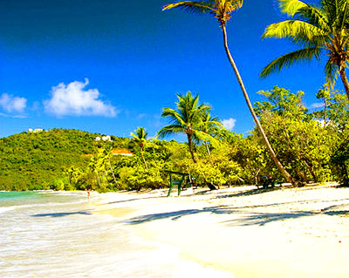
Chemistry In The Environment

Slide 2
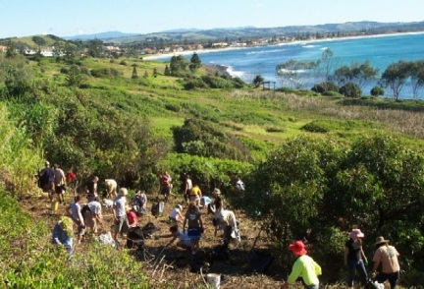
What is the environment?
The environment is all of our surroundings.
This includes the atmosphere, oceans, soil and all living things.

Slide 3
What are pollutants?
Our environment can be damaged by pollutants.
Pollutants are materials that can be toxic, can interfere with the food chain or change the rate of growth of species of animals and plants.
Pollutants can be in any physical state – solids, liquids or gases.
Even waste heat from a power station can be described as a pollutant.

Slide 4
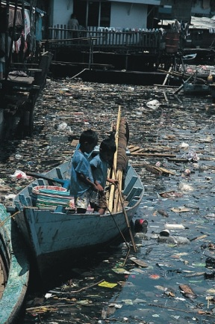
Pollutants

Slide 5
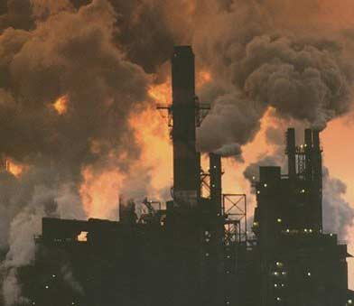
What is pollution?
Pollution is any damage to the environment that is caused by a pollutant.

Slide 6
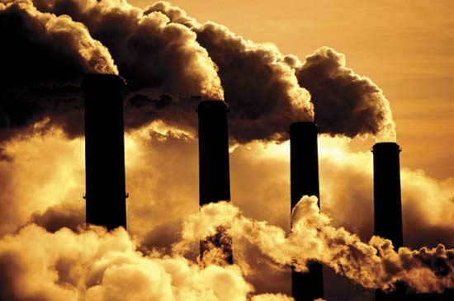
Sources of pollution
1. Burning of fossil fuels

Slide 7
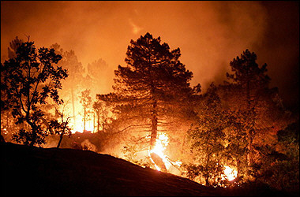
2. Land clearance by burning forests

Slide 8
3. Use of pesticides and fertilisers

Slide 9
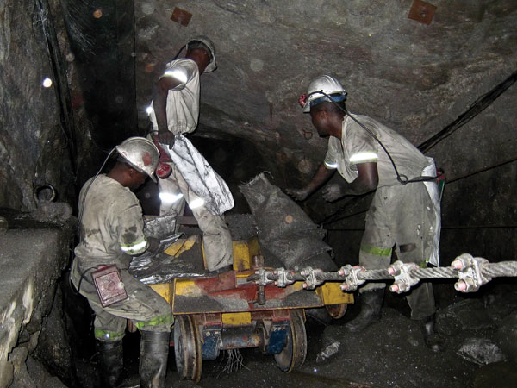
4. Waste materials from industrial processes such as mining, quarrying and smelting ores to make metals

Slide 10
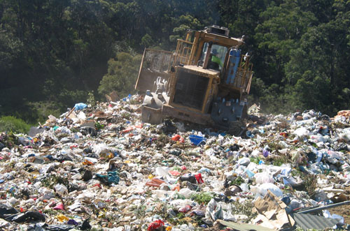
5. Disposal of plastic and other non-biodegradable waste materials

Slide 11
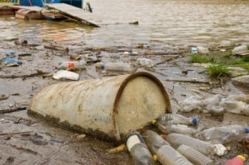
6. Sewage and other forms of water pollution

Slide 12
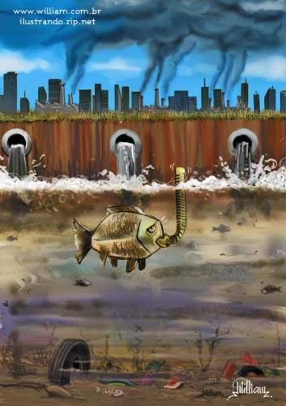
Activity: Identify three sources of pollution in the picture below and say how they can be prevented or managed.

Slide 13
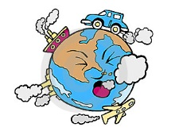
The Effects of Pollutants on the Environment
(Focus for CHEM092: Water Pollution, Air Pollution & Land Pollution)

Slide 14
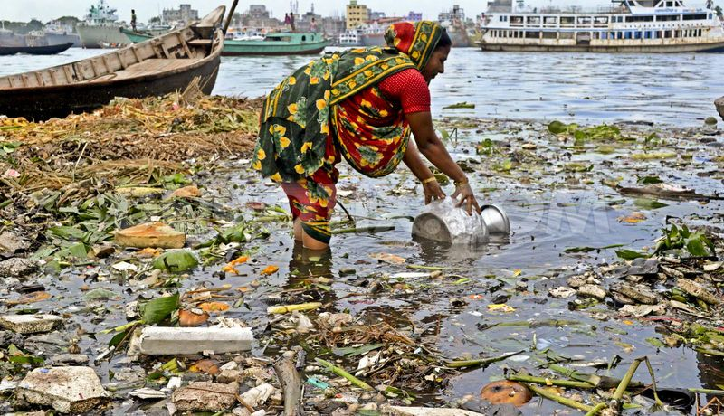
Water Pollution

Slide 15
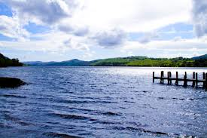
Why is Water Important?
Water covers over 70% of the Earth’s surface and is a very important resource for people and the environment.

Slide 16
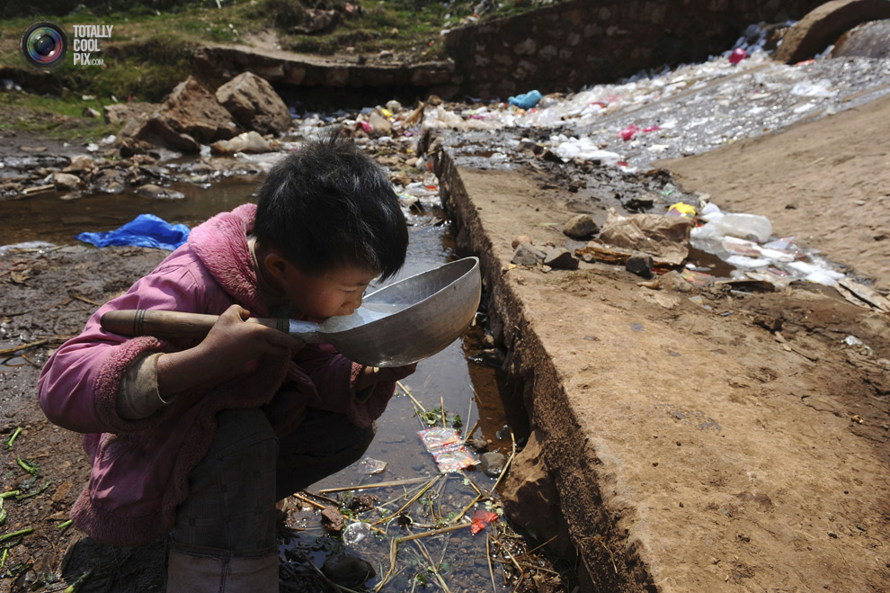
Why is Water Pollution Important?
Water pollution affects drinking water, rivers, lakes and oceans all over the world. This consequently harms human health and the natural environment.

Slide 17
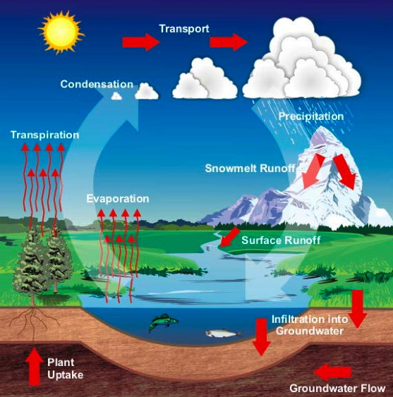
The Water Cycle

Slide 18
The Water Cycle
The earth has had the same amount of water for millions of years. Water is used over and over by nature and is recycled in the water cycle.
The water cycle is powered by the energy of the sun.
The sun provides energy to first change snow and ice to liquid, then to change liquid water in the ocean, lakes, and rivers to water vapor that becomes part of the air.
This is called the water cycle.

Slide 19
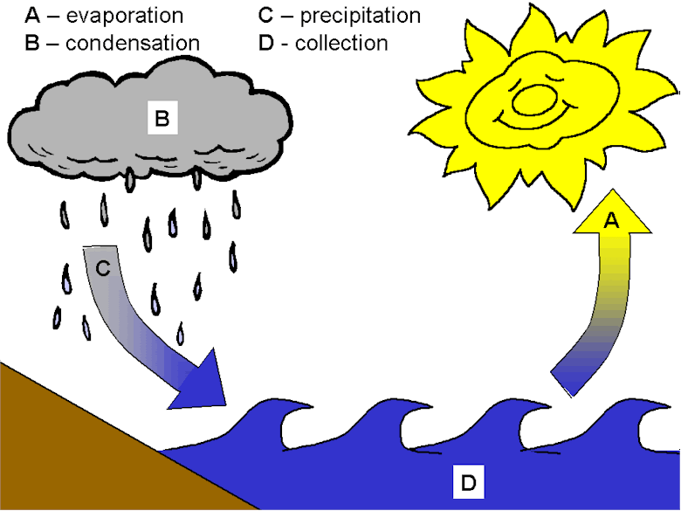
Steps In The Water Cycle
The Water Cycle is made up of four steps which are continually repeated, with no distinct beginning or end:
1. Evaporation 2. Condensation 3. Precipitation 4. Accumulation/Percolation

Slide 20
Explanation of Steps In The Water Cycle
Evaporation occurs when the sun's energy warms surface water on the ocean, lakes and rivers, and turns it into water vapor.
Water vapor in the atmosphere collects and forms couds. This is during the condensation phase.
Clouds are formed as the water vapor condenses. When the clouds are cool, water drops to the ground. This is called precipitation.

Slide 21
Precipitation is rain, snow or hail.
After precipitation, one of three things can happen to the water.
Most of it soaks into the ground (percolation), and is either used by plants or becomes part of underground reservoirs called aquifers.
About 1/3 of the precipitation runs off the surface and joins water in lakes and rivers (accumulation). Some of it ends up in the ocean, where the sun's energy will begin the evaporation process again.

Slide 22
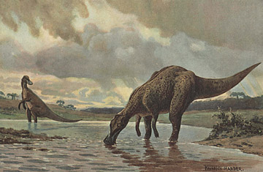
Because of the water cycle and its slow, constant recycling of water, your next drink could have once been a drink for a dinosaur!

Slide 23
The Purification of Drinking Water
Treating water to make it suitable to drink is much like wastewater treatment.
In areas that depend on surface water it is usually stored in a reservoir for several days, in order to improve clarity and taste by allowing more oxygen from the air to dissolve in it and allowing suspended matter to settle out.
The water is then pumped to a purification plant through pipelines, where it is treated, so that is will meet government treatment standards.

Slide 24
Usually the water runs through sand filters first and sometimes through activated charcoal, before it is disinfected.
Disinfection can be done by bacteria or by means of adding substances to remove contaminants from the water.
The number of purification steps that are taken depend on the quality of the water that enters the purification plant. In areas with very pure sources of groundwater little treatment is needed. Futher Reading:
http://www.lenntech.com/applications/drinking/faq/drinking-water-faq.htm#ixzz2jQ99KaHc

Slide 25
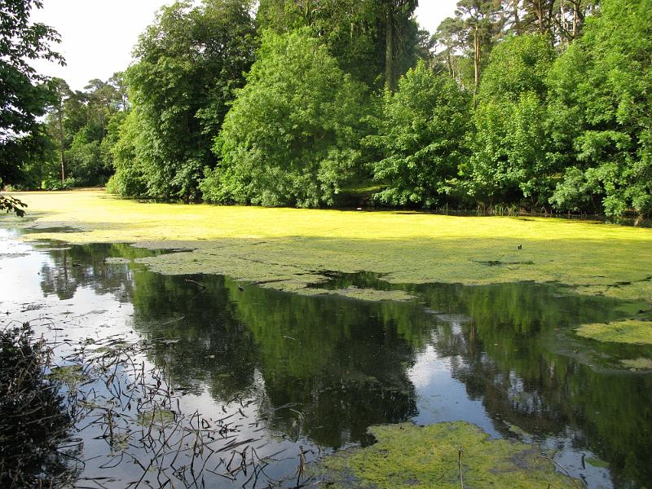
Eutrophication
Eutrophication is when the environment becomes enriched with nutrients. This can be a problem in marine habitats such as lakes as it can cause algal blooms.

Slide 26
Causes of Eutrophication
The main causes of eutrophication are:
natural run-off of nutrients from the soil and the weathering of rocks
run-off of inorganic fertiliser (containing nitrates and phosphates)
run-off of manure from farms (containing nitrates, phosphates and ammonia)
run-off from erosion (following mining, construction work or poor land use)

Slide 27
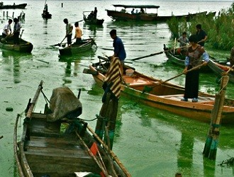
discharge of detergents (containing phosphates)
discharge of partially treated or untreated sewage (containing nitrates and phosphates)
In most freshwater lakes the limiting nutrient is phosphorus, so an input of phosphorus in the form of phosphate ions (PO₄³⁻) results in an increase in biological activity.

Slide 28
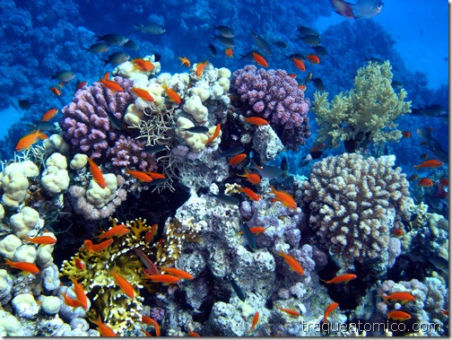
Effects of Water Pollution on Coral Reefs
Coral reefs need clean, clear water to survive.
When sediment and other pollutants enter the water, they smother coral reefs, speed the growth of damaging algae, and lower water quality.
Pollution can also make corals more susceptible to disease, impede coral growth and reproduction, and cause changes in food structures on the reef.

Slide 29
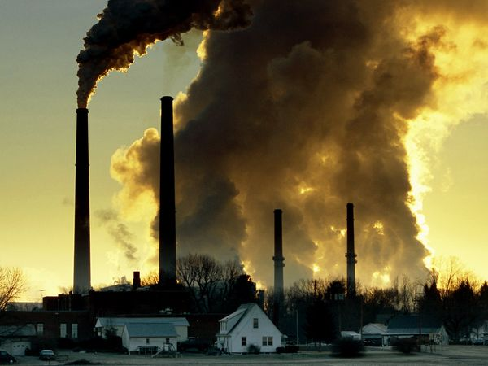
Air Pollution

Slide 30
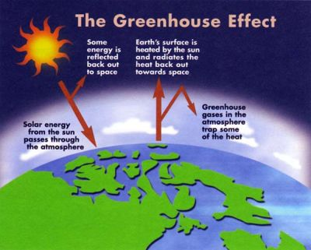
Effect 1: Global Warming – The ‘Greenhouse Effect’

Slide 31
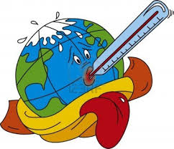
What is Global Warming?
Global warming is gradual increase in the overall temperature of the earth's atmosphere generally attributed to the greenhouse effect caused by increased levels of carbon dioxide, CFCs, and other pollutants.

Slide 32
Global Warming – The ‘Greenhouse Effect’
The absorption of infra-red radiation in this way is nothing new – it has always happened and is one of the processes which help to maintain the Earth at a temperature suitable for life.
The worry is that increased amounts of carbon dioxide caused by burning fossil fuels are upsetting the balance and causing unusually rapid increases in global temperatures.
Some things that are resulting from this are the melting of the polar ice caps, increased flooding and changes in the weather.

Slide 33
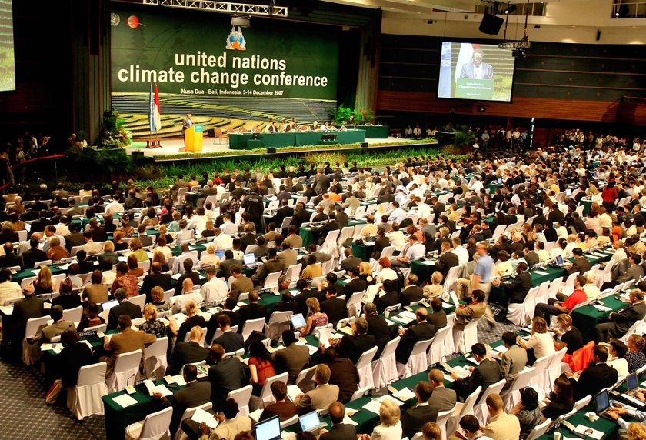
The Kyoto Protocol
The Kyoto Protocol is an agreement drawn up in 1997 in Japan by the United Nations to reduce the emission of greenhouse gases. Some 169 countries signed the agreement. The aim of the Kyoto Protocol is to reduce the effect greenhouse gases have on the climate.

Slide 34
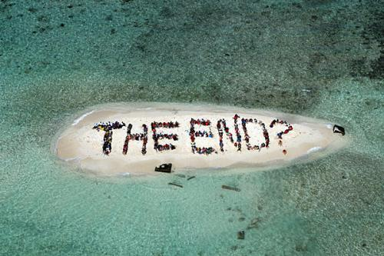
Harmful Effects of Global Warming on the Caribbean Islands
Small islands have characteristics that make them especially vulnerable to the effects of global warming, sea level rise, and extreme events. Our beautiful beaches, coral reefs, mangroves, fisheries, bird life, and livelihoods focused on the coast are all threatened by climate change.

Slide 35
Hurricanes and storms are predicted to become more frequent and intense.
Marine and coastal ecosystems are at risk.
Caribbean forests will also suffer from climate change, especially hurricane damage and increased drought.
• Summer drought is expected to increase, causing water shortages in many islands.
Further Reading: http://www.scscb.org/programs/Program_resources/Global-Warming-Fact-Sheet.pdf

Slide 36
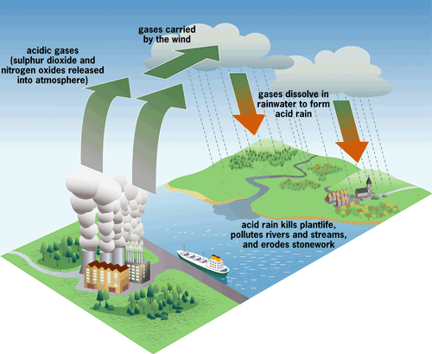
Effect 2: Acid Rain

Slide 37
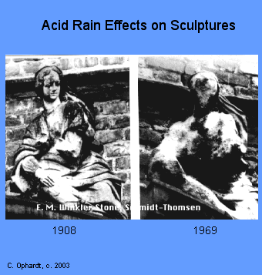
Acid Rain
Acid rain is acidic because of dissolved carbon dioxide.
Acid rain is even more acidic because of the presence of various pollutants.

Slide 38
How is acid rain caused?
Acid rain is caused when water and oxygen in the atmosphere react with sulphur dioxide to produce sulphuric acid, or with various oxides of nitrogen, NO_{x}, to give nitric acid.
These come mainly from power stations and factories burning fossil fuels, or from motor vehicles.
The high temperatures and pressures inside car engines make it possible for nitrogen and oxygen to react together. They form a mixture of nitrogen oxides which escape into the air from the exhaust pipe.

Slide 39
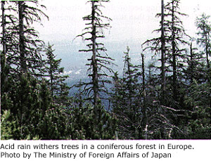
Why is acid rain worrying?
Acid rain is mainly worrying for its devastating effect on trees, and on life in lakes. In some areas, a high proportion of trees are affected and are either sick or dying. In some lakes the water is so acidic that it wont support life.

Slide 40
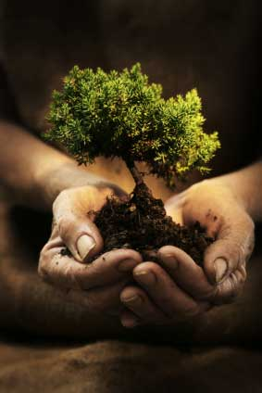
What is the solution to the acid rain problem?
Removing sulphur from fuels
‘Scrubbing’ the gases from power stations and factories to remove SO₂ and NO_{x}
Using catalytic converters in cars – helps to convert oxides of nitrogen into harmless nitrogen gas, but has no effect on sulphur dioxide
Further Reading: http://athome.harvard.edu/programs/sge/sge2.html

Slide 41
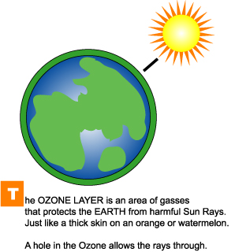
Effect 3: Ozone Layer Depletion

Slide 42
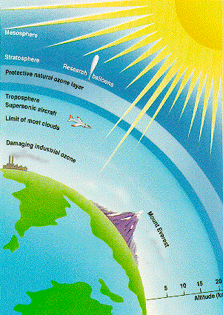
What is Ozone?
Ozone (O₃) is a gas found in the upper atmosphere which shields the Earth from dangerous ultraviolet (UV) rays.

Slide 43
How is the ozone layer depleted?
Chlorofluorocarbons (CFCs) are organic compounds containing carbon, chlorine and fluorine.
They have been used extensively in sprays as propellants and as coolants in refrigerators and air conditioners.
As CFCs do not dissolve in water or in the atmosphere, they accumulate in the atmosphere, where they break down the ozone molecules.

Slide 44
What happens when the ozone layer is depleted?
As the ozone layer becomes depleted, move UV light reaches the Earth.
As a result of this there has been a significant increase in the number of people developing skin cancer, cataracts and depressed immune systems.
It also adversely affects plant cells and lead to the death of aquatic organisms.
Depletion of the ozone layer is also contributing to the general increase in the word’s temperatures resulting in global warming.
Further Reading:
http://www.theguardian.com/environment/2009/dec/01/ozone-antarctica

Slide 45
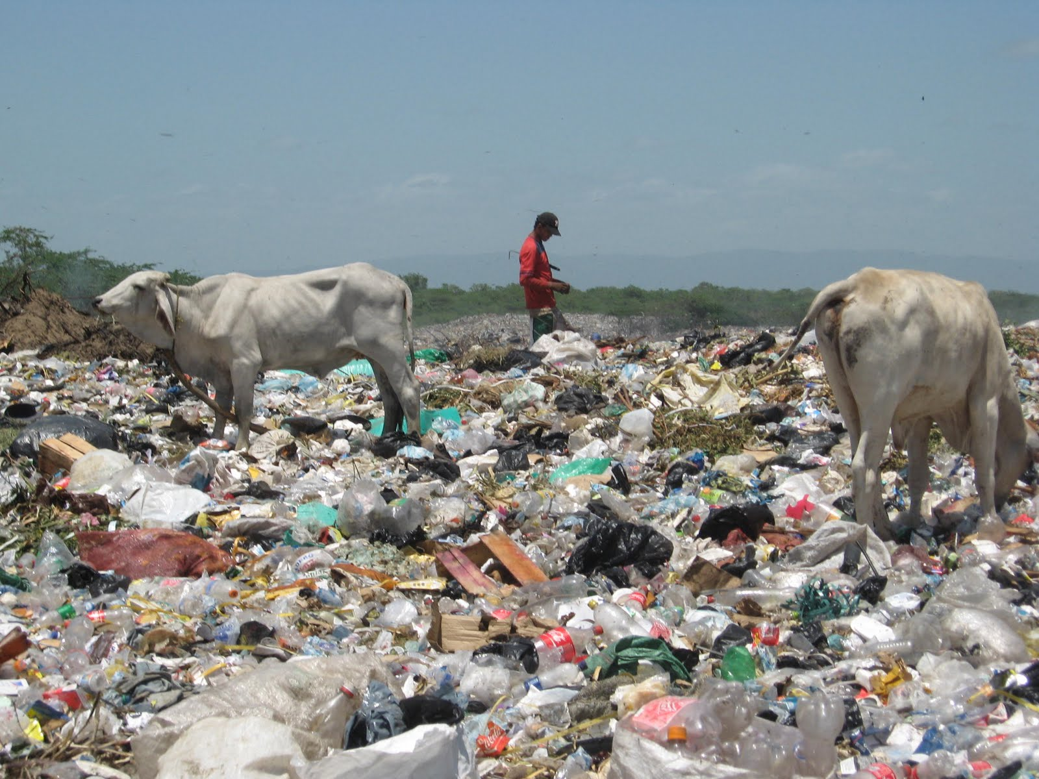
Land Pollution

Slide 46
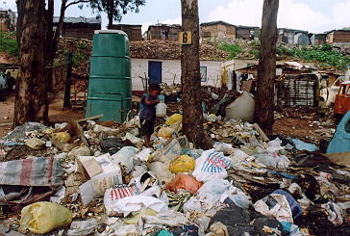
What is Land Pollution?
Land pollution is the deterioration (destruction) of the earth’s land surfaces, often directly or indirectly as a result of man’s activities and their misuse of land resources.

Slide 47
Sources of Land Pollution
Agricultural sources
Ashes
Mining Sources
Industrial Sources
Sewage Treatment
Garbage or Waste
Construction Sources
Deforestation
Chemical & Nuclear Plants
Oil Refineries
Further Reading:
http://eschooltoday.com/pollution/land-pollution/sources-of-land-pollution.html

