Slide 1
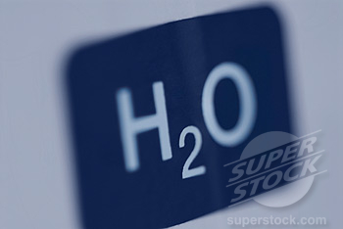
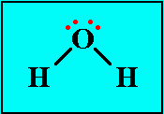
Chemical Formulae

Slide 2
Why Are Chemical Formulae Important?
Chemical formulae are important because they tell us which elements are found in a compound as well as the ratio between the elements in the compound.

Slide 3
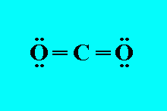
Types of Chemical Formulae
The molecular formula e.g. H₂O, CO₂, C₆H₁₂O
The structural formula e.g.
The empirical formula e.g. NaCl

Slide 4
Writing chemical formulae for ionic compounds
Ionic compounds are represented using an empirical formula. There are important points to note when writing the formulae of ionic compounds:
Metals generally lose electrons forming positive ions.
Non-metals generally gain electrons forming negative ions.

Slide 5
The charges must balance.
The magnitude of the charge on an ion of an element is the same as the oxidation state.
Transition elements often have multiple oxidation states.
Not all ions consist of one atom.
When balancing the number of charges, if multiple numbers of the polyatomic ion are required, the polyatomic ion is placed in brackets.

Slide 6
Writing Chemical Formulae
Steps:
1. Identify the metal and non-metal.
2. Write the symbols.
3. Write the charges.
4. Cross-over the charges from top to bottom.
5. Remove the charge.
6. Simplify the numbers and remove the 1’s.

Slide 7
Example 1
Write the chemical formula for calcium iodide.
Calcium and Iodide
Ca I
Ca²⁺ I¹⁻
Ca₁₋ I₂₊
Ca₁I₂
CaI₂

Slide 8
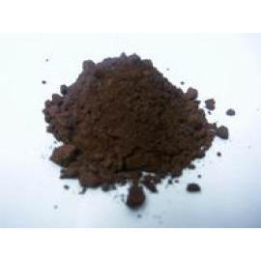
Example 2
Write the chemical formula for copper(II) oxide.
Copper and oxide
Cu O
Cu²⁺ O²⁻
Cu₂₋ O₂₊
Cu₂O₂
CuO

Slide 9
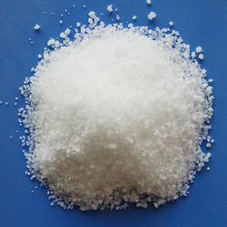
Example 3
Write the chemical formula for sodium phosphate.
Sodium and phosphate
Na PO₄
Na¹⁺ PO₄³⁻
Na₃₋ (PO₄)₁₊
Na₃ (PO₄)₁
Na₃ PO₄

Slide 10
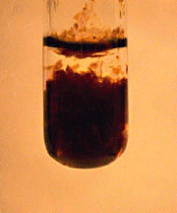
Example 4
Write the chemical formula for iron(II) hydroxide.
Iron and hydroxide
Fe OH
Fe²⁺ OH¹⁻
Fe₁₋ (OH)₂₊
Fe₁ (OH)₂
Fe (OH)₂

Slide 11
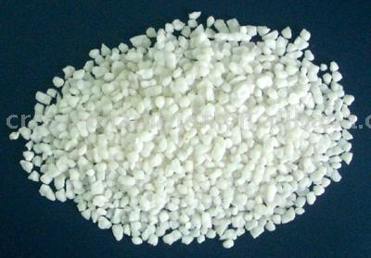
Example 5
Write the chemical formula for ammonium sulphate.
Ammonium and sulphate
NH₄ SO₄
NH₄¹⁺ SO₄²⁻
(NH₄)₂₋ (SO₄)₁₊
(NH₄)₂ (SO₄)₁
(NH₄)₂ SO₄

Slide 12
Naming ionic compounds
The names of ionic compounds are built from the cation and anion names.
Examples:
AgCl – Silver chloride
NaOH – Sodium hydroxide
Ca₃(PO₄)₂ – Calcium phosphate
(Na)₂Cr₂O₇ – Sodium dichromate

Slide 13
If the metal is a transition metal, determine the charge of the metal ion by looking at the ratio of the metal ion to the negative ion.
Example FeCl₂
Iron (Fe) is a transition metal.
Chloride (Cl) has a charge of 1- therefore 2 Cl will have a charge of 2-
The charge on iron (Fe) must therefore be 2+
Name of compound – iron(II) chloride.

Slide 14
Worksheet 1
1. Write the formula of each of the following compounds:
(a) Copper(I) hydroxide
(b) Magnesium sulphate
(c) Sodium carbonate
(d) Aluminium phosphate
2. Write the names of each of the following compounds:
LiF (b) KCl
(c) Ca₃(PO₄)₂ (d) CaSO₄

Slide 15
Relative Atomic Mass

Slide 16
Relative Atomic Mass
The relative atomic mass (A_{r}) of an element is found by comparing the mass of one atom of the element to the mass of a carbon-12 atom.
The relative atomic mass of an element can be found in the periodic table, for example:
1. Sodium relative atomic mass = 23
2. Calcium relative atomic mass = 40

Slide 17
Relative molecular mass & Relative formula mass
Relative molecular mass – The products of covalent bonding.
Relative formula mass – The products of ionic bonding.
To determine the relative molecular mass or relative formula mass, we add the relative atomic masses of all the elements present in the compound.

Slide 18
Example 1
Calculate the relative molecular mass of nitric acid, HNO₃.
Answer:
HNO₃ = 1 atom of H, 1 atom of N and 3 atoms of O.
Relative molecular mass = (1x1) + (1x14) + (3x16)
= 63

Slide 19
Example 2
Calculate the relative formula mass of calcium carbonate, CaCO₃.
Answer:
CaCO₃ = 1 atom of Ca, 1 atom of C and 3 atoms of O.
Relative formula mass = (1x40) + (1x12) + (3x16)
= 100

Slide 20
Molar Mass
The mass of one mole of a substance is known as the molar mass (M). The molar mass of an element or compound has a unit of grams per mole, i.e. gmol⁻¹
The molar mass of an element is the relative atomic mass in gmol⁻¹. The molar mass of a compound is the relative formula mass or relative molecular mass in gmol⁻¹.

Slide 21
Examples – Molar mass of elements
1. M(C) = 12 gmol⁻¹
2. M(Na) = 23 gmol⁻¹
3. M(Ca) = 40 gmol⁻¹
4. M(K) = 39 gmol⁻¹

Slide 22
Examples – Molar mass of compounds
1. M(H₂O) = (2x1) + 16 = 18 gmol⁻¹
2. M(CuSO₄) = 64 + 32 + (4x16) = 160 gmol⁻¹
3. M((NH₄)₂CO₃) = 2 x (14 + (4x1)) + 12 + (3x16)
= 96 gmol⁻¹
4. M(CuSO₄.5H₂O) = 160 + (5x18) = 250 gmol⁻¹

Slide 23
Relationship between mass, moles and number of atoms
Example: Sulphur
Relative atomic mass of sulphur, A_{r}(S) = 32
Therefore, molar mass of sulphur = 32 gmol⁻¹
The relationship between mass, moles and number of moles is given in the table below.
Mass of sulphur (g) | Number of moles | Number of atoms
32 | 1 | 6.0 x 10²³
16 | 0.5 | 3.0 x 10²³

Slide 24
Worksheet 2
1. Calculate the relative molecular mass of oxygen, O₂.
2. Calculate the relative molecular mass of a chlorine molecule, Cl₂
3. Calculate the relative formula mass of calcium hydroxide, Ca(OH)₂
4. Calculate the relative formula mass of hydrated copper sulphate, CuSO₄.5H₂O

